Slide 1
DSP: Z Transform
Irwan Prasetya Gunawan
Informatics Engineering
irwan.gunawan@bakrie.ac.id
Last Updated: 6/29/21

Slide 2
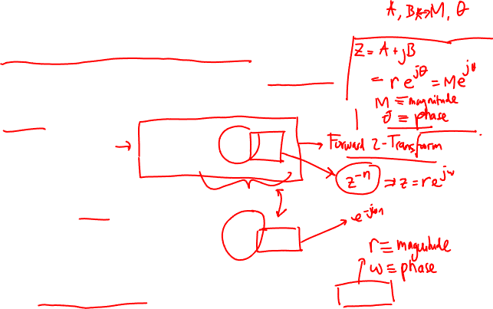
Reminder: A peek at the z-Transform
Generalization of the Fourier Transform
Fourier Transform does not exist for all signals
The z-Transform is often time more convenient to use
Definition:
Compare to DTFT definition:
z is a complex variable that can be represented as z=r e^{jω}
Substituting z=e^{jω} will reduce the z-transform to DTFT

Slide 3
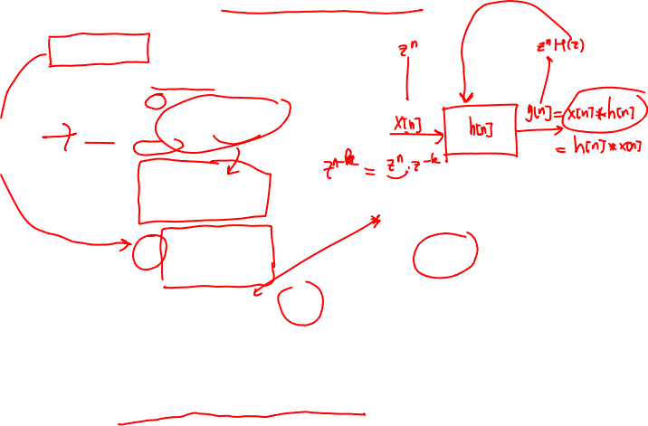
Discrete Time EigenFunctions
Consider a discrete-time input sequence (z is a complex number):
x[n] = z^{n}
Then using discrete-time convolution for an LTI system:
But this is just the input signal multiplied by H(z), the z-transform of the impulse response, which is a complex function of z.
z^{n} is an eigenfunction of a DT LTI system
Z-transform of the impulse response

Slide 4
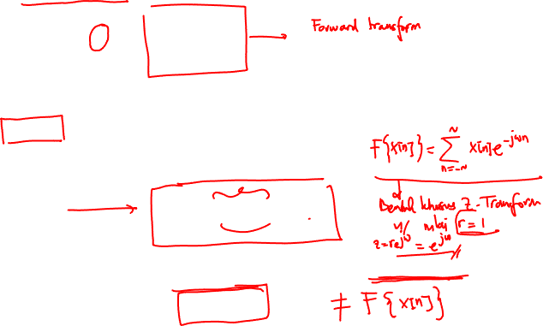
z-Transform vs DTFT
The z-transform of a discrete time signal is defined as:
To understand this relationship, put z in polar coordinate, i.e. z=re^{jω}
Therefore, this is just equivalent to the scaled DT Fourier Series:

Slide 5
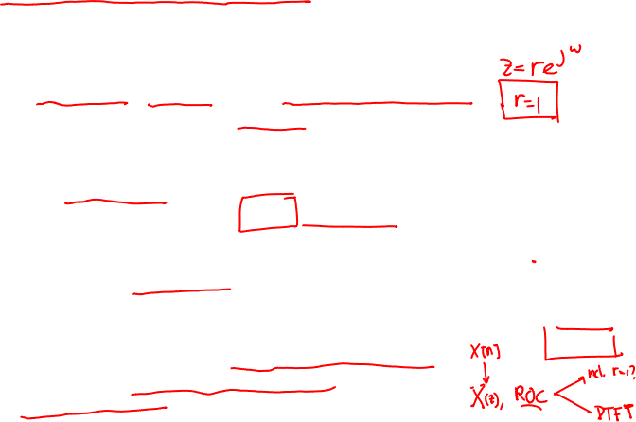
Geometric Interpretation & Convergence
The relationship between the z-transform and Fourier transform for DT signals, closely parallels the discussion for CT signals
The z-transform reduces to the DT Fourier transform when the magnitude is unity r=1 (rather than Re{s}=0 or purely imaginary for the CT Fourier transform)
For the z-transform convergence, we require that the Fourier transform of x[n]r^{-n} converges. This will generally converge for some values of r and not for others.
In general, the z-transform of a sequence has an associated range of values of z for which X(z) converges.
This is referred to as the Region of Convergence (ROC). If it includes the unit circle, the DT Fourier transform also converges.
Im(z)
r
ω
1
Re(z)
z-plane

Slide 6
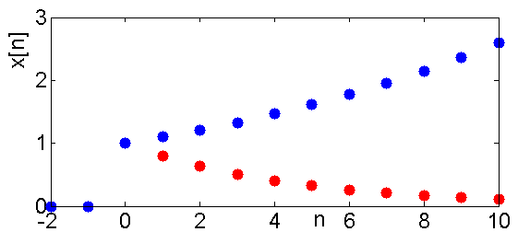
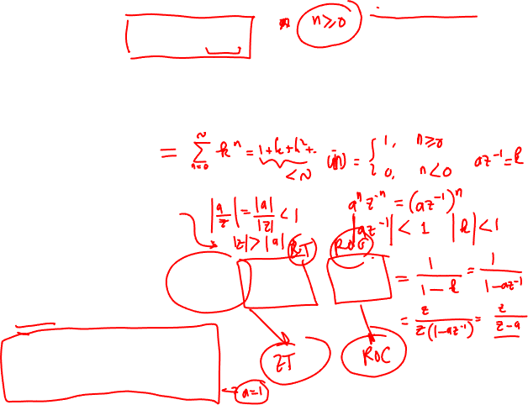
Example 1: z-Transform of Power Signal (right sided)
Consider the signal x[n] = a^{n}u[n]
Then the z-transform is:
For convergence of X(z), we require
The region of convergence (ROC) is
and the Z transform is:
When x[n] is the unit step sequence a=1

Slide 7
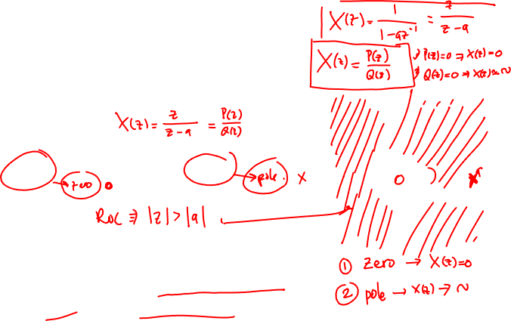
Example 1: Region of Convergence
The z-transform is a rational function so it can be characterized by its zeros (numerator polynomial roots) and its poles (denominator polynomial roots)
For this example there is one zero at z=0, and one pole at z=a.
The pole-zero and ROC plot is shown here
For |a|>1, the ROC does not include the unit circle, for those values of a, the discrete time Fourier transform of a^{n}u[n] does not converge.
Im(z)
x
1
a
Re(z)
Unit
circle

Slide 8
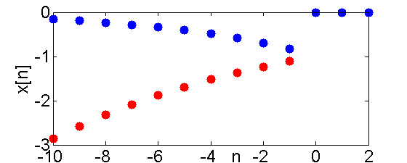
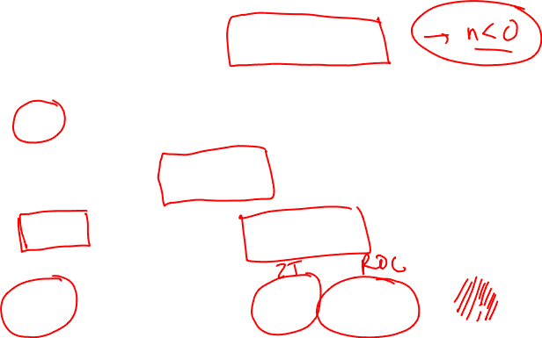
Example 2: z-Transform of Power Signal (left sided)
Now consider the signal x[n] = -a^{n}u[-n-1]
Then the Z transform is:
If |a⁻¹z|<1, or equivalently, |z|<|a|, this sum converges to:
The pole-zero plot and ROC is shown right for 0<a<1
Im(z)
x
1
a
Re(z)
Unit
circle

Slide 9
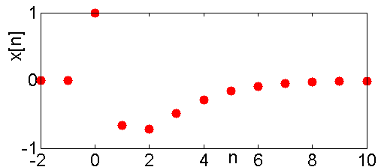
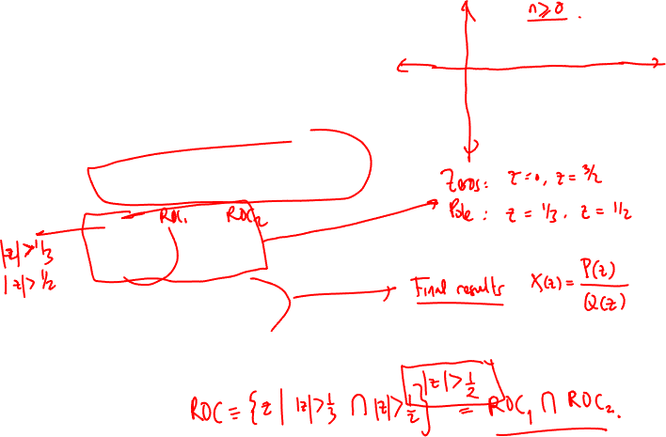
Example 3: Sum of Two Exponentials
Consider the input signal
The z-transform is then:
For the region of convergence we require both summations to converge |z|>1/3 and |z|>1/2, so
|z|>1/2

Slide 10
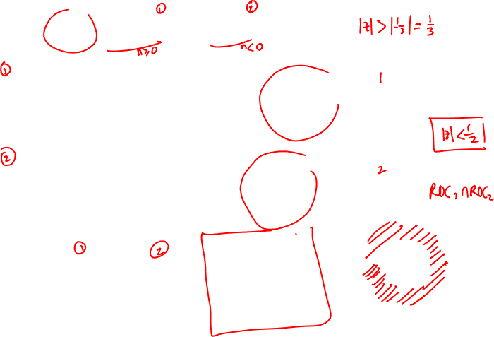
Two-Sided Exponential Sequence Example
Im
x
o
x
o
Re

Slide 11
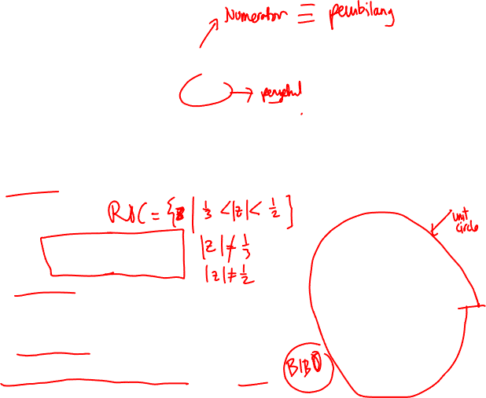

Pole and Zero
ZERO(S):
$N\left(z\right)=0 ⟹ z=0 or z=\frac{1}{12};$
roots of numerator $X(z)=0$
POLE(S):
$$D\left(z\right)=0 ⟹ z=−\frac{1}{3} or z=\frac{1}{2}$$
Roots of denominator $X(z)⟶∞$
Im
x
o
x
o
Re
Conclusion 1: z-transform exists only within the ROC
Conclusion 2: z-transform and ROC uniquely specify the signal.
Conclusion 3: poles cannot exist in the ROC; only on its boundary.
Note: if the ROC contains the unit circle (|z| = 1), the system is stable.

Slide 12
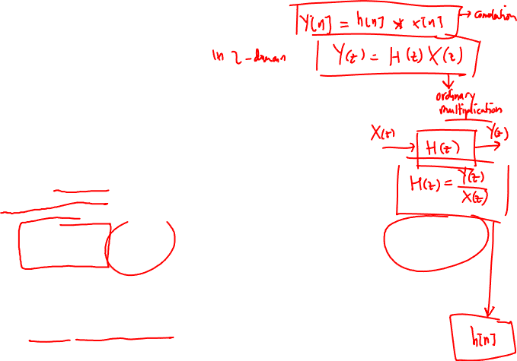
The transfer function
Time shift:
Consider an LCCDE:
and take z-transform utilizing time shift
LTI:
The system transfer function

Slide 13
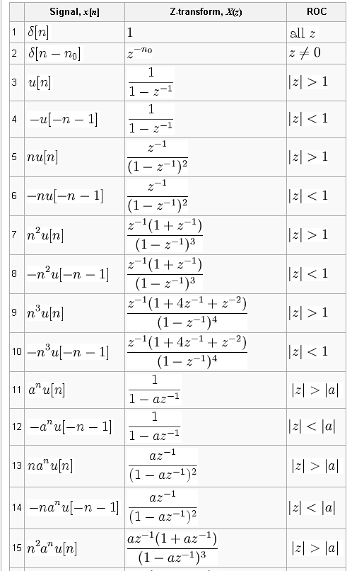
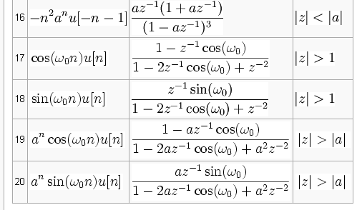
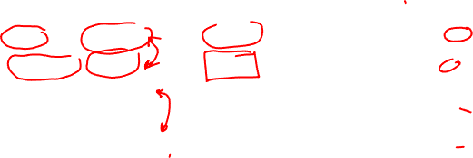
Common pairs

Slide 14

Z-Transform Properties: Linearity
Notation
Linearity
Time Shifting
Convolution

Slide 15
Linearity of the z-Transform
If
and
Then
This follows directly from the definition of the z-transform (as the summation operator is linear, see Example 3). It is easily extended to a linear combination of an arbitrary number of signals
ROC=R₁
ROC=R₂
ROC= R₁∩R₂

Slide 16
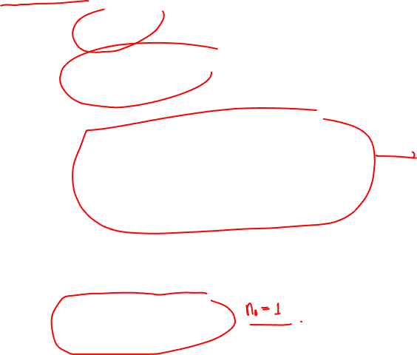
Time Shifting & z-Transforms
If
Then
Proof
This is very important for producing the z-transform transfer function of a difference equation which uses the property:
ROC=R
ROC=R

Slide 17
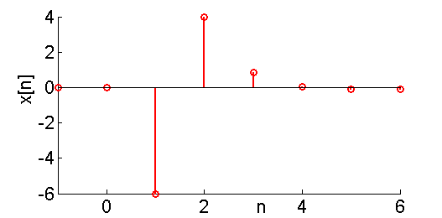
Example: Linear & Time Shift
Consider the input signal
We know that
So

Slide 18
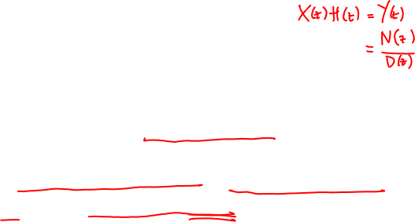
Convolution using z-Transforms
The z-transform also has the multiplication property, i.e.
Proof is “identical” to the Fourier transform convolution and follows from eigensystem property
Note that pole-zero cancellation may occur between H(z) and X(z) which extends the ROC
While this is true for any two signals, it is particularly important as H(z) represents the transfer function of discrete-time LTI system
ROC=R₁
ROC=R₂
ROC⊇R₁∩R₂

Slide 19
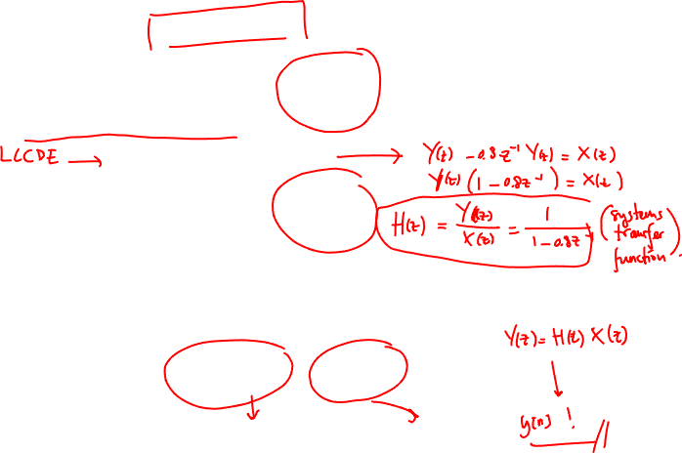
Example 1: First Order Difference Equation
Calculate the output of a first order difference equation of a input signal x[n] = 0.5^{n}u[n]
System transfer function (z-transform of the impulse response)
The (z-transform of the) output is therefore:
ROC |z|>0.8

Slide 20
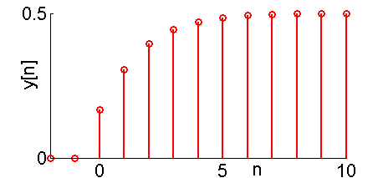

Example 2: 2nd Order Difference Equation
Consider the discrete time step input signal
to the 2nd order difference equation
To calculate the solution, multiply and express as partial fractions

