Slide 1
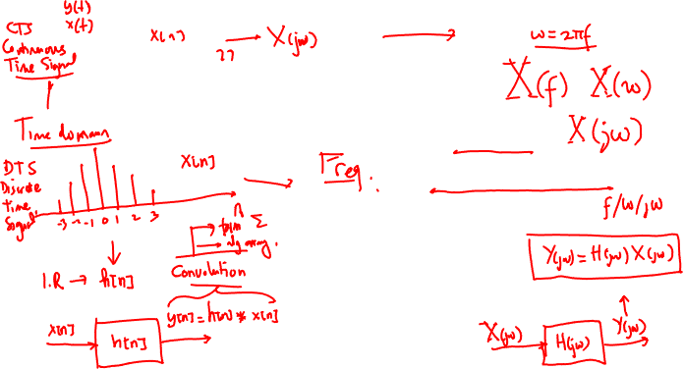
Frequency domain representation of signal
Digital Signal Processing
Irwan Prasetya Gunawan
Informatics Engineering
irwan.gunawan@bakrie.ac.id
Last Updated: 6/8/21

Slide 2
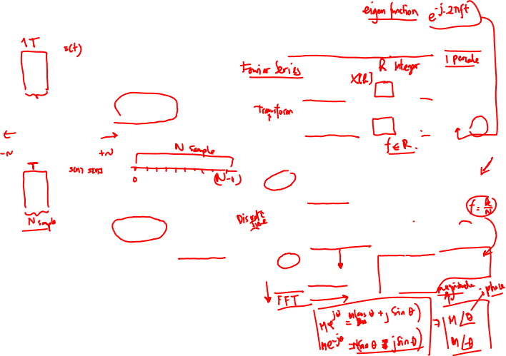

Summary: Fourier analysis - tools
Input Time Signal Frequency spectrum
Periodic (period T)
FS
Discrete
Continuous
Aperiodic
FT
Continuous
**
Periodic (period T)
DFS
Discrete
Discrete
DTFT
Continuous
Aperiodic
**
DFT
Discrete
Note: j =√-1, ω = 2π/T, s[n]=s(t_{n}), N = No. of samples
**
Calculated via FFT

Slide 3
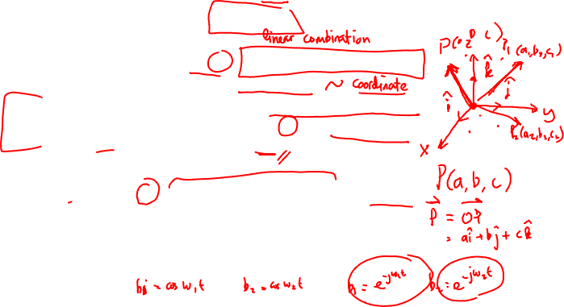
Review: Bases
Fundamental theorem in linear algebra
All linear vector spaces have a basis (usually more than one!)
A basis is a set of vectors b₁ b₂ … b_{d} that obeys 2 conditions :
1. spans the vector space
i.e., for every vector x : x = a₁ b₁ + a₂ b₂ + … + a_{d} b_{d}
where a₁ … a_{d} are a set of coefficients
2. the basis vectors b₁ b₂ … b_{d} are linearly independent
i.e., if a₁ b₁ + a₂ b₂ + … + a_{d} b_{d} = 0 (the zero vector)
then a₁ = a₂ = … = a_{d} = 0
OR
2. The expansion x = a₁ b₁ + a₂ b₂ + … + a_{d} b_{d} is unique
(easy to prove that these 2 statements are equivalent)
Since the expansion is unique
the coefficients a₁ … a_{d} represent the vector in that basis

Slide 4
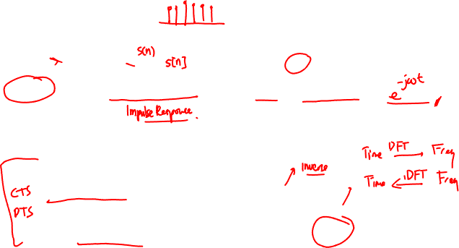
Time and frequency domains
Vector spaces of signals have two important bases (SUIs and sinusoids)
And the representations (coefficients) of signals in these two bases
give us two domains
Time domain (axis)
s(t) s_{n}
Basis - Shifted Unit Impulses
Frequency domain (axis)
S(ω) S_{k}
Basis - sinusoids
We use the same letter capitalized to stress that these are the same signal, just different representations
To go between the representations :
analog signals - Fourier transform FT/iFT
digital signals - Discrete Fourier transform DFT/iDFT
There is a fast algorithm for the DFT/iDFT called the FFT

Slide 5
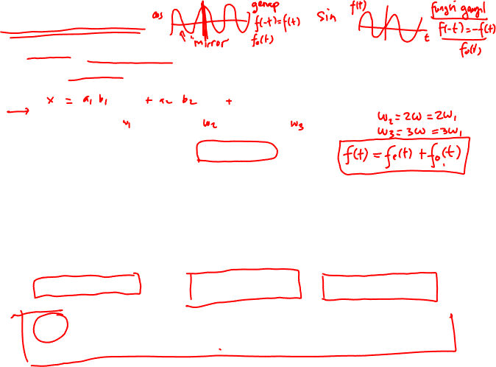
Fourier Series
Many periodic analog signals can be written as the sum of Harmonically Related Sinusoids (HRSs)
If the period is T, the frequency is f = 1/T, the angular frequency is ω = 2 π f = 2 π / T
s(t) = a₁ sin(ωt) + a₂ sin(2ωt) + a₃ sin(3ωt) + …
But this can’t be true for all periodic analog signals !
sum of sines is an odd function s(-t) = -s(t)
in particular, s(0) must equal 0
Similarly, it can’t be true that all periodic analog signals obey
s(t) = b₀ + b₁ cos(ωt) + b₂ cos(2ωt) + b₃ cos(3ωt) + …
Since this would give only even functions s(-t) = s(t)
We know that any (periodic) function can be written as the sum of
an even (periodic) function and an odd (periodic) function
s(t) = e(t) + o(t) where e(t) = ( s(t) + s(-t) ) / 2 and o(t) = ( s(t) - s(-t) ) / 2
So Fourier claimed that all periodic analog signals can be written :
s(t) = a₁ sin(ωt) + a₂ sin(2ωt) + a₃ sin(3ωt) + …
+ b₀ + b₁ cos(ωt) + b₂ cos(2ωt) + b₃ cos(3ωt) + …

Slide 6
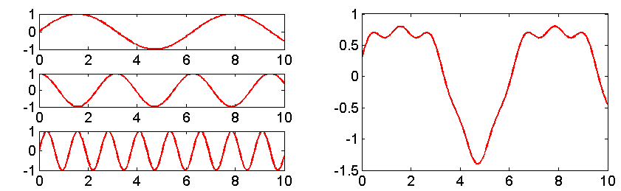
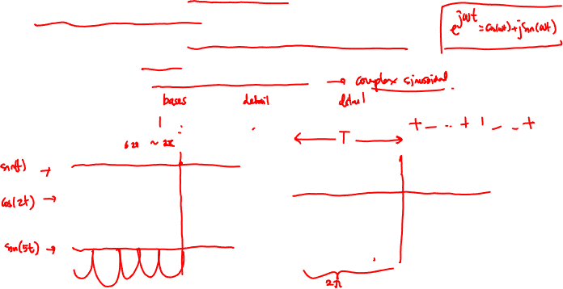
Fourier Series and Fourier Basis Functions
Previously, we have seen that any input signal can represented as a linear combination of shifted impulses (for either DT or CT signals)
However, it turns out that any signals can also be represented as a linear combination of Fourier basis functions which are purely imaginary exponentials
These are known as continuous-time Fourier series
The bases are scaled and shifted sinusoidal signals, which can be represented as complex exponentials
x(t) = sin(t) + 0.2cos(2t) + 0.1sin(5t)
e^{jωt}
x(t)

Slide 7
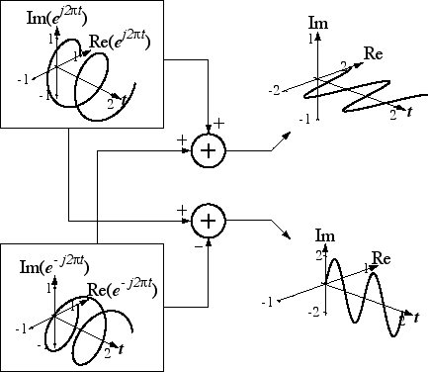
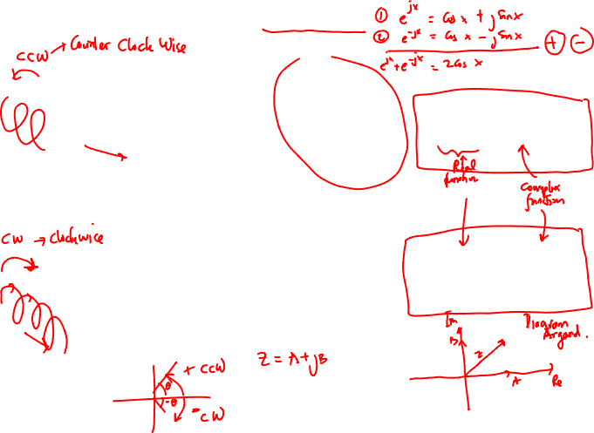
Real and Complex Sinusoids

Slide 8
Jean Baptiste Joseph Fourier
3/21/1768 - 5/16/1830

Slide 9
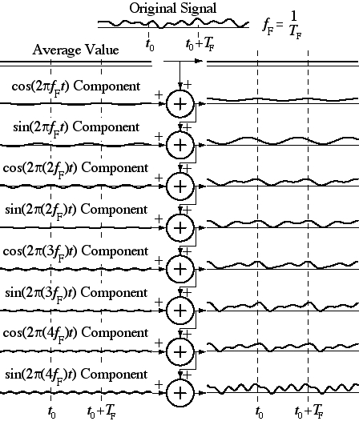
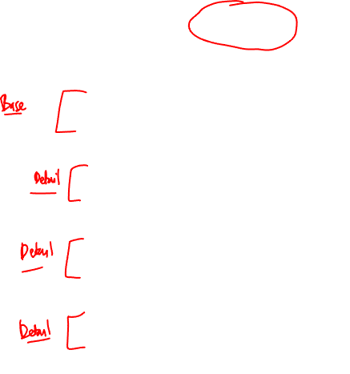
Continuous- Time Fourier Series Concept

Slide 10
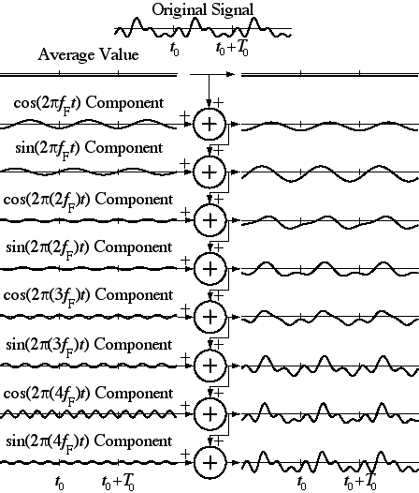

Continuous- Time Fourier Series Concept

Slide 11
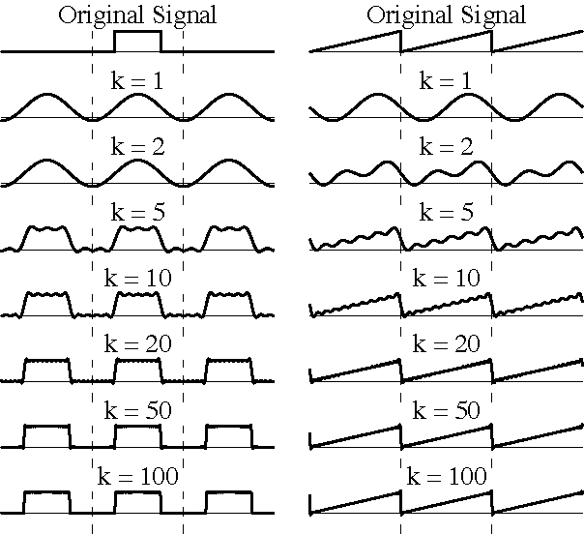
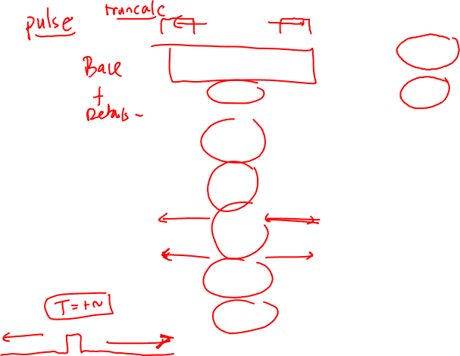
Continuous- Time Fourier Series Concept

Slide 12
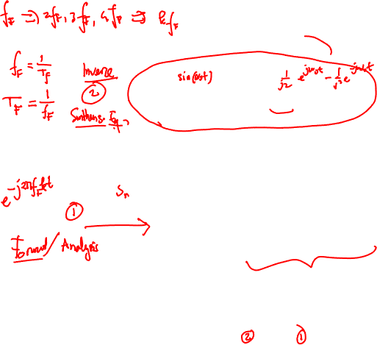
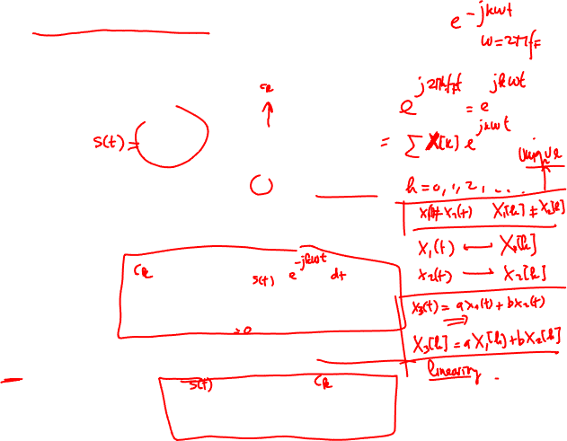
CT Fourier Series Definition
The Fourier series representation, , of a signal, x(t),
over a time, , is
where X[k] is the harmonic function, k is the harmonic
number and .
The harmonic function can be found from the signal as
The signal and its harmonic function form a Fourier series
pair indicated by the notation, .

Slide 13
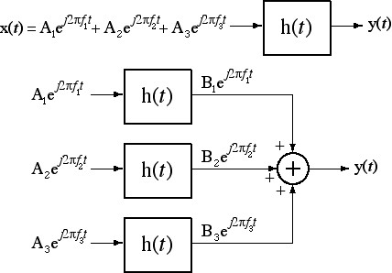
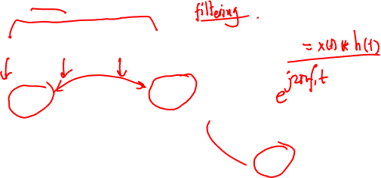
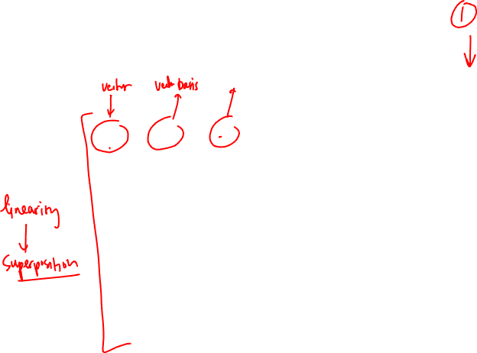
Why is Fourier Theory Important (i)?
If an excitation can be expressed as a sum of complex sinusoids
the response can be expressed as the sum of responses to
complex sinusoids.

Slide 14
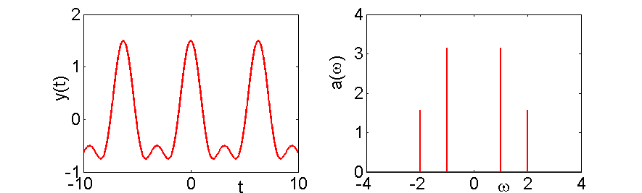
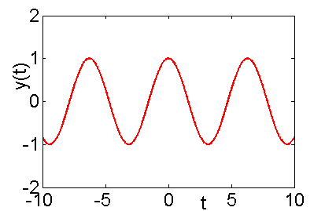
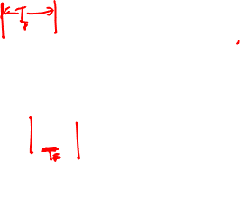
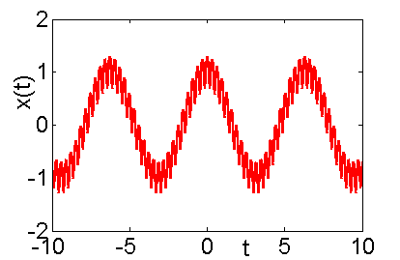
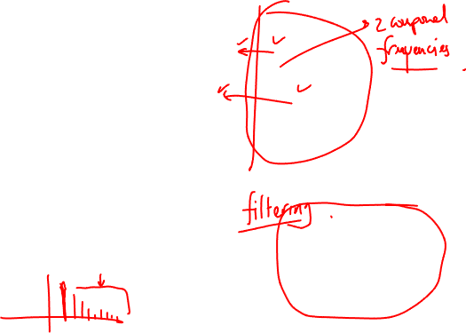
Why is Fourier Theory Important (ii)?
Fourier transforms map a time-domain signal into a frequency domain signal
Simple interpretation of the frequency content of signals in the frequency domain (as opposed to time).
Design systems to filter out high or low frequency components. Analyse systems in frequency domain.
Invariant to high frequency signals

Slide 15
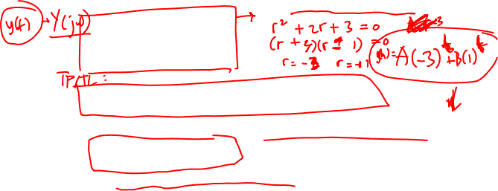
Why is Fourier Theory Important (iii)?
If F{x(t)} = X(jω) ω is the frequency
Then F{x’(t)} = jωX(jω)
So solving a differential equation is transformed from a calculus operation in the time domain into an algebraic operation in the frequency domain (see Laplace transform)
Example
becomes
and is solved for the roots ω (N.B. complementary equations):
and we take the inverse Fourier transform for those ω.

Slide 16
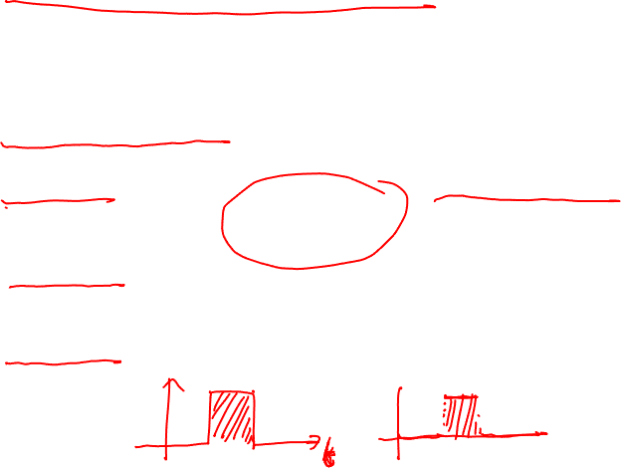
Convergence of Fourier Series
Not every periodic signal can be represented as an infinite Fourier series, however just about all interesting signals can be (note that the step signal is discontinuous)
The Dirichlet conditions are necessary and sufficient conditions on the signal.
Condition 1. Over any period, x(t) must be absolutely integrable
Condition 2. In any finite interval, x(t) is of bounded variation; that is there is no more than a finite number of maxima and minima during any single period of the signal
Condition 3. In any finite interval of time, there are only a finite number of discontinuities. Further, each of these discontinuities are finite.

Slide 17
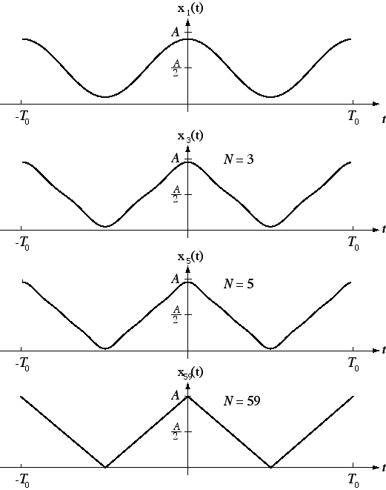
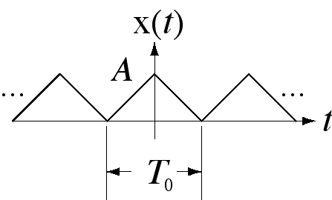
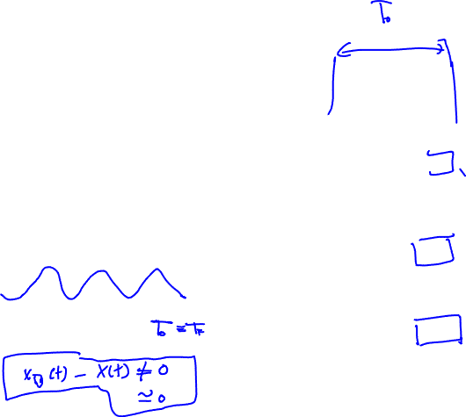
Convergence of the CTFS
Partial CTFS Sums
For continuous signals,
convergence is exact at
every point.
A Continuous Signal

Slide 18
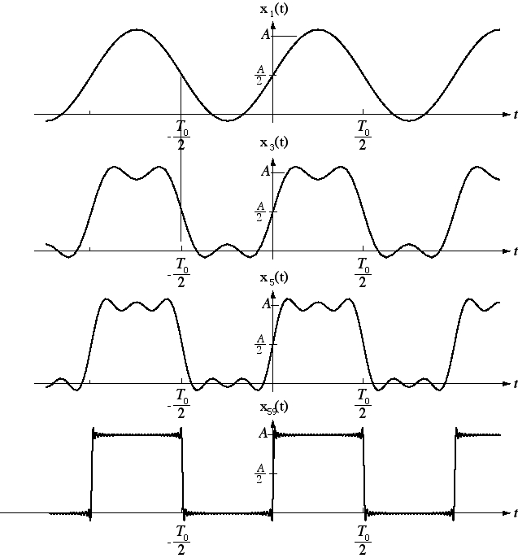
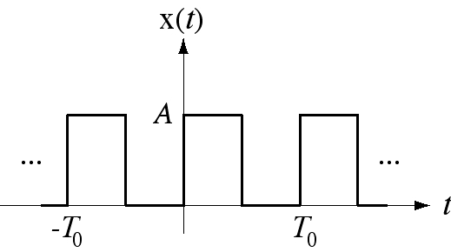
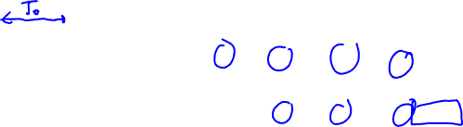
Convergence of the CTFS
Partial CTFS Sums
For discontinuous signals,
convergence is exact at
every point of continuity.
Discontinuous Signal

Slide 19
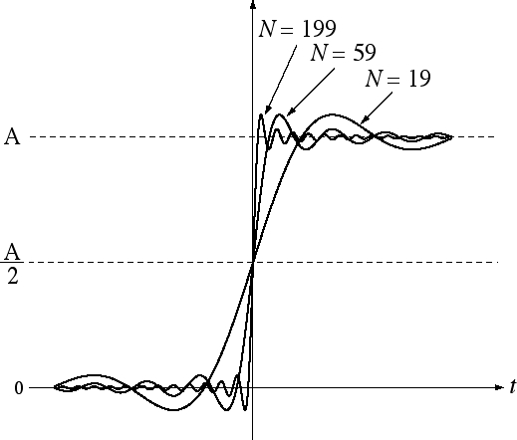
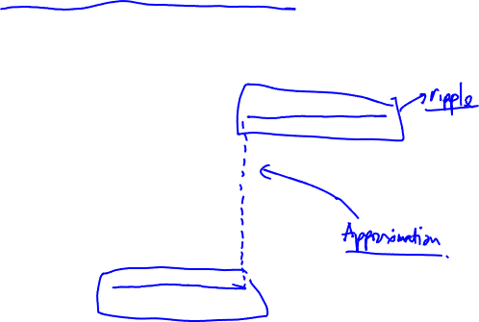
Convergence of the CTFS
The Gibbs Phenomenon

Slide 20
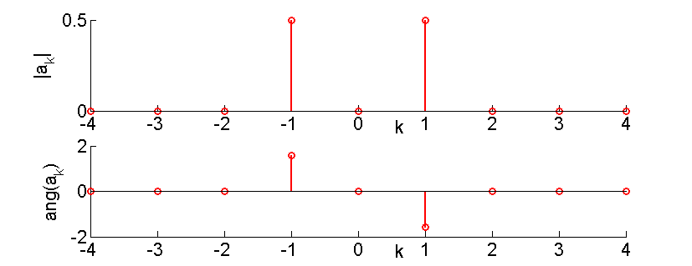
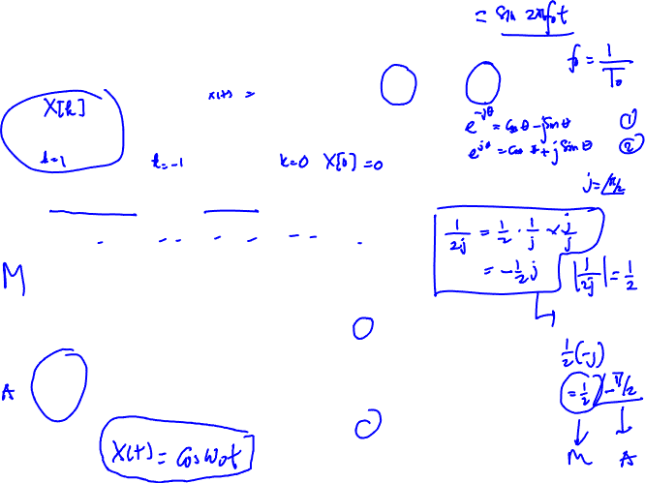
Example 1: Fourier Series sin(ω₀t)
The fundamental period of sin(ω₀t) is ω₀
By inspection we can write:
So a₁ = 1/2j, a₋₁ = -1/2j and a_{k} = 0 otherwise
The magnitude and angle of the Fourier coefficients are:

Slide 21
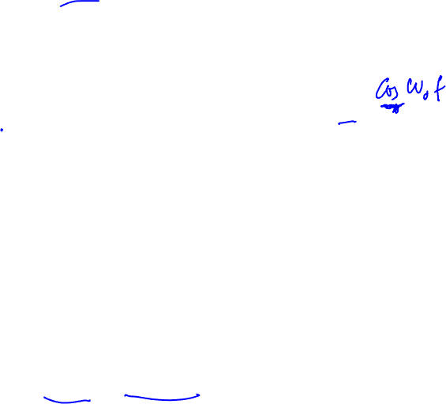
Example 1a: Fourier Series sin(ω₀t)
The Fourier coefficients can also be explicitly evaluated
When k = +1 or –1, the integrals evaluate to T and –T, respectively. Otherwise the coefficients are zero.
Therefore a₁ = 1/2j, a₋₁ = -1/2j

Slide 22
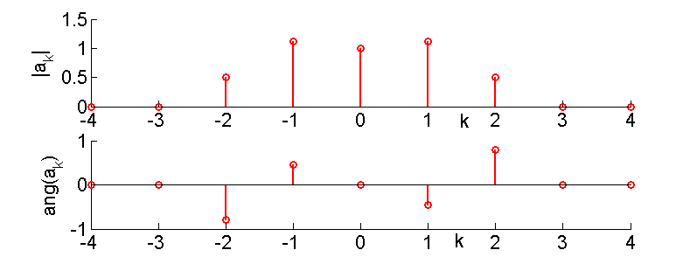
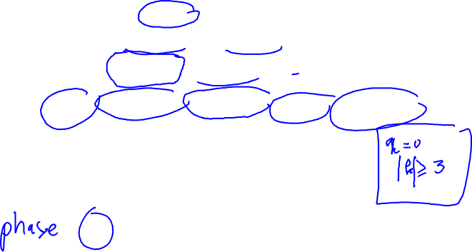
Example 2: Additive Sinusoids
Consider the additive sinusoidal series which has a fundamental frequency ω₀:
Again, the signal can be directly written as:
The Fourier series coefficients can then be visualised as:

Slide 23
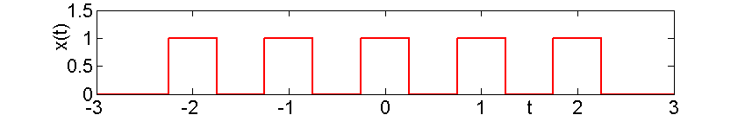
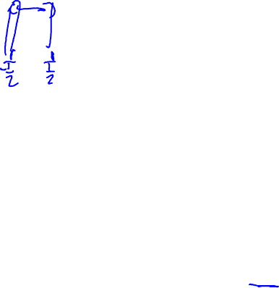
Example 3: Periodic Step Signal
Consider the periodic square wave, illustrated by:
and is defined over one period as:
Fourier coefficients:
NB, these coefficients are real

Slide 24
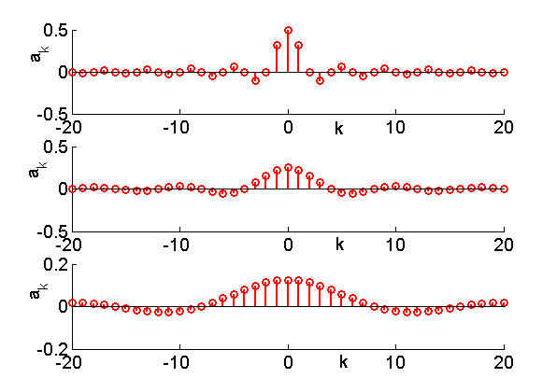
Example 3a: Periodic Step Signal
Instead of plotting both the magnitude and the angle of the complex coefficients, we only need to plot the value of the coefficients.
Note we have an infinite series of non-zero coefficients
T=4T₁
T=8T₁
T=16T₁

Slide 25

Fourier Series to Fourier Transform
For periodic signals, we can represent them as linear combinations of harmonically related complex exponentials (or HRS)
To extend this to non-periodic signals, we need to consider aperiodic signals as periodic signals with infinite period.
As the period becomes infinite, the corresponding frequency components form a continuum and the Fourier series sum becomes an integral
Instead of looking at the coefficients a harmonically –related Fourier series, we’ll now look at the Fourier transform which is a complex valued function in the frequency domain

Slide 26
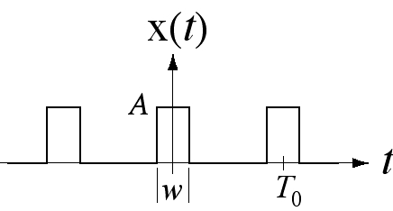
CTFS-to-CTFT Transition
Consider a periodic pulse-train signal, x(t), with duty cycle,
Its CTFS harmonic function is
As the period, , is increased, holding w constant, the duty
cycle is decreased. When the period becomes infinite (and
the duty cycle becomes zero) x(t) is no longer periodic.

Slide 27
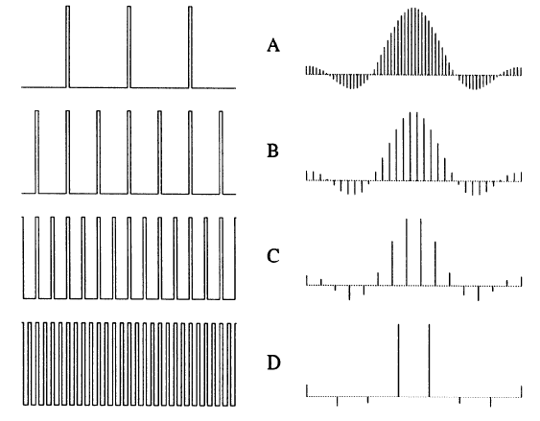
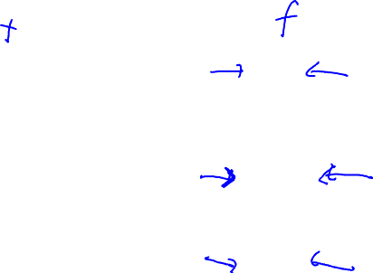
CTFS-to-CTFT Transition

Slide 28
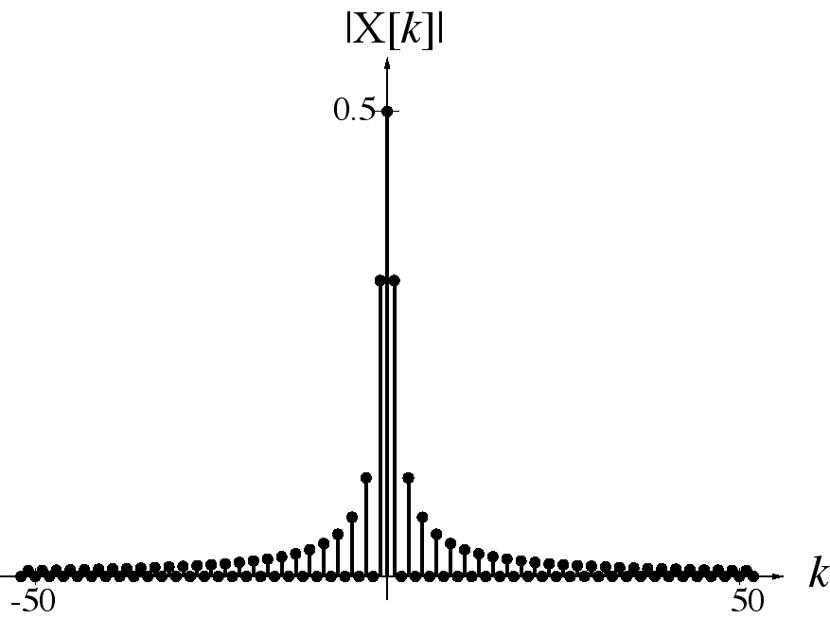
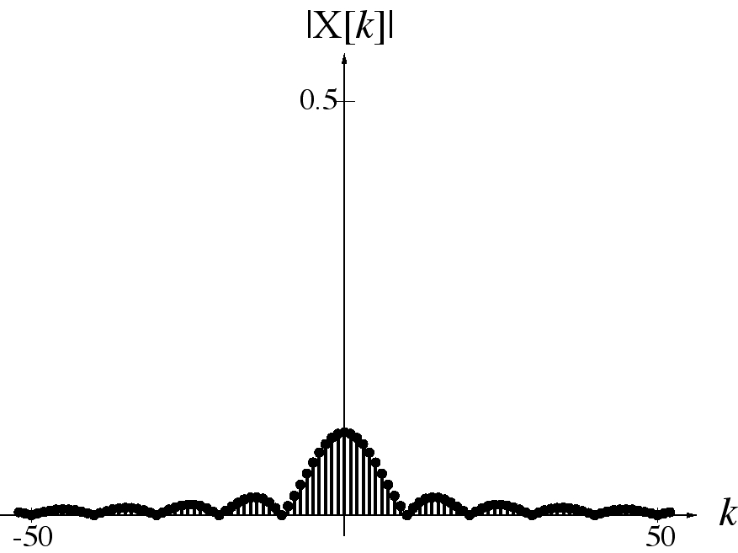
CTFS-to-CTFT Transition
Below are plots of the magnitude of X[k] for 50% and 10% duty
cycles. As the period increases the sinc function widens and its
magnitude falls. As the period approaches infinity, the CTFS
harmonic function becomes an infinitely-wide sinc function with zero amplitude.

Slide 29
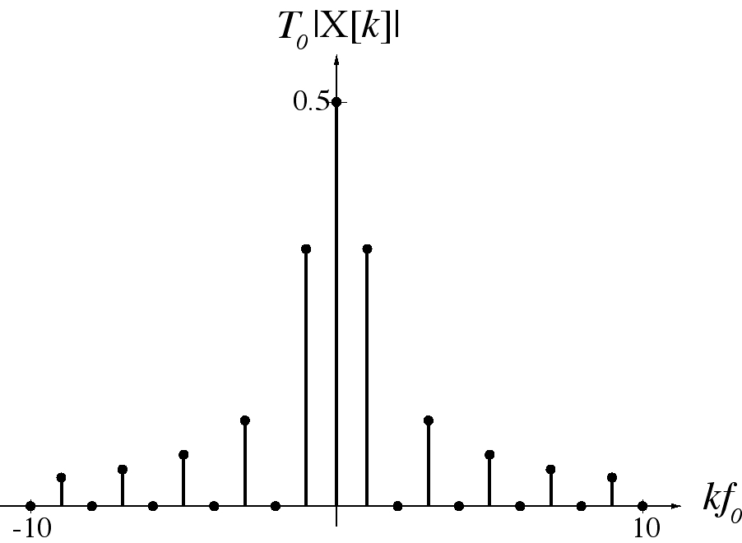
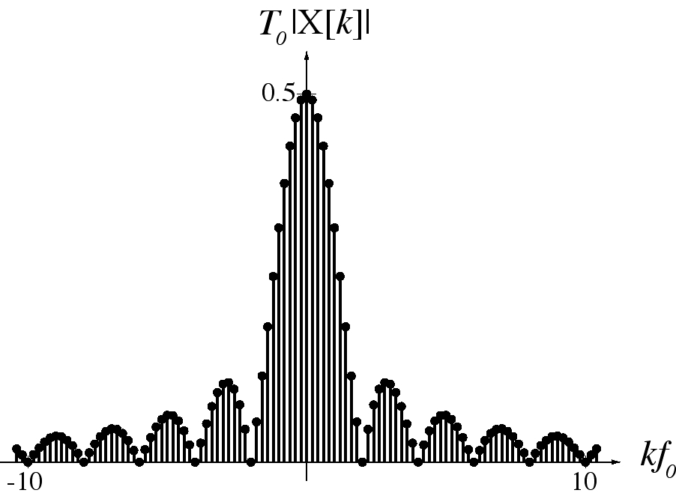
CTFS-to-CTFT Transition
This infinity-and-zero problem can be solved by normalizing
the CTFS harmonic function. Define a new “modified” CTFS
harmonic function,
and graph it versus instead of versus k.

Slide 30
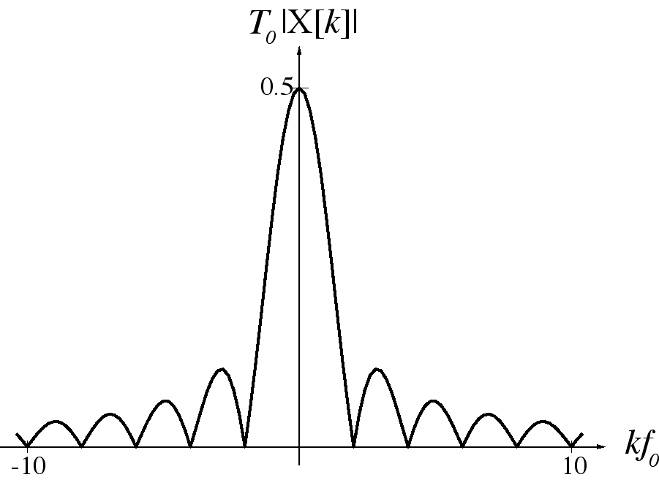

CTFS-to-CTFT Transition
In the limit as the period approaches infinity, the modified
CTFS harmonic function approaches a function of continuous
frequency f ( ).

Slide 31

Definition of the Fourier Transform
We will be referring to functions of time and their Fourier transforms. A signal x(t) and its Fourier transform X(jω) are related by the Fourier transform synthesis and analysis equations
and
We will refer to x(t) and X(jω) as a Fourier transform pair with the notation
As previously mentioned, the transform function X() can roughly be thought of as a continuum of the previous coefficients
A similar set of Dirichlet convergence conditions exist for the Fourier transform, as for the Fourier series (T=(- ∞,∞))

Slide 32

Example 1: Decaying Exponential
Consider the (non-periodic) signal
Then the Fourier transform is:
a = 1

Slide 33

Example 2: Single Rectangular Pulse
Consider the non-periodic rectangular pulse at zero
The Fourier transform is:
Note, the values are real
T₁ = 1

Slide 34
Example 3: Impulse Signal
The Fourier transform of the impulse signal can be calculated as follows:
Therefore, the Fourier transform of the impulse function has a constant contribution for all frequencies
X(jω)
ω

Slide 35
Example 4: Periodic Signals
A periodic signal violates condition 1 of the Dirichlet conditions for the Fourier transform to exist
However, lets consider a Fourier transform which is a single impulse of area 2π at a particular (harmonic) frequency ω=ω₀.
The corresponding signal can be obtained by:
which is a (complex) sinusoidal signal of frequency ω₀. More generally, when
Then the corresponding (periodic) signal is
The Fourier transform of a periodic signal is a train of impulses at the harmonic frequencies with amplitude 2πa_{k}

Slide 36

Negative Frequency
This signal is obviously a sinusoid. How is it described
mathematically?
It could be described by
But it could also be described by

Slide 37
Negative Frequency
x(t) could also be described by
or
and probably in a few other different-looking ways. So who is
to say whether the frequency is positive or negative? For the
purposes of signal analysis, it does not matter.

Slide 38

CTFT Properties
If
then the following properties can be proven.
Linearity

Slide 39

CTFT Properties
Time Shifting

Slide 40

CTFT Properties
Frequency Shifting

Slide 41
CTFT Properties
Time Scaling
Frequency Scaling

Slide 42

The “Uncertainty” Principle
The time and frequency scaling properties indicate that if a signal
is expanded in one domain it is compressed in the other domain.
This is called the “uncertainty principle” of Fourier analysis.

Slide 43
CTFT Properties
Transform of
a Conjugate
Multiplication-
Convolution
Duality

Slide 44

CTFT Properties

Slide 45
CTFT Properties
Time
Differentiation
Modulation
Transforms of
Periodic Signals

Slide 46
CTFT Properties
Parseval’s
Theorem
Integral Definition
of an Impulse

Slide 47

CTFT Properties

Slide 48
Assignment
Ch. 3/4 Assignment:
3.3.2
3.4.1
3.6.1
3.7.1
3.7.2
3.8.3
4.1.2
4.1.3
4.2.2
4.2.5
Submission:
Time/date due: Tuesday, 03 May 2016, 23:55 PM
Submission procedure: upload via BIG
Filename format: DSP_A03_name_studentnumber.PDF

Slide 49
Important Notes
Please note that this is an individual assignment and therefore no two students should write the same answers!
Cheating, plagiarism, copy-paste other people's work (incl. your friend's work) without giving appropriate credits will incur discount on your grades
Don't just answer by pointing out your references in your assignment without giving any further, necessary explanations (for example, you might be tempted to write: "Answer for Number 1 can be found in http://www.dspguide.com"); write your answer in your own words by making use of the references
In citing your references, you can any citation methods/style you'd might like; e.g.
Numerical style such as found in IEEE papers
Author-date style
Turabian style
MLA style
APA style
In MS Word (2007/2010), you'd probably like to try the citation & bibliography tools ('References >> Citation & Bibliography') to manage your reference list. Alternatively, you can also use EndNote for the same purpose (note however not all MS Word has EndNote pre-installed in its configuration). The only downside of EndNote is that it is not free.
If you're using LaTeX for writing your documents, BibTeX is very recommended. Both LaTeX and BibTeX are entirely free. You can use any general text editors you like for preparing documents in LaTeX (vi, emacs, notepad++) or alternatively use the ones more specifically designed for LaTeX preparation (e.g., TexWorks that comes with MikTeX -- a LaTeX installation for Windows, Texmaker, Lyx, etc)
Useful resources:
Numerical and author-date style widely used in computer science engineering students: http://www.lib.monash.edu.au/tutorials/citing/compsci.html
APA style citation method: http://www.uis.edu/ctl/writing/documents/APACitationMethods.pdf
MLA style citation method: http://www.uis.edu/ctl/writing/MLACitation_000.pdf.pdf
Turabian method: http://library.concordia.ca/help/howto/turabian.pdf

