Slide 1
Selasa, 09 Maret 2021 – start 07.45 WIB
Untuk yang sudah bergabung:
Tuliskan nama dan NIM di bagian chat (klik di bagian kiri bawah layar)
Ajak teman lainnya yang mungkin belum bergabung di sini untuk mengikuti kelas
Bantu temannya dengan mengapprove teman yang akan join class meeting
Cam on untuk dokumentasi dan syarat presensi kelas
Screenshot sample pada saat kelas mulai, termasuk absensi manual dengan nama/NIM masing-masing, screenshot video meeting dengan cam on dan off
Upload screenshot sample ke web E-Learning di alamat weekly meeting yang sudah ditentukan
Absensi melalui pemanggilan nama masing-masing akan dilakukan di 30 menit awal perkuliahan
Ketika kuliah berlangsung:
Mute Sound
Jika akan bertanya (atau ditanya), unmute sound
Unmute sound di laptop/PC bisa dilakukan dengan menekan Space Bar

Slide 2
Digital Signal Processing
Irwan Prasetya Gunawan
Informatics
ipg@bakrie.ac.id
Last Updated: 20210309

Slide 3
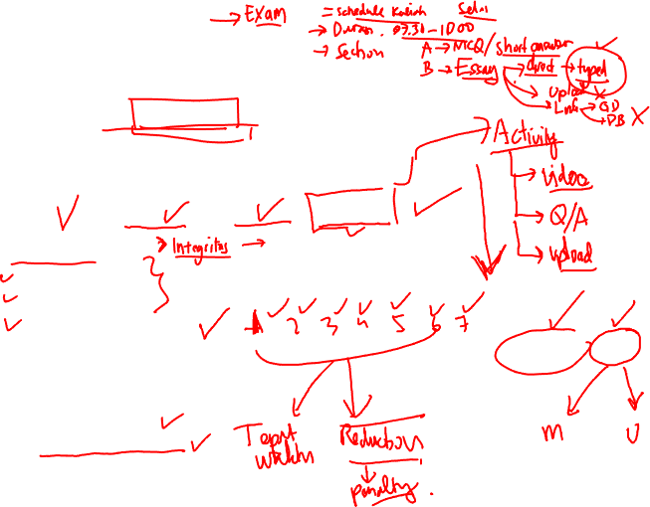
Course structure
Timetable
Class/room: https://meet.jit.si/UBTIF208_DSP_202002
Time: Tue / 07.30-10.00 WIB
Course plan
Credit: 3 SKS
14 lectures, once a week
Quizzes, Assignments, Homework, Lessons
Revisions
Assessment
Mid-test: 25%
Final-test: 35%
Assignments: 30%
Others (inc. but not limited to class participation, activities, discipline): 10%
Pre-requisites
Calculus 1 & 2
Linear Algebra
Complex variables

Slide 4
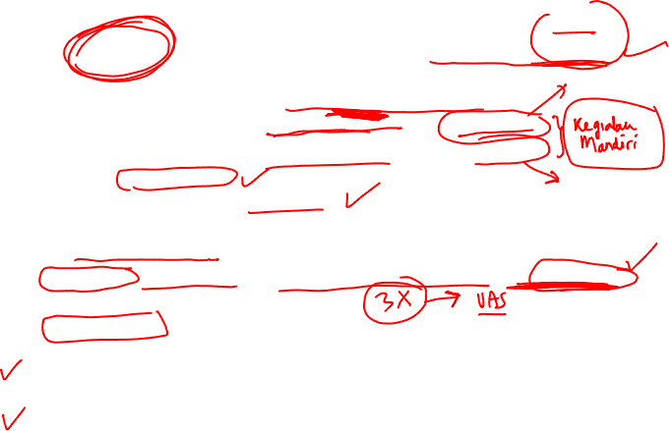
Rules of the game …
Be prepared before attending the class by reading the materials
Bear in mind that 3 SKS is equivalent to
3 x 50 min./week of class lecture attendance
3 x 60 min./week structured activity e.g. homework
3 x 60 min./week independent activity e.g. reading
Be more pro-active:
Asking reasonable questions
Giving out answers and/or opinions as required
Paying attentions to any discussions during class meeting
Work out any exercises / homeworks / assignments on your own, unless it is a group assignment
Attendance is important; 80% is the minimum requirement. Less than that, you’re not eligible for sitting in the exams
Late comings will have consequences! Tolerable 15 minutes of late coming to the class
Would appreciate if students keep staying in the classroom during the lecture, unless deemed necessary otherwise

Slide 5

Resources
Textbooks:
Jonathan Stein, “Digital Signal Processing: A Computer Science Perspective”, John Wiley & Sons, 2000
Unofficial url: dsp-book.narod.ru/DSPCSP/toc.htm
Unofficial pdf (55 MB pdf book): https://files.bakrie.ac.id/s/XGnTjLxLcM78QTT
Hardcopy is also available in our Library
Steven Smith, “The Scientist and Engineer’s Guide to Digital Signal Processing”, California Technical Publishing. Downloadable at http://www.dspguide.com/pdfbook.htm
Supporting reading materials:
Emmanuel C. Ifeachor and Barrie W. Jervis, “Digital Signal Processing: A Practical Approach”, Prentice-Hall, 2002
Sanjit K. Mitra and James F. Kaiser, “Handbook for Digital Signal Processing”, John Wiley & Sons, 1993
PA Lynn and W Fuerst, “Introductory Digital Signal Processing with Computer Applications”, Revised Edition, John Wiley & Sons, 1994
BP Lathi, “Signal Processing and Linear Systems”, Berkeley-Cambridge Press, 1998. PDF: https://files.bakrie.ac.id/s/tLfxQyxxcesjana
Dennis Freeman. 6.003 Signals and Systems, Fall 2011. (Massachusetts Institute of Technology: MIT OpenCourseWare), http://ocw.mit.edu (Accessed 25 Feb, 2015).
Alan Oppenheim. RES.6-008 Digital Signal Processing. Spring 2011. Massachusetts Institute of Technology: MIT OpenCourseWare, https://ocw.mit.edu/resources/res-6-008-digital- signal-processing-spring-2011/video-lectures/. License: Creative Commons BY-NC-SA.
Alan Oppenheim. 6.341 Discrete-Time Signal Processing. Fall 2005. Massachusetts Institute of Technology: MIT OpenCourseWare, https://ocw.mit.edu/courses/electrical-engineering- and-computer-science/6-341-discrete-time-signal-processing-fall-2005/#. License: Creative Commons BY-NC-SA.

Slide 6
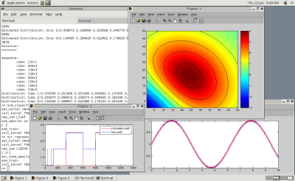
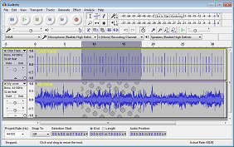
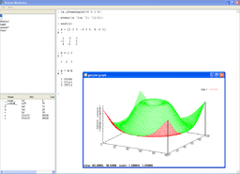
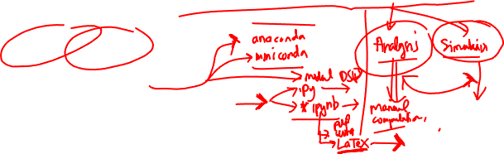
Tools in DSP
Used for assignments / exams
Audacity: http://www.audacityteam.org
Python: http://www.python.org
Google Colab: https://colab.research.google.com/
Octave: http://www.gnu.org/software/octave/
Matlab: http://www.mathworks.com/matlab/

Slide 7
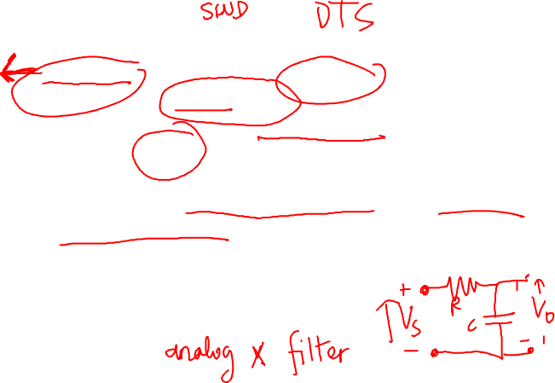
Objectives
Concepts of discrete-time signals and systems
Transform method and their inverse
Knowledge on digital filters and their realisation
Issues in sampling and reconstruction
Know about DFT and its fast computation
Apply frequency domain analysis using DFT
Understand the fundamental algorithms and structures used in DSP computation
Design and code DSP applications in a high-level language
Review state-of-the-art DSP R&D

Slide 8
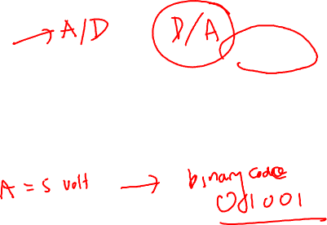
Syllabus at a glance
Background – Review on systems, signals, mathematical model, continuous time (CT) and discrete time (DT) signals
DSP at a glance – Introduction, Pros and Cons, Applications
Sampling theorem – Sampling, quantization, coding
Fourier and Z-transform – Properties of the transforms, convergence factor, transfer function of CT systems, frequency response, DFT, FFT, fast computation
Digital Filters – Structures, analysis, FIR, IIR

Slide 9
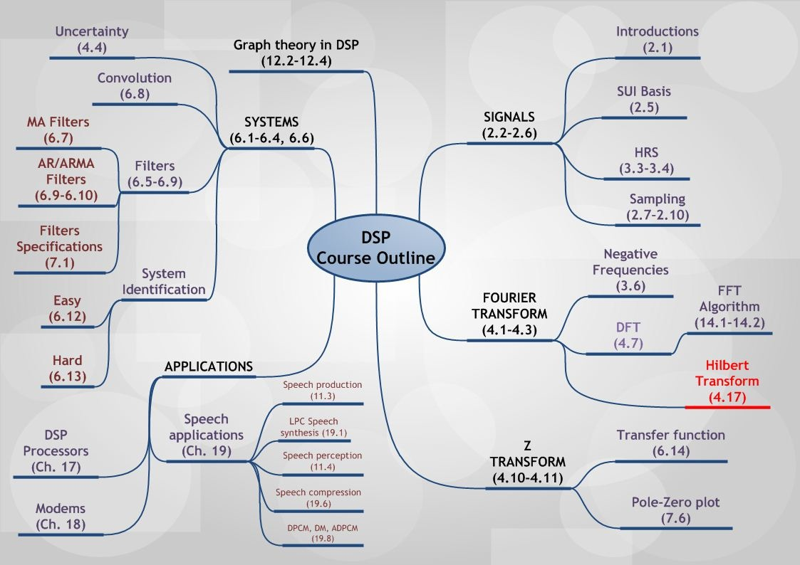
#5
#1
#6
#2
#10
#11
#3
#4
#9
#12
#13
#8

Slide 10
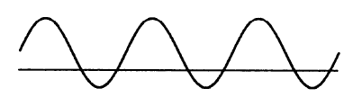
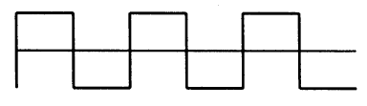

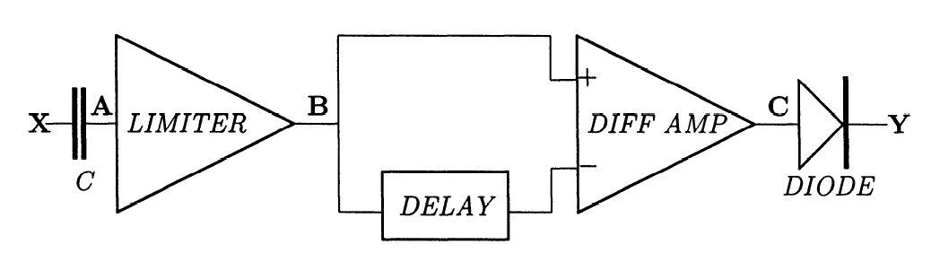
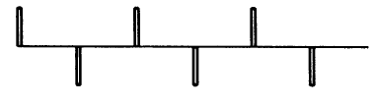
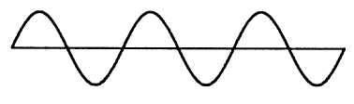
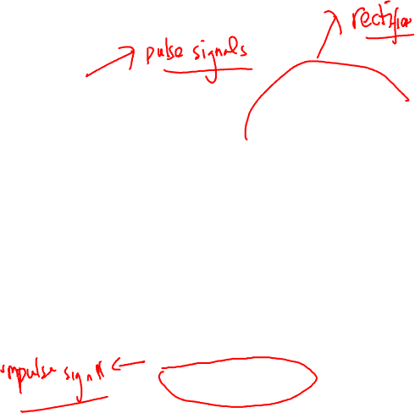
Signal processing: analog

Slide 11
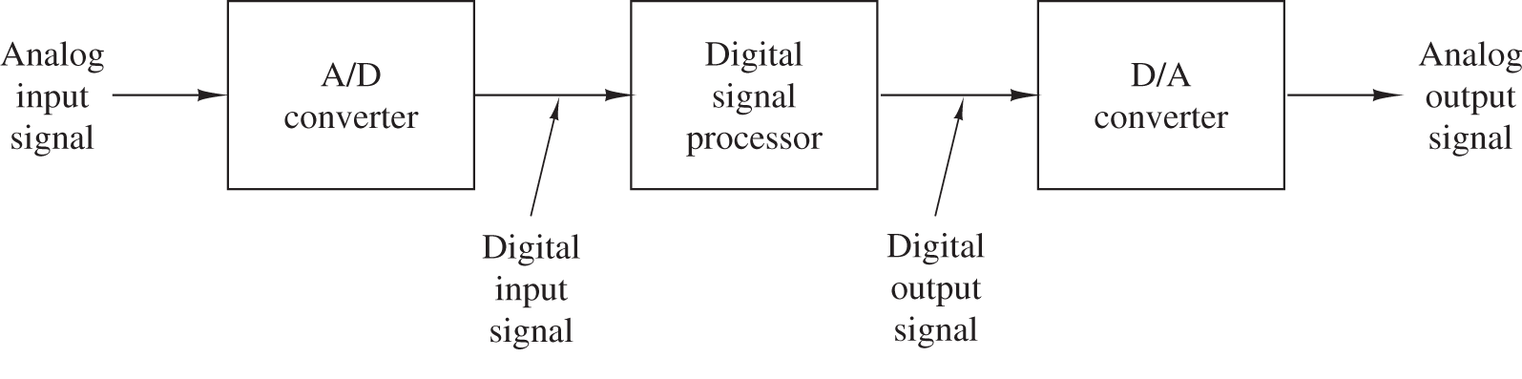
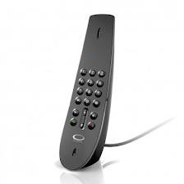
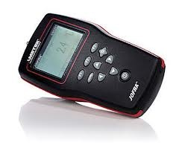



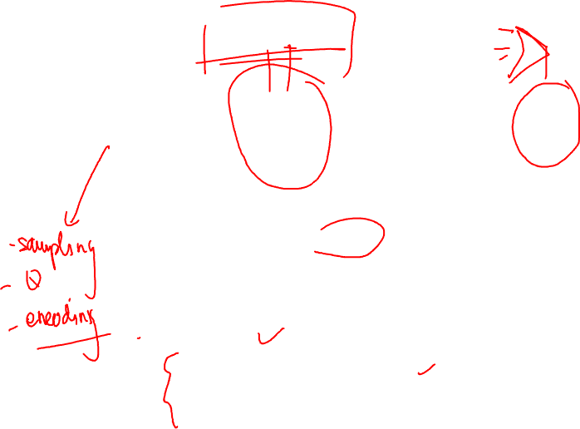
Signal processing: digital
Greater functionality
Accuracy and reproducibility
Modularity and flexibility
Increased price/performance
Reduced time-to-market

Slide 12
Issues in DSP
Reconstruction accuracy
It’s important to know the conditions for perfect reconstruction
Digital signal is not just an approximated representation of an analog signal
Could be generated digitally
The processing may not be reliasable in analog
The theory of discrete time signal processing is independent of continuous

Slide 13
Digital vs. Analog
Digital implementations are flexible, programmable, and modular
Can be more precise and repeatable
Performance and cost effectiveness
Direct mapping of mathematical expressions with less approximation possible (enables sophisticated algorithms)
Digital hardware can be multiplexed better than analog; this allows for integration of multiple operations and services on hardware platform
Digital storage is more reliable, cheaper, and more compact
However …
Analog signal processing still offers higher bandwidth
Higher dynamic range
Can be very low power

Slide 14
Hot applications in DSP
Entertainment: digital audio, digital TV, multimedia (voice mail, video, audio conferencing)
Medical imaging / data analysis
Information services, database
Meteorology
Non-destructive testing of materials
Digital process control for manufacturing
Automotive electronics
Sensor data transmission, storage, transmission
Voice and image synthesis
Environmental monitoring
DVD technology
Very low bit-rate audio coding
Scalable video coding
etc ...

Slide 15
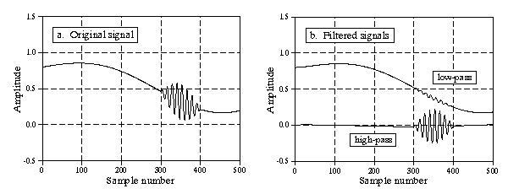
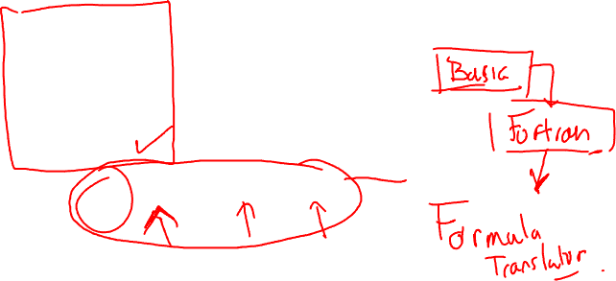
(relatively) simple programming
100 'RECURSIVE FILTER
110 'INITIALIZE AND DEFINE THE ARRAYS TO BE USED
120 DIM X[499] 'holds the input signal
130 DIM Y[499] 'holds the filtered output signal
140 '
150 A0 = 0.93 'Set the recursion coefficients
160 A1 = -0.93 '(these values define a high-pass filter)
170 B1 = 0.86
180 '
190 GOSUB XXXX 'Subroutine to load the input signal into X[ ]
200 '
210 'FILTER THE SIGNAL BY RECURSION TO FIND Y[ ]
220 FOR I% = 2 TO 499
230 Y[I%] = A0*X[I%] + A1*X[I%-1] + B1*Y[I%-1]
240 NEXT I%
250 '
260 END

Slide 16
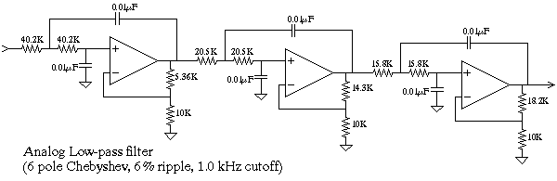
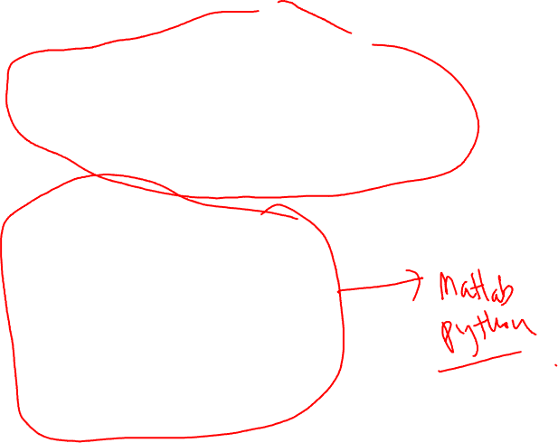
Examples: analog vs. digital filters
Analog implementation of a low-pass filter at 1 kHz, that might be used for noise reduction or separating multiplexed signals.
100 'LOW-PASS WINDOWED-SINC FILTER
110 'This program filters 5000 samples with a 101 point windowed-sinc
120 'filter, resulting in 4900 samples of filtered data.
130 '
140 ' 'INITIALIZE AND DEFINE THE ARRAYS USED
150 DIM X[4999] 'X[ ] holds the input signal
160 DIM Y[4999] 'Y[ ] holds the output signal
170 DIM H[100] 'H[ ] holds the filter kernel
180 '
190 PI = 3.14159265
200 FC = 0.1 'The cutoff frequency (0.1 of the sampling rate)
210 M% = 100 'The filter kernel length
220 '
230 GOSUB XXXX 'Subroutine to load X[ ] with the input signal
240 '
250 ' 'CALCULATE THE FILTER KERNEL
260 FOR I% = 0 TO 100
270 IF (I%-M%/2) = 0 THEN H[I%] = 2*PI*FC
280 IF (I%-M%/2) <> 0 THEN H[I%] = SIN(2*PI*FC * (I%-M%/2)) / (I%-M%/2)
290 H[I%] = H[I%] * (0.54 - 0.46*COS(2*PI*I%/M%) )
300 NEXT I%
310 '
320 'FILTER THE SIGNAL BY CONVOLUTION
330 FOR J% = 100 TO 4999
340 Y[J%] = 0
350 FOR I% = 0 TO 100
360 Y[J%] = Y[J%] + X[J%-I%] * H[I%]
370 NEXT I%
380 NEXT J%
390 '
400 END
Digital implementation of the same low-pass filter at 1 kHz, by digitizing the signal first and then applying digital filter.

Slide 17
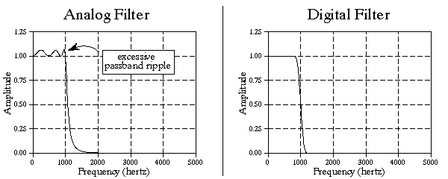
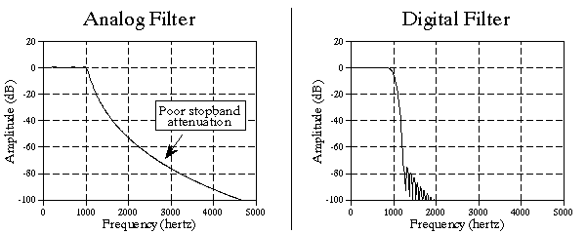
Examples: analog vs. digital filters
Better frequency response
Better in both roll-off and stopband attenuation

Slide 18
Signals & Systems
It’s called “signals and systems” to reflect the fact that most “systems” are driven by “signals” [Fowler, 2007]
Signals:
phenomena, arising in some environment, that may be described quantitatively [Kwakernaak and Sivan, 1991]
time-varying quantities that generally carry some information [Fowler, 2007]
patterns of variation of some form [Brown, 2008]
functions of independent variables that carry information [Willsky, 2003]
Examples: electrical signals, acoustic signals, mechanical signals, video signals
Systems:
extract, modify, transform, or manipulate information [Fowler, 2007]
process input signals and produce output signals [Brown, 2008]
Examples: electrical (RLC) circuit, CD player, a communication system, edge detection algorithm, etc

Slide 19
Specific uses of signals & systems
Telecommunications – answering machines, modems, fax, cell phones
Speech and audio – voice mail, synthetic speech, audio compression
Medical – MRI, ultrasound, remote monitoring, hearing aids
Image processing – image/video compression, image enhancement, super-resolution, HDTV, animation
Control systems – robots, motor control, laser control (e.g., printers, CD/DVD drives
Military & aerospace – radar, sonar, navigation systems, GPS, missile guidance, sensors, etc
From Electrical Engineering Uncovered, 2nd Ed. by White & Doering

Slide 20
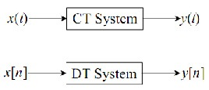
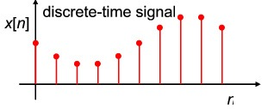
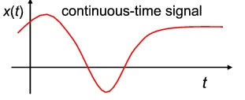
The independent variables (IV)
Can be continuous
Can be discrete
Can be 1-D, 2-D, …, N-D
On a single (1-D) independent variable, we usually deal with “time” as IV
Continuous-Time (CT) signals: x(t), t – continuous values.
Most of the signals in the physical world are CT signals: voltage & current, pressure, temperature, velocity, etc
Discrete-Time (DT) signals: x[n], n – integer values only, time varies discretely. DT signals are used to ease its processes by digital computers and DSPs.

Slide 21
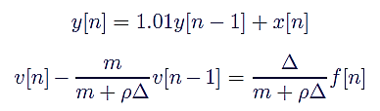

Continuous- vs. Discrete-Time Systems
Continuous-Time Systems
Discrete-Time Systems
Most continuous time systems represents how continuous signals are transformed via differential equations
Most discrete time systems represent how discrete signals are transformed via difference equations.
First order differential equation
First order difference equations

Slide 22
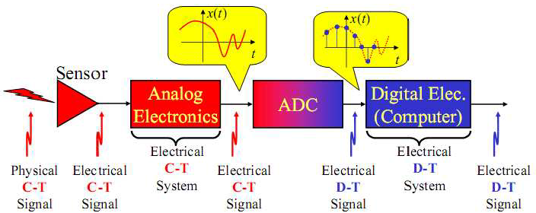
Typical modern systems
get a continuous-time signal from a sensor
have a continuous-time system modifies the signal
employ an ADC to sample the continuous-time signal to create a discrete-time signal
have a discrete-time system to do subsequent processing

Slide 23
Classification of systems
Static vs. Dynamic
Static: outputs depend only on the present value of the inputs.
Dynamic: outputs depend not only on the present value but also on the past values of the inputs (system with memory).
Important property: causality.
Linear vs. Nonlinear
Linear : system satisfies the superposition theorem; i.e., the output of the scaled sum of two input signals is the equivalent scaled sum of outputs.
Nonlinear : system does not satisfy the above-mentioned criteria.
Time-varying vs. Time-invariant
Time-invariant: system’s output is the same, given the same input signal, regardless of time.
Time-varying: given the same input signal, system’s output maybe different, depending on time.
Deterministic vs. Stochastic
Deterministic: system’s output(s) for any given input can be determined for all future time if all the initial conditions are known.
Stochastic: system and input can be described only in a statistical sense.

Slide 24
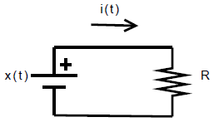
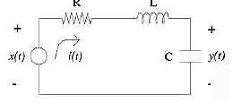
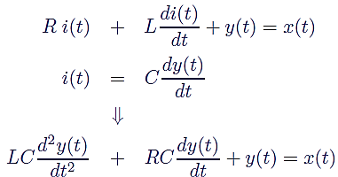

Statics vs. Dynamic Systems
Example of Static Systems: electrical circuit that contains only resistors as its circuit elements.
Example of Dynamic Systems: electrical circuit that contains circuit elements that store energy (inductors, capacitors).

Slide 25



Dynamic systems
In general, can be described by a differential equation of the form:
which is a linear differential equation of order n and for practical cases, n ≤ m. For convenience, we use an operator, p, to replace d/dt; hence
which may be written more compactly as:
where D(p) and N(p) are polynomials in the operator p:

Slide 26



Dynamic systems (cont’d)
Notes on p operator:
Represents an operation of differentiation
Can be regarded as a “shorthand” notation for writing d/dt, the derivative w.r.t time
Can be treated as an algebraic quantity (but careful with the order!!!)
Does not have the commutative property; i.e., py(t) ≠ y(t)p
By using such operator, it is common to describe a particular system by means of input-output relationship; e.g., the compact description of a system:
which can be re-written as:

Slide 27
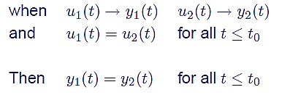
Causality
A system is causal if the output does not anticipate future values of the input, i.e., if the output at any time depends only on values of the input up to that time.
All real-time physical systems are causal, because times only moves
forward. Effect occurs after cause.
Causality does not apply to spatially varying signals.
Causality does not apply to systems processing recorded signals (consider taped sports games vs. live broadcast).
Stated mathematically, a system whose input and output are u(t) and y(t), respectively, is causal if:

Slide 28
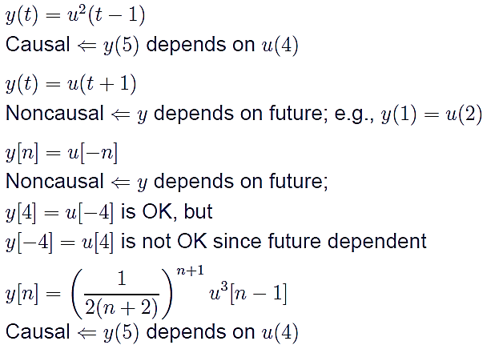
Causality check

Slide 29
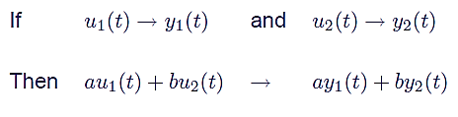
Linear and Nonlinear Systems
Many real-life systems are nonlinear; e.g., circuit elements (diode), dynamics of aircraft, human visual systems, etc
However, we focus on linear systems because:
Linear models can still represent accurate representations of behaviour of many systems (e.g., linear resistors, capacitors, etc)
Linearise models are sometimes used to examine “small signal” perturbation around “operating points”
Linear systems are analytically tractable, and hence can provide useful insight to the systems in observation
A system u(t) → y(t) is linear if it has the superposition property:

Slide 30
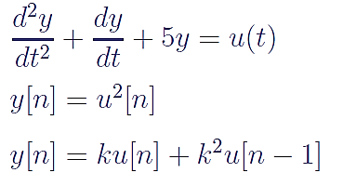
Linearity check

Slide 31

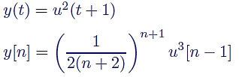
Time Invariance (TI)
A system is time-invariant (TI) if
Its behaviour does not depend on what time it is [Willsky, 2003], or
if its operator does not change with time [Sinha, 1991].
Mathematically speaking, a system u(t) → y(t) is TI if for any input u(t) and any time shift t0,
TI or not?

Slide 32
Closing remarks…
The world of science and engineering is filled with signals:
images from remote space probes,
voltages generated by the heart and brain,
radar and sonar echoes,
seismic vibrations, and
countless other applications.
Digital Signal Processing is the science of using computers to understand these types of data.
This includes a wide variety of goals:
filtering,
speech recognition,
image enhancement,
data compression,
neural networks,
and much more.
Suppose we attach an analog-to-digital converter to a computer, and then use it to acquire a chunk of real world data. DSP answers the question: What next?

Slide 33
Individual Assignment - Exercise (Problems)
What possible relationships might there be between DSP and the following fields?
Numerical analysis
Operating systems
Computer visions
Artifical Intelligence
Consider a mobile robot able only o avoid obstacles, and to locate an electric outlet when its batteries are low. What technologies would be needed to implement such a robot? Where is DSP needed? Now give the robot the ability to receive verbal commands, to retrieve objects, and to keep its owner informed. What DSP is needed now?
Along with a friend, using a computer with Audacity, record some naturally spoken speech and observe its waveform graphically. Does this picture contain all the information we can obtain from listening to the speech? You can easily find long silences and tell the difference between whispering and screaming. Try to tell where the words begin and end. Can you differentiate between male and female voices? Can you guess what is being said?
Compare digital Compact Disc (CD) technology with the mp3 records. Explain why mp3 has somewhat replace CD technology by considering sound quality, playing duration, noise, stereo separation, the effect of apging: media, and the ability to make copies

Slide 34
Individual Assignment - Exercise (Instructions)
Answers must be typed in English OR BAHASA.
You may cite/use any references; list your references in a Reference list
Save your answers as pdf file. For Problem #3, save your sound recordings in mp3 file format
Submission procedure:
Login to E-Learning, find “Ch. 1 Assignment “in Session 1
Upload/submit your answer file there. Only one file in pdf format for the report, along with a zip file containing your sound recordings, are requested
Filename format: DSP_A01_name_studentnumber.pdf (for typed answers) and DSP_A01_name_studentnumber.zip (for the collective of sound recording files). The zip file should contain the mp3 files named DSP_A01_name_studentnumber_01.mp3, DSP_A01_name_studentnumber_02.mp3, DSP_A01_name_studentnumber_03.mp3, etc.
Due date: Tuesday, 12 February 2019, 23:55 AM
Notes:
To get the most of the excercise, answer the question on your own!
This is individual assignment; no two students should write the same answers!
Cheating, plagiarisms, copy-paste other people’s work without giving appropriate credits will incur discount on your grades

Slide 35
Individual Assignment
Work out exercise from Ch. 1 DSPCSP book:
Ex. 1.2.1
Ex. 1.2.5 (Use PC/laptop and Audacity to capture/record and graphical interface)
Ex. 1.4.2
Ex. 1.4.3 (Only mathematical functions, no need to write routine codes)
Ex. 1.4.6 (Change LP with mp3)
Answers must be written in BAHASA; scan/photo your written answers and submit them according to the submission procedure explained below.
For Ex. 1.2.5, your waveform must be included digitally as an mp3 file (however, for documentation, saved as pictures and include them in your report document)
You may cite/use any references; list your references in a Reference list (typed)
Format: written (for answers) and LaTeX or Word and saved as pdf (for references, if any).
Submission procedure:
Login to E-Learning, find “Ch. 1 Assignment “in Session 1
Upload/submit your answer file there. Only one file in pdf format is requested for the report
Filename format: DSP_A01_name_studentnumber.pdf
Upload/submit your own sound recording in mp3 file format
Due date: Wednesday, 15 March 2017, 23:55 AM
Notes:
To get the most of the excercise, answer the question on your own!
This is individual assignment; no two students should write the same answers!
Cheating, plagiarisms, copy-paste other people’s work without giving appropriate credits will incur discount on your grades

Slide 36
References
Alan V. Oppenheim and Ronald W. Schafer. Discrete-Time Signal Processing. Prentice-Hall, 2nd edition, 1999.
John G. Proakis and Dimitris G. Manolakis. Digital Signal Processing: Principles, Algorithms, and Applications. Macmillan, second edition, 1992.
Paul A. Lynn and Wolfgang Fuerst. Introductory Digital Signal Processing with Computer Applications. John Wiley & Sons, revised edition, 1994.
Steven W. Smith. The Scientist and Engineer’s Guide to Digital Signal Processing. California Technical Publishing, 1997. URL http://www.dspguide.com/pdfbook.htm.
Sanjit K. Mitra and James F. Kaiser, editors. Handbook for Digital Signal Processing. John Wiley & Sons, 1993.
Alan V. Oppenheim. MIT OCW Lecture Notes on Digital Signals Processing. http://ocw.mit.edu/OcwWeb/Electrical-Engineering-and-Computer-Science/6-341Fall-2005/, 2005.
Naresh K. Sinha. Linear Systems. John Wiley and Sons, Inc., 1991.
Huibert Kwakernaak and Raphael Sivan. Modern Signals and Systems. Prentice-Hall International, 1991.
Rodger E. Ziemer, William H. Tranter, and D. Ronald Fannin. Signals and Systems: Continuous and Discrete. Maxwell Macmillan International, 2 edition, 1990.
Mark Fowler. Signals and systems. http://www.ws.binghamton.edu/fowler/fowler%20personal%20page/2007
Martin Brown. Lecture notes on signals and systems. http://personalpages.manchester.ac.uk/staff/martin.brown/signals/, 2008.
Alan S. Willsky. MIT OCW Lecture Notes on Signals and Systems. http://ocw.mit.edu/OcwWeb/Electrical-Engineering-and-Computer-Science/6-003Fall-2003/LectureNotes/index.htm, 2003.

Slide 37
Acknowledgment
Many portions of the slides used in this lecture were taken from OCW, Dr. Fowler’s, and Dr. Brown’s slides

