Slide 1
DSP: Systems
Irwan Prasetya Gunawan
Informatics Engineering
irwan.gunawan@bakrie.ac.id
Last Updated: 4/20/21

Slide 2
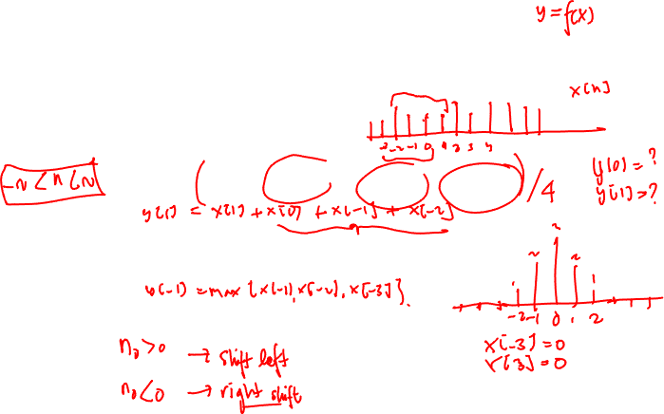
Discrete-Time Systems
Discrete-Time System is a mathematical operation that maps a given input sequence x[n] into an output sequence y[n]
Example Discrete-Time Systems
Moving (Running) Average
Maximum
Ideal Delay System
x[n]
T{.}
y[n]

Slide 3

Memoryless System
Memoryless System
A system is memoryless if the output y[n] at every value of n depends only on the input x[n] at the same value of n
Example Memoryless Systems
Square
Sign
Counter Example
Ideal Delay System

Slide 4

Linear Systems
Linear System: A system is linear if and only if
Examples
Ideal Delay System

Slide 5

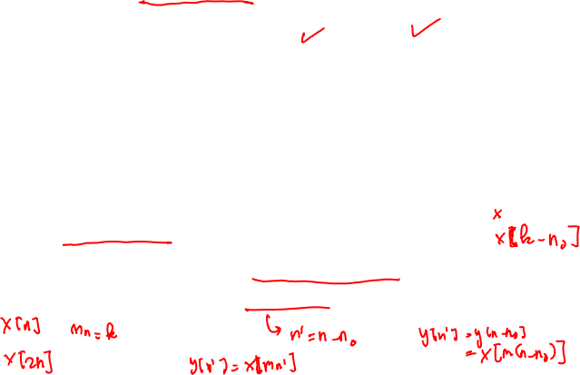
Time-Invariant Systems
Time-Invariant (shift-invariant) Systems
A time shift at the input causes corresponding time-shift at output
Example
Square
Counter Example
Compressor System

Slide 6
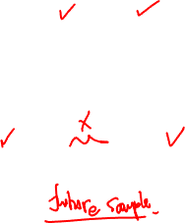
Causal System
Causality
A system is causal it’s output is a function of only the current and previous samples
Examples
Backward Difference
Counter Example
Forward Difference

Slide 7
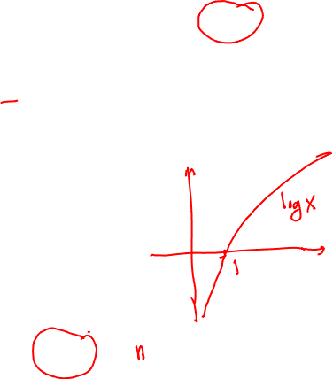
Stable System
Stability (in the sense of bounded-input bounded-output BIBO)
A system is stable if and only if every bounded input produces a bounded output
Example
Square
Counter Example
Log

Slide 8
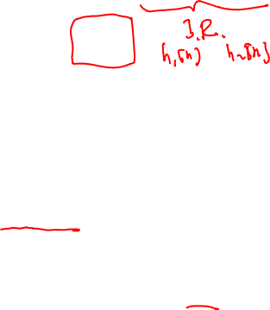
Linear-Time Invariant System
Special importance for their mathematical tractability
Most signal processing applications involve LTI systems
LTI system can be completely characterized by their impulse response
Represent any input
From time invariance we arrive at convolution
A system that is both linear and time invariant is called a filter
δ[n-k]
T{.}
h_{k}[n]

Slide 9
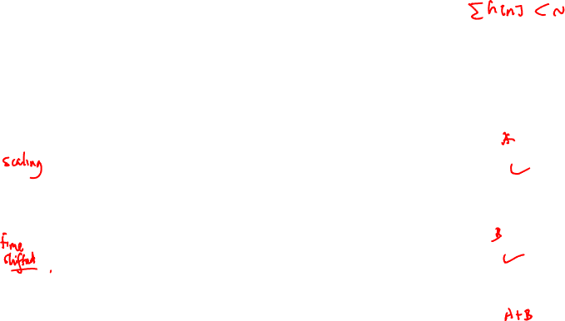
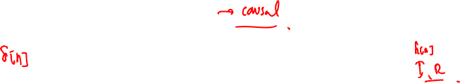
LTI System Example
1
1
LTI
0.5
0.5
0
0
-5
0
5
-5
0
5
2
2
LTI
1
1
0
0
-5
0
5
-5
0
5
2
2
LTI
1
1
0
0
-5
0
5
-5
0
5
2
4
LTI
1
2
0
0
-5
0
5
-5
0
5

Slide 10
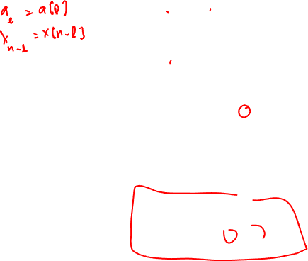
Convolution
The simplest filter types are amplification and delay
The next simplest is the moving average
a₂
a₁
a₂
a₀
a₁
a₂
a₀
a₁
a₂
a₀
a₂
a₁
a₁
a₀
a₂
a₀
a₁
a₀
*
*
*
*
*
*
*
*
*
*
*
*
*
*
*
*
*
*
*
*
*
*
*
*
*
*
*
*
*
*
*
*
*
*
*
*
*
*
*
*
*
*
*
*
*
x₀
x₁
x₂
x₃
x₄
x₅
y₀
y₀
y₀
y₀
y₀
y₀
y₁
y₁
y₁
y₁
y₁
y₂
y₂
y₂
y₂
y₃
y₃
y₃
y₄
y₄
y₅
Note that the indexes of a and x go in opposite directions
Such that the sum of the indexes equals the output index

Slide 11
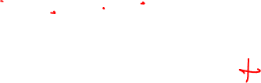
Convolution
You know all about convolution !
LONG MULTIPLICATION B₃ B₂ B₁ B₀
* A₃ A₂ A₁ A₀
-----------------------------------------------
A₀B₃ A₀B₂ A₀B₁ A₀B₀
A₁B₃ A₁B₂ A₁B₁ A₁B₀
A₂B₃ A₂B₂ A₂B₁ A₂B₀
A₃B₃ A₃B₂ A₃B₁ A₃B₀
------------------------------------------------------------------------------------
POLYNOMIAL MULTIPLICATION
(a₃ x³ +a₂ x² + a₁ x + a₀) (b₃ x³ +b₂ x² + b₁ x + b₀) =
a₃ b₃ x⁶ + … + (a₃ b₀ + a₂ b₁ + a₁ b₂ + a₀ b₃ ) x³ + … + a₀ b₀

Slide 12
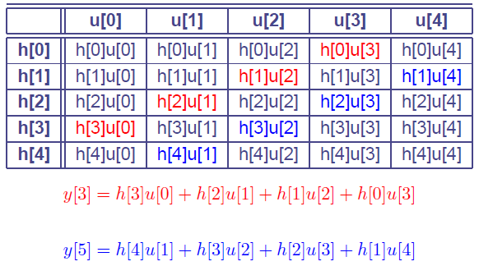
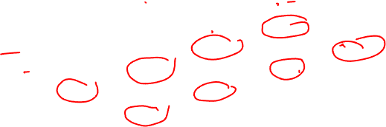
Array algorithm

Slide 13

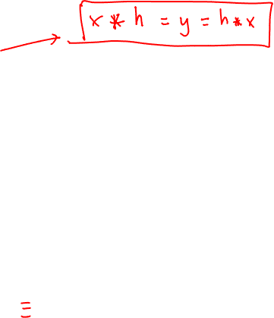
Properties of LTI Systems
Convolution is commutative
Convolution is distributive
x[n]
h[n]
y[n]
h[n]
x[n]
y[n]
h₁[n]
x[n]
y[n]
x[n]
h₁[n]+ h₂[n]
y[n]
+
h₂[n]

Slide 14

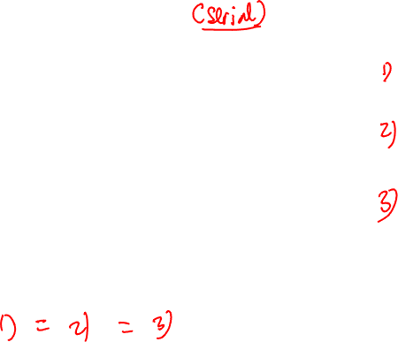
Properties of LTI Systems
Cascade connection of LTI systems
x[n]
h₁[n]
h₂[n]
y[n]
x[n]
h₂[n]
h₁[n]
y[n]
x[n]
h₁[n]∗h₂[n]
y[n]

Slide 15
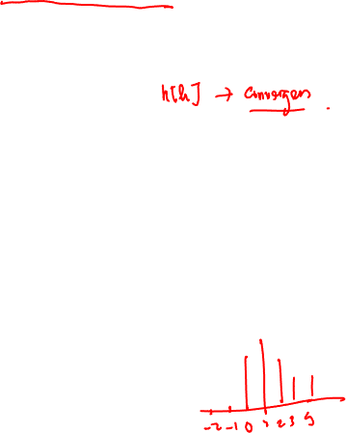

Stable and Causal LTI Systems
An LTI system is (BIBO) stable if and only if
Impulse response is absolute summable
Let’s write the output of the system as
If the input is bounded
Then the output is bounded by
The output is bounded if the absolute sum is finite
An LTI system is causal if and only if

Slide 16

Linear Constant-Coefficient Difference Equations (LCCDE)
An important class of LTI systems of the form
The output is not uniquely specified for a given input
The initial conditions are required
Linearity, time invariance, and causality depend on the initial conditions
If initial conditions are assumed to be zero system is linear, time invariant, and causal
Example
Moving Average
Difference Equation Representation

Slide 17

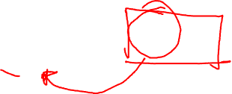
Eigenfunctions of LTI Systems
Complex exponentials are eigenfunctions of LTI systems:
Let’s see what happens if we feed x[n] into an LTI system:
The eigenvalue is called the frequency response of the system
H(e^{jω}) is a complex function of frequency
Specifies amplitude and phase change of the input
eigenfunction
eigenvalue

Slide 18
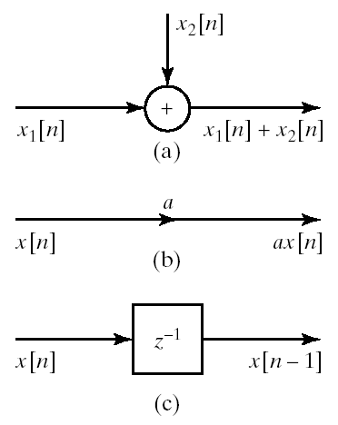
Block Diagram Representation
LTI systems with rational system function can be represented as constant-coefficient difference equation
The implementation of difference equations requires delayed values of the
input
output
intermediate results
The requirement of delayed elements implies need for storage
We also need means of
addition
multiplication

Slide 19
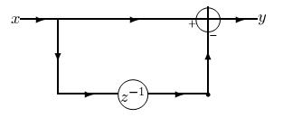
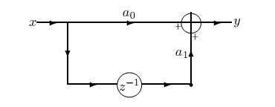
Basic blocks
y_{n} = x_{n} - x_{n-1}
y_{n} = a₀ x_{n} + a₁ x_{n-1}
Explicitly draw point only when need to store value (memory point)

Slide 20
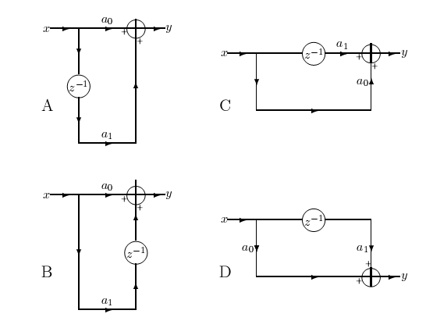
Basic MA blocks
y_{n} = a₀ x_{n} + a₁ x_{n-1}

Slide 21
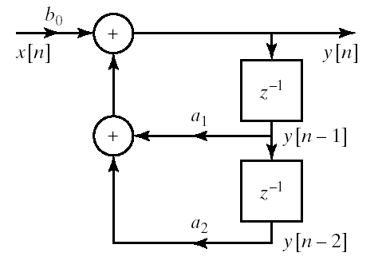
Example
Block diagram representation of

Slide 22
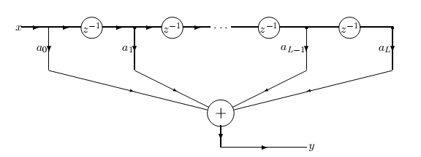
General MA
we would like to build
but we only have 2-input adders !
tapped delay line = FIFO

Slide 23
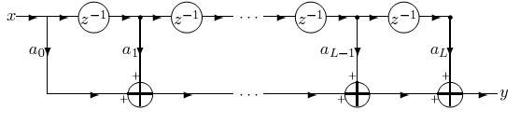
General MA (cont.)
Instead we can build
We still have tapped delay line = FIFO (data structure)
But now iteratively use basic block D (algorithm)
MACs

Slide 24
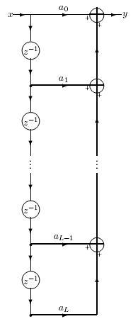
General MA (cont.)
There are other ways to implement the same MA
still have same FIFO (data structure)
but now basic block is A (algorithm)
Computation is performed in reverse
There are yet other ways (based on other blocks)
FIFO
MACs

Slide 25
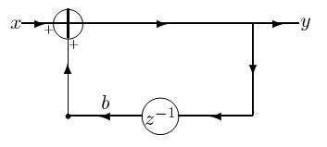
Basic AR block
One way to implement
Note the feedback
Whenever there is a loop, there is recursion (AR)
There are 4 basic blocks here too

Slide 26
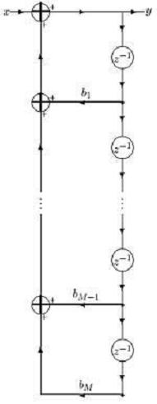
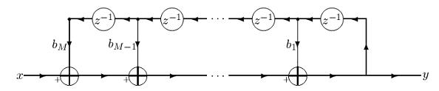
General AR filters
There are many ways to implement the general AR
Note the FIFO on outputs
and iteration on basic blocks

Slide 27
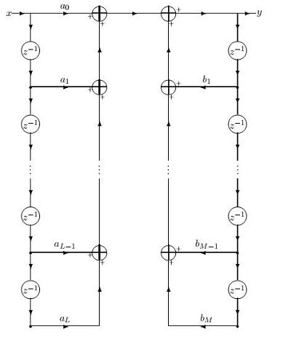
ARMA filters
The straightforward implementation :
Note L+M memory points
Now we can demonstrate
how to use graph theory
to save memory

Slide 28
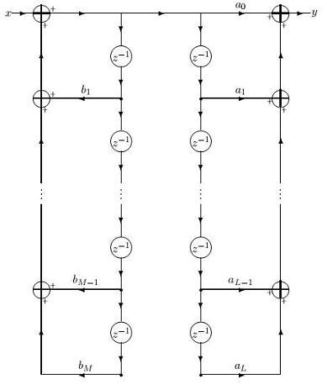
ARMA filters (cont.)
We can commute
the MA and AR filters
(any 2 filters commute)
Now that there are points representing
the same signal !
Assume that L=M (w.o.l.g.)

Slide 29
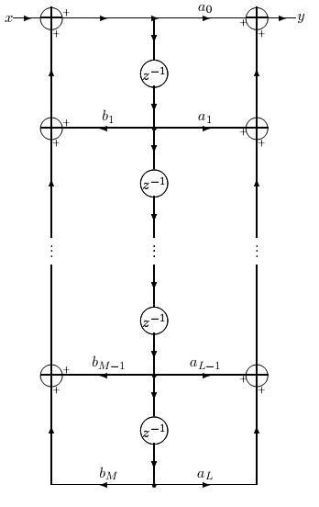
ARMA filters (cont.)
So we can use only one point
And eliminate redundant branches

Slide 30
Allowed transformations
Geometrical transformations that do no change topology
Commutation of any two filters
Unification of identical points (signals)
and elimination of un-needed branches
Transposition theorem
exchange input and output
reverse all arrows
replace adders with splitters
replace splitters with adders

Slide 31
A peek at the z-Transform
Generalization of the Fourier Transform
Fourier Transform does not exist for all signals
The z-Transform is often time more convenient to use
Definition:
Compare to DTFT definition:
z is a complex variable that can be represented as z=r e^{jω}
Substituting z=e^{jω} will reduce the z-transform to DTFT
Will discuss more on z-Transform in later chapters

Slide 32
Z-Transform Properties: Linearity
Notation
Linearity
Time Shifting
Convolution

Slide 33
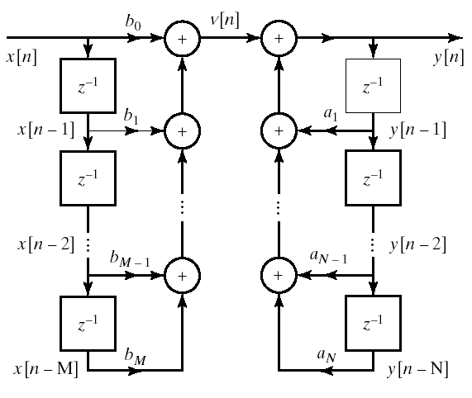
Direct Form I
General form of difference equation
Alternative equivalent form

Slide 34
Direct Form I
Transfer function can be written as
Direct Form I Represents

Slide 35
Alternative Representation
Replace order of cascade LTI systems

Slide 36
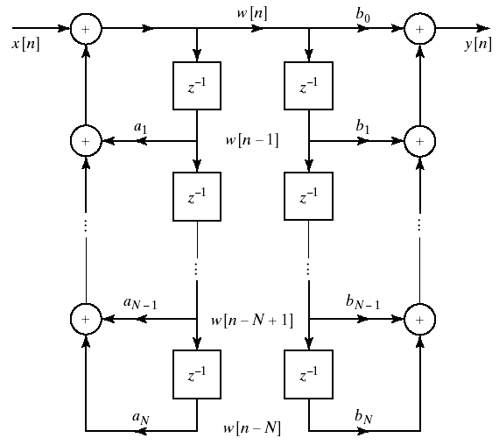
Alternative Block Diagram
We can change the order of the cascade systems

Slide 37
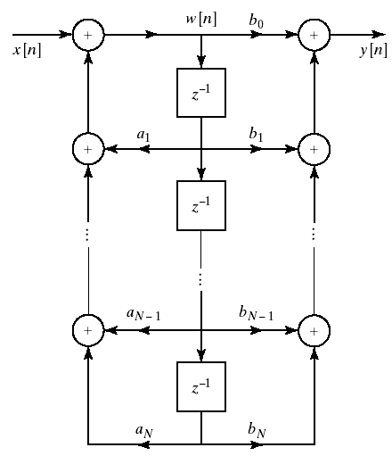
Direct Form II
No need to store the same data twice in previous system
So we can collapse the delay elements into one chain
This is called Direct Form II or the Canonical Form
Theoretically no difference between Direct Form I and II
Implementation wise
Less memory in Direct II
Difference when using finite-precision arithmetic

Slide 38
Graph theory
identity = assignment
DSP graphs are made up of
points
directed lines
special symbols
points = signals
all the rest = signal processing systems
x
y
y = x
a
x
y
y = a x
gain
y
y = x
and
z = x
x
z
x
adder
splitter = tee connector
z = x + y
z
y
x
z⁻¹
y
x
z
-
unit delay
y = z⁻¹ x
z = x - y
y

Slide 39
Why is graph theory useful ?
DSP graphs capture both
algorithms and
data structures
Their meaning is purely topological
Graphical mechanisms for simplifying (lowering MIPS or memory)
Four basic transformations
Topological (move points around)
Commutation of filters (any two filters commute!)
Identification of identical signals (points) and removal of redundant branches
Transposition theorem

Slide 40
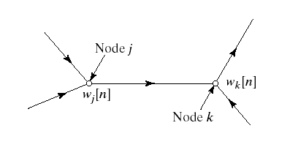
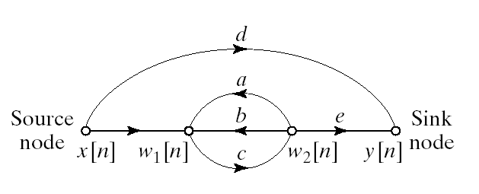
Signal Flow Graph Representation
Similar to block diagram representation
Notational differences
A network of directed branches connected at nodes
Example representation of a difference equation

Slide 41
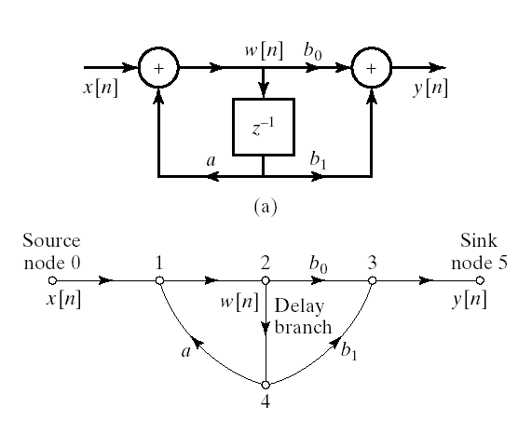
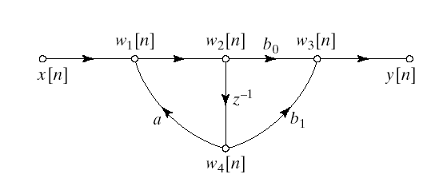
Example
Representation of Direct Form II with signal flow graphs

Slide 42
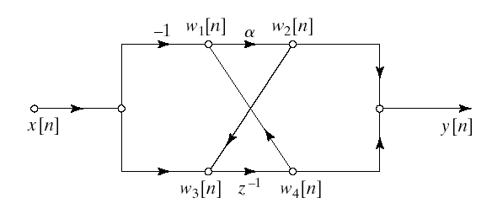
Determination of System Function from Flow Graph

Slide 43
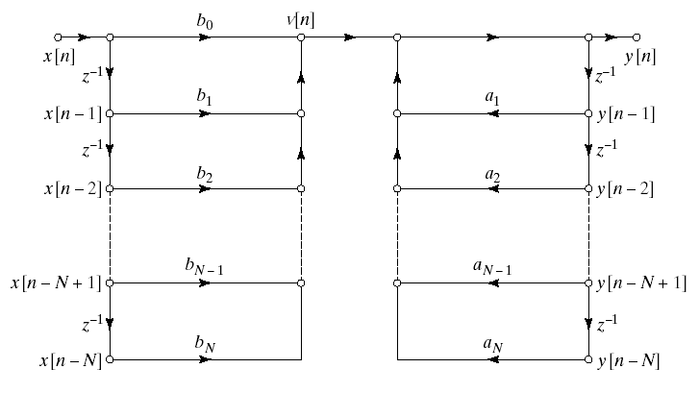
Basic Structures for IIR Systems: Direct Form I

Slide 44
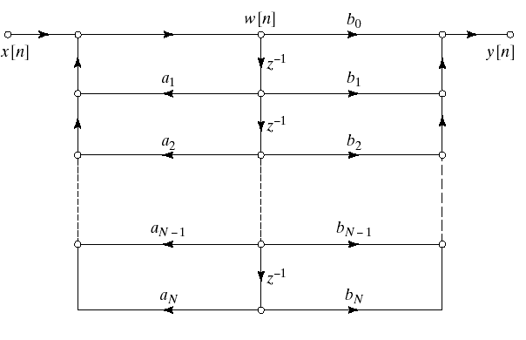
Basic Structures for IIR Systems: Direct Form II

Slide 45
Filters
Filters have an important property
Y(ω) = H(ω) X(ω) Y_{k} = H_{k} X_{k}
In particular, if the input has no energy at frequency f
then the output also has no energy at frequency f
(what you get out of it depends on what you put into it)
This is the reason to call it a filter
just like a colored light filter (or a coffee filter …)
Filters are used for many purposes, for example
filtering out noise or narrowband interference
separating two signals
integrating and differentiating
emphasizing or de-emphasizing frequency ranges

Slide 46

Filter design
f
f
f
f
f
low pass
high pass
band pass
band stop
notch
When designing filters, we specify
transition frequencies
transition widths
ripple in pass and stop bands
linear phase (yes/no/approximate)
computational complexity
memory restrictions
f
multiband
realizable LP

