Slide 1
Discrete Fourier Transform
Digital Signal Processing
Irwan Prasetya Gunawan
Informatics Engineering
irwan.gunawan@bakrie.ac.id
Last Updated: 6/15/21

Slide 2
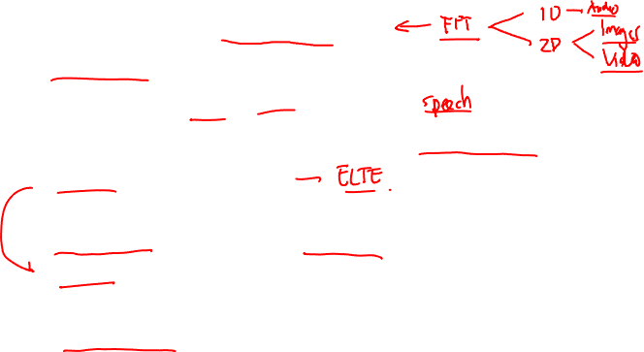
Fourier analysis - applications
Applications wide ranging and ever present in modern life
Telecomms - GSM/cellular phones,
Electronics/IT - most DSP-based applications,
Entertainment - music, audio, multimedia,
Accelerator control (tune measurement for beam steering/control),
Imaging, image processing,
Industry/research - X-ray spectrometry, chemical analysis (FT spectrometry), PDE solution, radar design,
Medical - (PET scanner, CAT scans & MRI interpretation for sleep disorder & heart malfunction diagnosis,
Speech analysis (voice activated “devices”, biometry, …).

Slide 3
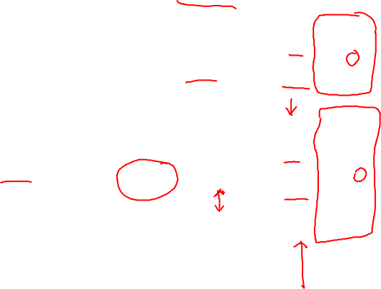
Summary: Fourier analysis - tools
Input Time Signal Frequency spectrum
Periodic (period T)
FS
Discrete
Continuous
Aperiodic
FT
Continuous
**
Periodic (period T)
DFS
Discrete
Discrete
DTFT
Continuous
Aperiodic
**
DFT
Discrete
Note: j =√-1, ω = 2π/T, s[n]=s(t_{n}), N = No. of samples
**
Calculated via FFT

Slide 4
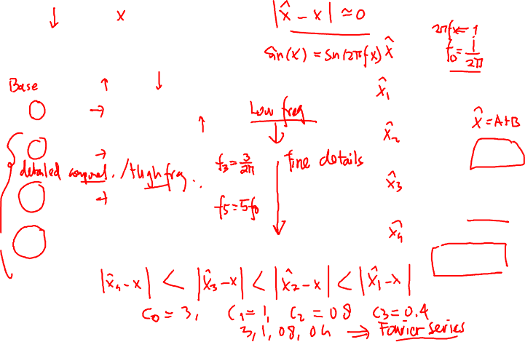
Reminder: sum of sines and cosines
=
A
sin(x)
A
3 sin(x)
+ 1 sin(3x)
B
A+B
+ 0.8 sin(5x)
C
A+B+C
+ 0.4 sin(7x)
D
A+B+C+D
Notes:
Accept without proof that every function is a sum of
sines/cosines
As frequency increases – more details are added
Low frequency – main details
Hight frequency – fine details
Coef decreases with the frequency

Slide 5
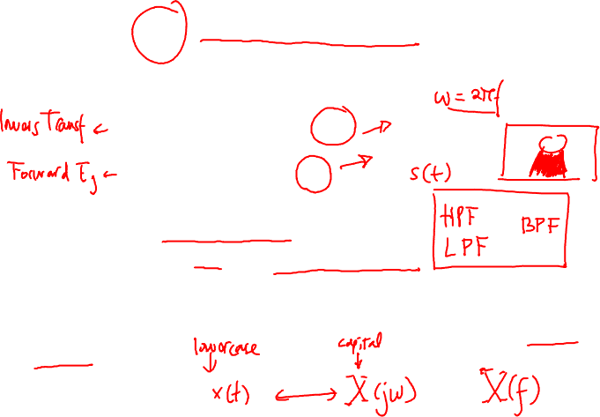
Reminder: CT Fourier Transform
CT Fourier transform maps a time domain frequency signal to the frequency domain via
The Fourier transform is used to
Analyse the frequency content of a signal
Design a system/filter with particular properties
Solve differential equations in the frequency domain using algebraic operators
Note that the transform/integral is not defined for some signals (infinite energy)

Slide 6
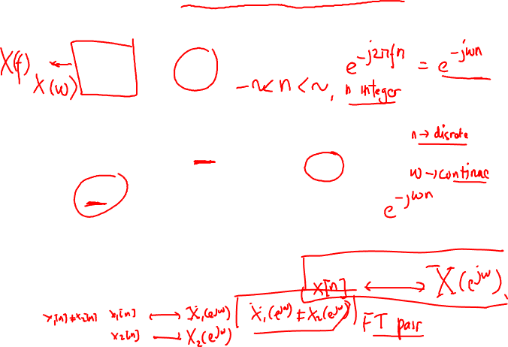
Derivation of the DT Fourier Transform
By analogy with the CT Fourier transform, we might “guess”
This is because t≈n, & the integral operator represents the limit of a sum as the sum’s width tends to zero.
X(e^{jω}) is periodic of period 2π, so is e^{jωn}. Try substituting into the inverse Fourier transform with integral over 2π:
which is the original DT signal.

Slide 7
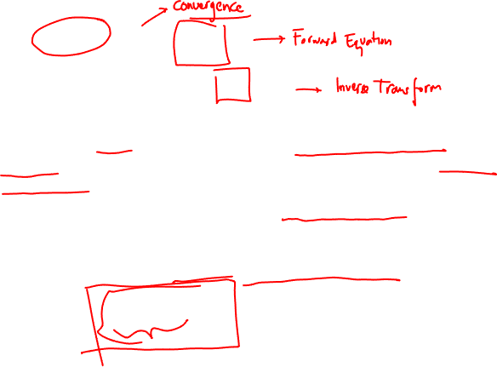
Discrete Time Fourier Transform (DTFT)
The DT Fourier transform analysis and synthesis equations are therefore:
The function X(e^{jω}) is referred to as the discrete-time Fourier transform and the pair of equations are referred to as the Fourier transform pair
X(e^{jω}) is sometimes referred to as the spectrum of x[n] because it provides us with information on how x[n] is composed of complex exponentials at different frequencies
It converges when the signal is absolutely summable

Slide 8
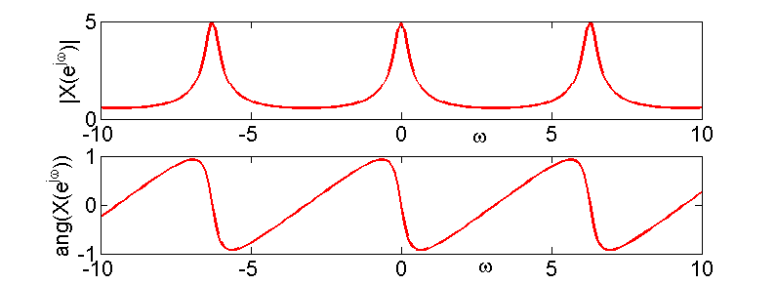
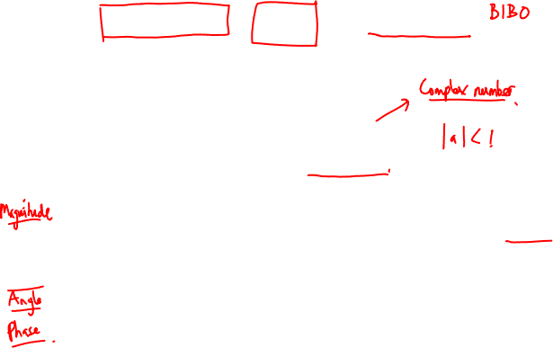
Example 1: 1st Order System, Decay Power
Calculate the DT Fourier transform of the signal:
Therefore:
stable system
a=0.8

Slide 9
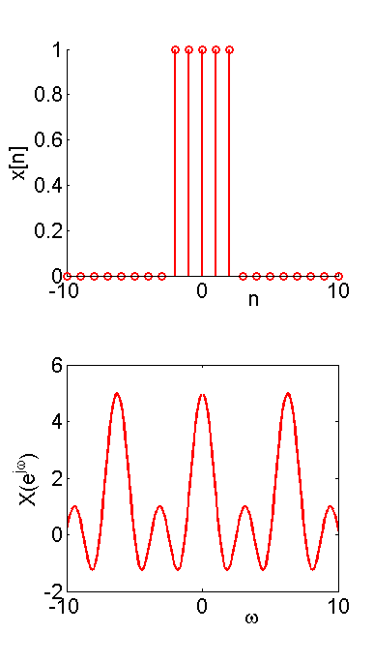
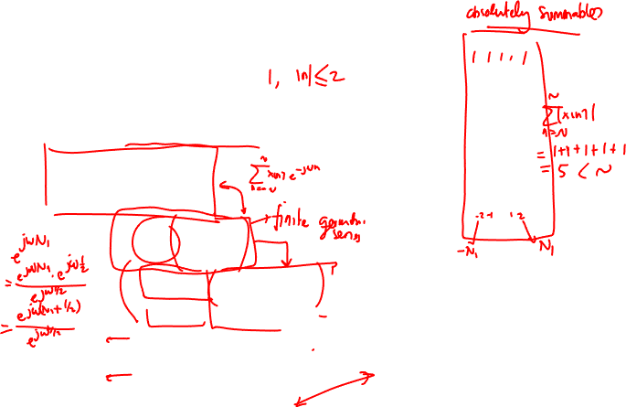
Example 2: Rectangular Pulse
Consider the rectangular pulse
and the Fourier transform is
N₁=2

Slide 10
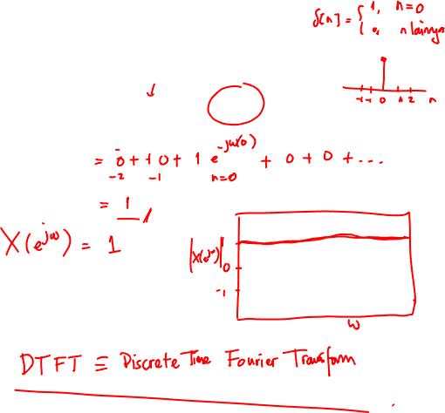
Example 3: Impulse Signal
Fourier transform of the DT impulse signal is

Slide 11
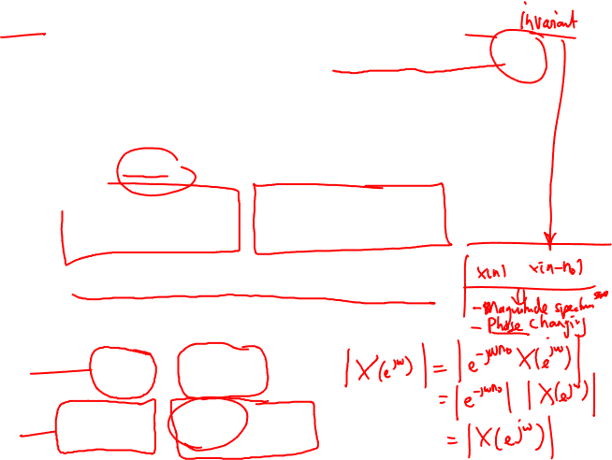
DTFT Properties: Periodicity, Linearity & Time
The DT Fourier transform is always periodic with period 2π, because
X(e^{j(ω+2π)}) = X(e^{jω})
It is relatively straightforward to prove that the DT Fourier transform is linear, i.e.
Similarly, if a DT signal is shifted by n₀ units of time

Slide 12
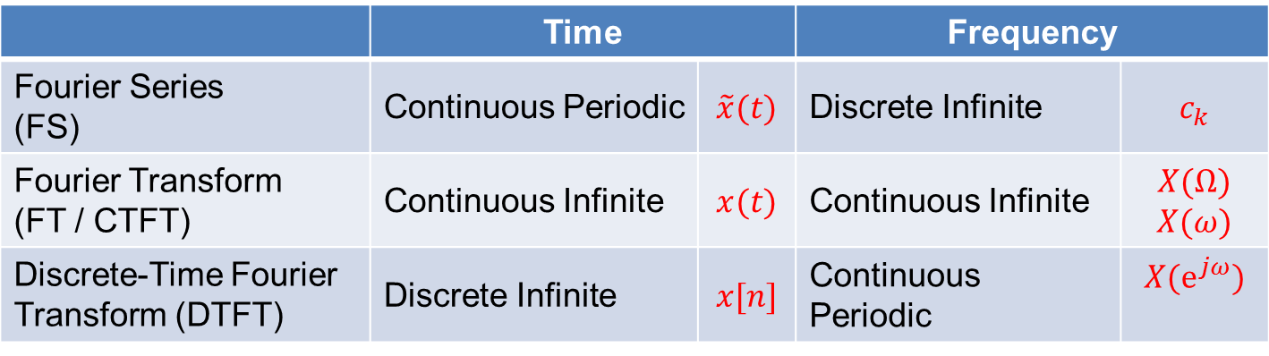
Summary of Fourier Transforms (so far…)
 | Time |  | Frequency
Fourier Series (FS) | Continuous Periodic | $$\tilde{x}(t)$$ | Discrete Infinite | $$c_{k}$$
Fourier Transform (FT / CTFT) | Continuous Infinite | $$x(t)$$ | Continuous Infinite | $X(Ω)$ $X(ω)$
Discrete-Time Fourier Transform (DTFT) | Discrete Infinite | $$x[n]$$ | Continuous Periodic | $$X(e^{jω})$$
Frequency: Discrete Finite
Time: Discrete Finite
?

Slide 13
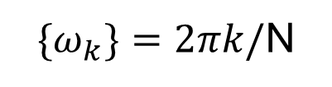
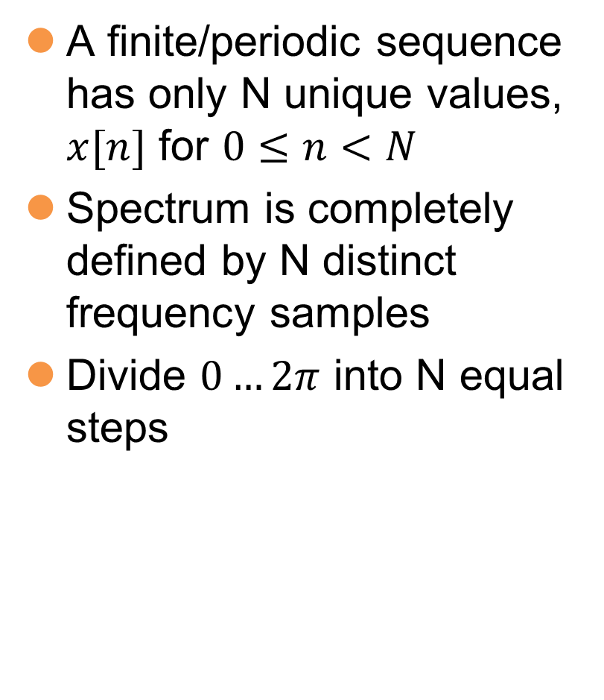
Discrete FT
Discrete finite/periodic x[n]
Discrete finite/periodic X[k]
A finite/periodic sequence has only N unique values, $x[n]$ for $0≤n<N$
Spectrum is completely defined by N distinct frequency samples
Divide $0…2π$ into N equal steps
$\{ω_{k}\}=2πk/$N

Slide 14
Discrete Functions through sampling
f(x)
f(n) = f(x₀ + nΔx)
f(x₀+2Δx)
f(x₀+3Δx)
f(x₀+Δx)
f(x₀)
x₀
x₀+Δx
x₀+2Δx
x₀+3Δx
0 1 2 3 ... N-1
The discrete function f:
{ f(0), f(1), f(2), … , f(N-1) }

Slide 15
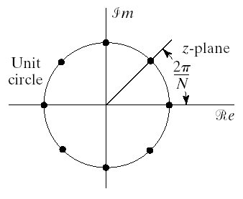
Sampling the Fourier Transform
Consider an aperiodic sequence with a Fourier transform
Assume that a sequence is obtained by sampling the DTFT
Since the DTFT is periodic resulting sequence is also periodic
The sampling points are shown in figure
could be the DFS of a sequence
Write the corresponding sequence

Slide 16
Sampling the Fourier Transform Cont’d
The only assumption made on the sequence is that DTFT exist
Combine equation to get
Term in the parenthesis is
So we get

Slide 17
Sampling the Fourier Transform Cont’d
Samples of the DTFT of an aperiodic sequence
can be thought of as DFS coefficients
of a periodic sequence
obtained through summing periodic replicas of original sequence
If the original sequence
is of finite length
and we take sufficient number of samples of its DTFT
the original sequence can be recovered by
It is not necessary to know the DTFT at all frequencies
To recover the discrete-time sequence in time domain
Discrete Fourier Transform
Representing a finite length sequence by samples of DTFT

Slide 18
DFT and IDFT
Consider an N-sequence x_{n} (at most N non-zero values for 0 ≤ n ≤ N-1)
(4.21.1)
uniformly spaced frequency samples
DFT:
(4.21.2)
Finite sum! Therefore, it’s computable.
(4.21.3)
(4.21.1) can be rewritten as:
(4.21.4)
(4.21.5)
Btw, DFT is a sampled version of DTFT.

Slide 19
DFT and IDFT (cont)
Let us verify (4.21.5). We multiply both sides by
(4.22.1)
(4.22.2)
(4.22.3)
(4.22.4)

Slide 20
The Discrete Fourier Transform
Consider a finite length sequence x[n] of length N
For given length-N sequence associate a periodic sequence
The DFS coefficients of the periodic sequence are samples of the DTFT of x[n]
Since x[n] is of length N there is no overlap between terms of x[n-rN] and we can write the periodic sequence as
To maintain duality between time and frequency
We choose one period of as the Fourier transform of x[n]

Slide 21
The Discrete Fourier Transform Cont’d
The DFS pair
The equations involve only on period so we can write
The Discrete Fourier Transform
The DFT pair can also be written as

Slide 22
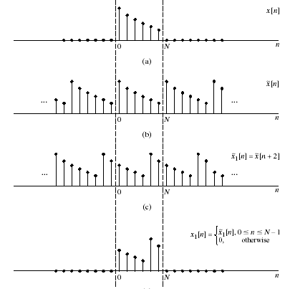
Properties of DFT
Linearity
Duality
Circular Shift of a Sequence

Slide 23
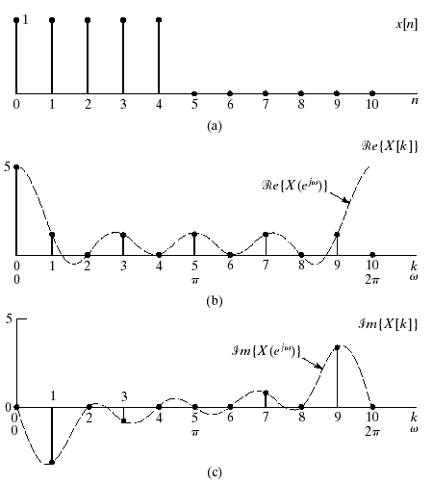
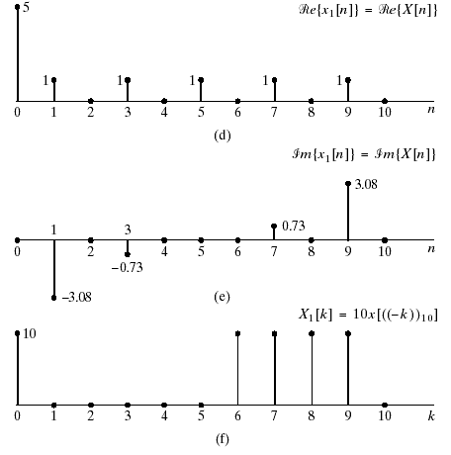
Example: Duality

Slide 24
Relation between DTFT and DFT
1. Sampling of DTFT
(4.24.1)
(4.24.2)
(4.24.3)
y_{n} is an infinite sum of shifted replicas of x_{n}. Iff x_{n} is a length M sequence (M ≤ N) than y_{n} = x_{n}. Otherwise, time-domain aliasing ⇒ x_{n} cannot be recovered!

Slide 25
Relation between DTFT and DFT (cont)
2. DTFT from DFT by Interpolation
Let x_{n} be a length N sequence:
Let us try to recover DTFT from DFT (its sampled version).
(4.25.1)
(4.25.2)
(4.25.3)
It’s possible to determine DTFT X(e^{jω}) from its uniformly sampled version uniquely!

Slide 26
Relation between DTFT and DFT (cont 2)
3. Numerical computation of DTFT from DFT
Let x_{n} is a length N sequence:
defined by N uniformly spaced samples
We wish to evaluate at more dense frequency scale.
(4.26.1)
Define:
zero-padding
(4.26.2)
(4.26.3)
No change in information, no change in DTFT… just a better “plot resolution”.

Slide 27
Discrete Fourier Transform
The DFT pair was given as
Baseline for computational complexity:
Each DFT coefficient requires
N complex multiplications
N-1 complex additions
All N DFT coefficients require
N² complex multiplications
N(N-1) complex additions
Complexity in terms of real operations
4N² real multiplications
2N(N-1) real additions
Most fast methods are based on symmetry properties
Conjugate symmetry
Periodicity in n and k

Slide 28
FFT
(4.23.1)
In the matrix form:
(4.23.2)
where:
(4.23.3)
(4.23.4)
(4.23.5)
(4.23.6)
(4.23.7)
This is actually FFT…

Slide 29
Decimation-In-Time FFT Algorithms
Makes use of both symmetry and periodicity
Consider special case of N an integer power of 2
Separate x[n] into two sequence of length N/2
Even indexed samples in the first sequence
Odd indexed samples in the other sequence
Substitute variables n=2r for n even and n=2r+1 for odd
G[k] and H[k] are the N/2-point DFT’s of each subsequence

Slide 30
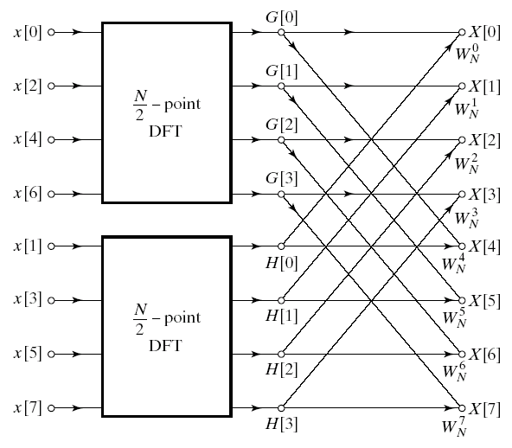
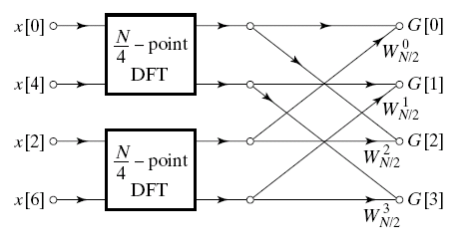
Decimation In Time
8-point DFT example using decimation-in-time
Two N/2-point DFTs
2(N/2)² complex multiplications
2(N/2)² complex additions
Combining the DFT outputs
N complex multiplications
N complex additions
Total complexity
N²/2+N complex multiplications
N²/2+N complex additions
More efficient than direct DFT
Repeat same process
Divide N/2-point DFTs into
Two N/4-point DFTs
Combine outputs

Slide 31
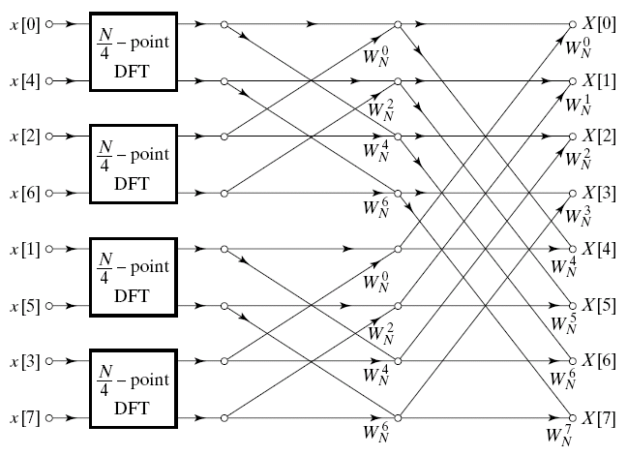
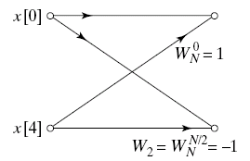
Decimation In Time Cont’d
After two steps of decimation in time
Repeat until we’re left with two-point DFT’s

Slide 32
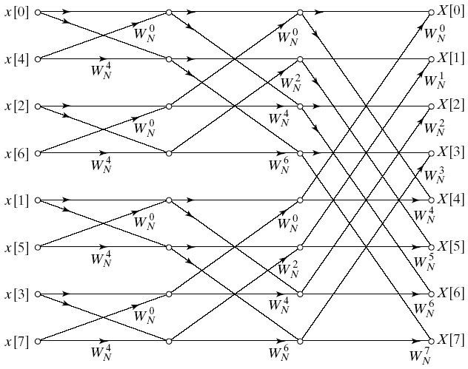
Decimation-In-Time FFT Algorithm
Final flow graph for 8-point decimation in time
Complexity:
Nlog₂N complex multiplications and additions

Slide 33
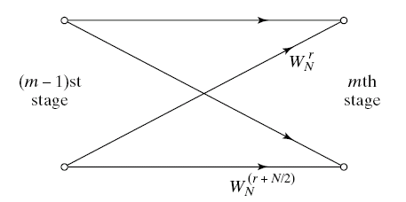
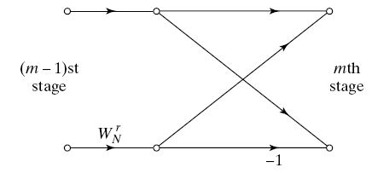
Butterfly Computation
Flow graph constitutes of butterflies
We can implement each butterfly with one multiplication
Final complexity for decimation-in-time FFT
(N/2)log₂N complex multiplications and additions

Slide 34
In-Place Computation
Decimation-in-time flow graphs require two sets of registers
Input and output for each stage
Note the arrangement of the input indices
Bit reversed indexing

Slide 35
Decimation-In-Frequency FFT Algorithm
The DFT equation
Split the DFT equation into even and odd frequency indexes
Substitute variables to get
Similarly for odd-numbered frequencies

Slide 36
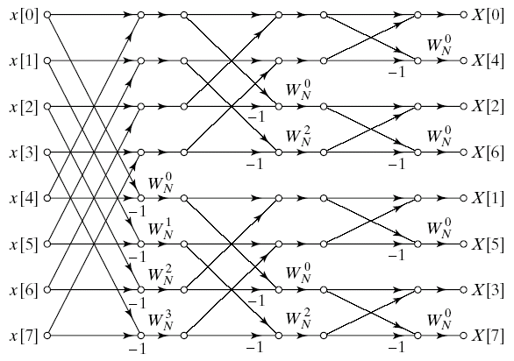
Decimation-In-Frequency FFT Algorithm
Final flow graph for 8-point decimation in frequency

Slide 37
Famous Fourier Transforms
Sine wave
Delta function

Slide 38
Famous Fourier Transforms
Gaussian
Gaussian

Slide 39
Famous Fourier Transforms
Sinc function
Square wave

Slide 40
Famous Fourier Transforms
Sinc function
Square wave

Slide 41
Famous Fourier Transforms
Exponential
Lorentzian

Slide 42
FFT of FID

Slide 43
FFT of FID

Slide 44
FFT of FID

Slide 45

Examples….

Slide 46
Spectrum (computed through FFT)
Peak
energies

Slide 47
Spectrum (computed through FFT)

Slide 48
Spectrum (computed through FFT)
Raw
Filtered

Slide 49
Spectrum (computed through FFT)
Simulated
Noise using
Tones at
185 Hz,
246 Hz,
308 Hz,
370 Hz

Slide 50
The Discrete Fourier Transform
1D Discrete Fourier Transform:
(u = 0,..., N-1)
(x = 0,..., N-1)
2D Discrete Fourier Transform:
(u = 0,..., N-1; v = 0,…,M-1)
(x = 0,..., N-1; y = 0,…,M-1)

Slide 51
The Fourier Image
Fourier spectrum |F(u,v)|
Image f
Fourier spectrum log(1 + |F(u,v)|)

Slide 52
The Fourier Image
Image f
Fourier spectrum |F(u,v)|

Slide 53
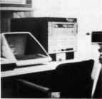
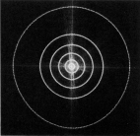
Frequency Bands
Image
Fourier Spectrum
Percentage of image power enclosed in circles (small to large) :
90%, 95%, 98%, 99%, 99.5%, 99.9%

Slide 54
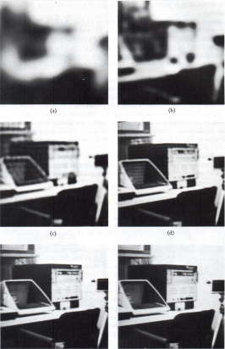
Low pass Filtering
90%
95%
98%
99%
99.5%
99.9%

Slide 55
Rotation
2D Image
2D Image - Rotated
Fourier Spectrum
Fourier Spectrum

Slide 56
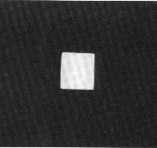
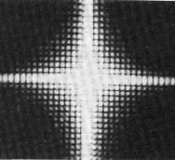
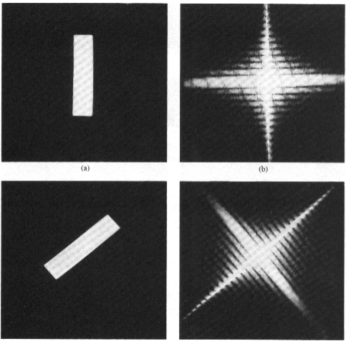
Fourier Transform -- Examples
Image
Domain
Frequency
Domain

Slide 57


Fourier Transform -- Examples
Image
Fourier spectrum

Slide 58
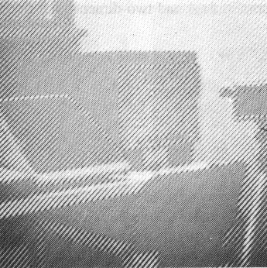
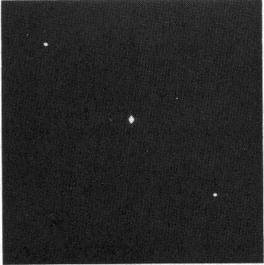
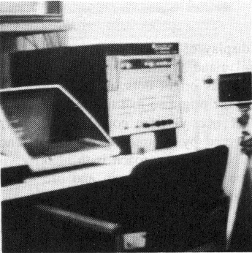
Noise Removal
Noisy image
Fourier Spectrum
Noise-cleaned image

Slide 59
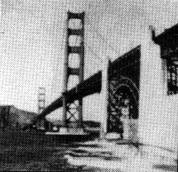
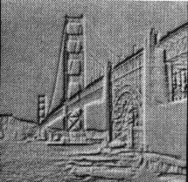
High Pass Filtering
Original
High Pass Filtered

Slide 60
High Frequency Emphasis
Original
High Pass Filtered
+

Slide 61
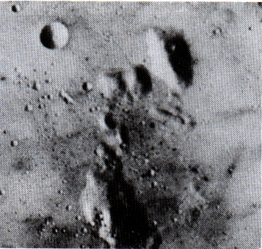
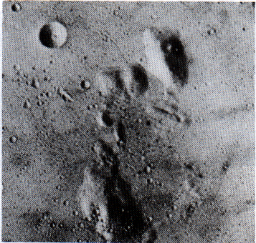
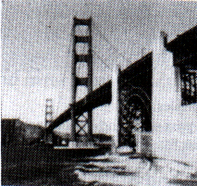
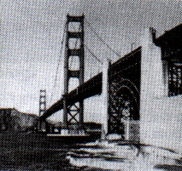
High Frequency Emphasis
Original
High Frequency Emphasis
High Frequency
Emphasis
Original

Slide 62
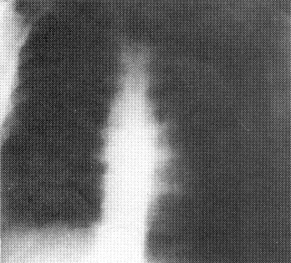
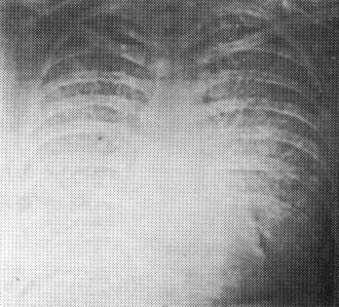
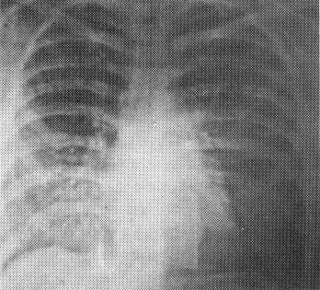
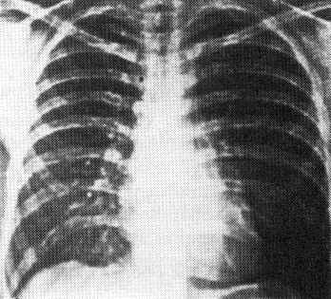
High Frequency Emphasis
Original
High pass Filter
High Frequency
Emphasis
High Frequency Emphasis
+
Histogram Equalization

Slide 63
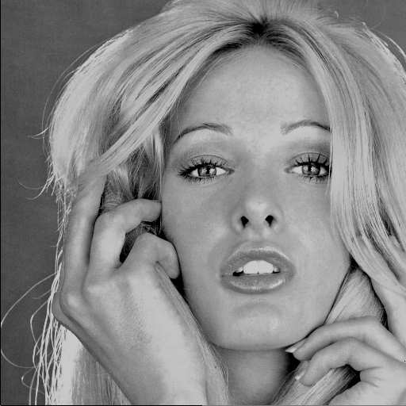

Compare – JPEG encoded image
Teach a machine/computer to recognize the original image to be able to rate the quality of the degraded one.
Tell the machine/computer to identify any differences between the images.

Slide 64
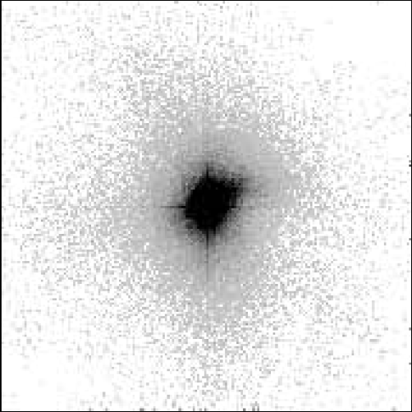
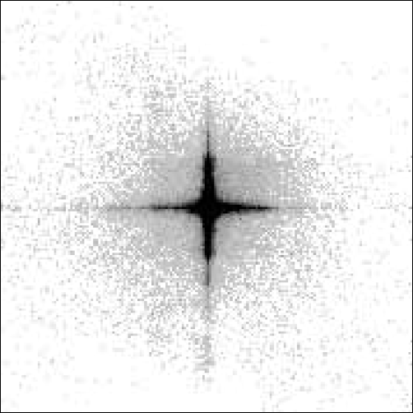
Feature Extraction Models
Division of horizontal (H) and vertical (V) spatial activity into HV (shaded) and Non-HV (white) distributions (Wolf and Pinson, 1999).

Slide 65
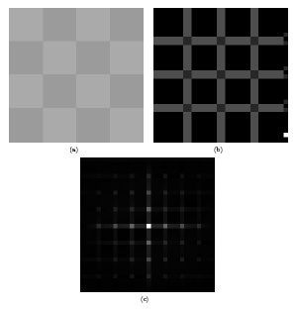


Harmonic analysis: review
Luminance discontinuities in coded picture act as pseudo-periodic pattern in spatial domain, and will generate harmonics in frequency domain
Pseudo-periodic pattern
A
B
Actual 32 × 32 gradient image
Luminance level of pixels along AB
Harmonics
Fundamental
Ref: Irwan Prasetya Gunawan andMohammed Ghanbari (2008). “Reduced-Reference Video Quality Assessment using Discriminative Local Harmonic Strength with Motion Consideration”, IEEE Transaction on Circuits and Systems for Video Technology, Vol. 18, No. 1, January 2008, pp. 71–83.
Fourier Transform
Notes:
Detection of blockiness

Slide 66


Examples
Identifying blocky picture using harmonic gain:
Ref: Irwan Prasetya Gunawan and Mohammed Ghanbari (2005).“Image Quality Assessment Based On Harmonics Gain/Loss Information”, in Proc. ICIP’05, IEEE International Conference on Image Processing 2005 (Genoa, Italy), Volume: 1, pp. 429 – 432, 11-14 Sept. 2005.

Slide 67
Summary: Fourier analysis - tools
Input Time Signal Frequency spectrum
Periodic (period T)
FS
Discrete
Continuous
Aperiodic
FT
Continuous
**
Periodic (period T)
DFS
Discrete
Discrete
DTFT
Continuous
Aperiodic
**
DFT
Discrete
Note: j =√-1, ω = 2π/T, s[n]=s(t_{n}), N = No. of samples
**
Calculated via FFT

