Slide 1
DSP: Systems Identification
Irwan Prasetya Gunawan
Informatics Engineering
irwan.gunawan@bakrie.ac.id
Last Updated: 7/6/21

Slide 2
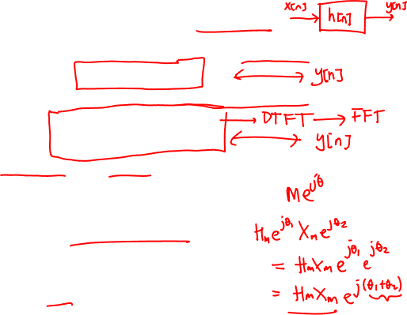
Quick Review of LTI Systems
LTI Systems are uniquely determined by their impulse response
We can write the input-output relation also in the z-domain
Or we can define an LTI system with its frequency response
H(e^{jω}) defines magnitude and phase change at each frequency
We can define a magnitude response
And a phase response

Slide 3
System identification
x
unknown
system
y
We are given an unknown system - how can we figure out what it is ?
What do we mean by "what it is" ?
Need to be able to predict output for any input
For example, if we know L, all a_{l}, M, all b_{m} or H(ω) for all ω
Easy system identification problem
We can input any x we want and observe y
Difficult system identification problem
The system is "hooked up" - we can only observe x and y
unknown
system

Slide 4
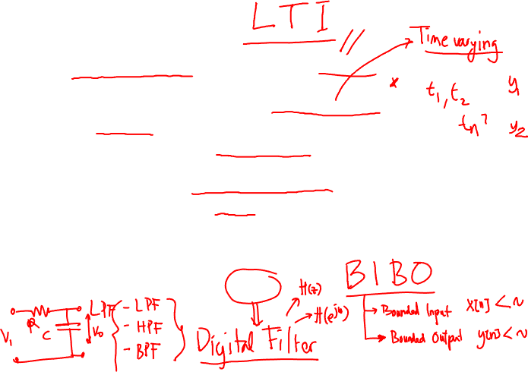
Filter identification
Is the system identification problem always solvable ?
Not if the system characteristics can change over time
Since you can't predict what it will do next
So only solvable if system is time invariant
Not if system can have a hidden trigger signal
So only solvable if system is linear
Since for linear systems
small changes in input lead to bounded changes in output
So only solvable if system is a filter !

Slide 5
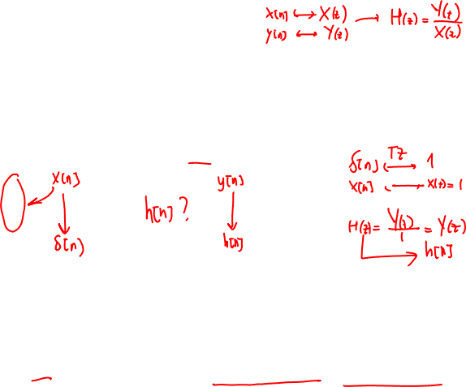
Easy problem Impulse Response (IR)
To solve the easy problem we need to decide which x signal to use
One common choice is the unit impulse
a signal which is zero everywhere except at a particular time (time zero)
The response of the filter to an impulse at time zero (UI)
is called the impulse response IR
Since a filter is time invariant, we know the response for impulses at any time (SUI)
Since a filter is linear, we know the response for the weighted sum of shifted impulses
But all signals can be expressed as weighted sum of SUIs
SUIs are a basis that induces the time representation
So knowing the IR is sufficient to predict the output of a filter for any input signal x
0
0

Slide 6
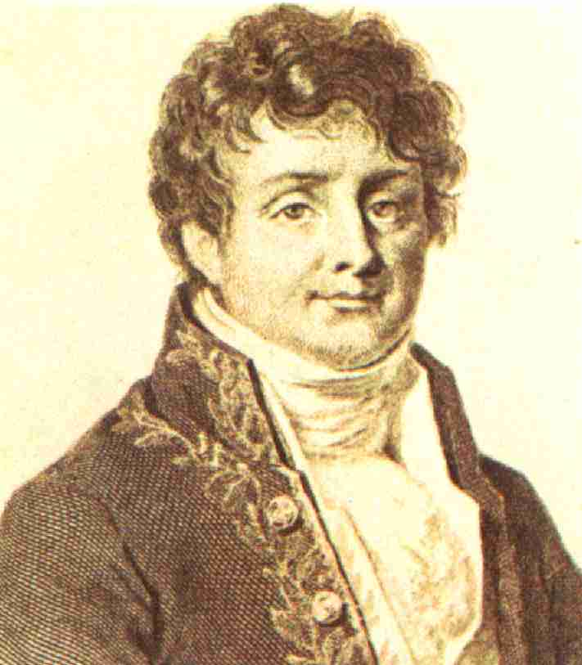

Easy problem Frequency Response (FR)
To solve the easy problem we need to decide which x signal to use
One common choice is the sinusoid x_{n} = sin ( ω n )
Since filters do not create new frequencies (sinusoids are eigensignals of filters)
the response of the filter to a a sinusoid of frequency ω
is a sinusoid of frequency ω (or zero) y_{n} = A_{ω} sin ( ω n + φ_{ω} )
So we input all possible sinusoids
but remember only the frequency response FR
the gain A_{ω}
the phase shift φ_{ω}
But all signals can be expressed as weighted sum of sinsuoids
Fourier basis induces the frequency representation
So knowing the FR is sufficient to predict the output of a filter for any input x
ω
A_{ω}
φ_{ω}

Slide 7

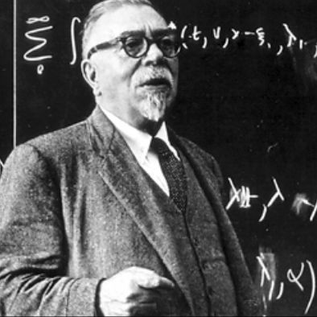

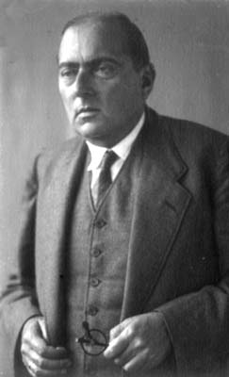

Hard problem Wiener-Hopf equations
Assume that the unknown system is an MA with 3 coefficients
Then we can write three equations for three unknown coefficients
(note - we need to observe 5 x and 3 y )
in matrix form
The matrix has Toeplitz form
which means it can be readily inverted
Note - WH equations are never written this way
instead use correlations

Slide 8
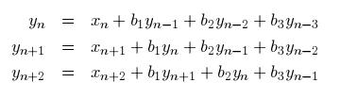

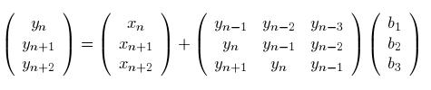
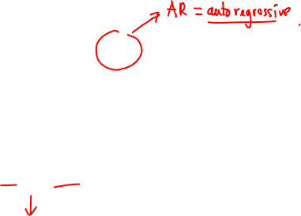
Hard problem Yule-Walker equations
Assume that the unknown system is an IIR with 3 coefficients
Then we can write three equations for three unknown coefficients
(note - need to observe 3 x and 5 y)
in matrix form
The matrix also has Toeplitz form
This is the basis of Levinson-Durbin equations for LPC modeling
Note - YW equations are never written this way
instead use correlations

Slide 9
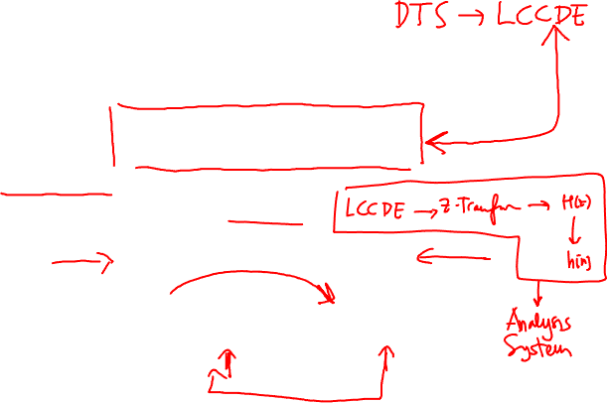
System Functions for Difference Equations
Ideal systems are conceptually useful but not implementable
Constant-coefficient difference equations are
general to represent most useful systems
Implementable
LTI and causal with zero initial conditions
The z-transform is useful in analyzing difference equations
Let’s take the z-transform of both sides

Slide 10
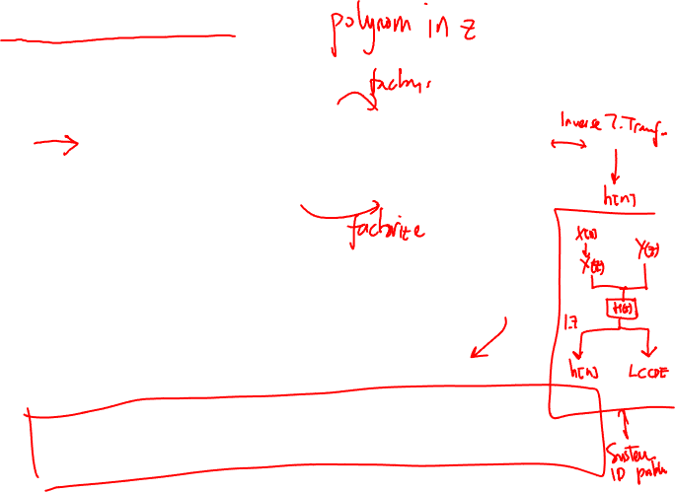
System Function
Systems described as difference equations have system functions of the form
Example

Slide 11
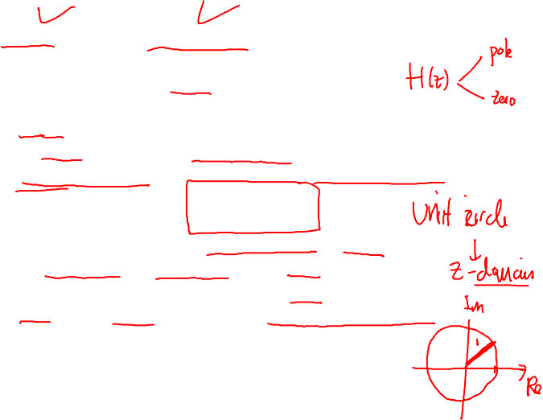
Stability and Causality
A system function does not uniquely specify a system
Need to know the ROC
Properties of system gives clues about the ROC
Causal systems must be right sided
ROC is outside the outermost pole
Stable system requires absolute summable impulse response
Absolute summability implies existence of DTFT
DTFT exists if unit circle is in the ROC
Therefore, stability implies that the ROC includes the unit circle
Causal AND stable systems have all poles inside unit circle
Causal hence the ROC is outside outermost pole
Stable hence unit circle included in ROC
This means outermost pole is inside unit circle
Hence all poles are inside unit circle

Slide 12
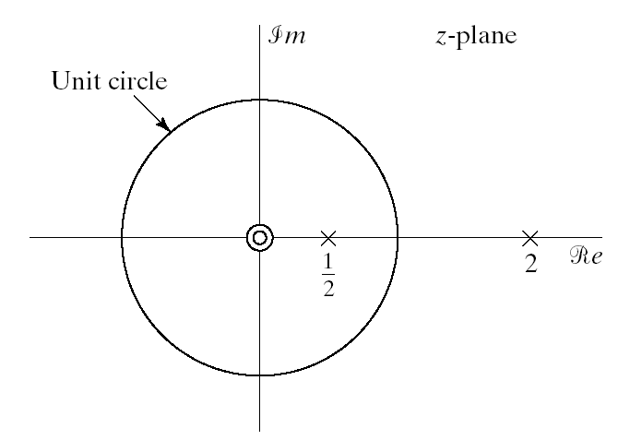
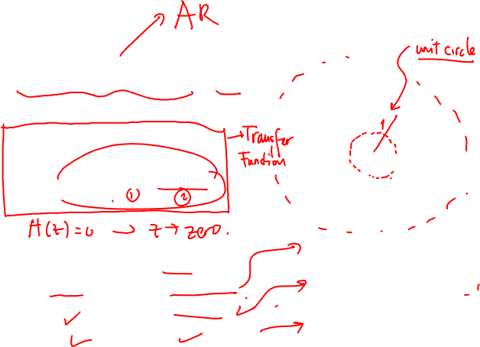
Example
Let’s consider the following LTI system
System function can be written as
Three possibilities for ROC
If causal ROC₁ but not stable
If stable ROC₂ but not causal
If not causal neither stable ROC₃

Slide 13
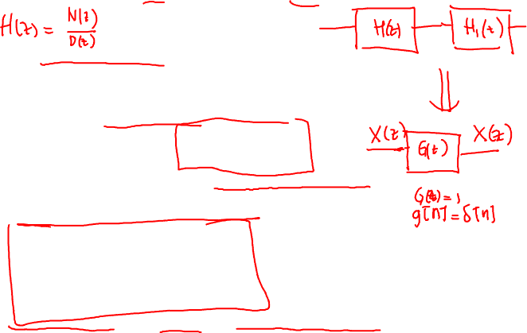
Inverse System
Given an LTI system H(z) the inverse system H_{i}(z) is given as
The cascade of a system and its inverse yields unity
If it exists, the frequency response of the inverse system is
Not all systems have an inverse: zeros cannot be inverted
Example: Ideal lowpass filter
The inverse of rational system functions
ROC of inverse has to overlap with ROC of original system

Slide 14
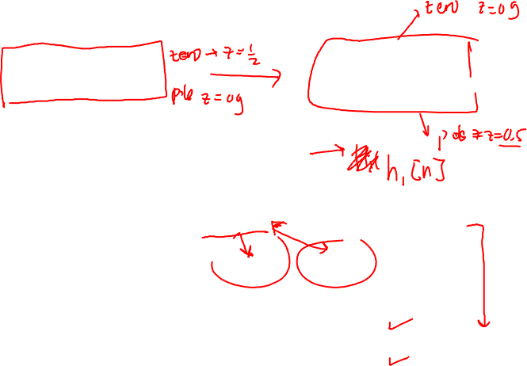
Examples: Inverse System
Example 1: Let’s find the inverse system of
The ROC of the inverse system is either
Only overlaps with original ROC
Example 2: Let’s find the inverse system of
Again two possible ROCs
This time both overlap with original ROC so both are valid
Two valid inverses for this system

