Slide 1
DSP: Filter design (FIR)
Irwan Prasetya Gunawan
Informatics Engineering
irwan.gunawan@bakrie.ac.id
Last Updated: 7/6/21

Slide 2
Quick Review of LTI Systems
LTI Systems are uniquely determined by their impulse response
We can write the input-output relation also in the z-domain
Or we can define an LTI system with its frequency response
H(e^{jω}) defines magnitude and phase change at each frequency
We can define a magnitude response
And a phase response

Slide 3

Filters
Filters have an important property
Y(ω) = H(ω) X(ω) Y_{k} = H_{k} X_{k}
In particular, if the input has no energy at frequency f
then the output also has no energy at frequency f
(what you get out of it depends on what you put into it)
This is the reason to call it a filter
just like a colored light filter (or a coffee filter …)
Filters are used for many purposes, for example
filtering out noise or narrowband interference
separating two signals
integrating and differentiating
emphasizing or de-emphasizing frequency ranges

Slide 4

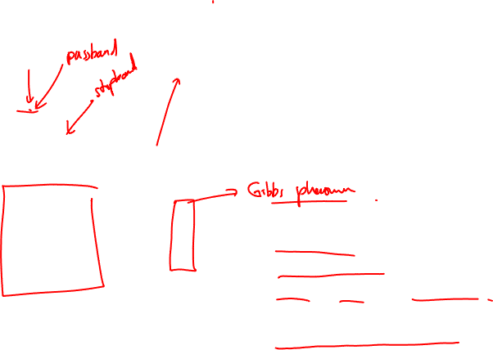
Filter design
f
f
f
f
f
low pass
high pass
band pass
band stop
notch
When designing filters, we specify
transition frequencies
transition widths
ripple in pass and stop bands
linear phase (yes/no/approximate)
computational complexity
memory restrictions
f
multiband
realizable LP

Slide 5
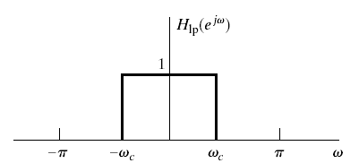
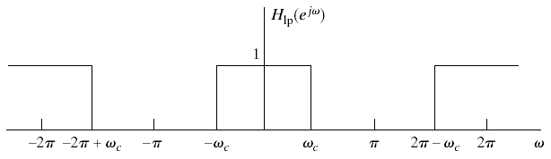
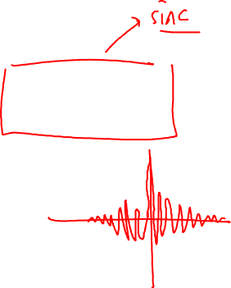
Ideal Low Pass Filter
Ideal low-pass filter

Slide 6
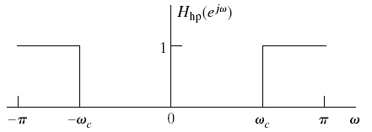
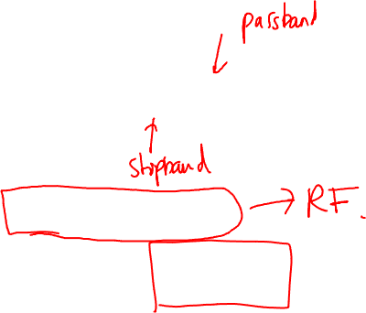
Ideal High-Pass Filter
Can be written in terms of a low-pass filter as

Slide 7
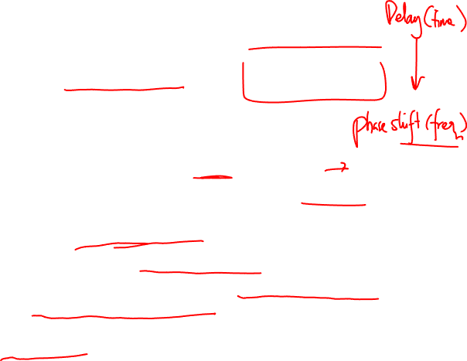
Phase Distortion and Delay
Remember the ideal delay system
In terms of magnitude and phase response
Delay distortion is generally acceptable form of distortion
Translates into a simple delay in time
Also called a linear phase response
Generally used as target phase response in system design
Ideal lowpass or highpass filters have zero phase response
Not implementable in practice
Usually we want all the frequencies that our filter passes to experience the same delay

Slide 8

Ideal Low-Pass with Linear Phase
Delayed version of ideal impulse response
Filters high-frequency components and delays signal by n_{d}
Linear-phase ideal lowpass filters is still not implementable
Group Delay
Effect of phase on a narrowband signal: Delay
Derivative of the phase
Linear phase corresponds to constant delay
Deviation from constant indicated degree of nonlinearity
arg[] defines unwrapped or continuous phase

Slide 9
FIR systems
Causal FIR system have no non-zero poles
M
y[n] = ∑b_{k} x[n-k]
k=0
x[n]
z⁻¹
z⁻¹
z⁻¹
b₀
b₁
b₂
b_{M}
y[n]
h[n] = {
b_{n} for n = 0,1,…M
0 otherwise
Direct Forms I and II, tapped delay line

Slide 10
Transpose form (how do we get it done?)
z⁻¹
z⁻¹
z⁻¹
y[n]
b_{M}
b_{M-1}
b₂
b₁
b₀
x[n]
Cascade form
M
M_{S}
∑
π
H(z) =
b_{k} z^{-k}
=
(b_{0k} + b_{1k} z ⁻¹ + b_{2k} z⁻²)
k=1
k=0
x[n]
b₀₁
b₀₂
b_{0Ms}
y[n]
z⁻¹
b₁₁
z⁻¹
b₁₂
z⁻¹
b_{1Ms}
z⁻¹
b₂₁
z⁻¹
b₂₂
z⁻¹
b_{2Ms}

Slide 11
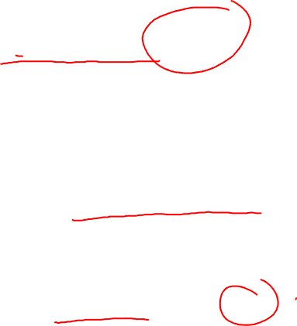
Linear phase FIR system
H(e ^{jω} ) = |H(e ^{jω} )| e^{-jω α}, |ω| < π
x[n]
w[n]
y[n]
|H(e ^{jω} )|
e^{-jω α}
where |H(e ^{jω} )| is a zero phase system and e^{-jωα} is a pure delay system
If h_{zp}[n] is symmetric about zero, H(e ^{jω} ) is zero phase
So, h_{lp}[n] is symmetric about α

Slide 12
To ensure causality, α ≥ M/2
Putting it all together
h[M-n] = h[n], for n = 0,1,…, M
or
h[M-n] = -h[n], for n = 0,1,…, M
x[n]
z⁻¹
z⁻¹
z⁻¹
b₀
b₁
b₂
b_{M}
y[n]
In the implementation above, we get b_{M}=b₀, b_{M-1}=b₁, etc.

Slide 13
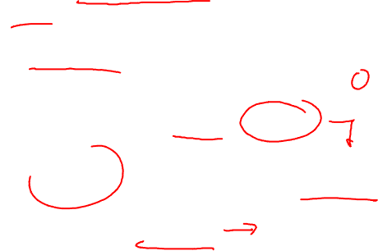
Linear Phase FIR Filters
Non-causal zero-phase filters :
example: symmetric impulse response
h[-L],….h[-1],h[0],h[1],...,h[L]
h[k]=h[-k], k=1..L
frequency response is
i.e. real-valued (=zero-phase) transfer function
k
L

Slide 14
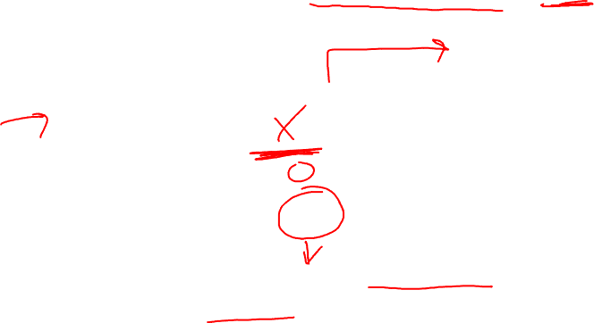
Linear Phase FIR Filters
Causal linear-phase filters = non-causal zero-phase + delay
example: symmetric impulse response & N even
h[0],h[1],….,h[N]
M=2L (even)
h[k]=h[M-k], k=0..L
frequency response is
= i.e. causal implementation of zero-phase filter, by
introducing (group) delay
k
0
M

Slide 15

If M is even
x[n]
z⁻¹
z⁻¹
z⁻¹
z⁻¹
z⁻¹
z⁻¹
z⁻¹
b₀
b₁
b₂
b_{M/2-1}
b_{M/2}
y[n]
If M is odd
x[n]
z⁻¹
z⁻¹
z⁻¹
z⁻¹
z⁻¹
z⁻¹
z⁻¹
b₀
b₁
b₂
b_{(M -3)/2}
b_{(M -1)/2}
y[n]

Slide 16
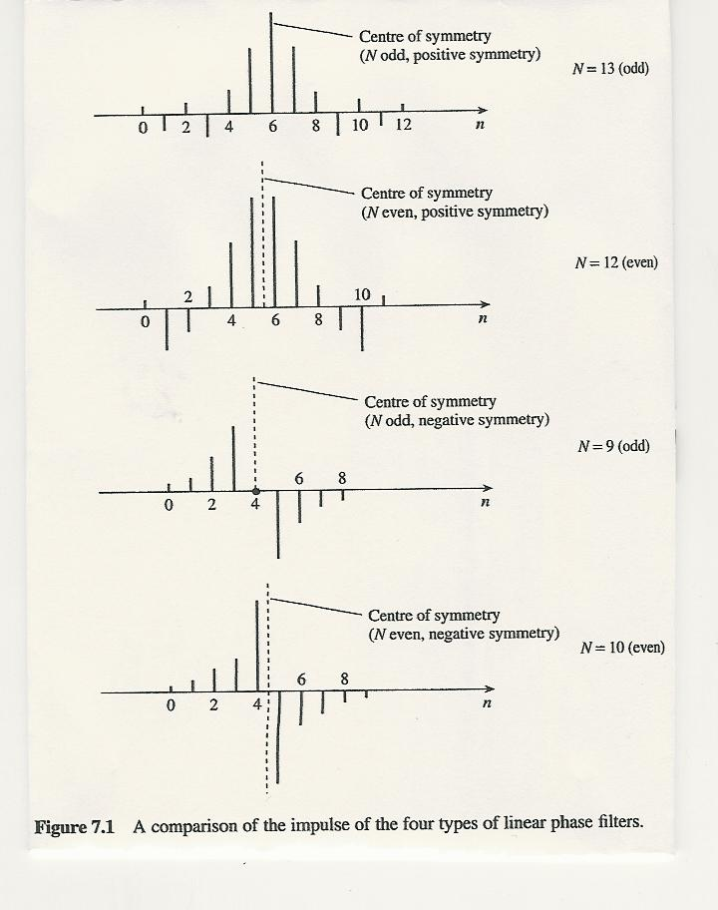

Notes:
16

Slide 17
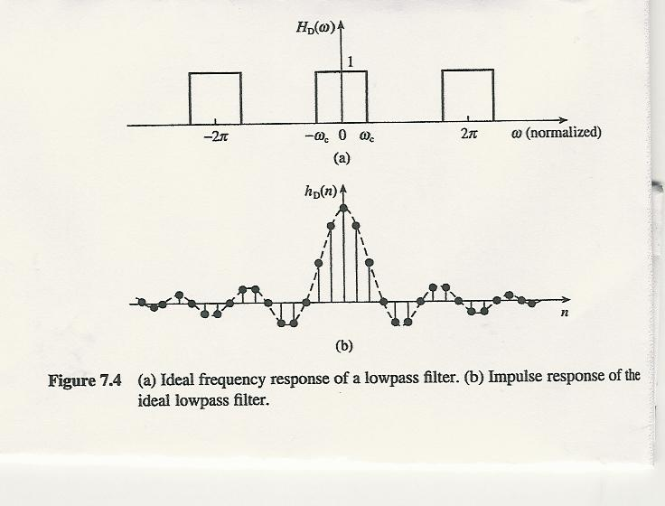
Window Method
Notes:
17

Slide 18
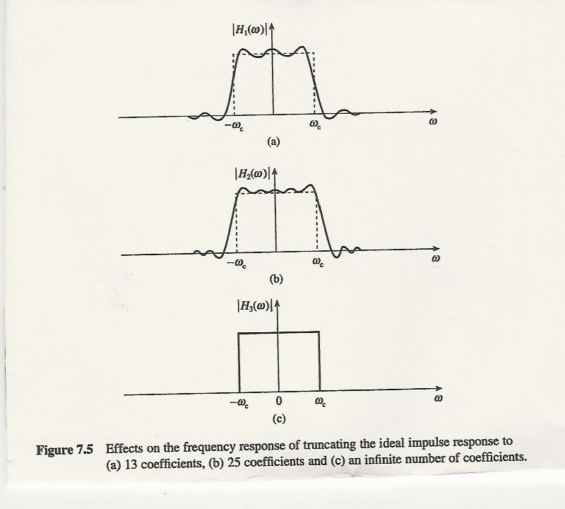
Notes:
18

Slide 19
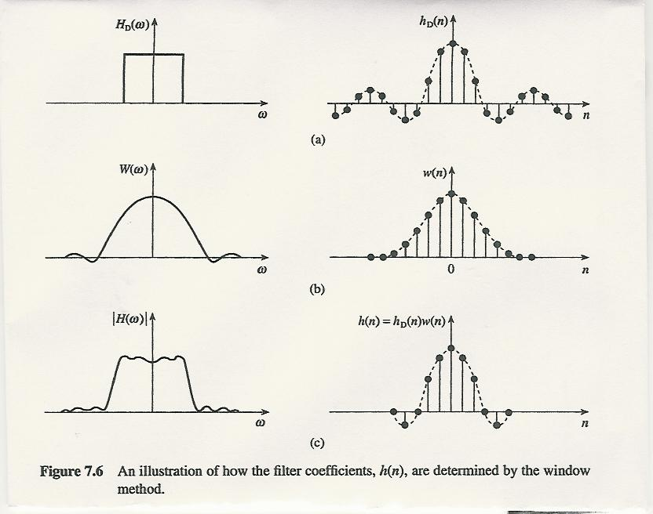
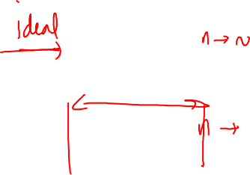
Some common window functions
Notes:
19

