Slide 1
Selasa, 23 Maret 2021 – start 07.45 WIB
Untuk yang sudah bergabung:
Tuliskan nama dan NIM di bagian chat (klik di bagian kiri bawah layar)
Ajak teman lainnya yang mungkin belum bergabung di sini untuk mengikuti kelas
Bantu temannya dengan mengapprove teman yang akan join class meeting
Cam on untuk dokumentasi dan syarat presensi kelas
Screenshot sample pada saat kelas mulai, termasuk absensi manual dengan nama/NIM masing-masing, screenshot video meeting dengan cam on dan off dengan tampilan materi perkuliahan saat ini
Upload screenshot sample ke web E-Learning di alamat weekly meeting yang sudah ditentukan
Absensi melalui pemanggilan nama masing-masing akan dilakukan di 30 menit awal perkuliahan
Ketika kuliah berlangsung:
Mute Sound
Jika akan bertanya (atau ditanya), unmute sound
Unmute sound di laptop/PC bisa dilakukan dengan menekan Space Bar

Slide 2
Operations on Signal
Digital Signal Processing
Irwan Prasetya Gunawan
Informatics
irwan.gunawan@bakrie.ac.id
Last Updated: 3/30/21

Slide 3
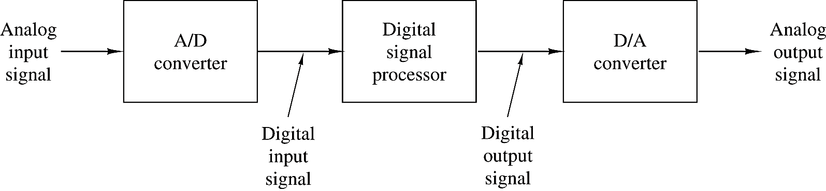
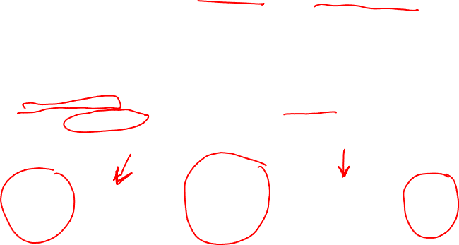
Brief review: DSP
Why DSP ? use (digital) computer instead of (analog) electronics
more flexible
new functionality requires code changes, not component changes
more accurate
even simple amplification can not be done exactly in electronics
more stable
code performs consistently
more sophisticated
can perform more complex algorithms
However
digital computers only process sequences of numbers
not analog signals
requires converting analog signals to digital domain for processing
and digital signals back to analog domain

Slide 4

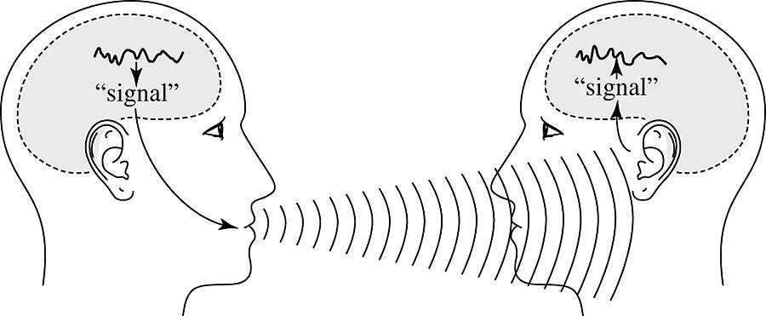

Signals
Speech sounds can be described as acoustic pressure that changes with time

Slide 5
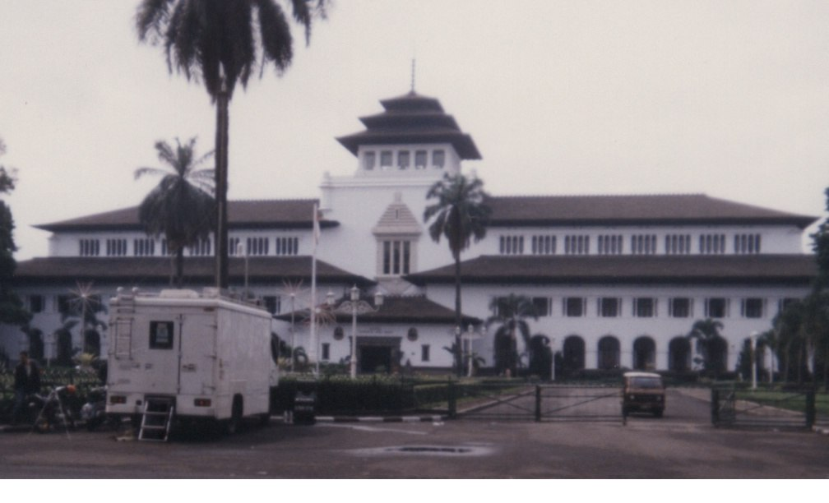
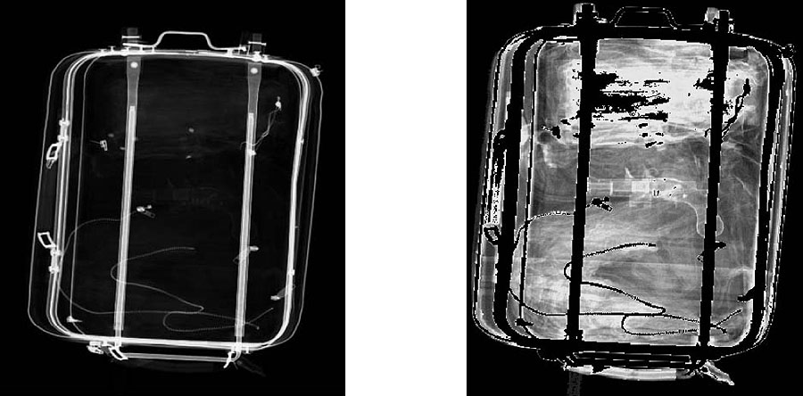
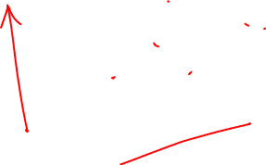
Signals (cont’d)
In addition to one-dimensional signal, we will often find two-dimensional signals. An example is the digital image. Consider a monochromatic image. Monochromatic image represented by the level of brightness as a function of the coordinates.

Slide 6
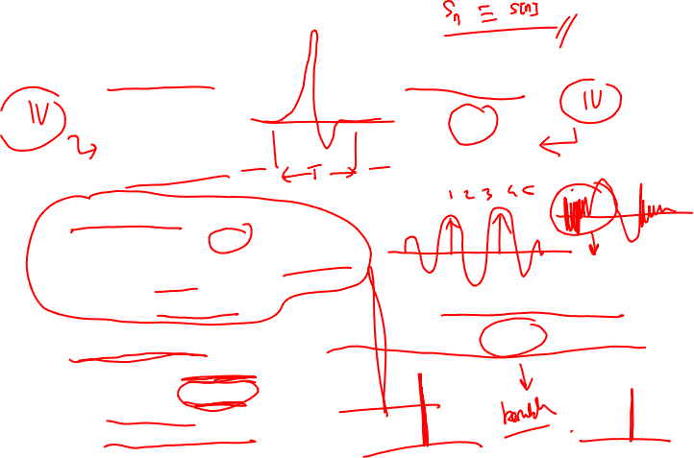
Signal representations
Analog signal
s(t)
continuous time
-∞ < t < +∞
Digital signal
s_{n}
discrete time
n = -∞ … +∞
Physicality requirements
s values are real
s values defined for all times
Finite energy
Finite bandwidth
Mathematical usage
s may be complex
s may be singular
Infinite energy allowed
Infinite bandwidth allowed
Energy = how "big" the signal is
Bandwidth = how "fast" the signal is

Slide 7
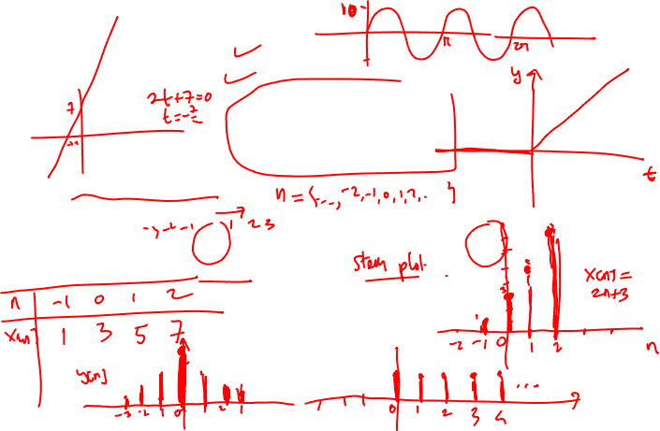
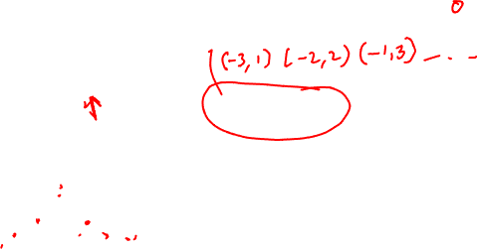
Signal representations (examples)
Continuous-time signals:
x(t) = 10 sin 2t
x(t) = 2t+7
Discrete-time signals:
x[n]=2n+3
y[n]=[1, 2, 3, 4, 3, 2, 1], note: the underscore ”_” is the reference point n=0.

Slide 8
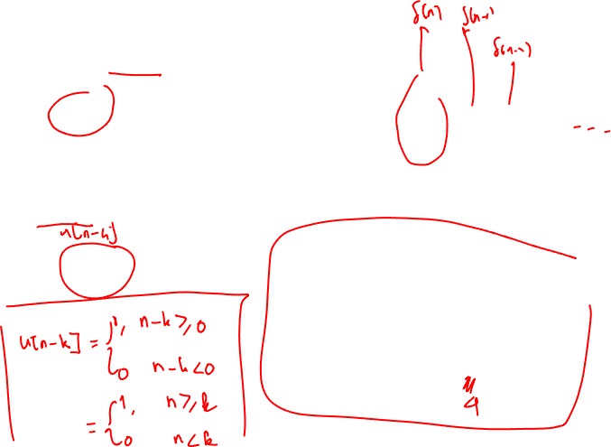
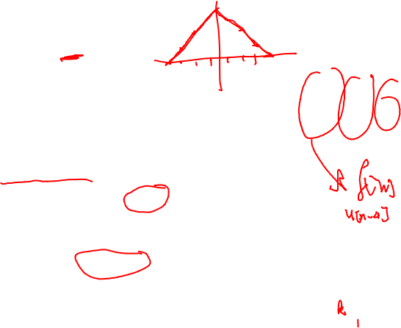
Unit Step
Discrete unit step
u[n]=
Shifted unit step
u[n-k]=
u[n]
1
n
-3
-2
-1
1
2
3
u[n-k]
1
n
-1
1
…
k

Slide 9

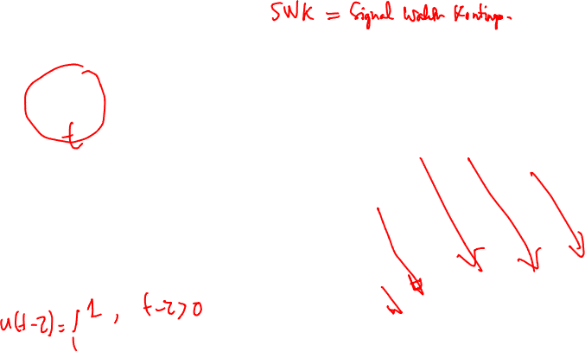
Unit Step (cont’d)
u(t)
Continuous unit step
u(t)=
Shifted unit step
u(t-τ)=
1
t
u(t- τ)
1
t
τ

Slide 10
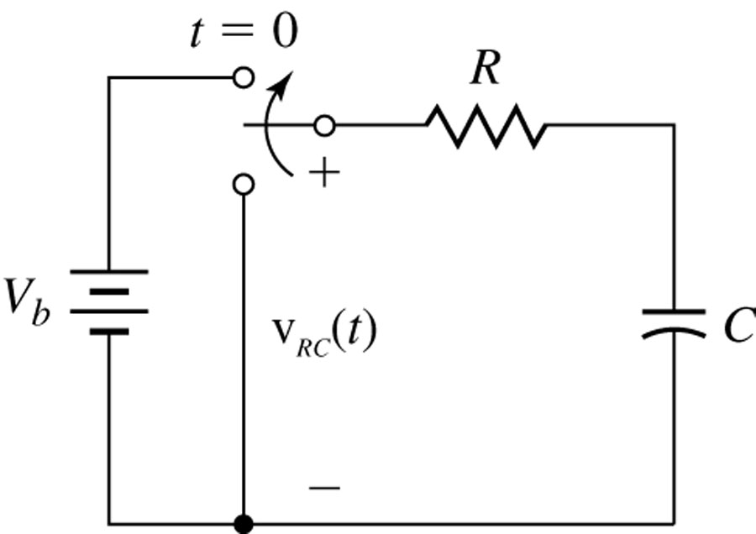
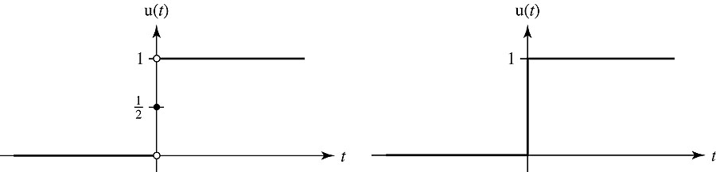
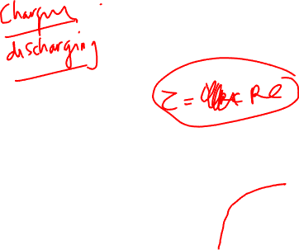
Unit Step (cont’d)

Slide 11
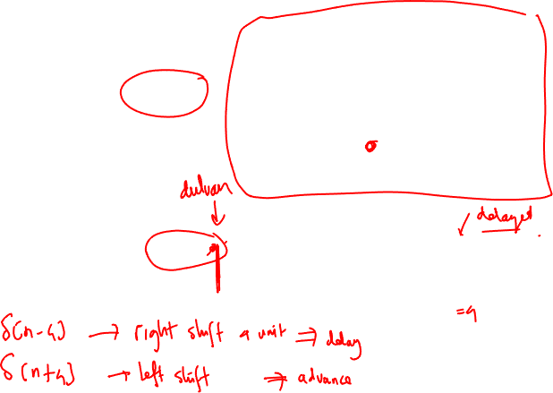
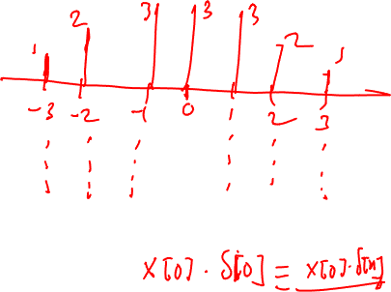
Unit Impulse
Discrete Unit Impulse
Shifted Unit Impulse
δ[n]
1
n
-3
-2
-1
1
2
3
δ[n-k]
1
n
-1
1
…
k

Slide 12
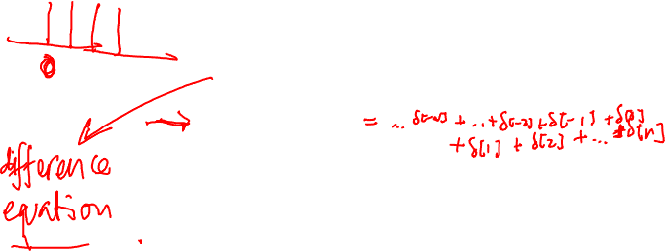
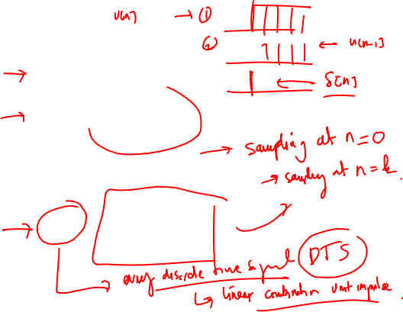
Unit Impulse (cont’d)
Properties of discrete unit impulse:

Slide 13
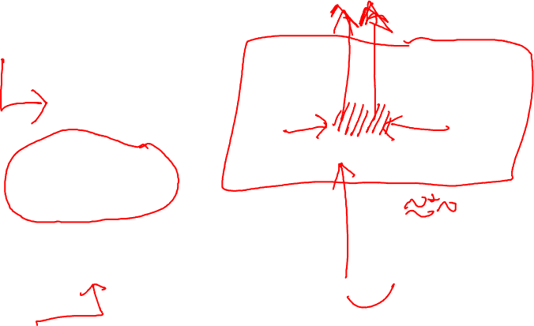
Unit Impulse (cont’d)
Continuous Unit Impulse:
δ_{ε}(t)
1/ε
t
δ(t)
ε→0
t

Slide 14
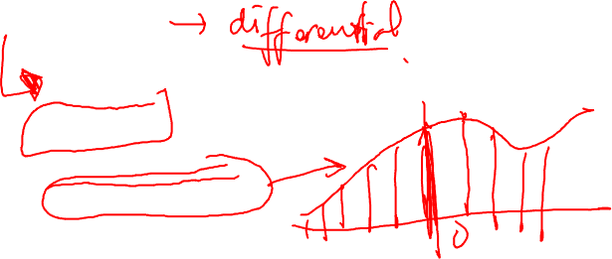
Unit Impuls (cont’d)
Shifted Unit Impulse:
Continuous Unit Impulse Properties:
δ(t-τ)
τ
t

Slide 15
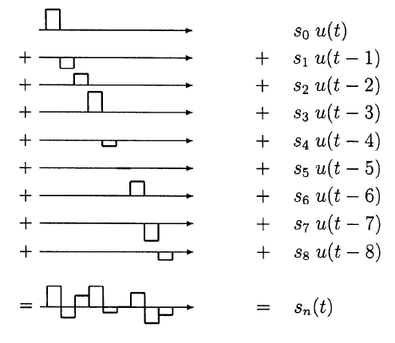
Analog signal construction

Slide 16
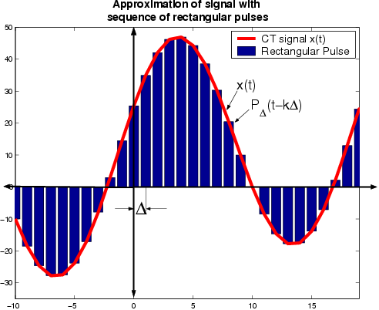
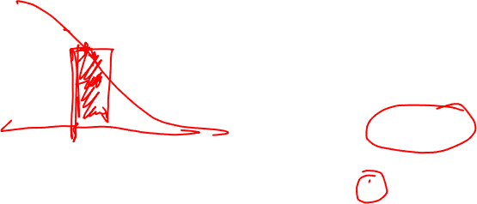
Representing signal with impulses

Slide 17
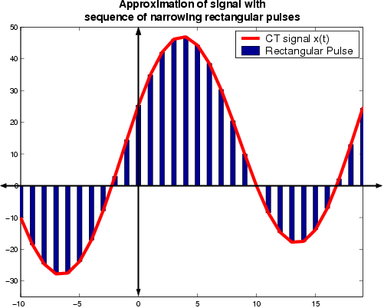
Representing signal with impulses

Slide 18
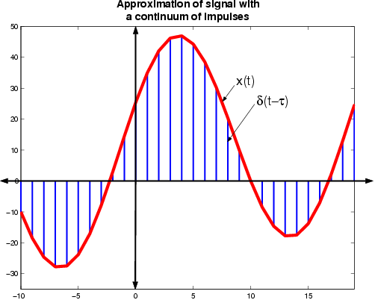
Representing signal with impulses

Slide 19
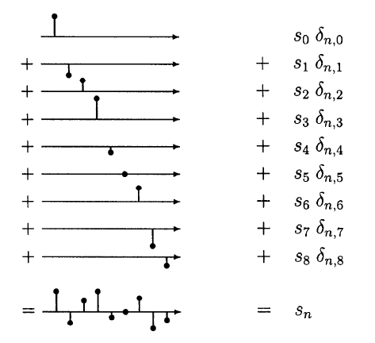
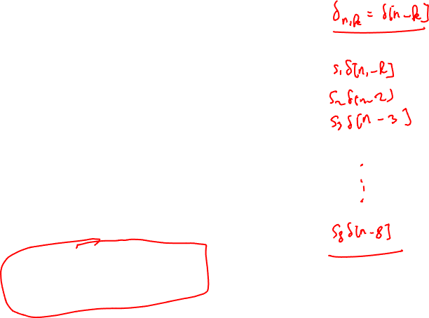
Discrete (digital) signal construction

Slide 20

Some digital “signals”
Zero signal
Constant signal
( ∞ energy!)
Unit Impulse (UI)
Shifted Unit Impulse (SUI)
Step
( ∞ energy!)
n=0
n=0
1
n=0
1
n=1
1
n=0

Slide 21
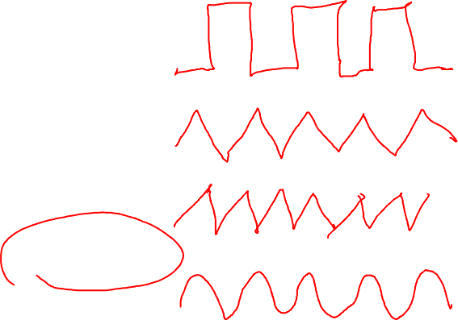
Some periodic digital “signals”
1
Square wave
Triangle wave
Saw tooth
Sinusoid
(not always periodic!)
n=0
-1

Slide 22
Signal types
Signals (analog or digital) can be:
deterministic or stochastic
if stochastic : white noise or colored noise
if deterministic : periodic or aperiodic
finite or infinite time duration

Slide 23
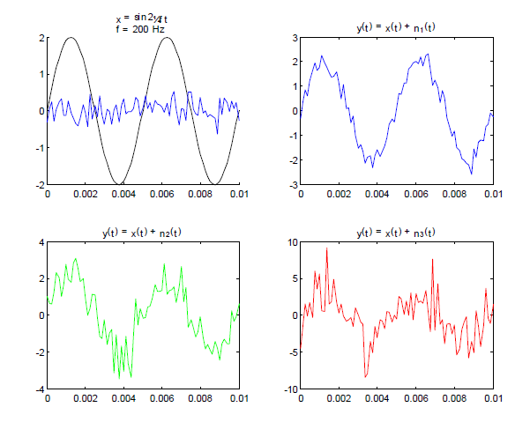
Signal types

Slide 24
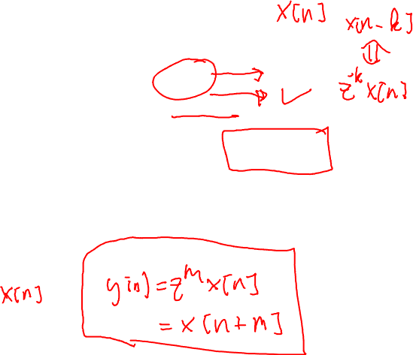
Signal types
Signals are more than their representation(s)
we can invert a signal y = -x
we can time-shift a signal y = z^{m} x
we can add two signals z = x + y
we can compare two signals (correlation)
various other operations on signals
first finite difference y = Δ x means y_{n} = x_{n} - x_{n-1}
Note Δ = 1 - z⁻¹
higher order finite differences y = Δ^{m} x
accumulator y = γ x means y_{n} = Σ_{m=-∞}^{n} x_{m}
Note γ Δ = Δ γ = 1
Hilbert transform

Slide 25

Digital signals and vectors
Digital signals are in many ways like vectors
… s₋₅ s₋₄ s₋₃ s₋₂ s₋₁ s₀ s₁ s₂ s₃ s₄ s₅ … ↔ (x, y, z)
In fact, they form a linear vector space
the zero vector 0 (0_{n} = 0 for all times n)
every two signals can be added to form a new signal x + y = z
every signal can be multiplied by a real number (amplified!)
every signal has an opposite signal -s so that s + -s = 0 (zero signal)
every signal has a length - its energy
Similarly, analog signals, periodic signals with given period, etc.
However
they are (denumerably) infinite dimension vectors
the component order is not arbitrary (time flows in one direction)
time advance operator z (z s)_{n} = s_{n+1}
time delay operator z⁻¹ (z⁻¹ s)_{n} = s_{n-1}

Slide 26

Example
DTMF pulse
Busy tone
Dial tone

Slide 27
Example (spectrum)
DTMF pulse
Busy tone
Dial tone
Dial tone

Slide 28
Example (spectrum)
Dial Tone is sent to a customer or operator to indicate that the receiving end is ready to receive dial pulses or DTMF signals.
Dial tone

Slide 29
z[n]
x[n]
y[n]

Slide 30
Analog to Digital Conversion
To convert “real-world” analog signals to digital signals for processing
Sampling
Quantizing and coding
X_{a}(t)
X [n]
X_{q}[n]
Quantizer
and Coder
Sampler
Analog signal
Digital signal
Discrete signal

Slide 31
∞
x_{s}(t) = ∑ x_{a}(nT) δ(t− nT)
x_{a}(t)
n=−∞
convert to
discrete
sequence
×
x
x[n] = x_{a}(nT)
∞
S(t) = ∑δ(t− nT)
n=−∞

Slide 32
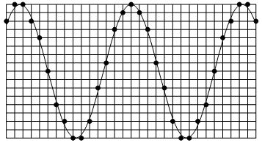
Sampling
From an analog signal we can create a digital signal
by SAMPLING
Under certain conditions
we can uniquely return to the analog signal
Nyquist (Low pass) Sampling Theorem
if the analog signal is BW limited and
has no frequencies in its spectrum above F_{Nyquist}
then sampling at above 2F_{Nyquist} causes no information loss

Slide 42
Sampling
Uniform
One sample every T seconds (ideally)
x[n] = x_{a}(nT), −∞<n<+∞
Sampling period: T
Sampling frequency: F_{s}=1/T
Assume: x_{a}(t) = Acos( 2πFt+θ) = Acos(Ω t+θ)
Then: x[n] = Acos[2πFnT+θ] = Acos[Ω Tn+θ]
= Acos[ω n+θ], where ω =Ω T is called the normalized or discrete domain frequency

Slide 43
f = F/F_{s} must be rational in order for x[n] to be periodic
If f = k/N, then x[n] is periodic with period N
Now, x_{a}(nT) = Acos(Ω Tn+θ)
= Acos((Ω +2πk/T)Tn+θ)
is periodic in Ω with period 2π/T
Also, x[n] = Acos[ω n+θ] = Acos[(ω+2πk) n +θ] is periodic in ω with period 2π

Slide 44
Example
Consider the analog signal:
x_{a}(t) = 3cos( 2000πt) +5sin( 6000πt) +
10cos( 12000πt)
What is the Nyquist rate for this signal?
The max. frequency in x_{a}(t) is f_{MAX}=6 Khz
The Nyquist rate is 12 Khz

Slide 45
x_{a}(t) = 3cos( 2000πt)+5sin( 6000πt)+10cos(12000πt)
If the signal is sampled at F_{S} = 5000 samples/sec, what is the discrete time signal obtained after sampling?
x[n] = x_{a}(nT) = x_{a}(n/5000)
= 3cos(2πn/5)+5sin(6πn/5)+10cos(12πn/5)
= 13cos(2πn/5)+5sin(2πn3/5)
= 13cos(2πn/5)−5sin(2πn2/5)

Slide 46
x_{a}(t) = 3cos( 2000πt)+5sin( 6000πt)+10cos(12000πt)
What is the analog signal that can be reconstructed from the resulting discrete signal, assuming ideal interpolation?
5
-5/2j
3/2
3/2
5/2j
5
3/2
3/2
5/2j
5
5
-5/2j
3/2
3/2
13/2
3/2
5/2j
-5/2j
3/2
13/2
-5/2j
13/2
13/2
5/2j
5/2j
-5/2j
13/2
13/2

Slide 47
Resulting analog signal after perfect interpolation:
^
x_{a}(t) = 13cos( 2000πt)−5sin( 4000πt)

Slide 48
Reconstruction
Frequency response of ideal reconstruction filter
H_{r}(jΩ) = {
T, Ω_{c}<Ω≤Ω_{c}
T
0, otherwise
−Ω_{c}
Ω_{c}
Impulse response of ideal reconstruction filter
sin πt/T
h_{r}(t)=
πt/T

Slide 49
x_{a}(t)
x_{s}(t)
h_{r}(t)
x_{r}(t)

Slide 50
Quantization and coding
Quantization:
Converting discrete time signal to digital
x_{q}(n) =Q [x(n)]
Δ
Quantization
step

Slide 51
Q(x)
3Δ
2Δ
Δ
−Δ/2
−7Δ/2
−5Δ/2
−3Δ/2
−Δ
Δ/2
3Δ/2
5Δ/2
7Δ/2
x
−2Δ
−3Δ
−4Δ

Slide 52
Quantization
Rounding: Assign x[n] to the closest quantization level
Quantization error
e_{q}[n] = x_{q}[n] - x[n]
−Δ/2 ≤ e_{q}[n] ≤ Δ/2
Uniformly distributed
mean = 0
variance = Δ²/12

Slide 53
Quantization
Range of quantizer: x_{max}-x_{min}
Quantization levels: m
Assuming uniform quantization
=
= 2X_{m}/ (m-1)
where X_{m} = (x_{max}-x_{min})/2 is called the full-scale level of the A/D converter
x_{max}-x_{min}
m-1

Slide 54
Coding
Coding is the process of assigning a unique binary number to each quantization level
Number of bits required ≥ log₂m
Alternatively, given b+1 bits
Δ = (x_{max}-x_{min})/2^{b+1} =X_{m} /2^{b}
For A/D devices, the higher F_{s} and m, the less the error (and the more the cost of the device)

Slide 55
Assignment
Ch. 2 Assignment:
2.1.2
2.2.4
2.2.5 (use Matlab/Octave)
2.2.7 (for asymmetric unit impulse only)
2.3.3
2.4.3
2.5.3
2.6.1
2.6.3
Submission:
Time/date due: Monday, 16 March 2020, 23:55 PM
Submission procedure: upload via E-learning
Typed answers, submit in a pdf file
For Matlab/Octave, upload the m files but include any figures/graph in the submitted pdf file
Filename format: DSP_A02_name_studentnumber.[pdf]

Slide 56
Important Notes
Please note that this is an individual assignment and therefore no two students should write the same answers!
Cheating, plagiarism, copy-paste other people's work (incl. your friend's work) without giving appropriate credits will incur discount on your grades
Don't just answer by pointing out your references in your assignment without giving any further, necessary explanations (for example, you might be tempted to write: "Answer for Number 1 can be found in http://www.dspguide.com"); write your answer in your own words by making use of the references
In citing your references, you can any citation methods/style you'd might like; e.g.
Numerical style such as found in IEEE papers
Author-date style
Turabian style
MLA style
APA style
In MS Word (2007/2010), you'd probably like to try the citation & bibliography tools ('References >> Citation & Bibliography') to manage your reference list. Alternatively, you can also use EndNote for the same purpose (note however not all MS Word has EndNote pre-installed in its configuration). The only downside of EndNote is that it is not free.
If you're using LaTeX for writing your documents, BibTeX is very recommended. Both LaTeX and BibTeX are entirely free. You can use any general text editors you like for preparing documents in LaTeX (vi, emacs, notepad++) or alternatively use the ones more specifically designed for LaTeX preparation (e.g., TexWorks that comes with MikTeX -- a LaTeX installation for Windows, Texmaker, Lyx, etc)
Useful resources:
Numerical and author-date style widely used in computer science engineering students: http://www.lib.monash.edu.au/tutorials/citing/compsci.html
APA style citation method: http://www.uis.edu/ctl/writing/documents/APACitationMethods.pdf
MLA style citation method: http://www.uis.edu/ctl/writing/MLACitation_000.pdf.pdf
Turabian method: http://library.concordia.ca/help/howto/turabian.pdf

