Slide 1
DSP: Inverse Z Transform
Irwan Prasetya Gunawan
Informatics Engineering
irwan.gunawan@bakrie.ac.id
Last Updated: 6/29/21

Slide 2
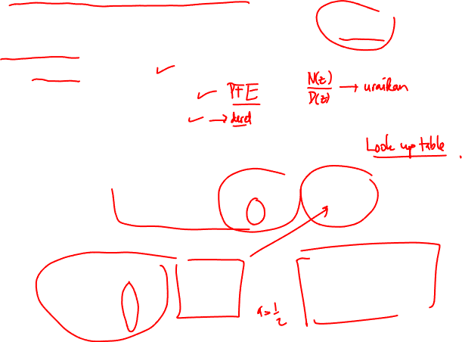
The Inverse Z-Transform
Formal inverse z-transform is based on a Cauchy integral
Less formal ways sufficient most of the time
Inspection method
Partial fraction expansion
Power series expansion
Inspection Method
Make use of known z-transform pairs such as
Example: The inverse z-transform of

Slide 3
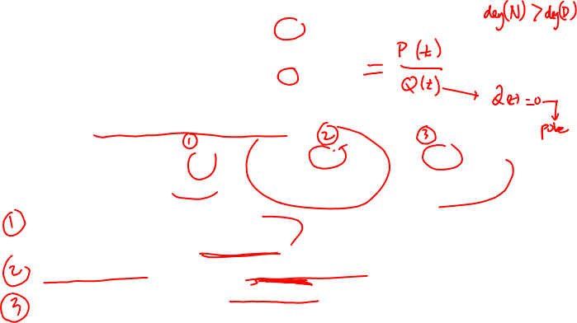
Inverse Z-Transform by Partial Fraction Expansion
Assume that a given z-transform can be expressed as
Apply partial fractional expansion
First term exist only if M>N
B_{r} is obtained by long division
Second term represents all first order poles
Third term represents an order s pole
There will be a similar term for every high-order pole
Each term can be inverse transformed by inspection

Slide 4
Partial Fractional Expression
Coefficients are given as
Easier to understand with examples

Slide 5
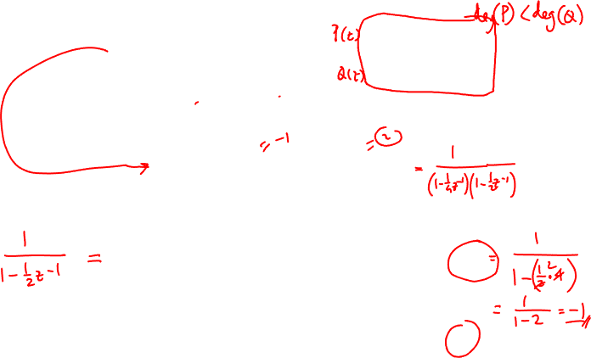
Example: 2nd Order Z-Transform
Order of nominator is smaller than denominator (in terms of z⁻¹)
No higher order pole

Slide 6
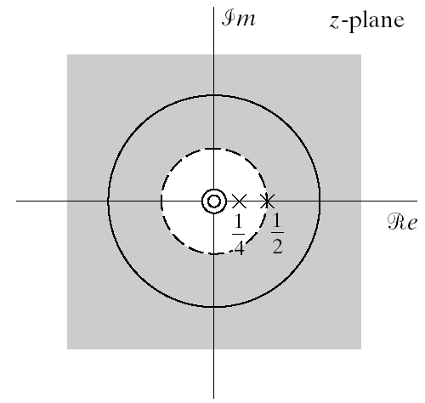
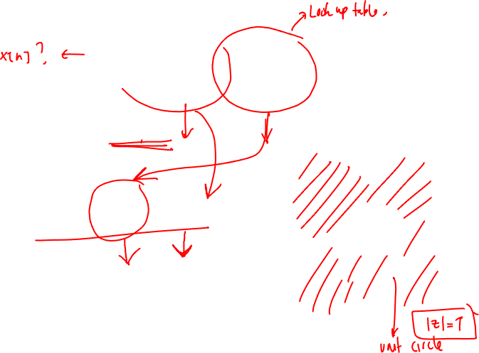
Example Continued
ROC extends to infinity
Indicates right sided sequence

Slide 7
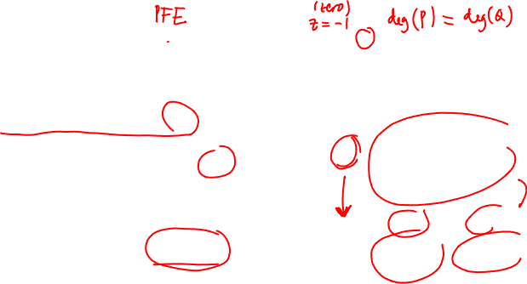
Example #2
Long division to obtain B_{o}

Slide 8
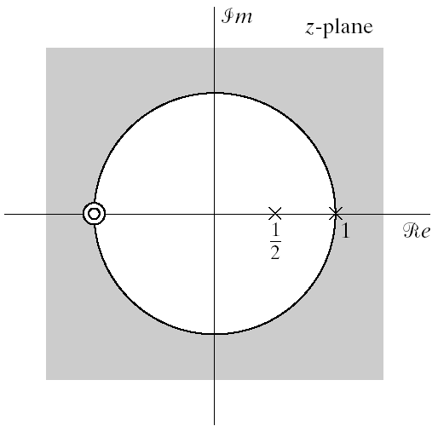
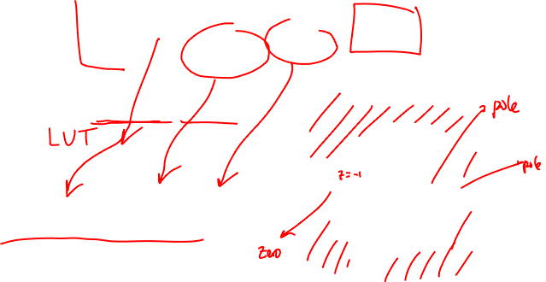
Example #2 Continued
ROC extends to infinity
Indicates right-sides sequence

Slide 9
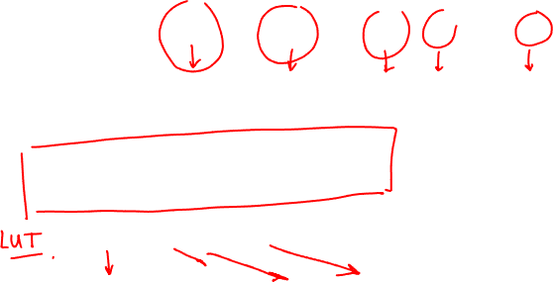
Inverse Z-Transform by Power Series Expansion
The z-transform is power series
In expanded form
Z-transforms of this form can generally be inversed easily
Especially useful for finite-length series
Example

Slide 10

Z-Transform Properties: Linearity
Notation
Linearity
Note that the ROC of combined sequence may be larger than either ROC
This would happen if some pole/zero cancellation occurs
Example:
Both sequences are right-sided
Both sequences have a pole z=a
Both have a ROC defined as |z|>|a|
In the combined sequence the pole at z=a cancels with a zero at z=a
The combined ROC is the entire z plane except z=0
We did make use of this property already, where?

Slide 11
Z-Transform Properties: Time Shifting
Here n_{o} is an integer
If positive the sequence is shifted right
If negative the sequence is shifted left
The ROC can change the new term may
Add or remove poles at z=0 or z=∞
Example

Slide 12
Z-Transform Properties: Multiplication by Exponential
ROC is scaled by |z_{o}|
All pole/zero locations are scaled
If z_{o} is a positive real number: z-plane shrinks or expands
If z_{o} is a complex number with unit magnitude it rotates
Example: We know the z-transform pair
Let’s find the z-transform of

Slide 13
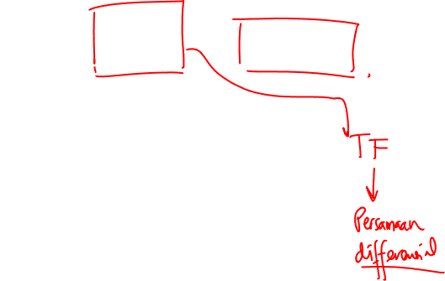
Z-Transform Properties: Differentiation
Example: We want the inverse z-transform of
Let’s differentiate to obtain rational expression
Making use of z-transform properties and ROC

Slide 14
Z-Transform Properties: Conjugation
Example

Slide 15
Z-Transform Properties: Time Reversal
ROC is inverted
Example:
Time reversed version of

Slide 16
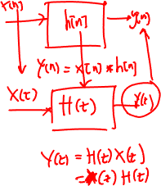
Z-Transform Properties: Convolution
Convolution in time domain is multiplication in z-domain
Example:Let’s calculate the convolution of
Multiplications of z-transforms is
ROC: if |a|<1 ROC is |z|>1 if |a|>1 ROC is |z|>|a|
Partial fractional expansion of Y(z)

