Slide 1
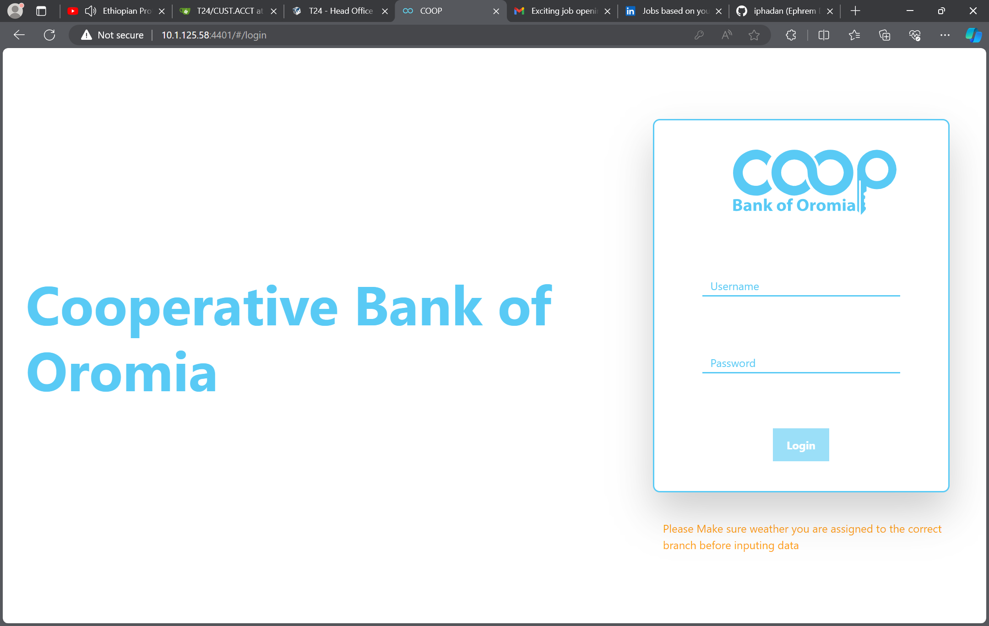
Login Using AD Into Microservice System based on a role

Slide 2
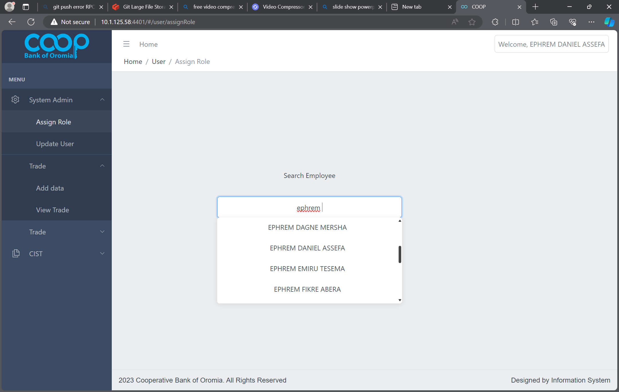
Assign a role to a user based on their AD name

Slide 3
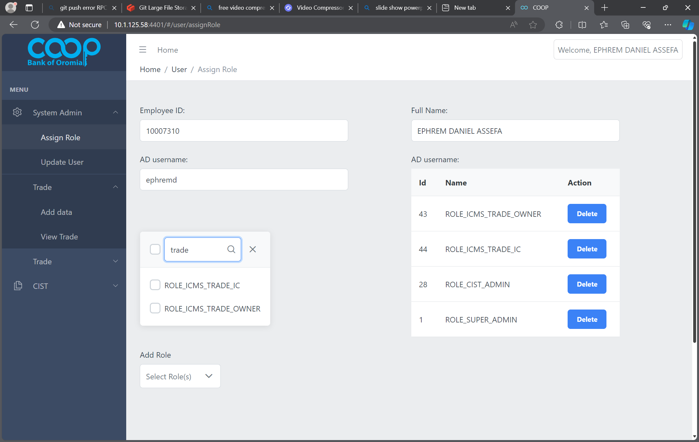
Assign a user a specific Trade roles

Slide 4
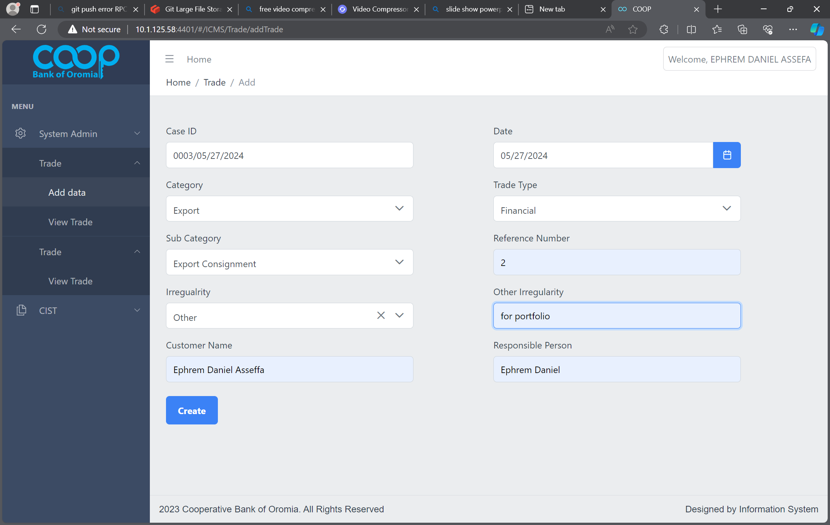
Add Trade Entry

Slide 5
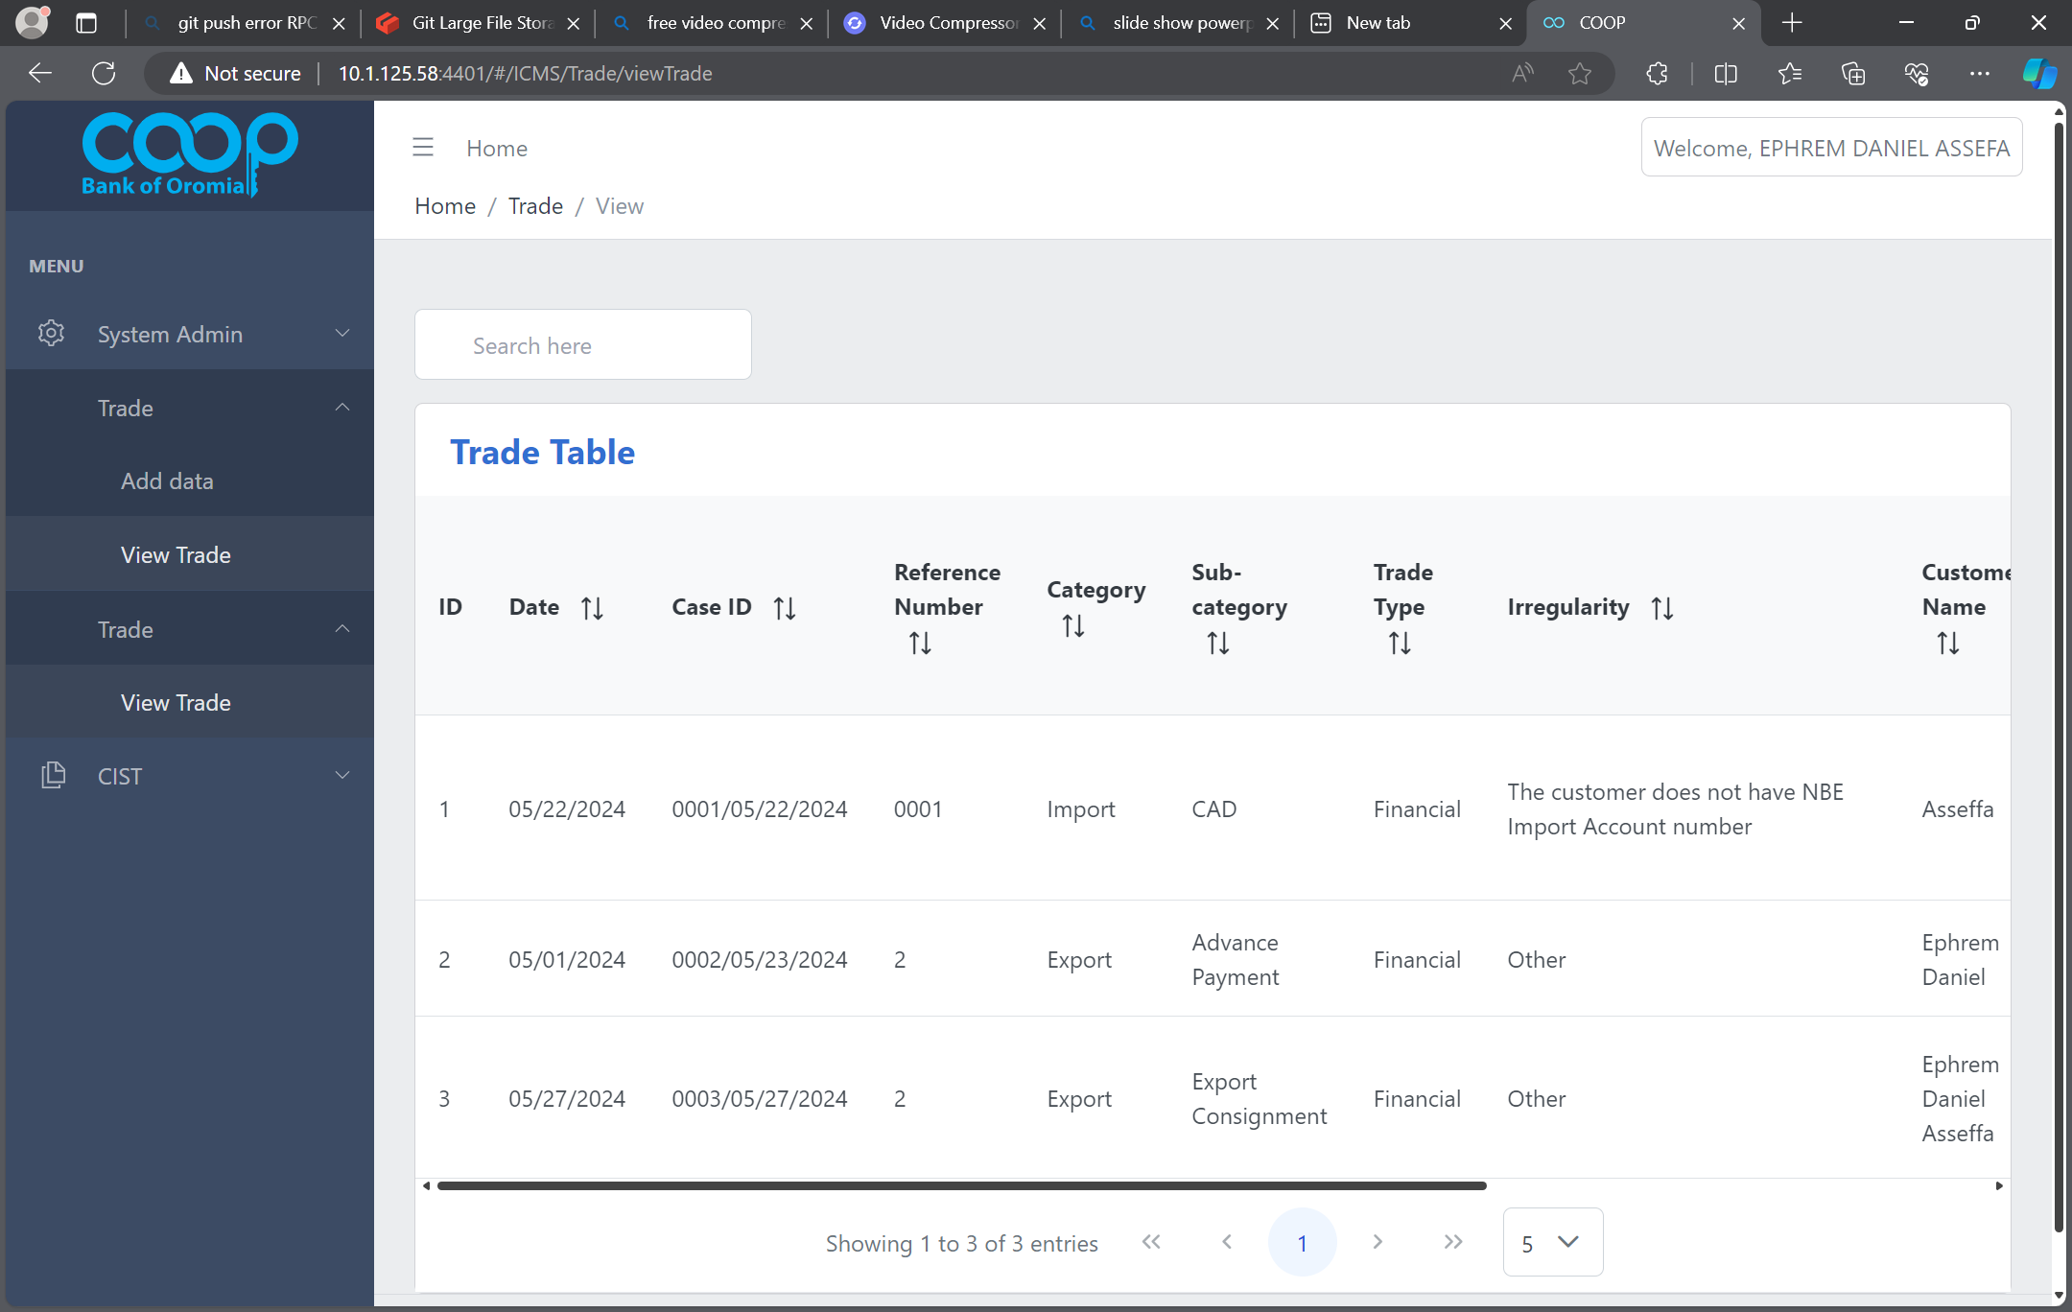
Trade Added and redirected to List view

Slide 6
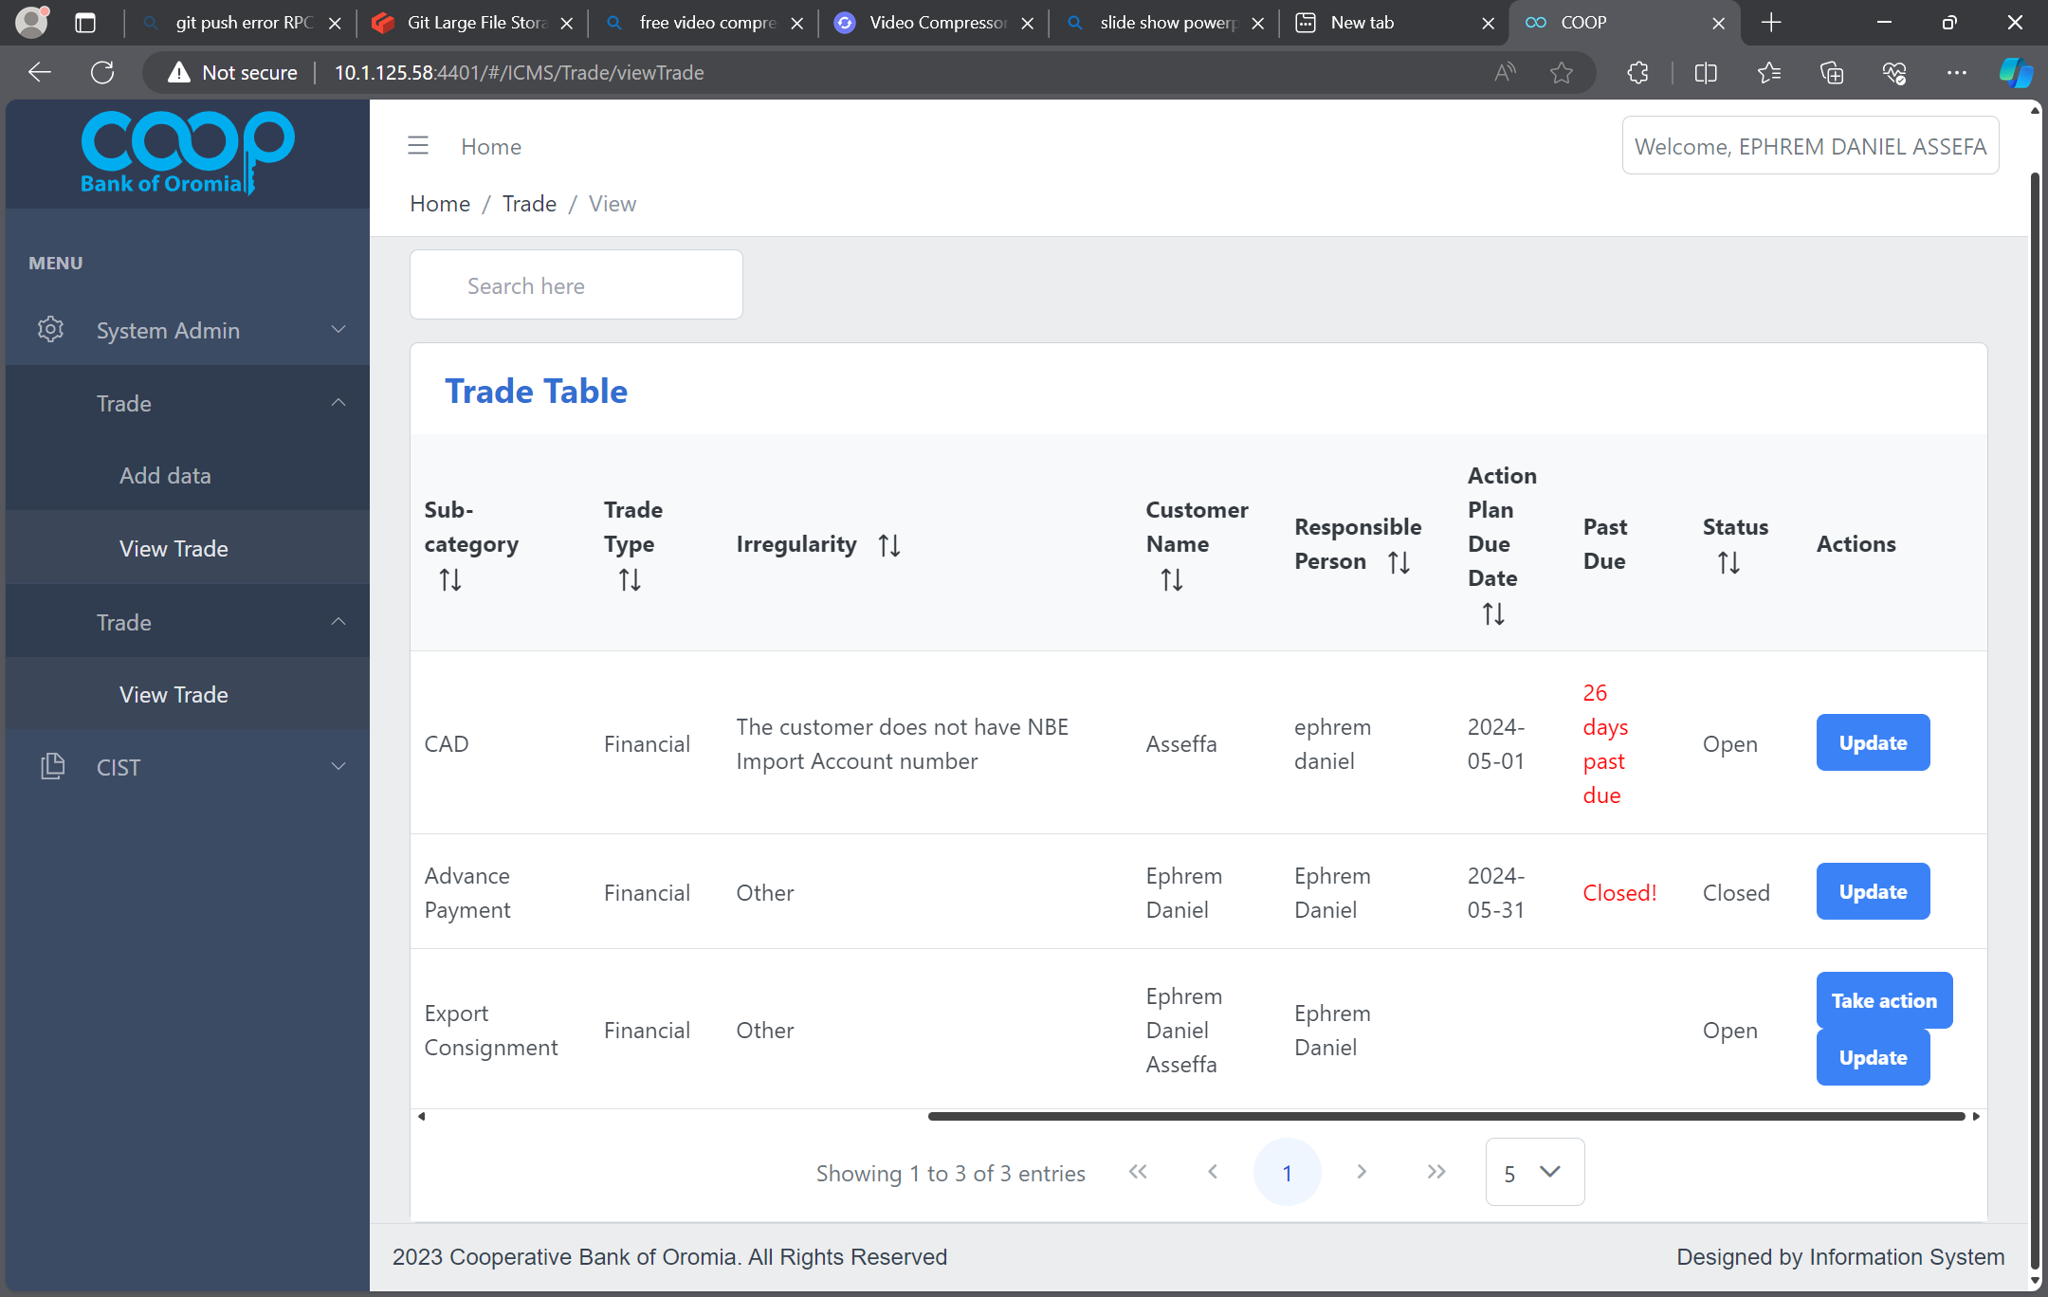
Trade List View

Slide 7
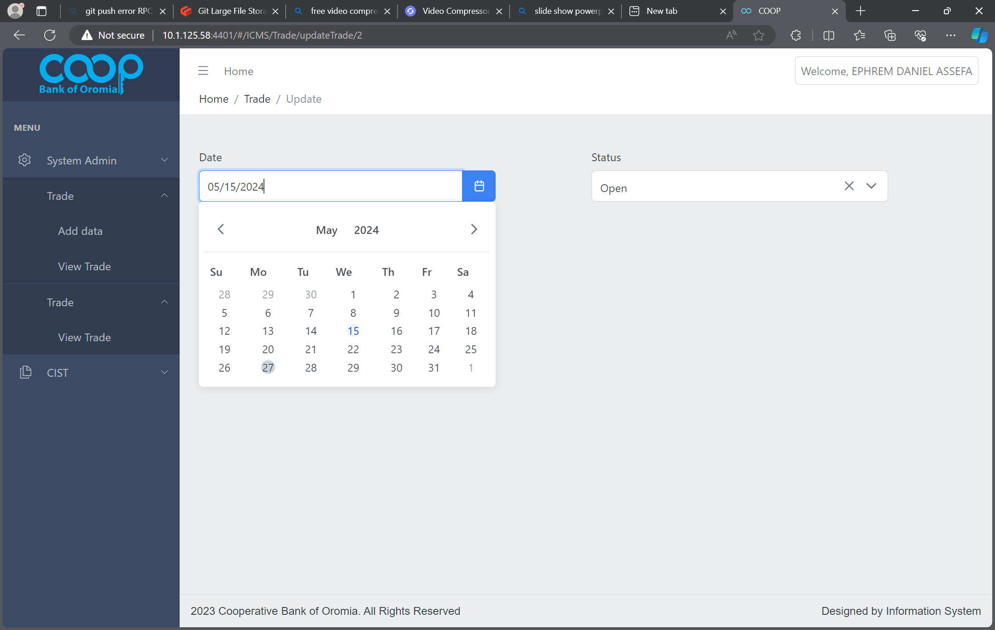
Update Button Clicked

Slide 8
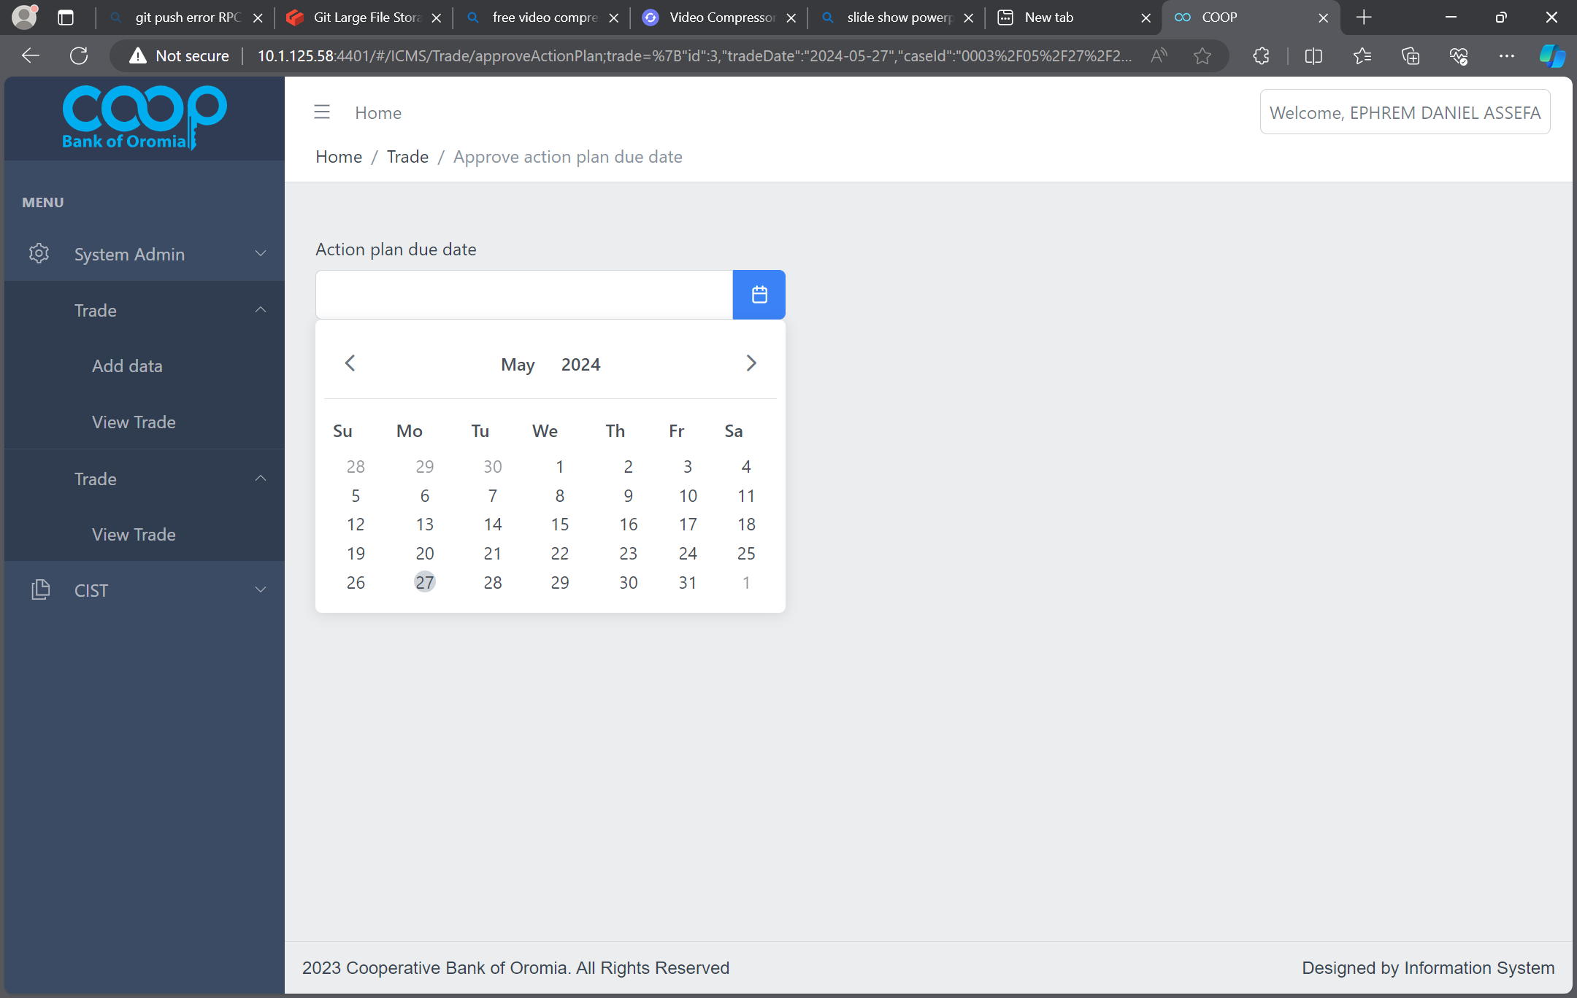
Take Action Button Clicked

