Slide 1
THIS IS OUR PRESENTATION ChatApp

Slide 2

HELLO!
This is my teammate in group
I am here because I would like to present
about our project ChatApp.
Lecturer: HENG Sotharith
By Group: 1

Slide 3
CONTENT:
1- Why we choose this project?
2- Our project diagram and flow.
3- Preview
4- Demo

Slide 4
WHY THIS PROEJECT ?
Talking is important but we do not have much time to talk
No need to direct talk to each other
Lack of information by not having efficient and effective conversation

Slide 5

USE DIAGRAMS TO EXPLAIN OUR IDEAS
Sign In
User’s Form
Authentication
Sing Out
Chat Group
User
Chat
Personal

Slide 6



OUR PROCESS FOLLOW BY FLOW
HTML+CSS
JavaScript
Framework
First just create interface and style
follow MockUp
Connect Database in firebase
Make function and restricting database from firebase to display
Use Angular to Webpage easy
Firebase for store database

Slide 7
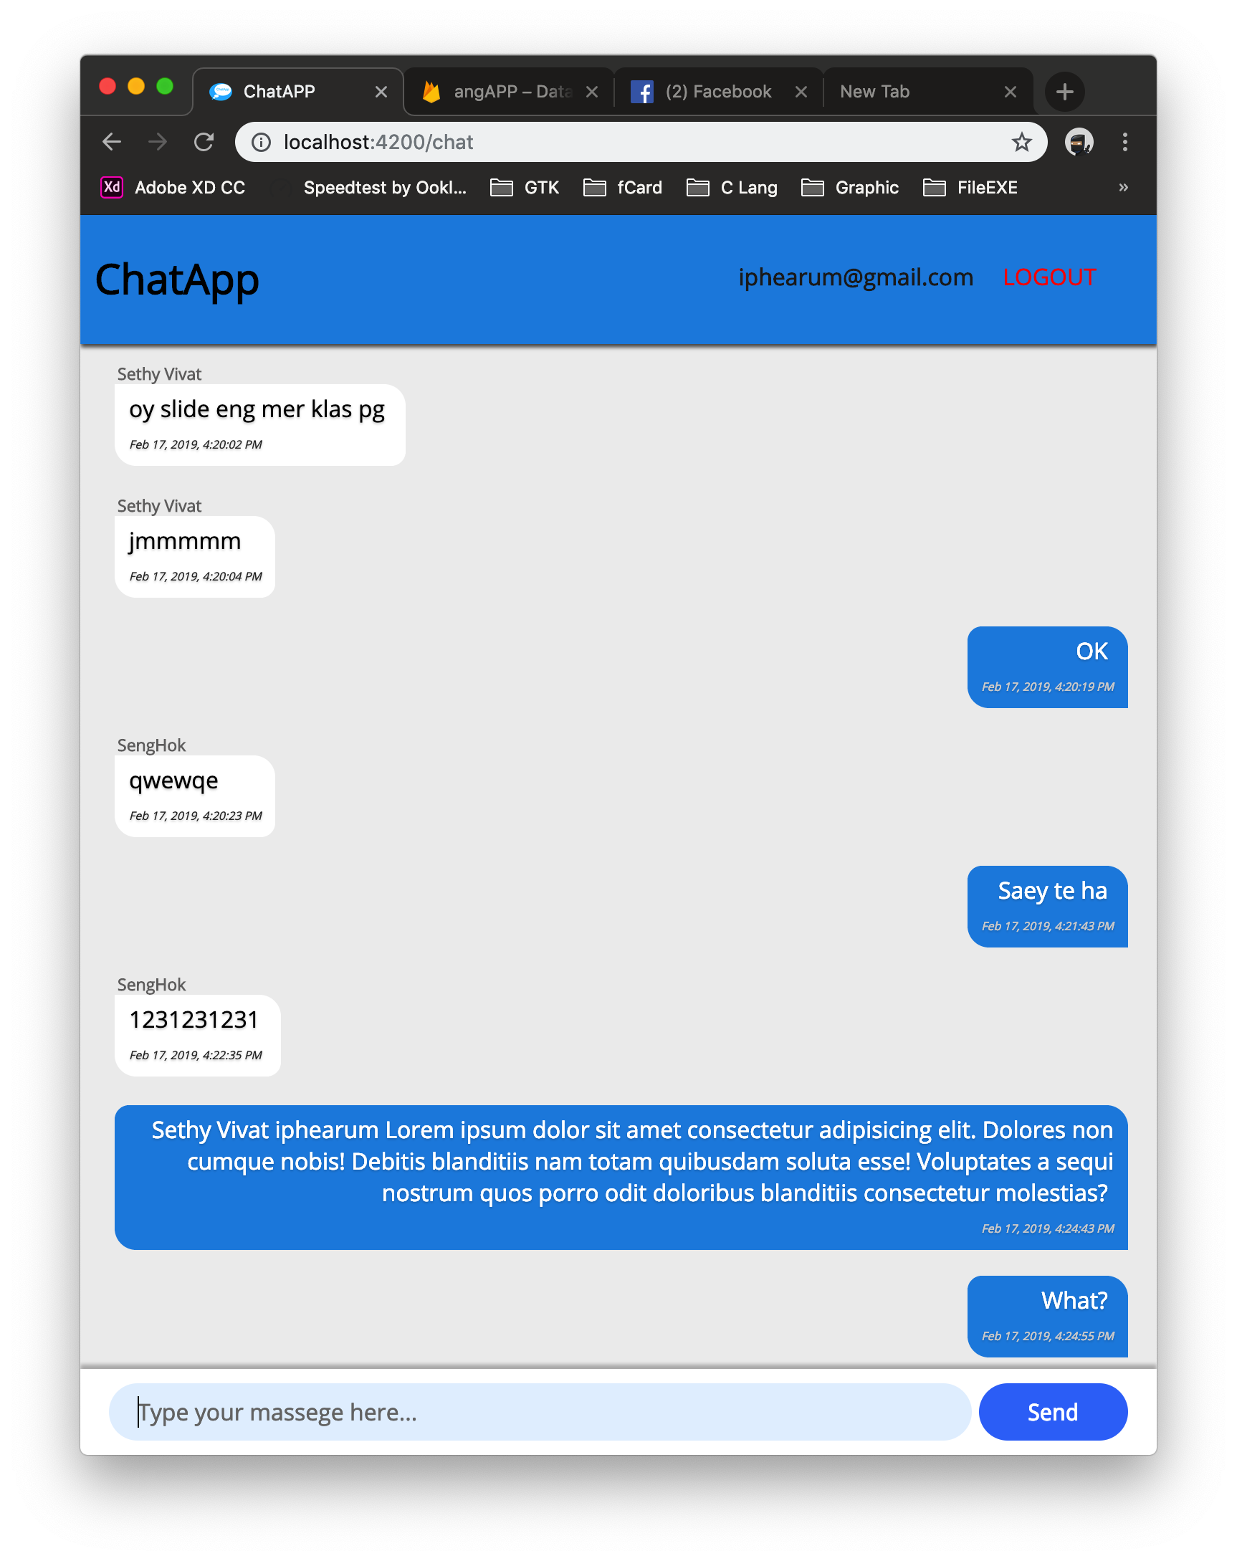
TABLET RESPONSIVE
Place your screenshot here
We can use Tablet or Mobile to chat for make comfortable without use PC.

Slide 8
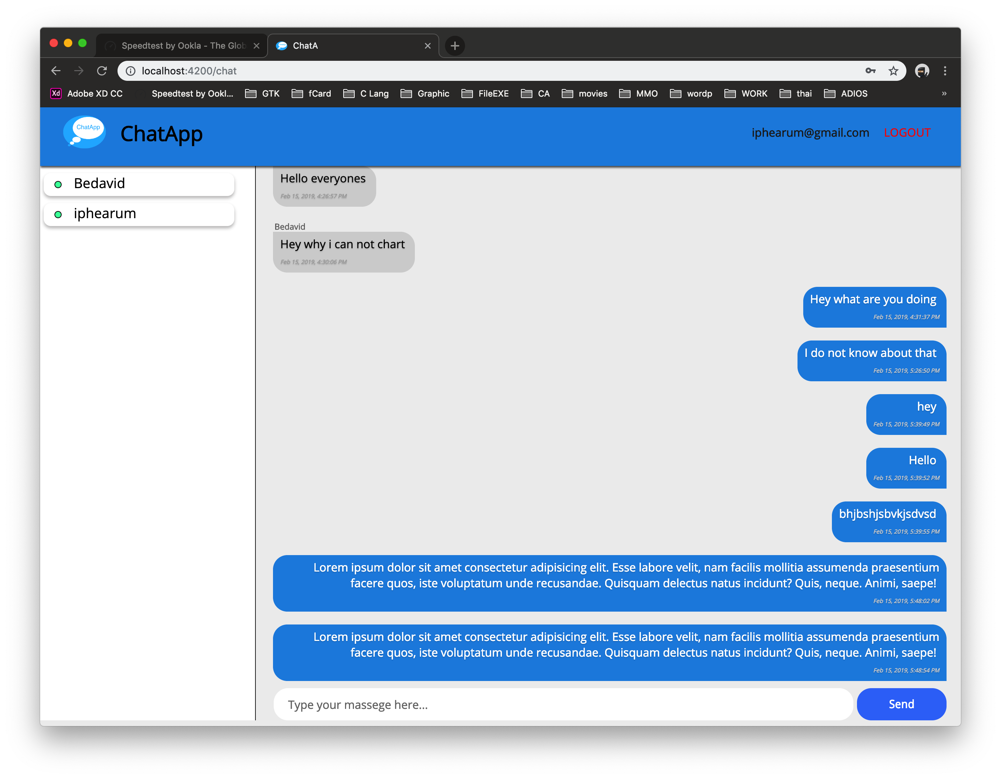
DESKTOP RESPONSIVE
For you will see like this
We can see who is online or offine
Place your screenshot here

Slide 9

DEMO
Enjoy it!

Slide 10
THANKS!
Any questions?

