Slide 1
CS 367 Introduction to Data Structures
Charles N. Fischer Spring 2018
http://www.cs.wisc.edu/~fischer/cnf367.s18

Slide 2
Today’s Agenda
Course overview
Classes and Interfaces
Java Generics

Slide 3
Class Meets Tuesdays and Thursdays, 1:00 — 2:15 132 Noland

Slide 4
Instructor
Charles N. Fischer
E-mail: fischer@cs.wisc.edu
5393 Computer Science
Office Hours:
Mondays, 12:00 – 3:00

Slide 5
Teaching Assistant
Gregory Short
E-mail: gshort2@wisc.edu
Office Hours:
Wednesdays, 12:00 – 2:00
Fridays, 2:00 – 4:00

Slide 6
Graders
Ankit Jain
E-mail: ajain64@wisc.edu
Prerak Mall
E-mail: pmall@wisc.edu

Slide 7
Course Components
Five programming assignments, each worth 10%
Six homework assignments, each worth 3%
A midterm and final exam, each worth 16%
Final grades are not curved.

Slide 8
Class Text and Notes
No class text book; instead a set of class notes (see syllabus page)
Each lecture has a corresponding set of notes
PowerPoint for lecture overheads will be available prior to lectures

Slide 9
Late & Partnership Policy
No late hand-ins unless approved in advance. Reasonable excuses will be considered.
Programs may be done individually, or in two person teams (your choice). All other work must be done individually.

Slide 10
Key Dates
February 8 | Project 1
February 9 | Homework 1
February 27 | Project 2
March 2 | Homework 2
March 15 | Midterm
March 20 | Project 3
March 23 | Homework 3

Slide 11
April 6 | Homework 4
April 10 | Project 4
April 20 | Homework 5
May 3 | Project 5
May 4 | Homework 6
May 9 | Final

Slide 12
Piazza
Piazza is an interactive online platform used to share class-related information
Use it to ask questions and track course-related information
Students may answer questions posed by others
https://piazza.com/wisc/spring2018/cs3671

Slide 13
Goals of Class
Survive 28 lectures!
Study fundamental data structures, including lists, trees, stacks, queues, graphs, and hash tables
Study important algorithms involving, sorting, lookup, and complexity
Learn advanced Java concepts, including interfaces, generics, iterators and exceptions

Slide 14
What makes software good?
Efficient (fast)
Reliable
Robust --- Handles errors well
Easy to use
Useful --- does important work
Lots of features
Friendly interface
Affordable
Easy to maintain & update
Scalable
Secure

Slide 15
What makes code reusable?
Well structured; follows coding rules
Good documentation
Modular --- Independent components
Public/private distinction
Compatible with other systems
Uses objects (abstract data types)
Generic code (type parameters)
Flexible user interface
Exceptions handle special cases

Slide 16
Abstract Data Types
Separate needed operations from actual implementation.
User determines what’s needed in an
Interface.
Implementer programs operations in a Class.
Can use any class that meets the interface requirements.

Slide 17


Interface says
what is needed
Class says what is
implemented

Slide 18
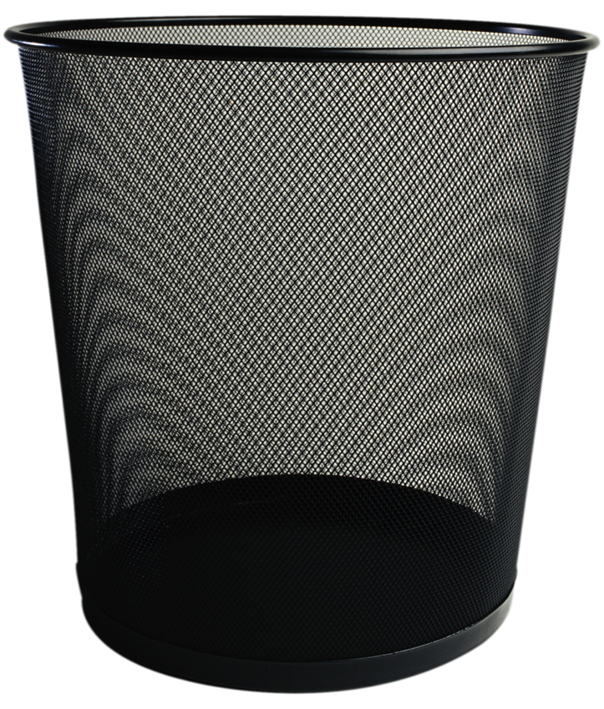

BAG Abstract Data Type
Add
Remove

Slide 19
Interfaces in Java
Interfaces specify the operations an AST will provide.
This is independent of implementation!

Slide 20
Interface for a Bag
public interface BagADT { void add(Object item); Object remove () throws NoSuchElementException; boolean isEmpty(); }

Slide 21
Interface issues
Why use class Object?
Why is an exception thrown?
Should insert of null be allowed?

Slide 22
Useful methods can be defined in terms of Interfaces
These methods can be used by any implementation of the Interface!

Slide 23
public static void printBag(BagADT myBag){ /* Body here */ }

Slide 24
public static void printBag(BagADT myBag){ while(! bag.isEmpty()) { /* Loop Body here */ } }

Slide 25
public static void printBag(BagADT myBag){ while(! bag.isEmpty()) { System.out.println(bag.remove()); } }

Slide 26
But printBag has a major flaw!
It has a side-effect (it is destructive!)
The following doesn’t work as expected:
printBag(myBag);
printBag(myBag);

Slide 27
The following simple fix doesn’t work:
public static void printBag(BagADT myBag){
BagADT temp = myBag; while(! temp.isEmpty()) { System.out.println(temp.remove()); } }

Slide 28
A simple assignment simply adds a new reference to an existing object.
After
temp = myBag;
we have two references to one object.

Slide 29
If we require that the interface implements:
BagADT clone();
We can use this:
public static void printBag(BagADT myBag){
BagADT temp = myBag.clone(); while(! temp.isEmpty()) { System.out.println(temp.remove()); } }

Slide 30
Let’s implement a BagADT
We need to define:
Local Data Structures
Constructors
Implementations of all interface methods

Slide 31
Let’s build a BagAST using an array of Objects.
Arrays are simple to use but also have a fixed size.

Slide 32
public class ArrayBag implements BagADT { /* Local data to implement a Bag */ /* One or more constructors */ /* Implementations for add, remove, isEmpty and clone */ }

Slide 33
public class ArrayBag implements BagADT { private Object[] items; private int itemCount; private final int INIT_SIZE; /* One or more constructors */ /* Implementations for add, remove, isEmpty and clone */ }

Slide 34
public class ArrayBag implements BagADT { private Object[] items; private int itemCount; private final int INIT_SIZE; public ArrayBag() { itemCount = 0; INIT_SIZE = 100; items = new Object[INIT_SIZE]; } /* Implementations for add, remove, isEmpty and clone */ }

Slide 35
public class ArrayBag implements BagADT { private Object[] items; private int itemCount; private final int INIT_SIZE; public ArrayBag() { … } public boolean isEmpty() { return (itemCount == 0); } }

Slide 36
public class ArrayBag implements BagADT { private Object[] items; private int itemCount; private final int INIT_SIZE; public ArrayBag() { … } public boolean isEmpty() { … } public void add(Object item) { if (item == null) throw new NullPointerException(); if (itemCount >= INIT_SIZE) throw new Error(); items[itemCount] = item; itemCount++; }}

Slide 37
public class ArrayBag implements BagADT { private Object[] items; private int itemCount; private final int INIT_SIZE; public ArrayBag() { … } public boolean isEmpty() { … } public void add(Object item) {…} public Object remove() throws NoSuchElementException { if (itemCount == 0) throw new NoSuchElementException(); else { itemCount--; return items[itemCount]; } }

Slide 38
public class ArrayBag implements BagADT { private Object[] items; private int itemCount; private final int INIT_SIZE; public ArrayBag() { … } public boolean isEmpty() { … } public void add(Object item) {…} public Object remove() throws NoSuchElementException {…} public ArrayBag clone() { ArrayBag copy = new ArrayBag(); copy.itemCount = itemCount; copy.items = items.clone(); return copy; } }

Slide 39
Examples of using ArrayBag:
ArrayBag bag = new ArrayBag();
bag.add(1); bag.add(2); bag.add(3);
printBag(bag);
int item = (int) bag.remove();
System.out.println(item);
Output is:
3
2
1
3

Slide 40
Using the Object class in BagADT can be problematic
You have to type-cast all objects returned by remove() (Why?)
It is hard to enforce a uniform type in a bag.
Bag declarations are uninformative. (All bags are essentially the same)

Slide 41
Java Generics
Generics allow you to add a type parameter to an interface or class:
BagADT<E> or ArrayBag<E>

Slide 42
When a type is declared, a class name
replaces the type parameter:
ArrayBag<Integer> or ArrayBag<String>
Only the declared type can be inserted.
Removed items need not be type-cast.

Slide 43
public interface BagADT<E> { void add(E item); E remove () throws NoSuchElementException; boolean isEmpty(); BagADT<E> clone(); }

Slide 44
public class ArrayBag<E> implements BagADT<E> { /* Local data to implement a Bag */ /* One or more constructors */ /* Implementations for add, remove, isEmpty and clone */ }

Slide 45
public class ArrayBag<E> implements BagADT<E> { private E[] items; private int itemCount; private final int INIT_SIZE; /* One or more constructors */ /* Implementations for add, remove, isEmpty and clone */ }

Slide 46
public class ArrayBag<E> implements BagADT<E> { private E[] items; private int itemCount; private final int INIT_SIZE; public ArrayBag() { itemCount = 0; INIT_SIZE = 100; // Kludge alert! items = (E[]) new Object[INIT_SIZE]; } /* Implementations for add, remove, isEmpty and clone */ }

Slide 47
public class ArrayBag<E> implements BagADT<E> { private E[] items; private int itemCount; private final int INIT_SIZE; public ArrayBag() { … } public boolean isEmpty() { return (itemCount == 0); } }

Slide 48
public class ArrayBag<E> implements BagADT<E> { private E[] items; private int itemCount; private final int INIT_SIZE; public ArrayBag() { … } public boolean isEmpty() { … } public void add(E item) { if (item == null) throw new NullPointerException(); if (itemCount >= INIT_SIZE) throw new Error(); items[itemCount] = item; itemCount++; }}

Slide 49
public class ArrayBag<E> implements BagADT<E> { private E[] items; private int itemCount; private final int INIT_SIZE; public ArrayBag() { … } public boolean isEmpty() { … } public void add(Object item) {…} public E remove() throws NoSuchElementException { if (itemCount == 0) throw new NoSuchElementException(); else { itemCount--; return items[itemCount]; } }

Slide 50
public class ArrayBag<E> implements BagADT<E> { private E[] items; private int itemCount; private final int INIT_SIZE; public ArrayBag() { … } public boolean isEmpty() { … } public void add(Object item) {…} public Object remove() throws NoSuchElementException {…} public ArrayBag<E> clone() { ArrayBag<E> copy = new ArrayBag<E>(); copy.itemCount = itemCount; copy.items = items.clone(); return copy; } }

Slide 51
printBag becomes:
public void printBag(BagADT<E> myBag){
BagADT<E> temp = myBag.clone();
while(! temp.isEmpty()) { System.out.println(temp.remove()); } }

Slide 52
Examples of using ArrayBag in Generic form:
ArrayBag<Integer> bag = new ArrayBag<Integer>();
bag.add(1); bag.add(2); bag.add(33);
bag.printBag(bag);
int item = bag.remove(); // No casting!
System.out.println(item);
Output is:
33
2
1
33

Slide 53
List ADT
A List is an ordered collection of items.
Each item has a position, starting at 0.
Item: “a” “b” “c” “d” “e”
Position: 0 1 2 3 4

Slide 54
Like an array, a list can be indexed.
But, a list can grow or shrink in size.
A size of zero (an empty list) is allowed.

Slide 55
Operations in a ListADT
void add(E item)
Add where?
At right end of list.
void add(int pos, E item)
add does not overwrite items, so list size grows.
Valid values for pos are
0 <= pos <= size()-1

Slide 56
boolean contains(E item)
Is E already in the list?
Use equals(item) to test membership.
int size()
Zero size is OK.
boolean isEmpty()
Same as size() == 0

Slide 57
E get(int pos)
Return value at pos. Non-destructive.
Requires 0 <= pos <= size()-1
E remove(int pos)
Remove and return value at pos.
Is destructive.
Requires 0 <= pos <= size()-1

Slide 58
Error Conditions
Can null be added?
We’ll ignore adds of null.
contains must handle null correctly.
Bad pos values will throw
IndexOutOfBounds
get or remove on empty list is really a bad pos error

Slide 59
Interface definition for ListADT
public interface ListADT<E> {
void add(E item);
void add(int pos, E item);
boolean contains(E item);
int size( );
boolean isEmpty( );
E get(int pos);
E remove(int pos);
}

Slide 60
Using the ListADT
Write a method that reverses the contents of a list.
Thus (1,2,3,4) becomes (4,3,2,1).
Choose the approach you will take before writing code.

Slide 61
One approach:
Move 2nd from right to very end.
Then 3rd from right to very end.
…
Finally, farthest from right (leftmost)
To very end.
(11,22,33,44) (11,22,44,33)
(11,44,33,22) (44,33,22,11)

Slide 62
Java code to reverse a List
void reverse(){
for (int i = size() - 2; i >= 0; i--)
add(remove(i));
}
Why start i at size() - 2?
Are “corner cases” (lists of size 0 or 1) handled
properly?

