Slide 1
CS 367 Introduction to Data Structures
Lecture 2

Slide 2
Today’s Agenda
Classes and Interfaces
Java Generics

Slide 3
Abstract Data Types
Separate needed operations from actual implementation.
User determines what’s needed in an
Interface.
Implementer programs operations in a Class.
Can use any class that meets the interface requirements.

Slide 4


Interface says
what is needed
Class says what is
implemented

Slide 5
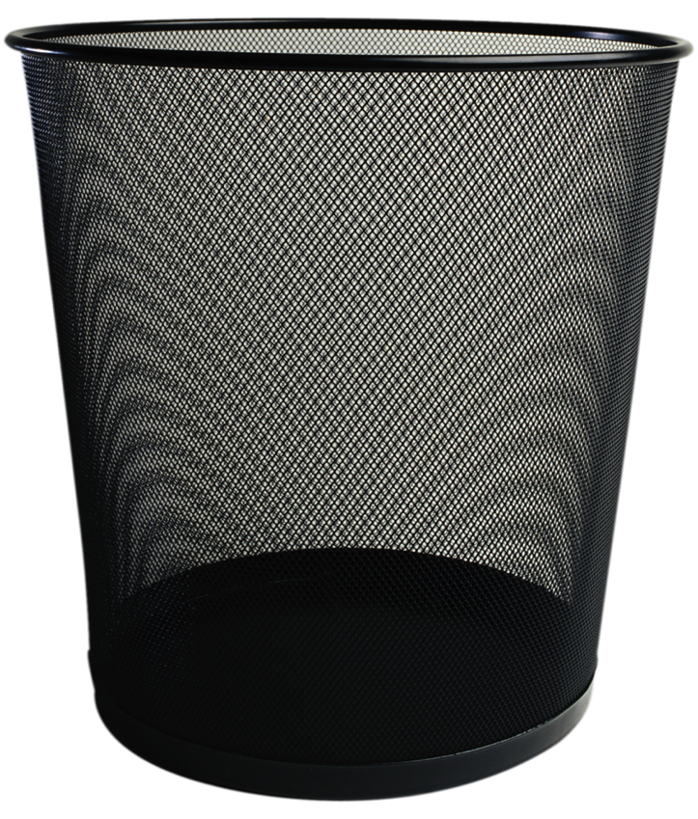

BAG Abstract Data Type
Add
Remove

Slide 6
Interfaces in Java
Interfaces specify the operations an AST will provide.
This is independent of implementation!

Slide 7
Interface for a Bag
public interface BagADT { void add(Object item); Object remove () throws NoSuchElementException; boolean isEmpty(); }

Slide 8
Interface issues
Why use class Object?
Why is an exception thrown?
Should insert of null be allowed?

Slide 9
Useful methods can be defined in terms of Interfaces
These methods can be used by any implementation of the Interface!

Slide 10
public static void printBag(BagADT myBag){ /* Body here */ }

Slide 11
public static void printBag(BagADT myBag){ while(! bag.isEmpty()) { /* Loop Body here */ } }

Slide 12
public static void printBag(BagADT myBag){ while(! bag.isEmpty()) { System.out.println(bag.remove()); } }

Slide 13
But printBag has a major flaw!
It has a side-effect (it is destructive!)
The following doesn’t work as expected:
printBag(myBag);
printBag(myBag);

Slide 14
The following simple fix doesn’t work:
public static void printBag(BagADT myBag){
BagADT temp = myBag; while(! temp.isEmpty()) { System.out.println(temp.remove()); } }

Slide 15
A simple assignment simply adds a new reference to an existing object.
After
temp = myBag;
we have two references to one object.

Slide 16
If we require that the interface implements:
BagADT clone();
We can use this:
public static void printBag(BagADT myBag){
BagADT temp = myBag.clone(); while(! temp.isEmpty()) { System.out.println(temp.remove()); } }

Slide 17
Let’s implement a BagADT
We need to define:
Local Data Structures
Constructors
Implementations of all interface methods

Slide 18
Let’s build a BagAST using an array of Objects.
Arrays are simple to use but also have a fixed size.

Slide 19
public class ArrayBag implements BagADT { /* Local data to implement a Bag */ /* One or more constructors */ /* Implementations for add, remove, isEmpty and clone */ }

Slide 20
public class ArrayBag implements BagADT { private Object[] items; private int itemCount; private final int INIT_SIZE; /* One or more constructors */ /* Implementations for add, remove, isEmpty and clone */ }

Slide 21
public class ArrayBag implements BagADT { private Object[] items; private int itemCount; private final int INIT_SIZE; public ArrayBag() { itemCount = 0; INIT_SIZE = 100; items = new Object[INIT_SIZE]; } /* Implementations for add, remove, isEmpty and clone */ }

Slide 22
public class ArrayBag implements BagADT { private Object[] items; private int itemCount; private final int INIT_SIZE; public ArrayBag() { … } public boolean isEmpty() { return (itemCount == 0); } }

Slide 23
public class ArrayBag implements BagADT { private Object[] items; private int itemCount; private final int INIT_SIZE; public ArrayBag() { … } public boolean isEmpty() { … } public void add(Object item) { if (item == null) throw new NullPointerException(); if (itemCount >= INIT_SIZE) throw new Error(); items[itemCount] = item; itemCount++; }}

Slide 24
public class ArrayBag implements BagADT { private Object[] items; private int itemCount; private final int INIT_SIZE; public ArrayBag() { … } public boolean isEmpty() { … } public void add(Object item) {…} public Object remove() throws NoSuchElementException { if (itemCount == 0) throw new NoSuchElementException(); else { itemCount--; return items[itemCount]; } }

Slide 25
public class ArrayBag implements BagADT { private Object[] items; private int itemCount; private final int INIT_SIZE; public ArrayBag() { … } public boolean isEmpty() { … } public void add(Object item) {…} public Object remove() throws NoSuchElementException {…} public ArrayBag clone() { ArrayBag copy = new ArrayBag(); copy.itemCount = itemCount; copy.items = items.clone(); return copy; } }

Slide 26
Examples of using ArrayBag:
ArrayBag bag = new ArrayBag();
bag.add(1); bag.add(2); bag.add(3);
printBag(bag);
int item = (int) bag.remove();
System.out.println(item);
Output is:
3
2
1
3

Slide 27
Using the Object class in BagADT can be problematic
You have to type-cast all objects returned by remove() (Why?)
It is hard to enforce a uniform type in a bag.
Bag declarations are uninformative. (All bags are essentially the same)

Slide 28
Java Generics
Generics allow you to add a type parameter to an interface or class:
BagADT<E> or ArrayBag<E>

Slide 29
When a type is declared, a class name
replaces the type parameter:
ArrayBag<Integer> or ArrayBag<String>
Only the declared type can be inserted.
Removed items need not be type-cast.

Slide 30
public interface BagADT<E> { void add(E item); E remove () throws NoSuchElementException; boolean isEmpty(); BagADT<E> clone(); }

Slide 31
public class ArrayBag<E> implements BagADT<E> { /* Local data to implement a Bag */ /* One or more constructors */ /* Implementations for add, remove, isEmpty and clone */ }

Slide 32
public class ArrayBag<E> implements BagADT<E> { private E[] items; private int itemCount; private final int INIT_SIZE; /* One or more constructors */ /* Implementations for add, remove, isEmpty and clone */ }

Slide 33
public class ArrayBag<E> implements BagADT<E> { private E[] items; private int itemCount; private final int INIT_SIZE; public ArrayBag() { itemCount = 0; INIT_SIZE = 100; // Kludge alert! items = (E[]) new Object[INIT_SIZE]; } /* Implementations for add, remove, isEmpty and clone */ }

Slide 34
public class ArrayBag<E> implements BagADT<E> { private E[] items; private int itemCount; private final int INIT_SIZE; public ArrayBag() { … } public boolean isEmpty() { return (itemCount == 0); } }

Slide 35
public class ArrayBag<E> implements BagADT<E> { private E[] items; private int itemCount; private final int INIT_SIZE; public ArrayBag() { … } public boolean isEmpty() { … } public void add(E item) { if (item == null) throw new NullPointerException(); if (itemCount >= INIT_SIZE) throw new Error(); items[itemCount] = item; itemCount++; }}

Slide 36
public class ArrayBag<E> implements BagADT<E> { private E[] items; private int itemCount; private final int INIT_SIZE; public ArrayBag() { … } public boolean isEmpty() { … } public void add(Object item) {…} public E remove() throws NoSuchElementException { if (itemCount == 0) throw new NoSuchElementException(); else { itemCount--; return items[itemCount]; } }

Slide 37
public class ArrayBag<E> implements BagADT<E> { private E[] items; private int itemCount; private final int INIT_SIZE; public ArrayBag() { … } public boolean isEmpty() { … } public void add(Object item) {…} public Object remove() throws NoSuchElementException {…} public ArrayBag<E> clone() { ArrayBag<E> copy = new ArrayBag<E>(); copy.itemCount = itemCount; copy.items = items.clone(); return copy; } }

Slide 38
printBag becomes:
public void printBag(BagADT<E> myBag){
BagADT<E> temp = myBag.clone();
while(! temp.isEmpty()) { System.out.println(temp.remove()); } }

Slide 39
Examples of using ArrayBag in Generic form:
ArrayBag<Integer> bag = new ArrayBag<Integer>();
bag.add(1); bag.add(2); bag.add(33);
bag.printBag(bag);
int item = bag.remove(); // No casting!
System.out.println(item);
Output is:
33
2
1
33

Slide 40
List ADT
A List is an ordered collection of items.
Each item has a position, starting at 0.
Item: “a” “b” “c” “d” “e”
Position: 0 1 2 3 4

Slide 41
Like an array, a list can be indexed.
But, a list can grow or shrink in size.
A size of zero (an empty list) is allowed.

Slide 42
Operations in a ListADT
void add(E item)
Add where?
At right end of list.
void add(int pos, E item)
add does not overwrite items, so list size grows.
Valid values for pos are
0 <= pos <= size()-1

Slide 43
boolean contains(E item)
Is E already in the list?
Use equals(item) to test membership.
int size()
Zero size is OK.
boolean isEmpty()
Same as size() == 0

Slide 44
E get(int pos)
Return value at pos. Non-destructive.
Requires 0 <= pos <= size()-1
E remove(int pos)
Remove and return value at pos.
Is destructive.
Requires 0 <= pos <= size()-1

Slide 45
Error Conditions
Can null be added?
We’ll ignore adds of null.
contains must handle null correctly.
Bad pos values will throw
IndexOutOfBounds
get or remove on empty list is really a bad pos error

Slide 46
Interface definition for ListADT
public interface ListADT<E> {
void add(E item);
void add(int pos, E item);
boolean contains(E item);
int size( );
boolean isEmpty( );
E get(int pos);
E remove(int pos);
}

Slide 47
Using the ListADT
Write a method that reverses the contents of a list.
Thus (1,2,3,4) becomes (4,3,2,1).
Choose the approach you will take before writing code.

Slide 48
One approach:
Move 2nd from right to very end.
Then 3rd from right to very end.
…
Finally, farthest from right (leftmost)
To very end.
(11,22,33,44) (11,22,44,33)
(11,44,33,22) (44,33,22,11)

Slide 49
Java code to reverse a List
void reverse(){
for (int i = size() - 2; i >= 0; i--)
add(remove(i));
}
Why start i at size() - 2?
Are “corner cases” (lists of size 0 or 1) handled
properly?

Slide 50
printBag becomes:
public void printBag(BagADT<E> myBag){
BagADT<E> temp = myBag.clone();
while(! temp.isEmpty()) { System.out.println(temp.remove()); } }

Slide 51
Examples of using ArrayBag in Generic form:
ArrayBag<Integer> bag = new ArrayBag<Integer>();
bag.add(1); bag.add(2); bag.add(33);
bag.printBag(bag);
int item = bag.remove(); // No casting!
System.out.println(item);
Output is:
33
2
1
33

Slide 52
List ADT
A List is an ordered collection of items.
Each item has a position, starting at 0.
Item: “a” “b” “c” “d” “e”
Position: 0 1 2 3 4

Slide 53
Like an array, a list can be indexed.
But, a list can grow or shrink in size.
A size of zero (an empty list) is allowed.

Slide 54
Operations in a ListADT
void add(E item)
Add where?
At right end of list.
void add(int pos, E item)
add does not overwrite items, so list size grows.
Valid values for pos are
0 <= pos <= size()-1

Slide 55
boolean contains(E item)
Is E already in the list?
Use equals(item) to test membership.
int size()
Zero size is OK.
boolean isEmpty()
Same as size() == 0

Slide 56
E get(int pos)
Return value at pos. Non-destructive.
Requires 0 <= pos <= size()-1
E remove(int pos)
Remove and return value at pos.
Is destructive.
Requires 0 <= pos <= size()-1

Slide 57
Error Conditions
Can null be added?
We’ll ignore adds of null.
contains must handle null correctly.
Bad pos values will throw
IndexOutOfBounds
get or remove on empty list is really a bad pos error

Slide 58
Interface definition for ListADT
public interface ListADT<E> {
void add(E item);
void add(int pos, E item);
boolean contains(E item);
int size( );
boolean isEmpty( );
E get(int pos);
E remove(int pos);
}

Slide 59
Using the ListADT
Write a method that reverses the contents of a list.
Thus (1,2,3,4) becomes (4,3,2,1).
Choose the approach you will take before writing code.

Slide 60
One approach:
Move 2nd from right to very end.
Then 3rd from right to very end.
…
Finally, farthest from right (leftmost)
To very end.
(11,22,33,44) (11,22,44,33)
(11,44,33,22) (44,33,22,11)

Slide 61
Java code to reverse a List
void reverse(){
for (int i = size() - 2; i >= 0; i--)
add(remove(i));
}
Why start i at size() - 2?
Are “corner cases” (lists of size 0 or 1) handled
properly?

