Slide 1
CS 367 Introduction to Data Structures
Lecture 5

Slide 2
Today’s Agenda
Warning – Windows and Unix/Mac OS X use different characters to end a line in text files. Unix & Mac OS X use \n. But Windows uses \r\n.
Exceptions
Complexity of Computations

Slide 3
Multiple Catch Blocks are Allowed
try{ /* Java code that might throw an exception */}
catch (ExceptionType1 id1) {
/* Java code to handle the caught exception */ }
catch(ExceptionType2 id2) {
/* Java code to handle the caught exception */}
Catch blocks are tried in order (can thrown exception match declared exception?)
If no catch matches, exception is passed to containing try block or
caller of current method.

Slide 4
An Example of Multiple Catch Blocks
static void tester(int i)
throws InvalidFlag, SizeTooLarge {
if (i == 1)
throw new InvalidFlag();
if (i == 2)
throw new SizeTooLarge();
else throw new NullPointerException();}
for (int i = 1; i <= 3; i++)
try { tester(i); }
catch (InvalidFlag exc) {
System.out.println("Invalid flag in call"); }
catch (SizeTooLarge exc) {
System.out.println("Data set too large"); }

Slide 5
Output is:
Invalid flag in call
Data set too large
Exception in thread "main"
java.lang.NullPointerException
at ThrowTest.tester(throw2.java:10)
at ThrowTest.main(throw2.java:16)

Slide 6
Exceptions are Java objects
They must be a subclass of Throwable.
Throwable has two subclasses, Error and Exception.
Exceptions in Error usually aren’t caught (they usually are unrecoverable).
Exceptions in Exception may be caught.
A subclass of Exception is RuntimeException.

Slide 7
Exceptions in RuntimeException often are not caught (e.g., NullPointerException).
They need not be checked for.
Exceptions in Exception but not in RuntimeException are called checked.
They must be handled.
How?
A method that may raise a checked exception may guarantee that it is handled by that method.
“What happens in Vegas stays in Vegas!”

Slide 8
Alternatively, a method may warn in its header that one or more checked exceptions may be returned to the caller
(who can handle them or pass them back to its caller.)
static void tester(int i)
throws InvalidFlag, SizeTooLarge { … }

Slide 9
Finally Block
A try-catch block may be ended with an optional finally block. It is used for code that must be executed whether an exception occurs or not.

Slide 10
try{ /* Java code that might throw an exception */}
catch (ExceptionType1 id1) {
/* Java code to handle the caught exception */ }
catch(ExceptionType2 id2) {
/* Java code to handle the caught exception */}
finally {
/* Java code always executed before try ends */ }

Slide 11
If there are no exceptions thrown, the try block executes then the finally block.
If an exception is thrown and caught in a catch block, part of the try block executes, then a catch block, then the finally block.
If an exception is thrown and not caught in a catch block, part of the try block executes, then the finally block, then the exception is propagated outside the try-catch.

Slide 12
An “Exception Tester”
public static void main(String[] args) {
if (args.length != 2) {
method = " "; color = " ";
} else { method = args[0]; color = args[1]; }
System.out.print("main[");
try { methodA();
System.out.print("after A, ");
methodE();
System.out.print("after E,"); }
catch (RedException exc) {
System.out.print("red,");}
catch (GreenException exc) {
System.out.print("green,"); }
System.out.println("]main");

Slide 13
private static void methodA() {
System.out.print("A[");
try { methodB();
System.out.print("after B,");}
catch (BlueException exc) {
System.out.print("blue,”);
System.out.print("]A "); }

Slide 14
private static void methodB() {
System.out.print("B[");
try {methodC();
System.out.print("after C,");}
catch (YellowException exc) {
System.out.print("yellow,");
throw new GreenException(); }
catch (RedException exc) {
System.out.print("red,"); }
methodD();
System.out.print("after D");
System.out.print("]B "); }

Slide 15
methodC, methodD and methodE all
behave the same:
If the method field matches their name, they throw an exception corresponding to the color field. Otherwise they do nothing but return.

Slide 16
Basic execution sequence
Below is a call tree. If no exceptions are thrown, execution sequence is depth-first:
Main
A
E
B
C
D

Slide 17
The generated trace is:
main[ A[ B[ after C, after D ]B after B,]A after A, after E, ]main

Slide 18
We alter execution order by throwing an exception
We direct C, D or E to throw an exception by setting the method field and the color field. So
method = "c"; color = "blue";
tells C to throw a blue exception.

Slide 19
The execution trace is now:
main[ A[ B[blue,]A after A,
after E, ]main
Why?
C throws blue. Its caller, B, doesn’t catch blue exceptions, so it is passed to B’s caller, A. A handles the exception, returns to main, and E is then called.

Slide 20
Try another:
method = ”e"; color = "blue";
main[ A[ B[after C, after D]B after B,]A after A
Exception in thread "main" BlueException

Slide 21
Additional Tests
You can run 15 different tests (3 methods, 5 exceptions). You should try several to perfect your understanding.
You can:
Run a test, then study the source to understand why the trace was generated.
Predict what a test will do, then run the program to verify your prediction.

Slide 22
Analyzing Algorithm Efficiency
The complexity of an algorithm is how it uses resources like CPU time or memory.
How does the cost scale as the problem size grows?

Slide 23
Some computations are constant time – no change as problem size grows.
Example: remove operation in a Bag ADT
Some computations grow linearly – double the size means double the time.
Example: finding a value in an unsorted array.

Slide 24
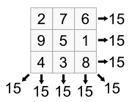
Some computations grow as the square – double the size means four times the time.
Example: many simple sorts.
Some computations grow much faster – exponentially or worse.
Example: magic square

Slide 25
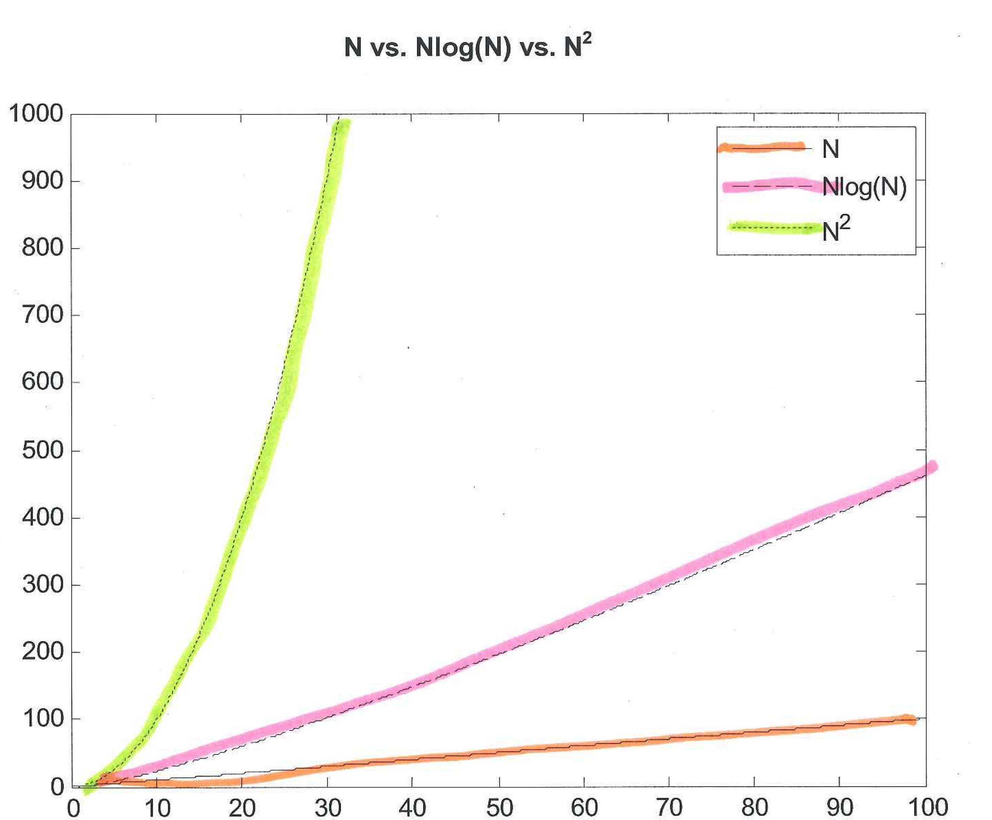
N vs. N log(N) vs. N²

Slide 26
N vs. N log(N) vs. N² vs. 2^{N}
N | N log(N) | N² | 2^{N}
2 | 2 | 4 | 4
4 | 8 | 16 | 16
6 | 15.5 | 36 | 64
8 | 24 | 64 | 256
20 | 84.6 | 400 | 1,048,576
100 | 664.4 | 10,000 | 1.3*10³⁰
1000 | 9965.8 | 1,000,000 | 1.1*10³⁰¹

Slide 27
What’s this log business?
Log is logarithm.
Remember that an exponent tells us how many times a number is to be multiplied:
10³ means 10*10*10
A logarithm tells us what exponent is needed to produce a particular value.
Hence log₁₀(1000) = 3 since 10³ = 1000.

Slide 28
Fractional exponents (and logs) are allowed
√x = x^{0.5}
This is because √x * √x = x,
so x^{0.5} * x^{0.5} = x¹ = x
Thus log₁₀(√x) = 0.5 * log₁₀(x).

Slide 29
What base do we use?
Usually base 2, but …
it doesn’t really matter.
Logs to different bases are related by a constant factor.
Log₂(x) is always 3.32… bigger than log₁₀(x).
Because 2^{3.32…} = 10

Slide 30
Many useful algorithms are n log(n) in complexity
This is way better than an n² algorithm
(because log(n) grows slowly as n grows).

Slide 31
Example: Giving a Toast
Fill the glasses.
Linear complexity
Raise glasses & give the toast
Constant time
3. Clink glasses.
Person 1 clinks with persons 2 to N
Person 2 clinks with persons 3 to N
…
Person N-1 clinks with person N

Slide 32
Total number of clinks is (n-1)+(n-2)+ … +1 +0.
This sums to n*(n-1)/2 = n²/2 – n/2.
So this step is quadratic.

Slide 33
Big O Notation
This is a notation that expresses the overall complexity of an algorithm.
Only the highest-order term is used; constants, coefficients, and lower-order terms are discarded.
O(1) is constant time.
O(N) is linear time.
O(N²) is quadratic time.
O(2^{N}) is exponential time.

Slide 34
The three functions:
4N²+3N+2,
300N²,
N(N-2)/2
Are all O(N²).

Slide 35
Formal Definition
A function T(N) is O(F(N)) if for some constant c and threshold n₀,
it is the case T(N) ≤ c F(N) for all N > n₀

Slide 36
Example
The function 3n²-n+3 is O(n²) with c =3 and n₀ = 3:
n | 3n²-n+3 | 3n²
1 | 5 | 3
2 | 13 | 12
3 | 27 | 27
4 | 47 | 48
5 | 73 | 75

Slide 37
Complexity in Java Code
Basic Operations
(assignment, arithmetic, comparison, etc.) :
Constant time, O(1)
List of statements:
statement₁;
statement₂;
…
statement_{k};
// k is independent of problem size

Slide 38
If each statement uses only basic operations,
complexity is k*O(1) = O(1)
Otherwise, complexity of the list is the
maximum of the individual statements.

Slide 39
If-Then-Else
if (cond) {
sequence₁ of statements }
else {
sequence₂ of statements }
Assume conditional requires O(N_{c}),
then requires O(N_{t}) and else requires O(N_{e}).

Slide 40
Overall complexity is:
O(N_{c}) + O(max(N_{t}, N_{e})) =
O(max(N_{c}, max(N_{t}, N_{e}))) =
O(max(N_{c},N_{t}, N_{e}))

Slide 41
Basic loops
for (i = 0; i < M; i++) {
sequence of statements
}
We have M iterations.
If the body’s complexity is O(N_{b}), the whole loop requires M*O(N_{b}) = O(M*N_{b})
(simplify O term if possible).

Slide 42
Nested Loops
for (i = 0; i < M; i++) {
for (j = 0; j < L; j++) {
sequence of statements
}
We have M*L iterations.
If the body’s complexity is O(N_{b}), the whole loop requires M*L*O(N_{b}) = O(M*L*N_{b})
(simplify O term if possible).

Slide 43
Method calls
Suppose f1(k) is O(1) (constant time):
for (i = 0; i < N; i++) {
f1(i);
}
Overall complexity is N*O(1) = O(N)

Slide 44
Suppose f2(k) is O(k) (linear time):
for (i = 0; i < N; i++) {
f2(N);
}
Overall complexity is N*O(N) = O(N²)

Slide 45
Suppose f2(k) is O(k) (linear time):
for (i = 0; i < N; i++) {
f2(i);
}
”Unroll” the loop. Complexity is:
O(0)+O(1)+… +O(N-1) = O(0+1+ … +N-1)
= O(N*(N-1)/2)
= O(N²)

Slide 46
Number Guessing Game
Person 1 picks a number between 1 and N.
Repeat until number is guessed: Person 2 guesses a number Person 1 answers "correct", "too high",
or "too low”
problem size = N count : # guesses

Slide 47
Algorithm 1:
Guess number = 1
Repeat
If guess is incorrect,
increment guess by 1
until correct
Best case: 1 guess
Worst case: N guesses
Average case: N/2 guesses
Complexity = O(N)

Slide 48
Algorithm 2:
Guess number = N/2
Set step = N/4
Repeat
If guess is too large, next guess =
guess - step
If guess is too small, next guess =
guess + step
step = step/2 (alternate rounding up/down)
until correct

Slide 49
Best case: 1 guess
Worst case: log₂(N).
So complexity is O(log N).
Algorithm 2 is way better!

Slide 50
Returning N Papers to N Students
problem size (N) = # students count # of "looks" at a paper
What is the complexity of each algorithm below?

Slide 51
Algorithm 1:
Call out each name, have student come forward & pick up paper
best-case: O(N)
worst-case: O(N)
But, this algorithm “cheats” a bit! Why?
Concurrency!

Slide 52
Algorithm 2:
Hand pile to first student, student searches & takes own paper,
then pass pile to next student.
best-case: Each of N students “hits” at first search. This is N*O(1) = O(N).
worst-case: N compares, then N-1 compares, etc. Time is O(N)+O(N-1)+… + O(1) =
O(N²).

Slide 53
Algorithm 3:
Sort the papers alphabetically,
hand pile to first student who does a binary search,
then pass pile to next student.
Sort is O(N log N).
Student 1 takes O(log N),
Student 2 takes O(log (N-1)), …
Bounded by N*O(log n).
Overall complexity is O(N log N).

Slide 54
Practice with analyzing complexity
For each of the following methods, determine the complexity.
Assume arrays A and B are each of size N (i.e., A.length = B.length = N)

Slide 55
method1
void method1(int[] A, int x, int y) {
int temp = A[x];
A[x] = A[y];
A[y] = temp;}
Constant time per call, thus O(1).

Slide 56
method2
void method2(int[] A, int s) {
for (int i = s; i < A.length - 1; i++)
if (A[i] > A[i+1])
method1(A, i, i+1); }
Number of iterations is at most N. Each call is O(1) so overall complexity is O(N).

Slide 57
method3
void method3(int[] B) {
for (int i = 0; i < B.length - 1; i++)
method2(B, i); }
Number of iterations is N-1.
method2 does N-1 iterations, then N-2, etc.
This totals to N², so overall complexity is O(N²).

Slide 58
method4
void method4(int N) {
int sum = 0, M = 1000;
for (int i = N; i > 0; i--)
for (int j = 0; j < M; j++)
sum += j; }
Since M is a constant, the entire inner loop takes a bounded amount of time; its complexity is O(1).
Outer loop iterates N times, so overall complexity is O(N).

Slide 59
What if M is a parameter?
void method4a(int N, int M) {
int sum = 0;
for (int i = N; i > 0; i--)
for (int j = 0; j < M; j++)
sum += j; }
Now the entire inner loops takes O(M) time.
The overall complexity is now O(N*M).

Slide 60
method5
public void method5(int N) {
int tmp, arr[];
arr = new int[N];
for (int i = 0; i < N; i++)
arr[i] = N - i;
for (int i = 1; i < N; i++) {
for (int j = 0; j < N - i; j++) {
if (arr[j] > arr[j+1]) {
tmp = arr[j];
arr[j] = arr[j+1];
arr[j+1] = tmp; }}}}
What does this do?

Slide 61
Complexity of method5
Analyze in steps:
The call to new is O(1).
The first loop iterates N times; loop body is O(1), so loop is O(N).
The nested loop body iterates N-1 times, then N-2 times, …, 1 time. Total is O(N²).
Overall complexity is O(1)+O(N)+O(N²) = O(N²).

Slide 62
Complexity Caveats
Algorithms with the same complexity can differ when constants, coefficients and lower-order terms are considered.
Which of these is better?
2N²+3N vs. 10N²

Slide 63
A better complexity means eventually an algorithm will be better. But for small to intermediate problem sizes, an inferior complexity may win out!
Consider 100*N vs. N²/100.
The quadratic complexity is better
until N = 10,000.

