Slide 1
CS 367 Introduction to Data Structures
Lecture 7

Slide 2
Today’s Agenda:
Linked Lists
Doubly-linked Lists
Circular Lists
Stacks

Slide 3
Primitive vs. Reference Types
Primitive types represent fundamental data values (integer, floating point, characters). Values are placed directly in memory.
An int value in one word (4 bytes):
1234

Slide 4

Reference Types
Data objects (created by new) are pointed to by a reference type.
Int []

Slide 5
Assignment
Assignment of a primitive type copies the actual value.
A = 1234; A:
B = A; B:
1234
1234

Slide 6
Assignment of a reference type copies
a pointer to an object. The object is
not duplicated.
B = A;
A
B

Slide 7
Assignment of Reference Types Leads to Sharing
Given
A[1] = 1; causes
A
B
1
B
A

Slide 8
Use clone() to create a distinct copy of an Object
B = A.clone();
creates:
A
B

Slide 9
But clone() makes a copy only of the object itself
Objects accessed by references aren’t copied.
If we clone A we get
A
B

Slide 10
A
B
A’
Why isn’t B copied too?

Slide 11
Consider:
But you can create your own version of clone() if you wish!
A
B

Slide 12
Linked Lists
Individual data items, called nodes, are linked together using references:
Advantages:
Easy to reorder nodes (by changing links).
Easy to add extra nodes as needed.

Slide 13
Disadvantages:
Each node needs a “next” field
Moving forward is tedious (one node at a time).
Moving backward is difficult or impossible.

Slide 14
Linked List in Java
public class Listnode<E> {
//*** fields ***
private E data;
private Listnode<E> next;
//*** constructors *** (why two?)
public Listnode(E d) {
this(d, null); }
public Listnode(E d, Listnode<E> n) {
data = d;
next = n; }

Slide 15
// methods to access fields
public E getData() {
return data;
}
public Listnode<E> getNext() {
return next;
}

Slide 16
// methods to modify fields
public void setData(E d) {
data = d;
}
public void setNext(Listnode<E> n) {
next = n;
}

Slide 17

Example
Create first node:
Listnode<String> l;
l = new Listnode<String>("ant");

Slide 18

Then add second node at end of list:
l.setNext(
new Listnode<String>("bat"));

Slide 19
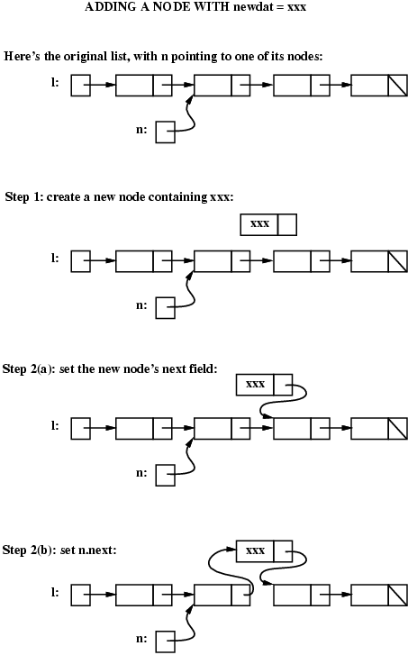
Adding a Node into a Linked List
Assume l points to start of list,
n points to node after which to insert:

Slide 20
Create node to be inserted:
Listnode<String> tmp =
new Listnode<String>(“xxx”);

Slide 21
Set the new node’s next field:
tmp.setNext( n.getNext() );

Slide 22
Reset n’s next field:
n.setNext ( tmp );

Slide 23
Removing a Node from a List
Goal:
Remove node n from list l
Approach:
Find n’s predecessor in the list
Link that predecessor to n’s successor

Slide 24
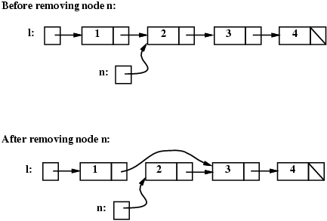

Slide 25
We search from head of list (l) to find n’s predecessor
Listnode<String> tmp = l;
while (tmp.getNext() != n) {
// find the node before n
tmp = tmp.getNext();
}

Slide 26
We then reset the Predecessor’s next field
tmp.setNext( n.getNext() );
// remove n from the linked list

Slide 27
Special Case Alert
What happens if n is first element of list?
It has no predecessor!
How does the code fail?
while (tmp.getNext() != n) {
tmp = tmp.getNext();
}

Slide 28
How do we handle this?
Add special case code
Make sure every node has a predecessor!

Slide 29
Enhanced Code
if (l == n) {
// special case: n is the first node in the list
l = n.getNext();
} else {
// general case: find the node before n, then "unlink" n
Listnode<String> tmp = l;
while (tmp.getNext() != n) { // find the node before n
tmp = tmp.getNext();
}
tmp.setNext(n.getNext());
}

Slide 30
Null List Reference vs. Null List
If L is a variable of type Listnode, what does L == null mean?
L is a null list (size == 0)
Maybe not!
L may be uninitialized (undefined)
These two interpretations are different!

Slide 31
Header Nodes
To distinguish between an undefined list and an empty (or null) list, we can add
an extra header node at the start of each list.
All lists now have at least one node. So an empty list isn’t equal to null.
Moreover, inserting a node at the start of a list is easy – it is placed just after the header node!

Slide 32
The LinkedList Class
Let’s implement a class that implements the ListADT interface using a linked list rather than an array.
We’ll use a header node to illustrate its utility.

Slide 33
Interface definition for ListADT
public interface ListADT<E> {
void add(E item);
void add(int pos, E item);
boolean contains(E item);
int size( );
boolean isEmpty( );
E get(int pos);
E remove(int pos);
}

Slide 34
public class LinkedList<E>
implements ListADT<E> {
/* private data declarations */
/* constructor(s) */
/* interface methods */
}

Slide 35
public class LinkedList<E>
implements ListADT<E> {
private Listnode<E> head;
private Listnode<E> tail;
private int itemCount;
/* constructor(s) */
/* interface methods */
}

Slide 36
public class LinkedList<E>
implements ListADT<E> {
private Listnode<E> head;
private Listnode<E> tail;
private int itemCount;
public LinkedList() {
itemCount = 0;
head = new Listnode<E>(null);
tail = head;
}
/* interface methods */
}

Slide 37
public class LinkedList<E>
implements ListADT<E> {
/* data defs & constructor */
public int size( ){
return itemCount;
}
public boolean isEmpty( ){
return (size() == 0);
}
}

Slide 38
public class LinkedList<E>
implements ListADT<E> {
/* data defs & constructor */
public void add(E item) {
if (item == null)
throw new NullPointerException();
Listnode<E> newNode =
new Listnode<E>(item);
tail.setNext(newNode);
tail = newNode;
itemCount++;
}
}

Slide 39
public class LinkedList<E> implements ListADT<E> {
public void add(int pos, E item){
if (item == null)
throw new NullPointerException();
if (pos < 0 || pos > itemCount) {
throw new IndexOutOfBoundsException(); }
if (pos == itemCount)
add(item);
else {// Find where to insert
Listnode<E> ptr = head;
for (int i = 0; i < pos; i++)
ptr = ptr.getNext();
Listnode<E> newNode = new Listnode<E>(item);
newNode.setNext(ptr.getNext());
ptr.setNext(newNode); }
itemCount++;
}}

Slide 40
public class LinkedList<E>
implements ListADT<E> {
/* data defs & constructor */
public E get(int pos) {
// check for bad pos
if (pos < 0 || pos >= itemCount) {
throw
new IndexOutOfBoundsException();
}
Listnode<E> ptr = head.getNext();
for (int i = 0; i < pos; i++)
ptr = ptr.getNext();
return ptr.getData();
}}

Slide 41
public class LinkedList<E>
implements ListADT<E> {
/* data defs & constructor */
public boolean contains(E item){
// null values are not allowed in the list
if (item == null)
return false;
Listnode<E> ptr = head.getNext();
while (ptr != null){
if (ptr.getData().equals(item))
return true;
else ptr = ptr.getNext();
}
return false;
}}

Slide 42
public class LinkedList<E>
implements ListADT<E> {
/* data defs & constructor */
public E remove(int pos) {
// check for bad pos
if (pos < 0 || pos >= itemCount) {
throw new IndexOutOfBoundsException();}
// decrease the number of items
itemCount--;
Listnode<E> prev = head, target;
for (int i = 0; i < pos; i++)
prev = prev.getNext();
target = prev.getNext();
prev.setNext(target.getNext());
if (target.getNext() == null)
tail = prev;
return target.getData(); }}

Slide 43
A Useful Debugging Trick
For each ADT written in Java, define a
toString() method. This allows you to use the standard print or println methods to see the contents of the ADT.

Slide 44
The toString method for LinkedList is fairly simple. It walks the list, adding the string value of each element to the overall string representation:
public String toString() {
String result = "(";
for (int k = 0; k < itemCount; k++) {
if (k==0)
result += get(0).toString() ;
else result +=
"," + get(k).toString();
}
return result + ")";
}

Slide 45
An Iterator for Linked Lists
It would be useful if linked lists had an iterator to visit each list member.
We need to create an iterator class,
LinkedListIterator, that implements the standard iterator methods: hasNext(), next() and remove().

Slide 46
public class LinkedListIterator<E> implements Iterator<E> {
private Listnode<E> curr; // current list node
public LinkedListIterator(Listnode<E> first) { curr = first; }
public boolean hasNext() {
return curr != null; }
public E next() {
if (!hasNext()) {
throw new NoSuchElementException(); }
E data = curr.getData();
curr = curr.getNext();
return data; }
public void remove() {
throw new UnsupportedOperationException() ;}
}

Slide 47
We need to add an iterator() method to the LinkedList class to generate the iterator:
public Iterator<E> iterator() {
return new LinkedListIterator(
head.getNext());
}

Slide 48
Now we can define a version of toString() that is independent of the details of how a list is implemented:
public String toString() {
Iterator<E> iter = this.iterator();
String result;
if (!iter.hasNext())
return "()";
result = "(" + iter.next().toString();
while (iter.hasNext() ){
result +=
"," + iter.next().toString();
}
return result + ")";
}

Slide 49
Why are there different implementations of the same interface?
Implementations can differ in the efficiency of various operations.

Slide 50
 | Array List | Linked List
Constructor | O(1) | O(1)
Add(E) | O(N) | O(1)
Add(int,E) | O(N) | O(N)
Contains(int) | O(N) | O(N)
Size | O(1) | O(1)
isEmpty | O(1) | O(1)
Get(int) | O(1) | O(N)
Remove(int) | O(N) | O(N)

Slide 51
Linked List Variations
Doubly-linked List:

Slide 52
Circular Singly-linked List:

Slide 53
Circular Doubly-linked List:

Slide 54

Doubly Linked Lists

Slide 55
public class DblListnode<E> {
private DblListnode<E> prev;
private E data;
private DblListnode<E> next;
//*** constructors ***
public DblListnode() {
this(null, null, null); }
public DblListnode(E d) {
this(null, d, null); }
public DblListnode(DblListnode<E> p, E d,
DblListnode<E> n) {
prev = p;
data = d;
next = n; }

Slide 56
public E getData() {
return data; }
public DblListnode<E> getNext() {
return next; }
public DblListnode<E> getPrev() {
return prev; }
public void setData(E d) {
data = d; }
public void setNext(DblListnode<E> n) {
next = n; }
public void setPrev(DblListnode<E> p) {
prev = p; }

Slide 57
Removing a Node
To remove a given node from a doubly linked list, we need to:
Change the prev field of the node to its right
Change the next field of the node to its left

Slide 58
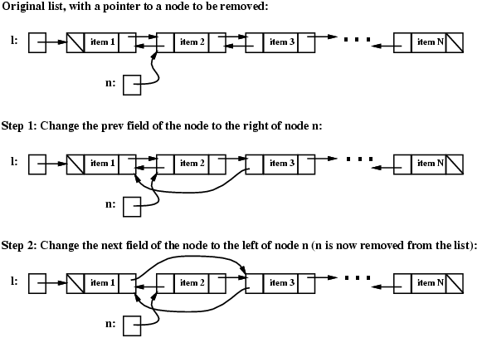

Slide 61
Here’s the code:
// Step 1: change the prev field of
// the node after n
DblListnode<E> tmp = n.getNext();
tmp.setPrev(n.getPrev());
// Step 2: change the next field of
// the node before n
tmp = n.getPrev();
tmp.setNext(n.getNext());

Slide 62
Special Cases
First or last nodes in list (because prev or next link is null).

Slide 63
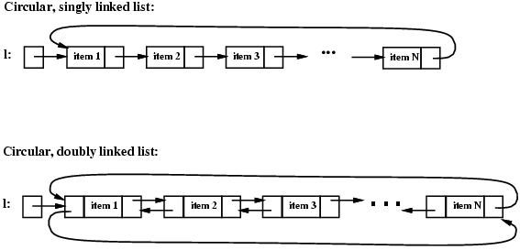
Circular Linked Lists

Slide 64
Class definitions (and remove method) still work
Fewer special cases (head pointer may need to be updated).

Slide 65
Position-Oriented ADTs
List – access i^{th} item
Stack – access only at the top
Queue – access only at front and rear

Slide 66


Stack Abstract Data Type
Push
Pop

Slide 67
Stack Operations
With a stack you push and pop values.
The most recently pushed item is always return by a pop. This is called LIFO (Last In First Out).

Slide 68
A Stack Interface
public interface StackADT<E> {
boolean isEmpty();
void push(E ob);
E pop() throws EmptyStackException;
E peek() throws
EmptyStackException;
}

Slide 69
peek() lets you “peek” at the top stack element without removing it.
Is peek() absolutely need?
No, it can be implemented by doing a pop, then a push.

Slide 70
How to implement a stack
Either an array or linked list may be used. One end of the array (or list) is designated as “top.”

Slide 71
Class ArrayStack
public class ArrayStack<E> implements StackADT<E>
private static final int INITSIZE = 10 private E[] items;
private int numItems;
public ArrayStack() {
items = (E[])(new Object[INITSIZE]);
numItems = 0;
}
...
}

Slide 72
public void push(E ob) {
if (items.length == numItems) {
expandArray();
}
items[numItems] = ob;
numItems++;
}

Slide 73
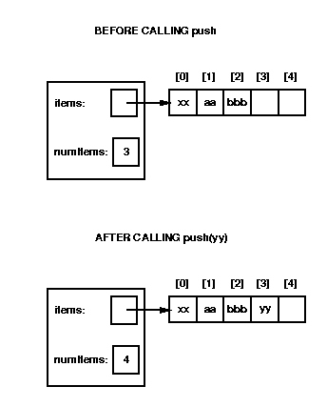

Slide 74
public E pop() throws EmptyStackException {
if (numItems == 0) {
throw new EmptyStackException();
}
else {
numItems--;
return items[numItems];
}
}

Slide 75
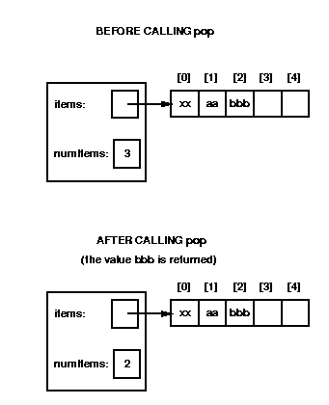
But bbb is still there!

Slide 76
peek is almost the same as pop:
public E peek()
throws EmptyStackException {
if (numItems == 0) {
throw new EmptyStackException();
}
else {
return items[numItems-1];
}
}

Slide 77
isEmpty is trivial
public boolean isEmpty() {
return(numItems == 0);
}

Slide 78
Worst case complexity of ArrayStack
Push: O(N)
Pop: O(1)
Peek: O(1)
isEmpty: O(1)

Slide 79
The “Shadow Array” Trick
Push is usually O(1)
But when the end of array is hit, we need O(N) time to copy current data into a new, bigger array.
An alternative is to allocate a second expanded array (the shadow array) when current array size hits a threshold.

Slide 80
Now each push copies pushed item into both arrays. In addition a few items are copied from old to new array.
Gradually all data from old array are copied into new array before the array fills. When old array fills, we switch to bigger array, already allocated and initialized!
Like a “Christmas Club” of years ago.

Slide 81
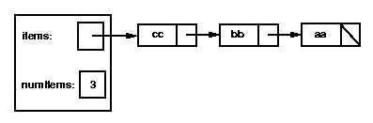
Implementing Stack Using Linked-lists
Linked lists are a very reasonable way to implement stacks. The head of the list is the top stack element:

Slide 82
We create a new class, LLStack, that implements the StackADT interface:
public class LLStack<E> implements StackADT<E>
private Listnode<E> items;
private int numItems;
...

Slide 83
The constructor and isEmpty method are both easy.
For push, we use:
public void push(E ob) {
items =
new Listnode<E>(ob, items);
numItems++;
}
(we might want to add code to check for null)

Slide 84
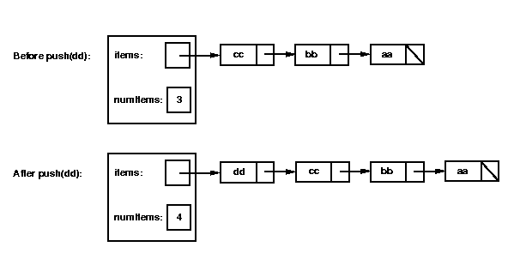
Graphically:

Slide 85
Let's consider how to write the pop method. It will need to perform the following steps:
Check whether the stack is empty; if so, throw an EmptyStackException.
Remove the first node from the linked list by setting items = items.getNext().
Decrement numItems.
Return the value that was in the first node in the list.

Slide 86
public E pop() throws
EmptyStackException {
if (isEmpty())
throw new EmptyStackException();
E tmp = items.getData();
items = items.getNext();
numItems--;
return tmp;
}

Slide 87
Complexity of LLStack
Because we add and remove stack elements at the head of the list, all stack operations are O(1)!

