Slide 1
CS 367 Introduction to Data Structures
Lecture 8

Slide 2
Today’s Agenda:
Linked Lists
Doubly-linked Lists
Circular Lists
Stacks

Slide 3
A Useful Debugging Trick
For each ADT written in Java, define a
toString() method. This allows you to use the standard print or println methods to see the contents of the ADT.

Slide 4
The toString method for LinkedList is fairly simple. It walks the list, adding the string value of each element to the overall string representation:
public String toString() {
String result = "(";
for (int k = 0; k < itemCount; k++) {
if (k==0)
result += get(0).toString() ;
else result +=
"," + get(k).toString();
}
return result + ")";
}

Slide 5
An Iterator for Linked Lists
It would be useful if linked lists had an iterator to visit each list member.
We need to create an iterator class,
LinkedListIterator, that implements the standard iterator methods: hasNext(), next() and remove().

Slide 6
public class LinkedListIterator<E> implements Iterator<E> {
private Listnode<E> curr; // current list node
public LinkedListIterator(Listnode<E> first) { curr = first; }
public boolean hasNext() {
return curr != null; }
public E next() {
if (!hasNext()) {
throw new NoSuchElementException(); }
E data = curr.getData();
curr = curr.getNext();
return data; }
public void remove() {
throw new UnsupportedOperationException() ;}
}

Slide 7
We need to add an iterator() method to the LinkedList class to generate the iterator:
public Iterator<E> iterator() {
return new LinkedListIterator(
head.getNext());
}

Slide 8
Now we can define a version of toString() that is independent of the details of how a list is implemented:
public String toString() {
Iterator<E> iter = this.iterator();
String result;
if (!iter.hasNext())
return "()";
result = "(" + iter.next().toString();
while (iter.hasNext() ){
result +=
"," + iter.next().toString();
}
return result + ")";
}

Slide 9
Why are there different implementations of the same interface?
Implementations can differ in the efficiency of various operations.

Slide 10
 | Array List | Linked List
Constructor | O(1) | O(1)
Add(E) | O(N) | O(1)
Add(int,E) | O(N) | O(N)
Contains(int) | O(N) | O(N)
Size | O(1) | O(1)
isEmpty | O(1) | O(1)
Get(int) | O(1) | O(N)
Remove(int) | O(N) | O(N)

Slide 11
Linked List Variations
Doubly-linked List:

Slide 12
Circular Singly-linked List:

Slide 13
Circular Doubly-linked List:

Slide 14

Doubly Linked Lists

Slide 15
public class DblListnode<E> {
private DblListnode<E> prev;
private E data;
private DblListnode<E> next;
//*** constructors ***
public DblListnode() {
this(null, null, null); }
public DblListnode(E d) {
this(null, d, null); }
public DblListnode(DblListnode<E> p, E d,
DblListnode<E> n) {
prev = p;
data = d;
next = n; }

Slide 16
public E getData() {
return data; }
public DblListnode<E> getNext() {
return next; }
public DblListnode<E> getPrev() {
return prev; }
public void setData(E d) {
data = d; }
public void setNext(DblListnode<E> n) {
next = n; }
public void setPrev(DblListnode<E> p) {
prev = p; }

Slide 17
Removing a Node
To remove a given node from a doubly linked list, we need to:
Change the prev field of the node to its right
Change the next field of the node to its left

Slide 18
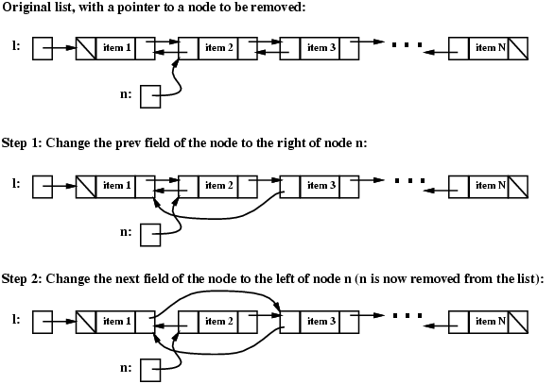

Slide 21
Here’s the code:
// Step 1: change the prev field of
// the node after n
DblListnode<E> tmp = n.getNext();
tmp.setPrev(n.getPrev());
// Step 2: change the next field of
// the node before n
tmp = n.getPrev();
tmp.setNext(n.getNext());

Slide 22
Special Cases
First or last nodes in list (because prev or next link is null).

Slide 23
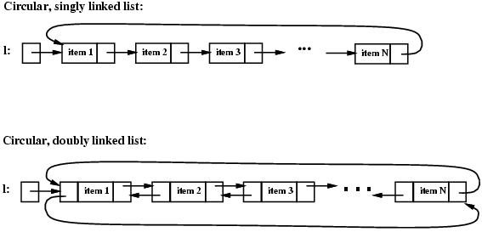
Circular Linked Lists

Slide 24
Class definitions (and remove method) still work
Fewer special cases (head pointer may need to be updated).

Slide 25
Position-Oriented ADTs
List – access i^{th} item
Stack – access only at the top
Queue – access only at front and rear

Slide 26


Stack Abstract Data Type
Push
Pop

Slide 27
Stack Operations
With a stack you push and pop values.
The most recently pushed item is always return by a pop. This is called LIFO (Last In First Out).

Slide 28
A Stack Interface
public interface StackADT<E> {
boolean isEmpty();
void push(E ob);
E pop() throws EmptyStackException;
E peek() throws
EmptyStackException;
}

Slide 29
peek() lets you “peek” at the top stack element without removing it.
Is peek() absolutely need?
No, it can be implemented by doing a pop, then a push.

Slide 30
How to implement a stack
Either an array or linked list may be used. One end of the array (or list) is designated as “top.”

Slide 31
Class ArrayStack
public class ArrayStack<E> implements StackADT<E>
private static final int INITSIZE = 10 private E[] items;
private int numItems;
public ArrayStack() {
items = (E[])(new Object[INITSIZE]);
numItems = 0;
}
...
}

Slide 32
public void push(E ob) {
if (items.length == numItems) {
expandArray();
}
items[numItems] = ob;
numItems++;
}

Slide 33
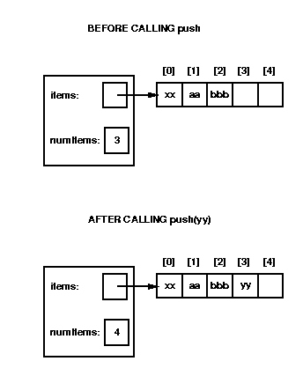

Slide 34
public E pop() throws EmptyStackException {
if (numItems == 0) {
throw new EmptyStackException();
}
else {
numItems--;
return items[numItems];
}
}

Slide 35
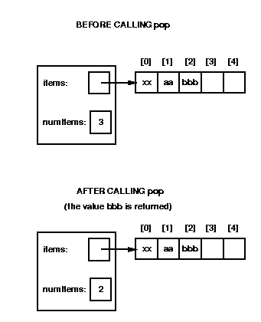
But bbb is still there!

Slide 36
peek is almost the same as pop:
public E peek()
throws EmptyStackException {
if (numItems == 0) {
throw new EmptyStackException();
}
else {
return items[numItems-1];
}
}

Slide 37
isEmpty is trivial
public boolean isEmpty() {
return(numItems == 0);
}

Slide 38
Worst case complexity of ArrayStack
Push: O(N)
Pop: O(1)
Peek: O(1)
isEmpty: O(1)

Slide 39
The “Shadow Array” Trick
Push is usually O(1)
But when the end of array is hit, we need O(N) time to copy current data into a new, bigger array.
An alternative is to allocate a second expanded array (the shadow array) when current array size hits a threshold.

Slide 40
Now each push copies pushed item into both arrays. In addition a few items are copied from old to new array.
Gradually all data from old array are copied into new array before the array fills. When old array fills, we switch to bigger array, already allocated and initialized!
Like a “Christmas Club” of years ago.

Slide 41
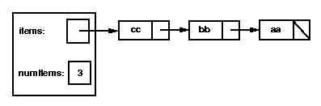
Implementing Stack Using Linked-lists
Linked lists are a very reasonable way to implement stacks. The head of the list is the top stack element:

Slide 42
We create a new class, LLStack, that implements the StackADT interface:
public class LLStack<E> implements StackADT<E>
private Listnode<E> items;
private int numItems;
...

Slide 43
The constructor and isEmpty method are both easy.
For push, we use:
public void push(E ob) {
items =
new Listnode<E>(ob, items);
numItems++;
}
(we might want to add code to check for null)

Slide 44
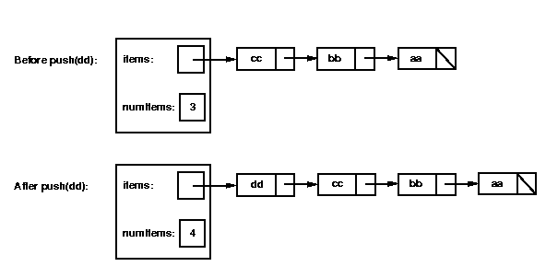
Graphically:

Slide 45
Let's consider how to write the pop method. It will need to perform the following steps:
Check whether the stack is empty; if so, throw an EmptyStackException.
Remove the first node from the linked list by setting items = items.getNext().
Decrement numItems.
Return the value that was in the first node in the list.

Slide 46
public E pop() throws
EmptyStackException {
if (isEmpty())
throw new EmptyStackException();
E tmp = items.getData();
items = items.getNext();
numItems--;
return tmp;
}

Slide 47
Complexity of LLStack
Because we add and remove stack elements at the head of the list, all stack operations are O(1)!

