Slide 1
CS 367 Introduction to Data Structures
Lecture 9

Slide 2
Steps in implementing Program 2:
Write EmptyLoopException class
Implement LinkedLoop<E> class
Implement LinkedLoopIterator<E> class
Complete implementation of ImageLoopEditor class
Test editor using GUI or text interface

Slide 3
Today’s Topics:
Stacks
Queues
Recursion

Slide 4
Worst case complexity of ArrayStack
Push: O(N)
Pop: O(1)
Peek: O(1)
isEmpty: O(1)

Slide 5
The “Shadow Array” Trick
Push is usually O(1)
But when the end of array is hit, we need O(N) time to copy current data into a new, bigger array.
An alternative is to allocate a second expanded array (the shadow array) when current array size hits a threshold.

Slide 6
Now each push copies pushed item into both arrays. In addition a few items are copied from old to new array.
Gradually all data from old array are copied into new array before the array fills. When old array fills, we switch to bigger array, already allocated and initialized!
Like a “Christmas Club” of years ago.

Slide 7
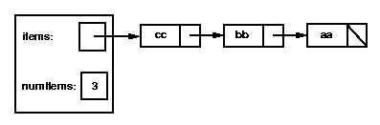
Implementing Stack Using Linked-lists
Linked lists are a very reasonable way to implement stacks. The head of the list is the top stack element:

Slide 8
We create a new class, LLStack, that implements the StackADT interface:
public class LLStack<E> implements StackADT<E>
private Listnode<E> items;
private int numItems;
...

Slide 9
The constructor and isEmpty method are both easy.
For push, we use:
public void push(E ob) {
items =
new Listnode<E>(ob, items);
numItems++;
}
(we might want to add code to check for null)

Slide 10
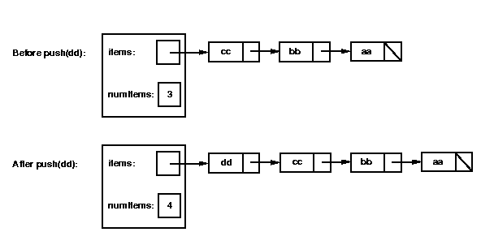
Graphically:

Slide 11
Let's consider how to write the pop method. It will need to perform the following steps:
Check whether the stack is empty; if so, throw an EmptyStackException.
Remove the first node from the linked list by setting items = items.getNext().
Decrement numItems.
Return the value that was in the first node in the list.

Slide 12
public E pop() throws
EmptyStackException {
if (isEmpty())
throw new EmptyStackException();
E tmp = items.getData();
items = items.getNext();
numItems--;
return tmp;
}

Slide 13
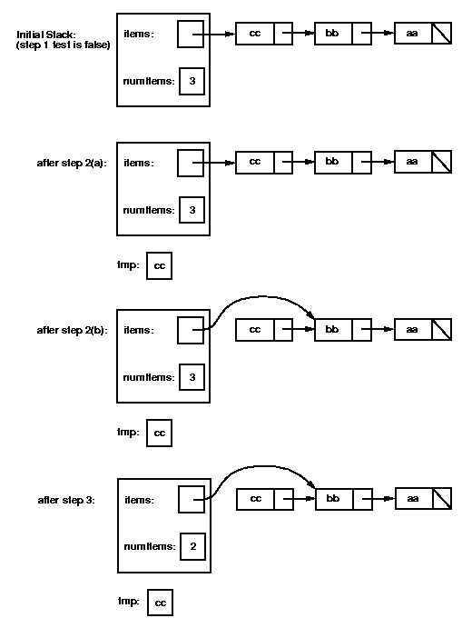
Graphically:

Slide 15
Complexity of LLStack
Because we add and removes stack elements at the head of the list, all stack operations are O(1)!

Slide 16

Queues
Dequeue
Enqeue

Slide 17
In a queue, items enter at the rear, via the enqueue operation.
Items are removed from the front of the queue, via the dequeue operation.
The isEmpty operation tells you if the queue is empty.

Slide 18
The QueueADT Interface
public interface QueueADT<E> {
boolean isEmpty();
void enqueue(E ob);
E dequeue() throws
EmptyQueueException;
}

Slide 19
Implementing a Queue using an Array
The fact that we add data at one end and remove it from the other end makes queues harder to implement than stacks.
As with stacks, we keep a count of items in the queue and an array to hold them.

Slide 20
public class ArrayQueue<E>
implements QueueADT<E> {
private static final int INITSIZE = 10;
private E[] items;
private int numItems;
. . .

Slide 21
Like stacks, we enter new items to the right, at the first unused position.
We remove the leftmost item at position 0. But after this dequeue operation, the leftmost item is now at position 1. If we shift all data left one location, each dequeue has an O(N) complexity.
Alternatively, we can track where the leftmost valid item is, but then “gaps” of unused array locations form:

Slide 22
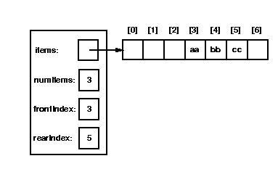

Slide 23
This gap continues to grow until the whole array is filled. We could expand the array, but the gap of unused array space at the left persists.
The solution is to let data “wrap around” from the rightmost array position to position 0, then 1, etc.

Slide 24
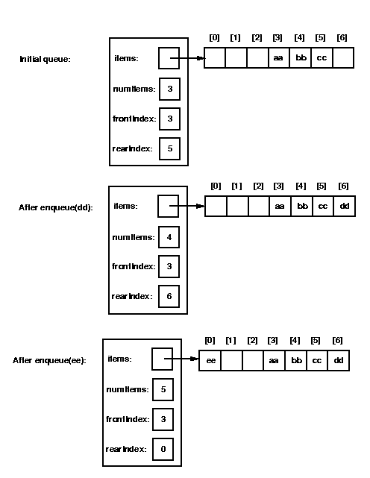

Slide 25
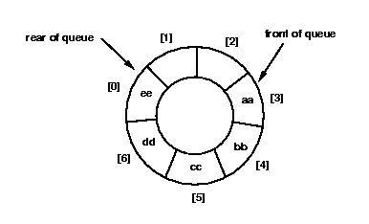
In effect we have a “circular array:”

Slide 26
Incrementing the Index in a Circular Array
We must provide for a possible “wrap around” when we increment an array index. The code is:
private int incrementIndex(int index) {
if (index == items.length-1)
return 0;
else
return index + 1;
}

Slide 27
The enqueue method
Adding to a queue (at the rear) is easy if we ignore expanding a full array:
public void enqueue(E ob) {
if (items.length == numItems) {
/*code missing here */ }
rearIndex =
incrementIndex(rearIndex);
items[rearIndex] = ob;
numItems++;
}

Slide 28
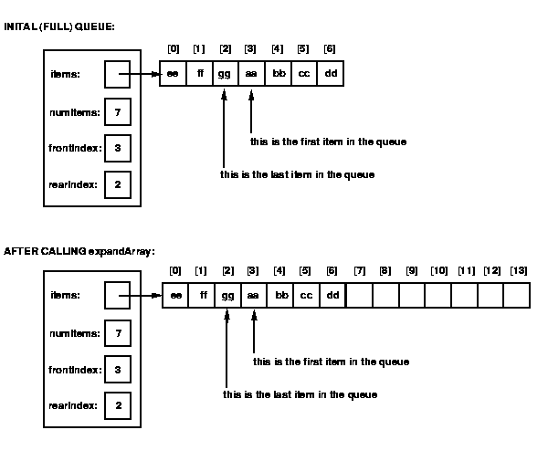
We can’t use expandArray() for queues!

Slide 29
Here’s what we need to do:
Allocate a new array of twice the size.
Copy the values in the range items[frontIndex] to items[items.length-1] into the new array (starting at position frontIndex in the new array).
Copy the values in the range items[0] to items[rearIndex] into the new array (starting at position items.length in the new array). Note: if the front of the queue was in items[0], then all of the values were copied by step 2, so this step is not needed.
Set items to point to the new array.
Fix the value of rearIndex.

Slide 30
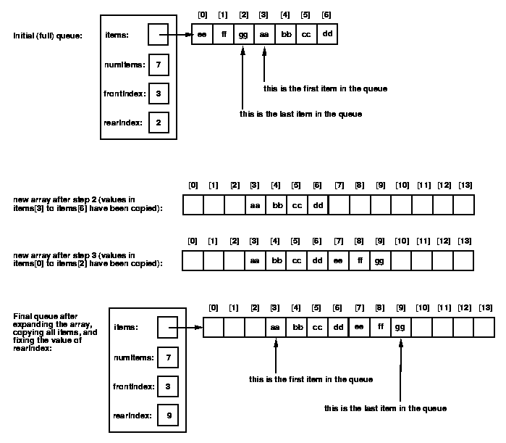

Slide 32
Here’s the missing code for enqueue:
if (items.length == numItems) {
E[] tmp = (E[])(new Object[items.length*2]);
System.arraycopy(items, frontIndex, tmp,
frontIndex, items.length-frontIndex);
if (frontIndex != 0) {
System.arraycopy(items, 0, tmp, items.length,
frontIndex);}
items = tmp;
rearIndex = frontIndex + numItems - 1;
}

Slide 33
Implementing dequeue
Dequeue is far simpler to implement because we don’t have to handle expanding the array (dequeue removes elements).
We return the data at frontIndex and increment that index using incrementIndex (to get the wrap around effect).

Slide 34
Implementing Queues using Linked-lists
With linked-lists, queues are much easier to implement.
The data needed is:
public class LLQueue<E> implements QueueADT<E> {
private Listnode<E> qFront;
private Listnode<E> qRear;
private int numItems;
...

Slide 35
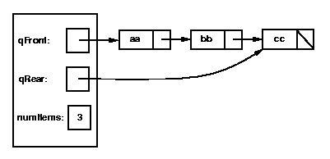
Items are added to the end of the list and removed from the front of the list.

Slide 36
Complexity of Queue Operations
In the linked-list implementation, all operations are O(1).
In the array implementation, enquque has a worst case complexity of O(N) when the array has to be expanded. This can be avoided using a shadow array.

Slide 37
A Hybrid Implementation
The main drawback of the simple linked-list queue is that we maintain a link for each data item.
What if we linked subarrays instead?

Slide 38
...
Both the front and rear indices always move to the right. When the rear index hits the end of a subarray, a new subarray is allocated and linked. When the front index hits the end of the subarray, the subarray is deleted and the next subarray is used.
Array 1
Array N
Front Index
Rear Index

Slide 39
Recursion
Most programming languages, including Java, allow a method to call itself:
void f(){
... f(); ...
}

Slide 40
Indirect recursion is also allowed:
void f(){
... g(); ...
}
void g(){
... f(); ...
}

Slide 41
Recursion seems like is ought not to work – a solution is defined in terms of itself!
But when used properly recursion can lead to simple and elegant solutions.

Slide 42
Many Data Structures are Naturally Recursive
What is a linked list?
Simply a data value combined with another list. That is, lists are built from lists!

Slide 43
public class Listnode<E> {
//*** fields ***
private E data;
private Listnode<E> next;
public int length() {
if (getNext() == null)
return 1;
else return
1 + getNext().length();
} ... }

Slide 44
Notice that there is no explicit iteration in length()!
toString is equally elegant:
public String toString(){
if (next == null)
return data.toString();
else return data.toString()
+ ",” + next.toString();
}

Slide 45
How does Recursion work?
We can imagine that each recursive call to a method f creates a new identical copy of f. The normal call/return mechanism is then used.

Slide 46
Consider
void printInt( int k ) {
if (k == 0) {
return; }
System.out.println( k );
printInt( k - 1 ); System.out.println("all done");
}

Slide 47
We’ll trace the effect of the call printInt(2):
We print 2 then reach the call
printInt(k - 1) which is really
printInt(1).
We now call a new copy of printInt, shown in blue, with a k value of 1.

Slide 48
void printInt( int k ) {
if (k == 0) {
return; }
System.out.println( k );
printInt( k - 1 ); System.out.println("all done");
}
The value of k, which is 1, is printed. Then
another copy of printInt, shown in red is called with a 0 parameter:

Slide 49
void printInt( int k ) {
if (k == 0) {
return; }
System.out.println( k );
printInt( k - 1 ); System.out.println("all done");
}
Since k is 0, this version of printInt returns immediately. Then the blue and black versions each print “all done”.

Slide 50
Why are different colors (versions) needed?
We need different versions (colors) because different calls may have different parameter values, different local variable values and different return points.
The red value of k is different than the black value. Similarly, a red routine returns to a red call point, not a black or blue one.

Slide 51
Do we actually make different copies of recursive routines?
No, but we do make different copies of parameter values, local variables and return points. These are packaged into a memory block, called a “frame” or “activation record.” The code for a method uses one particular frame, allocated on a run-time stack in memory.

Slide 52
Each frame corresponds to a different call.
k = 0
Top of stack
k = 1
k = 2
Bottom of stack

Slide 53
Frames are placed on a stack because calls are LIFO (most recent call is first to return).
In fact, all methods (not just recursive ones) use frames.
A program may have many methods, but only those that are active (running) are allocated frames on the stack.

Slide 54
Rules for Recursion
Badly written recursive routines can fail.
Consider:
void badPrint(int k) {
System.out.println(k);
badPrint(k + 1);
}
There is an unlimited number of calls (an infinite recursion). Execution stops when the frame stack overflows.

Slide 55
A correct recursive routine should follow these two rules:
There must be a base case which makes no further recursive calls.
In printInt this was the k == 0 test.
Each recursive call must make progress toward the base case.
In printInt k is repeatedly reduced
by 1, making progress toward 0.

Slide 56
What does the call
printInt(-1)
do?
It causes an infinite recursion.
Why?
Because k makes no progress toward the base case.

Slide 57
An Interesting Recursive Routine: palindrome
What is a palindrome?
A word or phrase that is spelled the same left to right or right to left:
Examples:
deed
radar
step on no pets
a man a plan a canal panama

Slide 58
Palindromes have an elegant recursive definition:
All strings of length 0 or 1 are trivially palindromes
Longer strings are palindromes if the first and last character match and the remaining string is also a palindrome

Slide 59
A Java palindrome method
Useful string methods:
int length(): Length of string
char charAt(int index):
The character at position index
(starting at 0)
String substring(int begin, int last):
Substring from position begin up to but not including last

Slide 60
boolean isPalindrome(String s){
if (s.length() == 0 ||
s.length() == 1 )
return true;
char first = s.charAt(0);
char last =
s.charAt(s.length()-1);
return (first == last) &&
isPalindrome(
s.substring(1, s.length()-1));
}

Slide 61
Does isPalindrome satisfy the rules of recursion?
Is there a base case?
Yes – the test for 0 or 1 character
strings.
Does each recursive call make progress?
Yes – the string parameter gets smaller
at each call.

Slide 62
Iteration vs. Recursion
Many methods can use iteration rather than recursion. For example:
factorial of 0 is 1
factorial of N (for N > 0) is
N*N-1* ... *3*2*1
or:
factorial of 0 is 1
factorial of N (for N > 0) is
N * factorial (N-1)

Slide 63
Iterative version of Factorial
int factorial(int N) {
if (N == 0) {
return 1;
}
int tmp = N;
for (int k = N-1; k >= 1; k--) {
tmp = tmp * k;
}
return (tmp);
}

Slide 64
Recursive version of Factorial
int factorial(int N) {
if (N == 0) {
return 1;
} else {
return (N * factorial( N-1 ));
}
}

Slide 65
Comparing the Two Implementations
The recursive version is:
A little shorter
A little clearer (closer to mathematical definition)
A little slower
Why?

Slide 66
Fibonacci Series
fibonacci of 1 or 2 is 1
fibonacci of N (for N>2) is
fibonacci of (N-1) + fibonacci of (N-2)

Slide 67
Iterative version of Fibonacci
int fib( int N ) {
int k1, k2, k3;
k1 = k2 = k3 = 1;
for (int j = 3; j <= N; j++) {
k3 = k1 + k2;
k1 = k2;
k2 = k3;
}
return k3;
}

Slide 68
Recursive version of Fibonacci
int fib( int N ) {
if ((N == 1) || (N == 2)) {
return 1;
} else {
return (fib( N-1 ) +
fib( N-2 ));
}
}

Slide 69
Comparing the Two Implementations
The recursive version is:
Shorter
Much clearer (closer to mathematical definition)
Much slower
Why?

Slide 70
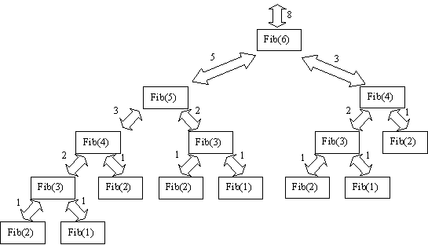
Look at call tree:

Slide 71
Calls are repeated unnecessarily.
(fib(4) twice, fib(3) three times!)
Unnecessary calls can be removed by explicitly remembering previous calls
or
by using an advanced compiler optimization called memoizing.

Slide 72
Analyzing Runtime for Recursive Methods
We can use informal reasoning
or
use recurrence equations

Slide 73
Informal Reasoning
We simply determine how many recursive call occur and how much work each call does.
Recall printInt:
void printInt( int k ) {
if (k == 0) {
return; }
System.out.println( k );
printInt( k - 1 ); System.out.println("all done");
}

Slide 74
Each call does four units of work and there are N+1 total calls, so the overall time complexity is just O(N)

Slide 75
Recurrence Equations
We determine an equation for the base case and a recurrence equation for recursive calls.
For printInt we have
T(0) = 1
T(N) = 1 + T(N-1)

Slide 76
To solve these equations we do three steps:
Expand the equations for a few small values
Look for a pattern and guess a solution
Verify that the guessed solution satisfies the recurrence equations

Slide 77
For printInt we have:
T(0) = 1
T(N) = 1 + T(n-1)
So we determine
T(1) = 1 +T(0) = 2
T(2) = 1 + T(1) = 1 + 2 = 3
The cost grows by 1 at each level.

Slide 78
We guess that T(N) = N +1
To verify we substitute the guess in the recurrence rule and verify that the equation holds.
Starting at T(N) = 1 + T(N-1)
We substitute our guess and simplify:
N+1 =?= 1 + ((N-1) + 1) = N + 1
The solution works!

Slide 79
Another Example
Recall the isPalindrome method.
For size 0 or 1 it immediately returned.
For longer strings it removed two characters and recursively tested the remaining string.
The recurrence equations are:
T(0) = T(1) = 1
T(N) = 1 + T(N-2)

Slide 80
Expanding:
The cost increases by 1 every second step. T(N) = 1 + N/2 fits this pattern.
0 | 1
1 | 1
2 | 1+T(0) = 2
3 | 1+T(1) = 2
4 | 1+T(2) = 3
5 | 1+T(3) = 3
6 | 1+T(4) = 4
7 | 1+T(5) = 4

Slide 81
We verify this guess satisfies the equations:
We require
T(N) = 1 + T(N-2)
Substituting:
1+N/2 =?= 1 + (1+ (N-2)/2) =
2+(N/2 – 1) = 1+N/2 ✔

Slide 82
Searching
A common operation in a data structure is to search for a value.
One simple approach is to examine every value in a structure until a match is found (or the search is exhausted).
Iterators facilitate this approach.
But, it may be too slow. A faster “targeted” approach may be preferable.

Slide 83
Searching an Array
Sequential Search
You examine each element in the
array until a match is found.
If the array has N elements, you need,
on average, N/2 tests. The search is
O(N).

Slide 84
Binary Search
If the array holds values in sorted order a much faster search strategy exists. It is called binary search. It is simple and recursive.

Slide 85
Say we want to find a value v:
If the midpoint entry, at position N/2 matches, we are done.
If the midpoint entry is smaller than v do a binary search on the upper half of the array (positions( N/2)+1 to N-1.
Otherwise do a binary search on the lower half of the array (positions 0 to (N/2) -1.

Slide 86
We do at most log₂(N) matches, so binary search is much faster than sequential search.
For example, if N = 1024, we do at most 10 matches (log₂(1024) = 10).

Slide 87
The Comparable Interface
Binary searching is much faster than sequential searching. We already know how to compare numbers or strings, but what about other objects?
Java provide the
Comparable<C>
interface.

Slide 88
This interface requires only one method:
int compareTo(C item)
Since compareTo is in an object (of class C)
We call it as
S1.compareTo(S2)
It returns an integer value that is:
negative if S1 is less than S2;
zero if S1 is equal to S2;
positive if S1 is greater than S2.

Slide 89
To make a Java object comparable
Include
implements Comparable<C>
as part of class definition
Define the compareTo method in the class

Slide 90
public class Name implements Comparable<Name> {
private String firstName, lastName;
public int compareTo(Name other) {
int tmp =
lastName.compareTo(other.lastName);
if (tmp != 0) {
return tmp; }
return
firstName.compareTo(other.firstName);
}
}

