Slide 1
CS 367 Introduction to Data Structures
Lecture 11

Slide 2
Today’s Topics
Searching
Trees
Binary Trees
Binary Search Trees

Slide 3
Searching
A common operation in a data structure is to search for a value.
One simple approach is to examine every value in a structure until a match is found (or the search is exhausted).
Iterators facilitate this approach.
But, it may be too slow. A faster “targeted” approach may be preferable.

Slide 4
Searching an Array
Sequential Search
You examine each element in the
array until a match is found.
If the array has N elements, you need,
on average, N/2 tests. The search is
O(N).

Slide 5
Binary Search
If the array holds values in sorted order a much faster search strategy exists. It is called binary search. It is simple and recursive.

Slide 6
Say we want to find a value v:
If the midpoint entry, at position N/2 matches, we are done.
If the midpoint entry is smaller than v do a binary search on the upper half of the array (positions( N/2)+1 to N-1.
Otherwise do a binary search on the lower half of the array (positions 0 to (N/2) -1.

Slide 7
We do at most log₂(N) matches, so binary search is much faster than sequential search.
For example, if N = 1024, we do at most 10 matches (log₂(1024) = 10).

Slide 8
The Comparable Interface
Binary searching is much faster than sequential searching. We already know how to compare numbers or strings, but what about other objects?
Java provide the
Comparable<C>
interface.

Slide 9
This interface requires only one method:
int compareTo(C item)
Since compareTo is in an object (of class C)
We call it as
S1.compareTo(S2)
It returns an integer value that is:
negative if S1 is less than S2;
zero if S1 is equal to S2;
positive if S1 is greater than S2.

Slide 10
To make a Java object comparable
Include implements Comparable<C> as part of class definition
Define the compareTo method in the class

Slide 11
public class Name implements Comparable<Name> {
private String firstName, lastName;
public int compareTo(Name other) {
int tmp =
lastName.compareTo(other.lastName);
if (tmp != 0) {
return tmp; }
return
firstName.compareTo(other.firstName);
}
}

Slide 12
Introduction to Trees
All the data structures we’ve seen so far are linear in structure.
Trees are non-linear:
More than one item may follow another
The number of items that follow can vary

Slide 13
Trees are used for a wide variety of purposes:
Family trees
To show the structure of a program
To represent decision logic
To provide fast access to data

Slide 14
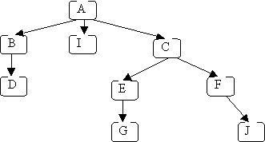
Each letter represents one node
The arrows from one node to another are called edges
The topmost node (with no incoming edges) is the root (node A)
The bottom nodes (with no outgoing edges) are the leaves (nodes D, I, G & J)

Slide 15
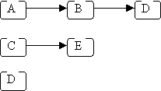
Computer Science trees have the root at the top, not bottom!
A path in a tree is a sequence of (zero or more) connected nodes; for example, here are 3 of the paths in the tree shown previously

Slide 16
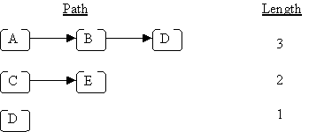
The length of a path is the number of nodes in the path:

Slide 17
The height of a tree is the length of the longest path from the root to a leaf.
For the above example, the height is
4 (because the longest path from the
root to a leaf is A → C → E → G
or A → C → E → J).
An empty tree has height = 0.

Slide 18
The depth of a node is the length of the path from the root to that node; for the above example:
the depth of J is 4
the depth of D is 3
the depth of A is 1

Slide 19

Given two connected nodes like this:
Node A is called the parent, and node B is called the child.

Slide 20
A subtree of a given node includes one of its children and all of that child's descendants. In the original example, node A has three subtrees:
B, D
I
C, E, F, G, J

Slide 21
Binary Trees
An important special kind of tree is the binary tree. In a binary tree:
Each node has 0, 1, or 2 children.
Each child is either a left child or a right child

Slide 22
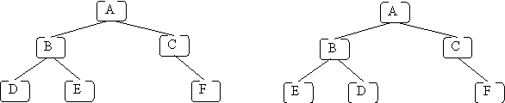
Two Binary Trees

Slide 23
Representing Trees in Java
A Binary Tree:
class BinaryTreenode<T> {
private T data;
private BinaryTreenode<T> leftChild;
private BinaryTreenode<T> rightChild;
... }
Notice the recursive nature of the definition.

Slide 24
General Trees in Java
We use a list to hold the children of a node:
class Treenode<T> {
private T data;
private ListADT<Treenode<T>> children;
...
}

Slide 25
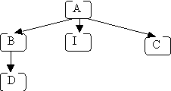
Given the tree
Using arrays to implement lists, we represent it as:

Slide 26
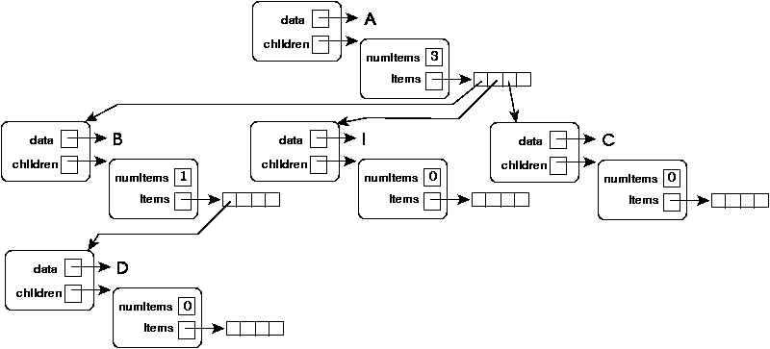

Slide 27
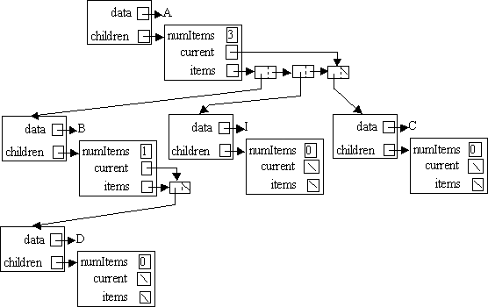
Using linked lists:

Slide 28
Tree Traversals
We may want to iterate through a tree for many reasons:
to print all values
to determine if there is a node with some property
to make a copy

Slide 29
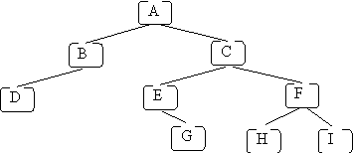
Given the two dimensional nature of trees, there is no one obvious traversal order. In fact several have been studied and used. Assume the following tree:

Slide 30
Pre-order
A pre-order traversal can be defined (recursively) as follows:
visit the root
perform a pre-order traversal of the first subtree of the root
perform a pre-order traversal of the second subtree of the root
Repeat for all the remaining subtrees of the root
If we use a pre-order traversal on the example tree given above and we print the letter in each node when we visit that node, the following will be printed:
A B D C E G F H I.

Slide 31
Post-order
A post-order traversal visits the root visited last rather than first:
perform a postorder traversal of the first subtree of the root
perform a postorder traversal of the second subtree of the root
Repeat for all remaining subtrees visit the root
For our example tree we get:
D B G E H I F C A.

Slide 32

Level-order
The idea of a level-order traversal is to visit the root, then visit all nodes "1 level away" (depth 2) from the root (left to right), then all nodes "2 levels away" (depth 3) from the root, etc. For the example tree, the goal is to visit the nodes in the following order:

Slide 33
To do a level-order traversal, we need to use a queue rather than just simple recursion:
Q.enqueue(root);
while (! Q.empty()) {
Treenode<T> n = Q.dequeue();
System.out.print(n.getData());
ListADT<Treenode<T>> kids =
n.getChildren();
Iterator<Treenode<T>> it =
kids.iterator();
while (it.hasNext()) {
Q.enqueue(it.next());
}
}

Slide 34


Slide 35
In-order
For binary trees, we can specify a traversal order that visits the root “in between.” visiting children:
perform an in-order traversal of the left subtree of the root
visit the root
perform an in-order traversal of the right subtree of the root
For our example tree we get:
D B A E G C H F I

Slide 36
Binary Search Trees
A binary search tree (BST) is a special kind of binary tree designed to facilitate searching.
Each node contains a key (and maybe some data). For each node n is the BST:
All keys in n's left subtree are less than the key in n, and
All keys in n's right subtree are greater than the key in n.

Slide 37
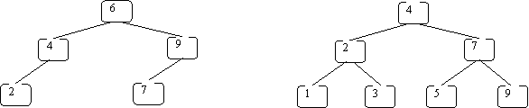
We normally assume that keys are unique. Here are some BSTs:

Slide 38
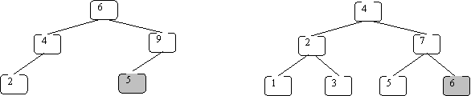
These are invalid BSTs:
Why?

Slide 39
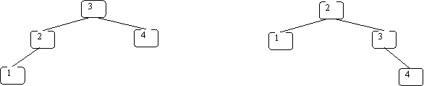
BSTs need not be unique
Both of the BSTs below store the same set of keys:

Slide 40
Operations supported by BSTs
The following operations can be implemented efficiently using a BST:
insert a key value
determine whether a key value is in the tree
remove a key value from the tree
print all of the key values in sorted order

Slide 41
Implementing BSTs in Java
We define a class for one tree node (BSTNode) and another for the entire tree (BST):

Slide 42
class BSTnode<K> {
// *** fields ***
private K key;
private BSTnode<K> left, right;
// *** constructor ***
public BSTnode(K key,
BSTnode<K> left,
BSTnode<K> right) {
this.key = key;
this.left = left;
this.right = right; }

Slide 43
// accessors (access to fields)
public K getKey() { return key; }
public BSTnode<K> getLeft() { return left; }
public BSTnode<K> getRight() { return right; }
// mutators (change fields)
public void setKey(K newK) { key = newK; }
public void setLeft(BSTnode<K> newL) {
left = newL; }
public void setRight(BSTnode<K> newR) {
right = newR; }
}

Slide 44
public class BST<K extends
Comparable<K>> {
// *** fields ***
private BSTnode<K> root;
// ptr to the root of the BST
// *** constructor ***
public BST() { root = null; }

Slide 45
public void insert(K key) throws DuplicateException
{ ... }
// add key to this BST; error if it is already there
public void delete(K key) { ... }
// remove node containing key from BST if there;
// otherwise, do nothing
public boolean lookup(K key) { ... }
// if key is in BST, return true; else, return false
public void print(PrintStream p) { ... }
// print the values in BST in sorted order (to p)
}

Slide 46
Key-Value Pairs in BSTs
We add a value field to the BSTnode and BST classes:
class BSTnode<K, V> {
private K key;
private V value;
private BSTnode<K, V> left, right;

Slide 47
// *** constructor ***
public BSTnode(K key, V value,
BSTnode<K, V> left,
BSTnode<K, V> right) {
this.key = key;
this.value = value;
this.left = left;
this.right = right; }

Slide 48
// *** methods ***
...
public V getValue() { return value; }
public void setValue(V newV) { value = newV; }
...

Slide 49
public class BST<K extends Comparable<K>, V> {
// *** fields ***
private BSTnode<K, V> root;
// ptr to the root of the BST
// *** constructor ***
public BST() { root = null; }

Slide 50
public void insert(K key, V value) throws DuplicateException {...}
// add key and value to this BST;
// error if key is already there
public void delete(K key) {...}
// remove node containing key if there
// otherwise, do nothing
public V lookup(K key) {...}
// if key is in BST, return associated
// value; otherwise, return null

Slide 51
The lookup Method
Given a BST and a key, the node we want may be:
In the root
In the left subtree
In the right subtree

Slide 52
There are two base cases:
Tree is empty – return false
Key is in root node – return true
Otherwise, we search the left subtree or the right subtree, but not both!
Why?
All values less than key are in left subtree; all values greater are in right subtree

Slide 53
We start the lookup at the root of the BST (note use of auxiliary method also named lookup):
public boolean lookup(K key) {
return lookup(root, key);
}

Slide 54
private boolean lookup(BSTnode<K> n, K key) {
if (n == null) {
return false; }
if (n.getKey().equals(key)) {
return true; }
if (key.compareTo(n.getKey()) < 0) {
// key < node's key; look in left subtree
return lookup(n.getLeft(), key); }
else {
// key > node's key; look in right subtree
return lookup(n.getRight(), key);
}
}

Slide 55
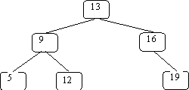
An Example
We’ll search for 12 in:

Slide 56
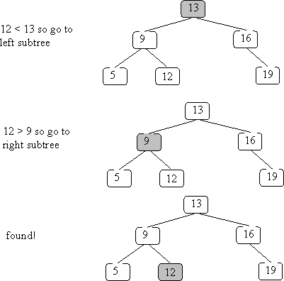

Slide 59
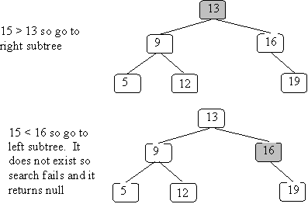
What if the key isn’t in the BST?
Search for 15:

Slide 61
How fast is insertion into a BST?
Depends on the “shape” of the tree!
We always trace a path from the root to a node (or where the node would have been). So the lookup time is limited by the longest path from a root to a leaf.
This is the tree’s height.

Slide 62
Sometimes a tree is just a linked list, with each node having only one child:
50
/
10
\
15
\
30
/
20

Slide 63
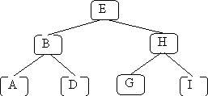
In these cases lookup time is linear (O(N)), just like linked lists.
In the best case, all leaves have the same depth:
This is a full tree.

Slide 64
A full tree with N nodes has a height equal to log₂(N).
In the tree above, there are 7 nodes, and
we never visit more than 3 nodes.
log₂(7) is essentially 3 (2.807).
We aim to keep BSTs well balanced, so a lookup time of O(log(N)) is the norm.

Slide 65
Inserting into a BST
Where does the new node go?
Just where our lookup routine will expect to find it!
public void insert(K key) throws DuplicateException {
root = insert(root, key);
}

Slide 66
We use a helper routine also named insert that returns a BST (rather than void). This covers the case in which we insert into an empty BST (denoted by null).
Duplicate keys may not be inserted (an exception is thrown).

Slide 67
private BSTnode<K>
insert(BSTnode<K> n, K key) throws DuplicateException {
if (n == null) {
return
new BSTnode<K>(key, null, null);
}
if (n.getKey().equals(key)) {
throw new DuplicateException();
}

Slide 68
if (key.compareTo(n.getKey()) < 0) {
// add key to the left subtree
n.setLeft( insert(n.getLeft(), key) );
return n;
}
else {
// add key to the right subtree
n.setRight( insert(n.getRight(), key) );
return n;
}
}

Slide 69
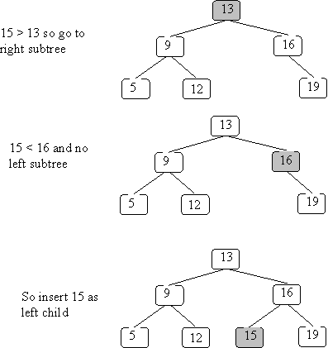
Example of insertion
We insert 15 into the BST we used earlier:

Slide 71
Insert has the same complexity as lookup – it is bounded by the longest path in the tree (usually O(log(N)).

Slide 72
Deleting from a BST
Before we can delete a node, we must first find it! Hence, our delete routine will behave like a lookup until the deletion target is found.

Slide 73
public void delete(K key) {
root = delete(root, key);
}
private BSTnode<K>
delete(BSTnode<K> n, K key) {
if (n == null) {
return null;
}
if (key.equals(n.getKey())) {
// n is the node to be removed
// code must be added here

Slide 74
else if (key.compareTo(n.getKey()) < 0) {
n.setLeft( delete(n.getLeft(), key) );
return n;
}
else {
n.setRight( delete(n.getRight(), key) );
return n;
}
}

Slide 75
What happens if we delete a key not in the BST?
Nothing!
We find where the node would have been (a subtree is null) and leave it null.

Slide 76
If the key is in the BST we have 3 possibilities:
The key is in a leaf node
The key is in a node with one child
The key is in a node with two children

Slide 77
If the node is a leaf, deletion is easy – we set the link to the deleted node to null. This can happen in 3 places:
root = delete(root, key);
n.setLeft( delete(n.getLeft(), key) );
n.setRight( delete(n.getRight(), key) );
At the deleted node, we return null, which replaces the leaf node with nothing.

Slide 78
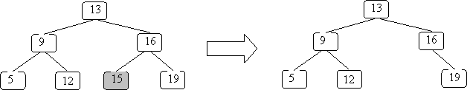
If we remove 15 from the example BST:

Slide 79
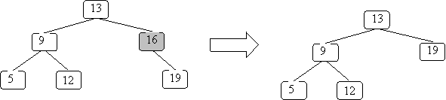
The case where a node has only one subtree is pretty easy too – you replace the node with its sole subtree:

Slide 80
Here is the code for these first two cases:
if (key.equals(n.getKey())) {
// n is the node to be removed
if (n.getLeft() == null && n.getRight() == null){
return null;
}
if (n.getLeft() == null) {
return n.getRight(); }
if (n.getRight() == null) {
return n.getLeft();}
// if we get here, then n has 2 children
// code still needs to be added here...
}

Slide 81
The case in which a node has two subtrees is the hardest – we can’t just replace the node with one tree and ignore the other!
Instead we look for a key in one of the subtrees we can put in the node and then remove that key from the subtree.
But we must preserve the ordering required in a BST.

Slide 82
Two possibilities come to mind – the largest key in the left subtree or the smallest key in the right subtree. Both are “closer” to the deleted key than any other subtree value.

Slide 83
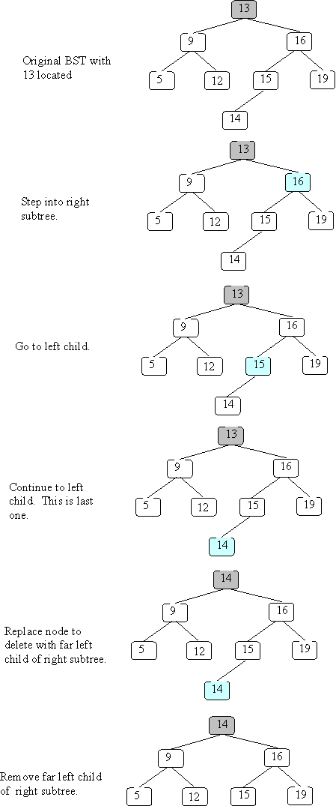
For example, in
node 13 could be overwritten with either 12 or 14.

Slide 84
We’ll arbitrarily select the smallest value in the right subtree. We replace the key to be deleted with this smallest right subtree value.
We next find the duplicate value in the right subtree and remove it.

Slide 85
Here is a method that finds the smallest value in a non-null BST:
private K smallest(BSTnode<K> n)
// precondition: n is not null
// postcondition: return the smallest
// value in the subtree rooted at n
{
if (n.getLeft() == null) {
return n.getKey();
} else {
return smallest(n.getLeft());
}
}

Slide 86
The code for the two children case is now straightforward:
// if we get here, then n has 2 children
K smallVal = smallest(n.getRight());
n.setKey(smallVal);
n.setRight(
delete(n.getRight(), smallVal) );
return n;

Slide 87
Example
We’ll delete 13 from the following BST:

Slide 90
Maps and Sets
Java provides several “industrial-strength” implementations of maps and sets. Two of these, TreeSet and TreeMap, are implemented using BSTs.

Slide 91
A set simply keeps track of what values are in the set. In Java, the Set interface is implemented (in several ways).
One use of a set is a simple spell-checker. It loads valid words into a set and checks spelling by checking membership in the valid word set.
(More thorough checkers know about variations of a word, like plurals and tenses).

Slide 92
Set<String> dictionary = new TreeSet<String>();
Set<String> misspelled = new TreeSet<String>();
// Create a set of "good" words.
while (...) {
String goodWord = ...;
dictionary.add(goodWord);
}
// Look up various other words
while (...) {
String word = ...;
if (! dictionary.contains(word)) {
misspelled.add(word);
}
}

Slide 93
Maps are used to store information relating to a key value. The structure “maps” a key into a result.
One application of a map is to count the number of times a word appears in a document.
(This is similar to the “word-cloud” of project 3.)

Slide 94
public class CountWords {
Map<String, Integer> wordCount =
new TreeMap<String, Integer>();
...
Scanner in =
new Scanner(new File(args[0]));
in.useDelimiter("\\W+");
...

Slide 95
while (in.hasNext()) {
String word = in.next();
Integer count = wordCount.get(word);
if (count == null) {
wordCount.put(word, 1);
} else {
wordCount.put(word, count + 1);}
}
for (String word : wordCount.keySet()) {
System.out.println(word + " " +
count.get(word));
}
} // CountWords}

