Slide 1
CS 367 Introduction to Data Structures
Lecture 12

Slide 2
Today’s Topics
Trees
Binary Trees
Binary Search Trees

Slide 3

Level-order
The idea of a level-order traversal is to visit the root, then visit all nodes "1 level away" (depth 2) from the root (left to right), then all nodes "2 levels away" (depth 3) from the root, etc. For the example tree, the goal is to visit the nodes in the following order:

Slide 4
To do a level-order traversal, we need to use a queue rather than just simple recursion:
Q.enqueue(root);
while (! Q.empty()) {
Treenode<T> n = Q.dequeue();
System.out.print(n.getData());
ListADT<Treenode<T>> kids =
n.getChildren();
Iterator<Treenode<T>> it =
kids.iterator();
while (it.hasNext()) {
Q.enqueue(it.next());
}
}

Slide 5


Slide 6
In-order
For binary trees, we can specify a traversal order that visits the root “in between.” visiting children:
perform an in-order traversal of the left subtree of the root
visit the root
perform an in-order traversal of the right subtree of the root
For our example tree we get:
D B A E G C H F I

Slide 7
Binary Search Trees
A binary search tree (BST) is a special kind of binary tree designed to facilitate searching.
Each node contains a key (and maybe some data). For each node n is the BST:
All keys in n's left subtree are less than the key in n, and
All keys in n's right subtree are greater than the key in n.

Slide 8
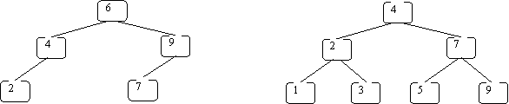
We normally assume that keys are unique. Here are some BSTs:

Slide 9
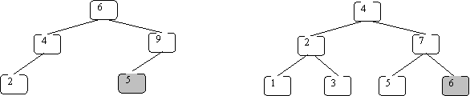
These are invalid BSTs:
Why?

Slide 10
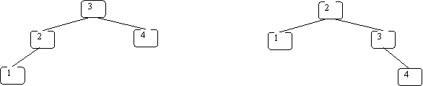
BSTs need not be unique
Both of the BSTs below store the same set of keys:

Slide 11
Operations supported by BSTs
The following operations can be implemented efficiently using a BST:
insert a key value
determine whether a key value is in the tree
remove a key value from the tree
print all of the key values in sorted order

Slide 12
Implementing BSTs in Java
We define a class for one tree node (BSTNode) and another for the entire tree (BST):

Slide 13
class BSTnode<K> {
// *** fields ***
private K key;
private BSTnode<K> left, right;
// *** constructor ***
public BSTnode(K key,
BSTnode<K> left,
BSTnode<K> right) {
this.key = key;
this.left = left;
this.right = right; }

Slide 14
// accessors (access to fields)
public K getKey() { return key; }
public BSTnode<K> getLeft() { return left; }
public BSTnode<K> getRight() { return right; }
// mutators (change fields)
public void setKey(K newK) { key = newK; }
public void setLeft(BSTnode<K> newL) {
left = newL; }
public void setRight(BSTnode<K> newR) {
right = newR; }
}

Slide 15
public class BST<K extends
Comparable<K>> {
// *** fields ***
private BSTnode<K> root;
// ptr to the root of the BST
// *** constructor ***
public BST() { root = null; }

Slide 16
public void insert(K key) throws DuplicateException
{ ... }
// add key to this BST; error if it is already there
public void delete(K key) { ... }
// remove node containing key from BST if there;
// otherwise, do nothing
public boolean lookup(K key) { ... }
// if key is in BST, return true; else, return false
public void print(PrintStream p) { ... }
// print the values in BST in sorted order (to p)
}

Slide 17
Key-Value Pairs in BSTs
We add a value field to the BSTnode and BST classes:
class BSTnode<K, V> {
private K key;
private V value;
private BSTnode<K, V> left, right;

Slide 18
// *** constructor ***
public BSTnode(K key, V value,
BSTnode<K, V> left,
BSTnode<K, V> right) {
this.key = key;
this.value = value;
this.left = left;
this.right = right; }

Slide 19
// *** methods ***
...
public V getValue() { return value; }
public void setValue(V newV) { value = newV; }
...

Slide 20
public class BST<K extends Comparable<K>, V> {
// *** fields ***
private BSTnode<K, V> root;
// ptr to the root of the BST
// *** constructor ***
public BST() { root = null; }

Slide 21
public void insert(K key, V value) throws DuplicateException {...}
// add key and value to this BST;
// error if key is already there
public void delete(K key) {...}
// remove node containing key if there
// otherwise, do nothing
public V lookup(K key) {...}
// if key is in BST, return associated
// value; otherwise, return null

Slide 22
The lookup Method
Given a BST and a key, the node we want may be:
In the root
In the left subtree
In the right subtree

Slide 23
There are two base cases:
Tree is empty – return false
Key is in root node – return true
Otherwise, we search the left subtree or the right subtree, but not both!
Why?
All values less than key are in left subtree; all values greater are in right subtree

Slide 24
We start the lookup at the root of the BST (note use of auxiliary method also named lookup):
public boolean lookup(K key) {
return lookup(root, key);
}

Slide 25
private boolean lookup(BSTnode<K> n, K key) {
if (n == null) {
return false; }
if (n.getKey().equals(key)) {
return true; }
if (key.compareTo(n.getKey()) < 0) {
// key < node's key; look in left subtree
return lookup(n.getLeft(), key); }
else {
// key > node's key; look in right subtree
return lookup(n.getRight(), key);
}
}

Slide 26
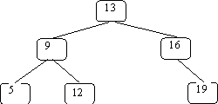
An Example
We’ll search for 12 in:

Slide 27
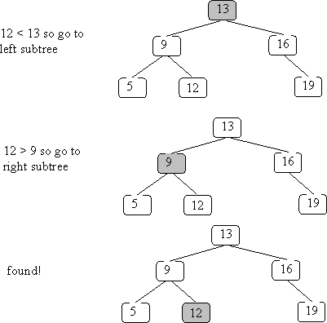

Slide 30
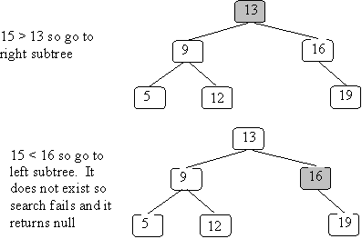
What if the key isn’t in the BST?
Search for 15:

Slide 32
How fast is lookup in a BST?
Depends on the “shape” of the tree!
We always trace a path from the root to a node (or where the node would have been). So the lookup time is limited by the longest path from a root to a leaf.
This is the tree’s height.

Slide 33
Sometimes a tree is just a linked list, with each node having only one child:
50
/
10
\
15
\
30
/
20

Slide 34
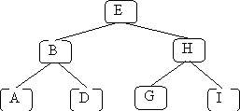
In these cases lookup time is linear (O(N)), just like linked lists.
In the best case, all leaves have the same depth:
This is a full tree.

Slide 35
A full tree with N nodes has a height equal to log₂(N).
In the tree above, there are 7 nodes, and
we never visit more than 3 nodes.
log₂(7) is essentially 3 (2.807).
We aim to keep BSTs well balanced, so a lookup time of O(log(N)) is the norm.

Slide 36
Inserting into a BST
Where does the new node go?
Just where our lookup routine will expect to find it!
public void insert(K key) throws DuplicateException {
root = insert(root, key);
}

Slide 37
We use a helper routine also named insert that returns a BST (rather than void). This covers the case in which we insert into an empty BST (denoted by null).
Duplicate keys may not be inserted (an exception is thrown).

Slide 38
private BSTnode<K>
insert(BSTnode<K> n, K key) throws DuplicateException {
if (n == null) {
return
new BSTnode<K>(key, null, null);
}
if (n.getKey().equals(key)) {
throw new DuplicateException();
}

Slide 39
if (key.compareTo(n.getKey()) < 0) {
// add key to the left subtree
n.setLeft( insert(n.getLeft(), key) );
return n;
}
else {
// add key to the right subtree
n.setRight( insert(n.getRight(), key) );
return n;
}
}

Slide 40
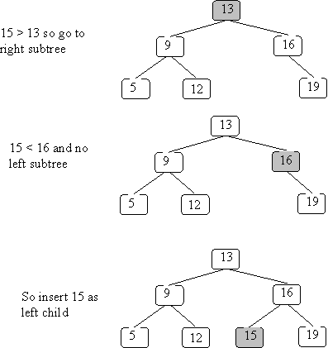
Example of insertion
We insert 15 into the BST we used earlier:

Slide 42
Insert has the same complexity as lookup – it is bounded by the longest path in the tree (usually O(log(N)).

Slide 43
Deleting from a BST
Before we can delete a node, we must first find it! Hence, our delete routine will behave like a lookup until the deletion target is found.

Slide 44
public void delete(K key) {
root = delete(root, key);
}
private BSTnode<K>
delete(BSTnode<K> n, K key) {
if (n == null) {
return null;
}
if (key.equals(n.getKey())) {
// n is the node to be removed
// code must be added here

Slide 45
else if (key.compareTo(n.getKey()) < 0) {
n.setLeft( delete(n.getLeft(), key) );
return n;
}
else {
n.setRight( delete(n.getRight(), key) );
return n;
}
}

Slide 46
What happens if we delete a key not in the BST?
Nothing!
We find where the node would have been (a subtree is null) and leave it null.

Slide 47
If the key is in the BST we have 3 possibilities:
The key is in a leaf node
The key is in a node with one child
The key is in a node with two children

Slide 48
If the node is a leaf, deletion is easy – we set the link to the deleted node to null. This can happen in 3 places:
root = delete(root, key);
n.setLeft( delete(n.getLeft(), key) );
n.setRight( delete(n.getRight(), key) );
At the deleted node, we return null, which replaces the leaf node with nothing.

Slide 49
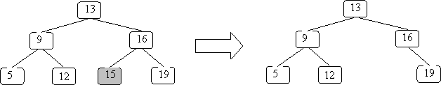
If we remove 15 from the example BST:

Slide 50
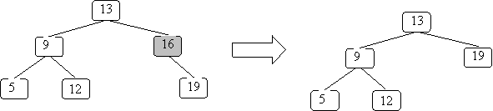
The case where a node has only one subtree is pretty easy too – you replace the node with its sole subtree:

Slide 51
Here is the code for these first two cases:
if (key.equals(n.getKey())) {
// n is the node to be removed
if (n.getLeft() == null && n.getRight() == null){
return null;
}
if (n.getLeft() == null) {
return n.getRight(); }
if (n.getRight() == null) {
return n.getLeft();}
// if we get here, then n has 2 children
// Code still needs to be added here...
}

Slide 52
The case in which a node has two subtrees is the hardest – we can’t just replace the node with one tree and ignore the other!
Instead we look for a key in one of the subtrees we can put in the node and then remove that key from the subtree.
But we must preserve the ordering required in a BST.

Slide 53
Two possibilities come to mind – the largest key in the left subtree or the smallest key in the right subtree. Both are “closer” to the deleted key than any other subtree value.

Slide 54
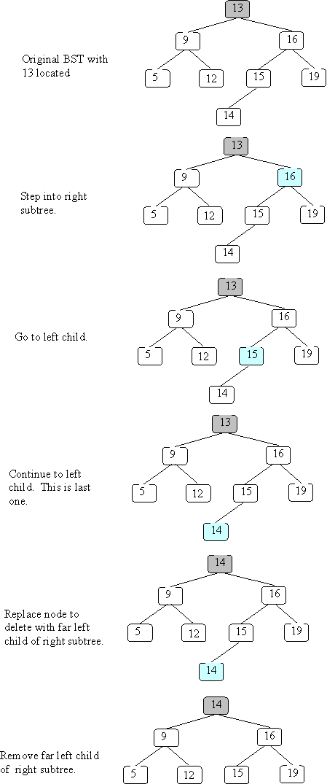
For example, in
node 13 could be overwritten with either 12 or 14.

Slide 55
We’ll arbitrarily select the smallest value in the right subtree. We replace the key to be deleted with this smallest right subtree value.
We next find the duplicate value in the right subtree and remove it.

Slide 56
Here is a method that finds the smallest value in a non-null BST:
private K smallest(BSTnode<K> n)
// precondition: n is not null
// postcondition: return the smallest
// value in the subtree rooted at n
{
if (n.getLeft() == null) {
return n.getKey();
} else {
return smallest(n.getLeft());
}
}

Slide 57
The code for the two children case is now straightforward:
// if we get here, then n has 2 children
K smallVal = smallest(n.getRight());
n.setKey(smallVal);
n.setRight(
delete(n.getRight(), smallVal) );
return n;

Slide 58
Example
We’ll delete 13 from the following BST:

Slide 61
Maps and Sets
Java provides several “industrial-strength” implementations of maps and sets. Two of these, TreeSet and TreeMap, are implemented using BSTs.

Slide 62
A set simply keeps track of what values are in the set. In Java, the Set interface is implemented (in several ways).
One use of a set is a simple spell-checker. It loads valid words into a set and checks spelling by checking membership in the valid word set.
(More thorough checkers know about variations of a word, like plurals and tenses).

Slide 63
Set<String> dictionary = new TreeSet<String>();
Set<String> misspelled = new TreeSet<String>();
// Create a set of "good" words.
while (...) {
String goodWord = ...;
dictionary.add(goodWord);
}
// Look up various other words
while (...) {
String word = ...;
if (! dictionary.contains(word)) {
misspelled.add(word);
}
}

Slide 64
Maps are used to store information relating to a key value. The structure “maps” a key into a result.
One application of a map is to count the number of times a word appears in a document.
(This is similar to the “word-cloud” of project 3.)

Slide 65
public class CountWords {
Map<String, Integer> wordCount =
new TreeMap<String, Integer>();
...
Scanner in =
new Scanner(new File(args[0]));
in.useDelimiter("\\W+");
...

Slide 66
while (in.hasNext()) {
String word = in.next();
Integer count = wordCount.get(word);
if (count == null) {
wordCount.put(word, 1);
} else {
wordCount.put(word, count + 1);}
}
for (String word : wordCount.keySet()) {
System.out.println(word + " " +
count.get(word));
}
} // CountWords}

