Slide 1
CS 367 Introduction to Data Structures
Lecture 13

Slide 2
Today:
Binary Search Trees
Priority Queues and Heaps

Slide 3
The lookup Method
Given a BST and a key, the node we want may be:
In the root
In the left subtree
In the right subtree

Slide 4
There are two base cases:
Tree is empty – return false
Key is in root node – return true
Otherwise, we search the left subtree or the right subtree, but not both!
Why?
All values less than key are in left subtree; all values greater are in right subtree

Slide 5
We start the lookup at the root of the BST (note use of auxiliary method also named lookup):
public boolean lookup(K key) {
return lookup(root, key);
}

Slide 6
private boolean lookup(BSTnode<K> n, K key) {
if (n == null) {
return false; }
if (n.getKey().equals(key)) {
return true; }
if (key.compareTo(n.getKey()) < 0) {
// key < node's key; look in left subtree
return lookup(n.getLeft(), key); }
else {
// key > node's key; look in right subtree
return lookup(n.getRight(), key);
}
}

Slide 7
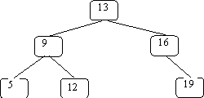
An Example
We’ll search for 12 in:

Slide 8
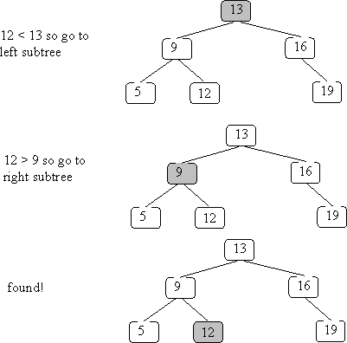

Slide 11
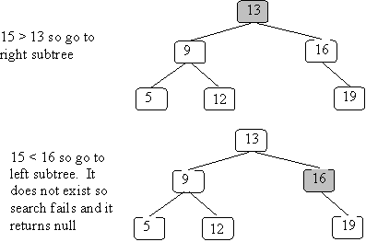
What if the key isn’t in the BST?
Search for 15:

Slide 13
How fast is lookup in a BST?
Depends on the “shape” of the tree!
We always trace a path from the root to a node (or where the node would have been). So the lookup time is limited by the longest path from a root to a leaf.
This is the tree’s height.

Slide 14
Sometimes a tree is just a linked list, with each node having only one child:
50
/
10
\
15
\
30
/
20

Slide 15
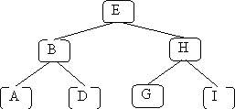
In these cases lookup time is linear (O(N)), just like linked lists.
In the best case, all leaves have the same depth:
This is a full tree.

Slide 16
A full tree with N nodes has a height equal to log₂(N).
In the tree above, there are 7 nodes, and
we never visit more than 3 nodes.
log₂(7) is essentially 3 (2.807).
We aim to keep BSTs well balanced, so a lookup time of O(log(N)) is the norm.

Slide 17
Inserting into a BST
Where does the new node go?
Just where our lookup routine will expect to find it!
public void insert(K key) throws DuplicateException {
root = insert(root, key);
}

Slide 18
We use a helper routine also named insert that returns a BST (rather than void). This covers the case in which we insert into an empty BST (denoted by null).
Duplicate keys may not be inserted (an exception is thrown).

Slide 19
private BSTnode<K>
insert(BSTnode<K> n, K key) throws DuplicateException {
if (n == null) {
return
new BSTnode<K>(key, null, null);
}
if (n.getKey().equals(key)) {
throw new DuplicateException();
}

Slide 20
if (key.compareTo(n.getKey()) < 0) {
// add key to the left subtree
n.setLeft( insert(n.getLeft(), key) );
return n;
}
else {
// add key to the right subtree
n.setRight( insert(n.getRight(), key) );
return n;
}
}

Slide 21
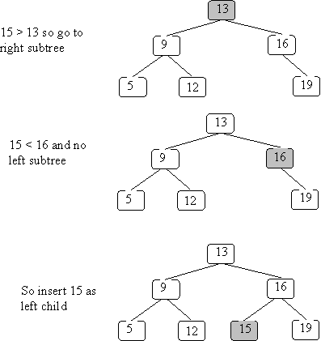
Example of insertion
We insert 15 into the BST we used earlier:

Slide 23
Insert has the same complexity as lookup – it is bounded by the longest path in the tree (usually O(log(N)).

Slide 24
Deleting from a BST
Before we can delete a node, we must first find it! Hence, our delete routine will behave like a lookup until the deletion target is found.

Slide 25
public void delete(K key) {
root = delete(root, key);
}
private BSTnode<K>
delete(BSTnode<K> n, K key) {
if (n == null) {
return null;
}
if (key.equals(n.getKey())) {
// n is the node to be removed
// code must be added here

Slide 26
else if (key.compareTo(n.getKey()) < 0) {
n.setLeft( delete(n.getLeft(), key) );
return n;
}
else {
n.setRight( delete(n.getRight(), key) );
return n;
}
}

Slide 27
What happens if we delete a key not in the BST?
Nothing!
We find where the node would have been (a subtree is null) and leave it null.

Slide 28
If the key is in the BST we have 3 possibilities:
The key is in a leaf node
The key is in a node with one child
The key is in a node with two children

Slide 29
If the node is a leaf, deletion is easy – we set the link to the deleted node to null. This can happen in 3 places:
root = delete(root, key);
n.setLeft( delete(n.getLeft(), key) );
n.setRight( delete(n.getRight(), key) );
At the deleted node, we return null, which replaces the leaf node with nothing.

Slide 30
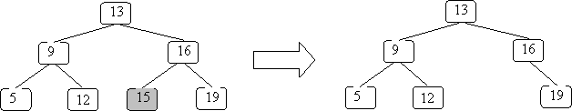
If we remove 15 from the example BST:

Slide 31
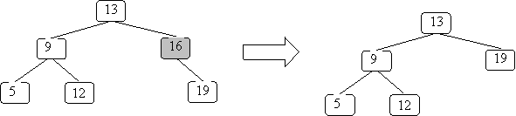
The case where a node has only one subtree is pretty easy too – you replace the node with its sole subtree:

Slide 32
Here is the code for these first two cases:
if (key.equals(n.getKey())) {
// n is the node to be removed
if (n.getLeft() == null && n.getRight() == null){
return null;
}
if (n.getLeft() == null) {
return n.getRight(); }
if (n.getRight() == null) {
return n.getLeft();}
// if we get here, then n has 2 children
// Code still needs to be added here...
}

Slide 33
The case in which a node has two subtrees is the hardest – we can’t just replace the node with one tree and ignore the other!
Instead we look for a key in one of the subtrees we can put in the node and then remove that key from the subtree.
But we must preserve the ordering required in a BST.

Slide 34
Two possibilities come to mind – the largest key in the left subtree or the smallest key in the right subtree. Both are “closer” to the deleted key than any other subtree value.

Slide 35
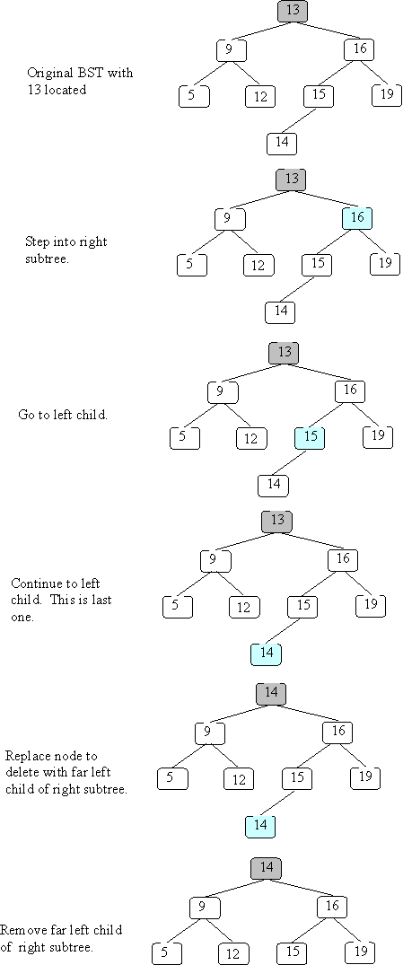
For example, in
node 13 could be overwritten with either 12 or 14.

Slide 36
We’ll arbitrarily select the smallest value in the right subtree. We replace the key to be deleted with this smallest right subtree value.
We next find the duplicate value in the right subtree and remove it.

Slide 37
Here is a method that finds the smallest value in a non-null BST:
private K smallest(BSTnode<K> n)
// precondition: n is not null
// postcondition: return the smallest
// value in the subtree rooted at n
{
if (n.getLeft() == null) {
return n.getKey();
} else {
return smallest(n.getLeft());
}
}

Slide 38
The code for the two children case is now straightforward:
// if we get here, then n has 2 children
K smallVal = smallest(n.getRight());
n.setKey(smallVal);
n.setRight(
delete(n.getRight(), smallVal) );
return n;

Slide 39
Example
We’ll delete 13 from the following BST:

Slide 42
Maps and Sets
Java provides several “industrial-strength” implementations of maps and sets. Two of these, TreeSet and TreeMap, are implemented using BSTs.

Slide 43
A set simply keeps track of what values are in the set. In Java, the Set interface is implemented (in several ways).
One use of a set is a simple spell-checker. It loads valid words into a set and checks spelling by checking membership in the valid word set.
(More thorough checkers know about variations of a word, like plurals and tenses).

Slide 44
Set<String> dictionary = new TreeSet<String>();
Set<String> misspelled = new TreeSet<String>();
// Create a set of "good" words.
while (...) {
String goodWord = ...;
dictionary.add(goodWord);
}
// Look up various other words
while (...) {
String word = ...;
if (! dictionary.contains(word)) {
misspelled.add(word);
}
}

Slide 45
Maps are used to store information relating to a key value. The structure “maps” a key into a result.
One application of a map is to count the number of times a word appears in a document.
(This is similar to the “word-cloud” of project 3.)

Slide 46
public class CountWords {
Map<String, Integer> wordCount =
new TreeMap<String, Integer>();
...
Scanner in =
new Scanner(new File(args[0]));
in.useDelimiter("\\W+");
...

Slide 47
while (in.hasNext()) {
String word = in.next();
Integer count = wordCount.get(word);
if (count == null) {
wordCount.put(word, 1);
} else {
wordCount.put(word, count + 1);}
}
for (String word : wordCount.keySet()) {
System.out.println(word + " " +
count.get(word));
}
} // CountWords}

Slide 48
Priority Queues
A priority queue is a variation of ordinary queues. Items are added with a priority.
Items are removed in priority order.
For example, emergency rooms operate as priority queues, with the most serious injuries treated first.

Slide 49
A priority queue implements the following operations:
boolean isEmpty()
return true iff the PriorityQueue is empty
void insert(Comparable p)
add priority p to the PriorityQueue

Slide 50
Comparable removeMax()
remove and return the highest priority from the PriorityQueue (error if the PriorityQueue is empty)
Comparable getMax()
return the highest priority from the PriorityQueue, but do not remove it (error if the PriorityQueue is empty)

Slide 51
For getMax or removeMax any entry with the highest priority may be returned.
What if we want some notion of LIFO or FIFO?
Adjust priorities to reflect “tie breaker”

Slide 52
How should we implement a Priority Queue?
How about using a list?
If it’s ordered, removeMax is easy,
but insert is expensive
If it’s unordered, removeMax is expensive
How about a BST?
If the BST becomes unbalanced insert and removeMax both become expensive!

Slide 53
We might use red-black trees, but these are pretty complicated.
Any other option?
Yes, a heap!

Slide 54
Heaps
A heap is a binary tree (in which each node contains a Comparable key value), with two special properties:

Slide 55
The ORDER property:
For every node N, the value in N is greater than or equal to the values in its children (and thus is also greater than or equal to all of the values in its subtrees).

Slide 56
The SHAPE property:
All leaves are either at depth d or d-1 (for some value d).
All of the leaves at depth d-1 are to the right of the leaves at depth d.
(a) There is at most 1 node with just 1 child.
(b) That child is the left child of its parent, and
(c) it is the rightmost leaf at depth d.

Slide 57
The shape property just says that a heap is a BST built in a very special way.
Nodes are always added in level order:
First the root is added.
Then the two nodes at level 2, in left-to-right order.
Then the four nodes at level 3, in left-to-right order.

Slide 58
Why this odd order?
Because we can visit parents or children without pointers!

Slide 59
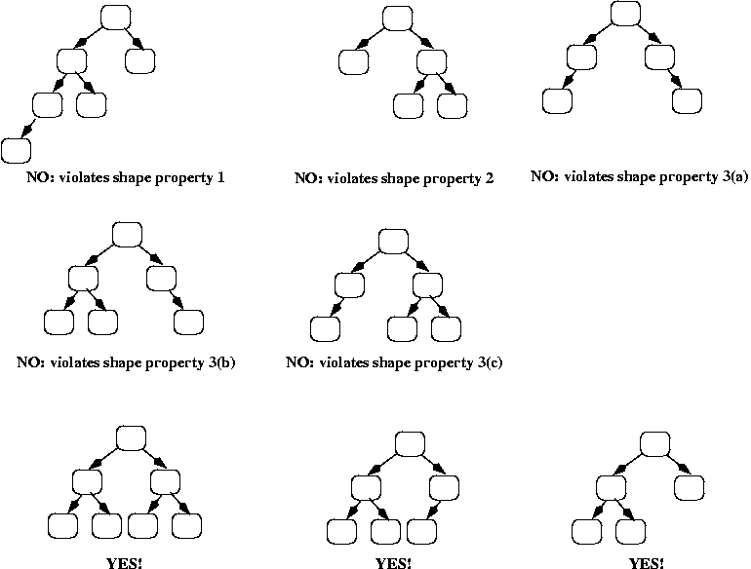
Examples

Slide 61
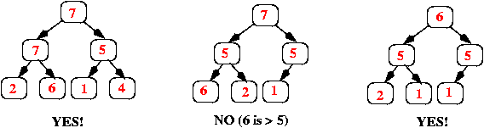
And here are some more trees; they all have the shape property but some violate the order property:

Slide 62
Implementing a Priority Queue using a Heap
We will use an array (or an ArrayList), starting at position 1 (instead of 0), where each item in the array corresponds to one node in the heap as follows:
The root of the heap is always in array[1].
Its left child is in array[2].
Its right child is in array[3].

Slide 63
In general, if a node is in array[k], then its left child is in array[k*2] and its right child is in array[k*2 + 1].
If a node is in array[k], then its parent is in array[k/2] (using integer division, so that if k is odd, then the result is truncated, e.g., 3/2 = 1).

Slide 64
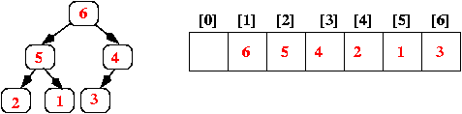
Here's an example, showing both the conceptual heap (the binary tree) and its array representation:
Note that the heap's shape property guarantees that there are never any "holes" in the array.

Slide 65
Implementing Insert
When a new value is inserted into a heap, we need to:
add the value so that the heap still has the order and shape properties, and
do it efficiently!

Slide 66
Add the new value at the end of the array; that corresponds to adding it as a new rightmost leaf in the tree (or, if the tree was a full binary tree, i.e., all leaves were at the same depth d, then that corresponds to adding a new leaf at depth d+1).
Step 1 above ensures that the heap still has the shape property; however, it may not have the order property. We can check that by comparing the new value to the value in its parent. If the parent is smaller, we swap the values, and we continue this check-and-swap procedure up the tree until we find that the order property holds, or we get to the root.

Slide 67
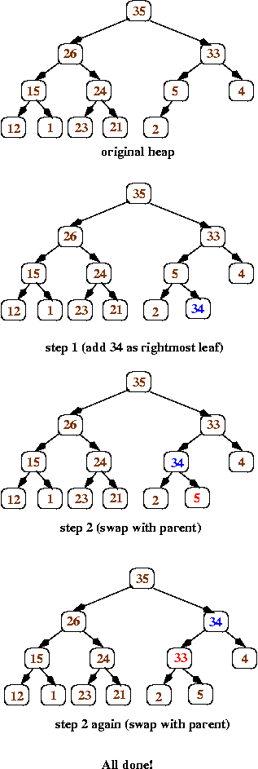
Here's a series of pictures to illustrate inserting the value 34 into a heap:

Slide 69
Implementing getMax and removeMax
Heaps have the order property – the max is always at the root!
getMax is trivial!
removeMax does a getMax, and then removes the root node.
But how?

Slide 70
We must maintain the shape and order properties.
We do the following:
Replace the value in the root with the value at the end of the array (which corresponds to the heap's rightmost leaf at depth d). Remove that leaf from the tree.
(Shape property preserved)

Slide 71
Now work your way down the tree, swapping values to restore the order property: each time, if the value in the current node is less than one of its children, then swap its value with the larger child (that ensures that the new root value is larger than both of its children).

Slide 72
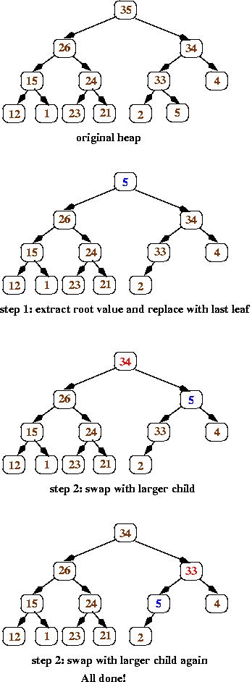
Here’s an illustration of removeMax:

Slide 74
Complexity of Priority Queues
Insert:
Add element at end of array – O(1)
Swap elements up tree to restore order – O(log n) since tree is balanced
Overall – O(log n)

Slide 75
removeMax:
Replace root with end of array element – O(1)
Swap elements to restore order – O(log n) since tree is balanced
Overall – O(log n)

