Slide 1
CS 367 Introduction to Data Structures
Lecture 14

Slide 2
Today:
Midterm, Thursday March 15, 7:15-9:15 PM, 1361 Chemistry
Review session, in class, March 15
How to build in-order BST Iterator
How to display a tree
Priority Queues and Heaps
Red-black trees

Slide 3
Maps and Sets
Java provides several “industrial-strength” implementations of maps and sets. Two of these, TreeSet and TreeMap, are implemented using BSTs.

Slide 4
A set simply keeps track of what values are in the set. In Java, the Set interface is implemented (in several ways).
One use of a set is a simple spell-checker. It loads valid words into a set and checks spelling by checking membership in the valid word set.
(More thorough checkers know about variations of a word, like plurals and tenses).

Slide 5
Set<String> dictionary = new TreeSet<String>();
Set<String> misspelled = new TreeSet<String>();
// Create a set of "good" words.
while (...) {
String goodWord = ...;
dictionary.add(goodWord);
}
// Look up various other words
while (...) {
String word = ...;
if (! dictionary.contains(word)) {
misspelled.add(word);
}
}

Slide 6
Maps are used to store information relating to a key value. The structure “maps” a key into a result.
One application of a map is to count the number of times a word appears in a document.
(This is similar to the “word-cloud” of project 3.)

Slide 7
public class CountWords {
Map<String, Integer> wordCount =
new TreeMap<String, Integer>();
...
Scanner in =
new Scanner(new File(args[0]));
in.useDelimiter("\\W+");
...

Slide 8
while (in.hasNext()) {
String word = in.next();
Integer count = wordCount.get(word);
if (count == null) {
wordCount.put(word, 1);
} else {
wordCount.put(word, count + 1);}
}
for (String word : wordCount.keySet()) {
System.out.println(word + " " +
count.get(word));
}
} // CountWords}

Slide 9
Priority Queues
A priority queue is a variation of ordinary queues. Items are added with a priority.
Items are removed in priority order.
For example, emergency rooms operate as priority queues, with the most serious injuries treated first.

Slide 10
A priority queue implements the following operations:
boolean isEmpty()
return true iff the PriorityQueue is empty
void insert(Comparable p)
add priority p to the PriorityQueue

Slide 11
Comparable removeMax()
remove and return the highest priority from the PriorityQueue (error if the PriorityQueue is empty)
Comparable getMax()
return the highest priority from the PriorityQueue, but do not remove it (error if the PriorityQueue is empty)

Slide 12
For getMax or removeMax any entry with the highest priority may be returned.
What if we want some notion of LIFO or FIFO?
Adjust priorities to reflect “tie breaker”

Slide 13
How should we implement a Priority Queue?
How about using a list?
If it’s ordered, removeMax is easy,
but insert is expensive
If it’s unordered, removeMax is expensive
How about a BST?
If the BST becomes unbalanced insert and removeMax both become expensive!

Slide 14
We might use red-black trees, but these are pretty complicated.
Any other option?
Yes, a heap!

Slide 15
Heaps
A heap is a binary tree (in which each node contains a Comparable key value), with two special properties:

Slide 16
The ORDER property:
For every node N, the value in N is greater than or equal to the values in its children (and thus is also greater than or equal to all of the values in its subtrees).

Slide 17
The SHAPE property:
All leaves are either at depth d or d-1 (for some value d).
All of the leaves at depth d-1 are to the right of the leaves at depth d.
(a) There is at most 1 node with just 1 child.
(b) That child is the left child of its parent, and
(c) it is the rightmost leaf at depth d.

Slide 18
The shape property just says that a heap is a BST built in a very special way.
Nodes are always added in level order:
First the root is added.
Then the two nodes at level 2, in left-to-right order.
Then the four nodes at level 3, in left-to-right order.

Slide 19
Why this odd order?
Because we can visit parents or children without pointers!

Slide 20
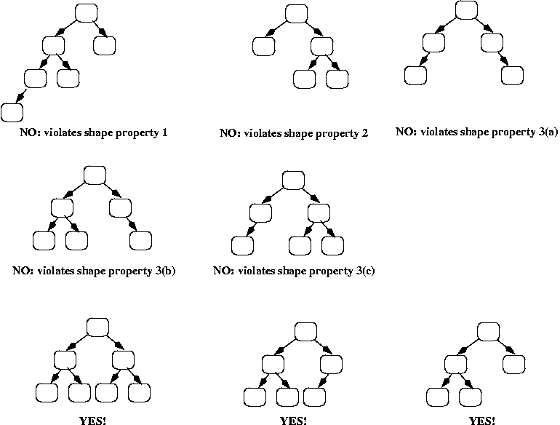
Examples

Slide 22
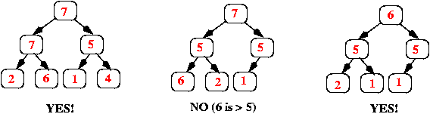
And here are some more trees; they all have the shape property but some violate the order property:

Slide 23
Implementing a Priority Queue using a Heap
We will use an array (or an ArrayList), starting at position 1 (instead of 0), where each item in the array corresponds to one node in the heap as follows:
The root of the heap is always in array[1].
Its left child is in array[2].
Its right child is in array[3].

Slide 24
In general, if a node is in array[k], then its left child is in array[k*2] and its right child is in array[k*2 + 1].
If a node is in array[k], then its parent is in array[k/2] (using integer division, so that if k is odd, then the result is truncated, e.g., 3/2 = 1).

Slide 25
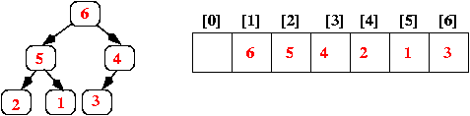
Here's an example, showing both the conceptual heap (the binary tree) and its array representation:
Note that the heap's shape property guarantees that there are never any "holes" in the array.

Slide 26
Implementing Insert
When a new value is inserted into a heap, we need to:
add the value so that the heap still has the order and shape properties, and
do it efficiently!

Slide 27
Add the new value at the end of the array; that corresponds to adding it as a new rightmost leaf in the tree (or, if the tree was a full binary tree, i.e., all leaves were at the same depth d, then that corresponds to adding a new leaf at depth d+1).
Step 1 above ensures that the heap still has the shape property; however, it may not have the order property. We can check that by comparing the new value to the value in its parent. If the parent is smaller, we swap the values, and we continue this check-and-swap procedure up the tree until we find that the order property holds, or we get to the root.

Slide 28
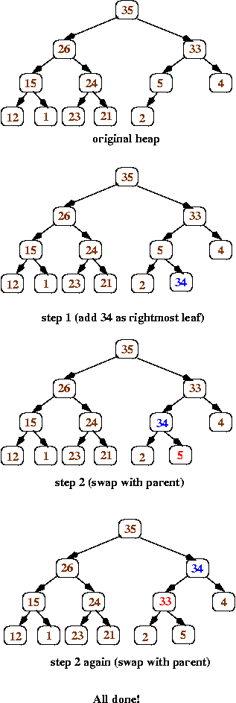
Here's a series of pictures to illustrate inserting the value 34 into a heap:

Slide 30
Implementing getMax and removeMax
Heaps have the order property – the max is always at the root!
getMax is trivial!
removeMax does a getMax, and then removes the root node.
But how?

Slide 31
We must maintain the shape and order properties.
We do the following:
Replace the value in the root with the value at the end of the array (which corresponds to the heap's rightmost leaf at depth d). Remove that leaf from the tree.
(Shape property preserved)

Slide 32
Now work your way down the tree, swapping values to restore the order property: each time, if the value in the current node is less than one of its children, then swap its value with the larger child (that ensures that the new root value is larger than both of its children).

Slide 33
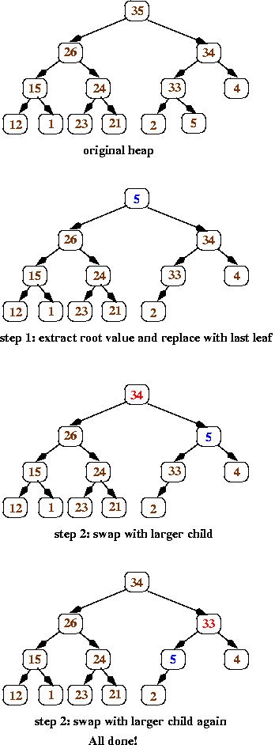
Here’s an illustration of removeMax:

Slide 35
Complexity of Priority Queues
Insert:
Add element at end of array – O(1)
Swap elements up tree to restore order – O(log n) since tree is balanced
Overall – O(log n)

Slide 36
removeMax:
Replace root with end of array element – O(1)
Swap elements to restore order – O(log n) since tree is balanced
Overall – O(log n)

Slide 37
Unbalanced BSTs
The fast access time offered by BSTs requires that the tree be balanced (or nearly so).
An unbalanced tree can have path lengths greater than O(log N).

Slide 38
Unfortunately, reasonable entry orders can lead to an unbalanced tree.
Consier keys entered in alphabetic or numeric order.
Consider keys 1, 2, 3, 4, ... :
1
1
2

Slide 39
1
1
2
2
3
3
4

Slide 40
Rebalancing a BST
We’d like to rebalance a BST if it starts to become unbalanced. Red-black trees do this.

Slide 41
Red-Black Trees
A red-black tree is simply a BST with one added property – a color (red or black).
Informally, black nodes are the “core” of the tree – nearly balanced.
Red nodes are newly added nodes. As the tree becomes unbalanced, nodes are
recolored or restructured.

Slide 42
A red-black tree must satisfy the following rules:
(root property) The root of the red-black tree is black
(red property) The children of a red node are black.
(black property) The number of black nodes on the path from the root to any null child is the same.

Slide 43
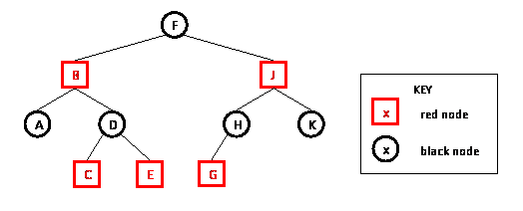
A null child is simply a null value used to mark a null subtree.

Slide 44
In a red-black tree no path from the root to a leaf can have two consecutive red nodes.
Why?
Since all paths from the root to a null child have the same number of black nodes, no path from root to a null child can differ by more than a factor of two.
Why?

Slide 45
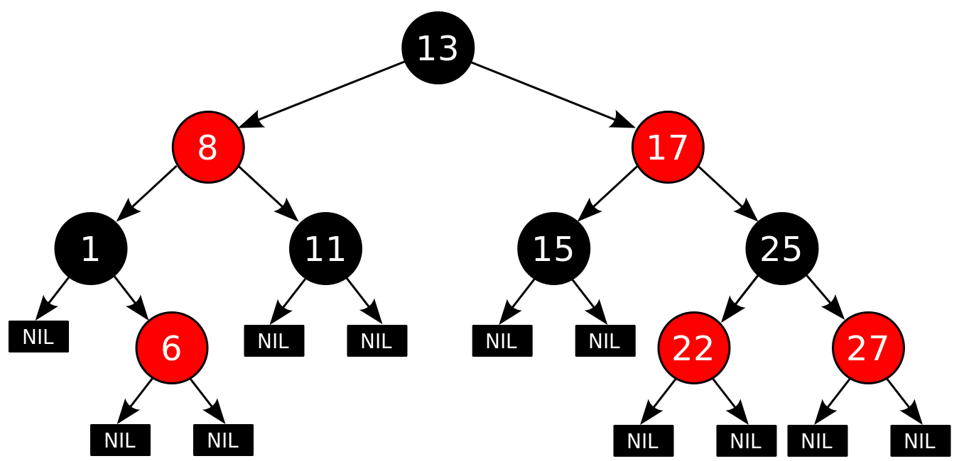
A technical detail
In a red-black tree, all null children are considered to be colored black:

Slide 46
Operations on Red-black Trees
Operations like lookup or tree traversal that don’t add or remove nodes are entirely unchanged.
Why?

Slide 47
Insertion into a Red-black Tree
A simple special case:
If the BST is empty, we insert the node as the root and color it black.
Otherwise, we know the existing BST is non-empty and has a black root.

Slide 48
Insertion operation:
Use the BST insert algorithm to add K to the tree
Color the node containing K red
Restore red-black tree properties (if necessary)

Slide 49
Assume we have just inserted K into a red-black tree.
What can go wrong?
K is red. If its parent is black, the BST is still valid!
Why?

Slide 50
If K’s parent is red, we are in violation of the red property.
We must restructure or recolor.
Call K’s parent P. (It is red.)
P must have a black parent (K’s grandparent)
Why?
Call the grandparent G.

Slide 51
P may have a sibling, S (G’s other child) or P may be an only child.
If P is an only child, or S is black, we do restructuring.
If S is red, we do recoloring.

Slide 52
Restructuring.
Look at just the three nodes, K, P and G in the BST. Four structures are possible:
G
G
G
G
P
P
P
P
K
K
K
K

Slide 53
Each of K, P and G have a distinct key value. We’ll choose the middle value and restructure so that the middle value is the new parent of the other two nodes.
Each of the 4 cases is detailed in the following slides.

Slide 54
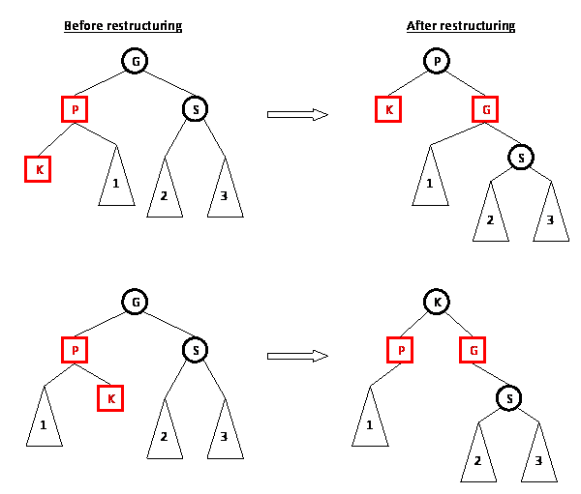
Note the recoloring of the 3 nodes.
Now it is a valid red-black tree.
Why?

Slide 55
Note the recoloring of the 3 nodes.
Now it is a valid red-black tree.
Why?

Slide 56
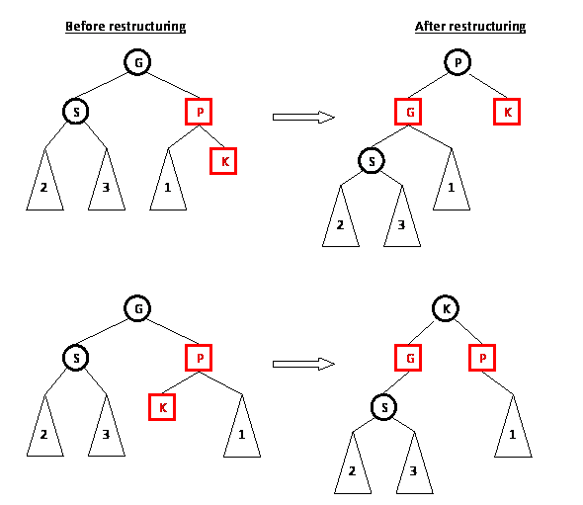
Note the recoloring of the 3 nodes.
Now it is a valid red-black tree.
Why?

Slide 57
Note the recoloring of the 3 nodes.
Now it is a valid red-black tree.
Why?

Slide 58
Recoloring
We know P and K are both red. If S, P’s sibling, is also red we do a recoloring – P and S become black:

Slide 59
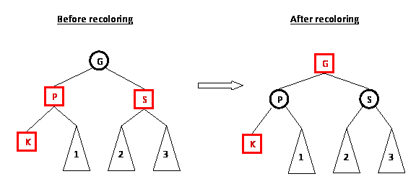
The red-red conflict between P and K is resolved.
Moreover, the count of black nodes is unchanged.

Slide 60
But, recoloring G to red might introduce a red-red conflict between G and its parent.
If so, we just reapply the restructure/recolor rules to those two nodes and resolve the problem (working up the tree toward the root).

Slide 61
Insertion Example
Recall that inserting keys in numeric or alphabetic order can create very unbalanced BSTs.
For 1,2,3,4 we got:
1
2
3
4

Slide 62
Let’s do the same insertions using red-black trees.
We insert 1 as a red node. Since it is a root, it is immediately recolored to black:
Next we insert 2 as a red node (getting a valid red-black tree):
1
1
2

Slide 63
Next we add 3 as a red node getting an invalid red-black tree:
1
2
3

Slide 64
The tree is restructured, making 2 the new root:
2
1
3

Slide 65
Now 4 is inserted as a red node, creating an invalid red-black tree:
2
1
3
4

Slide 66
Since 1, 3 and 4 are all red, we do a recoloring. Nodes 1 and 3 become black. Node 2 becomes red, then is changed back to black because it is the root.
2
1
3
4

Slide 67
Finally, 5 is added as a red node:
2
1
3
4
5

Slide 68
The 3 – 4– 5 subtree is restructured:
2
1
4
3
5

Slide 69
Class Participation
Insert the following into a red-black tree:
7, 14, 18, 23, 1, 11, 20, 29, 25, 27

Slide 70
Complexity of Insertion into a Red-black Tree
Insertion requires three steps:
An ordinary BST insertion. This is O(log n) if the tree is balanced.
Color new node red – O(1) time

Slide 71
Restore red-black properties (if needed).
Restructuring is done at most once. It is O(1) since only a limited number of
pointers are reset.
Recoloring is also O(1) but may need to be repeated up the tree. Since the tree is balanced, at most O(log n) recolorings are needed.
The overall complexity is therefore O(log n).

Slide 72
Deletion from Red-black Trees
The delete operation is similar in feel to the insert operation, but more complicated. You will not be expected to know its operation.

