Slide 1
CS 367 Introduction to Data Structures
Lecture 15

Slide 2
Today:
Midterm, Thursday March 15, 7:15-9:15 PM, 1361 Chemistry
Review session, in class, March 15
Priority Queues and Heaps
Red-black trees

Slide 3
Implementing getMax and removeMax
Heaps have the order property – the max is always at the root!
getMax is trivial!
removeMax does a getMax, and then removes the root node.
But how?

Slide 4
We must maintain the shape and order properties.
We do the following:
Replace the value in the root with the value at the end of the array (which corresponds to the heap's rightmost leaf at depth d). Remove that leaf from the tree.
(Shape property preserved)

Slide 5
Now work your way down the tree, swapping values to restore the order property: each time, if the value in the current node is less than one of its children, then swap its value with the larger child (that ensures that the new root value is larger than both of its children).

Slide 6
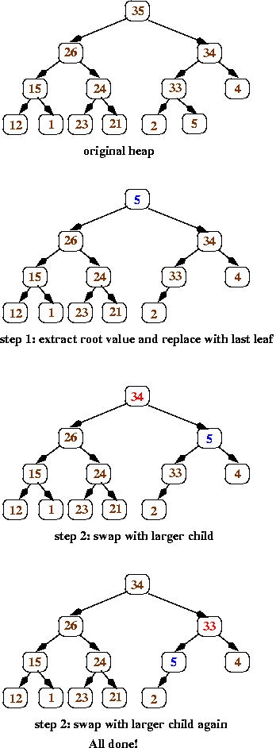
Here’s an illustration of removeMax:

Slide 8
Complexity of Priority Queues
Insert:
Add element at end of array – O(1)
Swap elements up tree to restore order – O(log n) since tree is balanced
Overall – O(log n)

Slide 9
removeMax:
Replace root with end of array element – O(1)
Swap elements to restore order – O(log n) since tree is balanced
Overall – O(log n)

Slide 10
Unbalanced BSTs
The fast access time offered by BSTs requires that the tree be balanced (or nearly so).
An unbalanced tree can have path lengths greater than O(log N).

Slide 11
Unfortunately, reasonable entry orders can lead to an unbalanced tree.
Consier keys entered in alphabetic or numeric order.
Consider keys 1, 2, 3, 4, ... :
1
1
2

Slide 12
1
1
2
2
3
3
4

Slide 13
Rebalancing a BST
We’d like to rebalance a BST if it starts to become unbalanced. Red-black trees do this.

Slide 14
Red-Black Trees
A red-black tree is simply a BST with one added property – a color (red or black).
Informally, black nodes are the “core” of the tree – nearly balanced.
Red nodes are newly added nodes. As the tree becomes unbalanced, nodes are
recolored or restructured.

Slide 15
A red-black tree must satisfy the following rules:
(root property) The root of the red-black tree is black
(red property) The children of a red node are black.
(black property) The number of black nodes on the path from the root to any null child is the same.

Slide 16
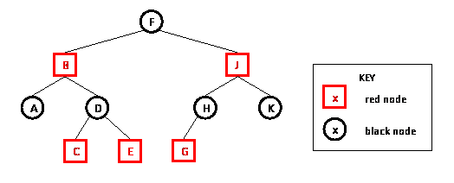
A null child is simply a null value used to mark a null subtree.

Slide 17
In a red-black tree no path from the root to a leaf can have two consecutive red nodes.
Why?
Since all paths from the root to a null child have the same number of black nodes, no path from root to a null child can differ by more than a factor of two.
Why?

Slide 18
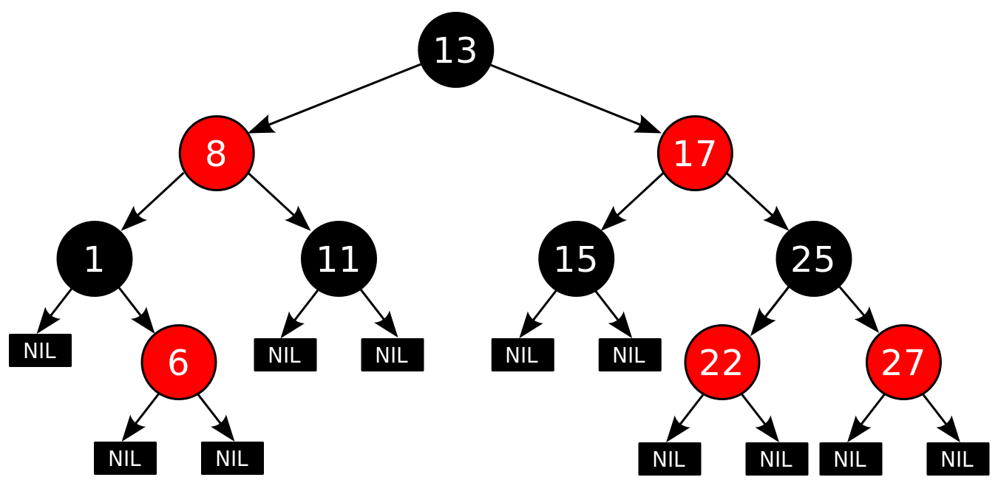
A technical detail
In a red-black tree, all null children are considered to be colored black:

Slide 19
Operations on Red-black Trees
Operations like lookup or tree traversal that don’t add or remove nodes are entirely unchanged.
Why?

Slide 20
Insertion into a Red-black Tree
A simple special case:
If the BST is empty, we insert the node as the root and color it black.
Otherwise, we know the existing BST is non-empty and has a black root.

Slide 21
Insertion operation:
Use the BST insert algorithm to add K to the tree
Color the node containing K red
Restore red-black tree properties (if necessary)

Slide 22
Assume we have just inserted K into a red-black tree.
What can go wrong?
K is red. If its parent is black, the BST is still valid!
Why?

Slide 23
If K’s parent is red, we are in violation of the red property.
We must restructure or recolor.
Call K’s parent P. (It is red.)
P must have a black parent (K’s grandparent)
Why?
Call the grandparent G.

Slide 24
P may have a sibling, S (G’s other child) or P may be an only child.
If P is an only child, or S is black, we do restructuring.
If S is red, we do recoloring.

Slide 25
Restructuring.
Look at just the three nodes, K, P and G in the BST. Four structures are possible:
G
G
G
G
P
P
P
P
K
K
K
K

Slide 26
Each of K, P and G have a distinct key value. We’ll choose the middle value and restructure so that the middle value is the new parent of the other two nodes.
Each of the 4 cases is detailed in the following slides.

Slide 27
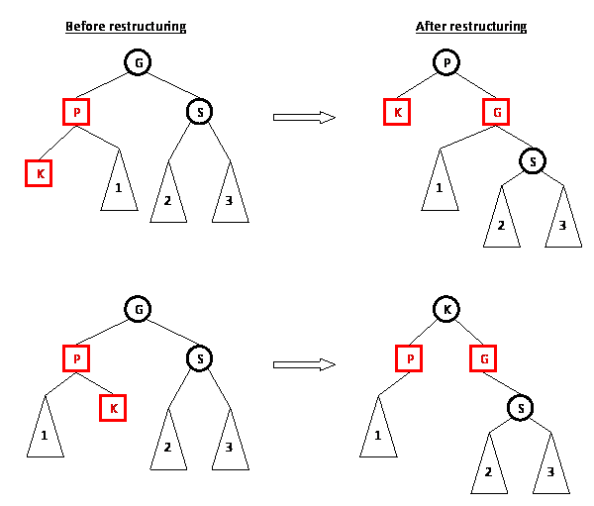
Note the recoloring of the 3 nodes.
Now it is a valid red-black tree.
Why?

Slide 28
Note the recoloring of the 3 nodes.
Now it is a valid red-black tree.
Why?

Slide 29
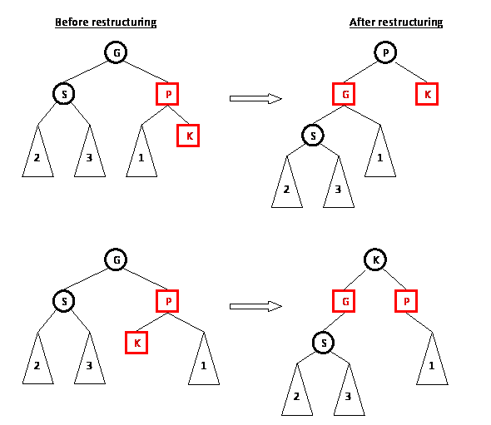
Note the recoloring of the 3 nodes.
Now it is a valid red-black tree.
Why?

Slide 30
Note the recoloring of the 3 nodes.
Now it is a valid red-black tree.
Why?

Slide 31
Recoloring
We know P and K are both red. If S, P’s sibling, is also red we do a recoloring – P and S become black:

Slide 32
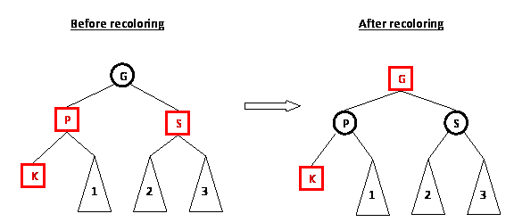
The red-red conflict between P and K is resolved.
Moreover, the count of black nodes is unchanged.

Slide 33
But, recoloring G to red might introduce a red-red conflict between G and its parent.
If so, we just reapply the restructure/recolor rules to those two nodes and resolve the problem (working up the tree toward the root).

Slide 34
Insertion Example
Recall that inserting keys in numeric or alphabetic order can create very unbalanced BSTs.
For 1,2,3,4 we got:
1
2
3
4

Slide 35
Let’s do the same insertions using red-black trees.
We insert 1 as a red node. Since it is a root, it is immediately recolored to black:
Next we insert 2 as a red node (getting a valid red-black tree):
1
1
2

Slide 36
Next we add 3 as a red node getting an invalid red-black tree:
1
2
3

Slide 37
The tree is restructured, making 2 the new root:
2
1
3

Slide 38
Now 4 is inserted as a red node, creating an invalid red-black tree:
2
1
3
4

Slide 39
Since 1, 3 and 4 are all red, we do a recoloring. Nodes 1 and 3 become black. Node 2 becomes red, then is changed back to black because it is the root.
2
1
3
4

Slide 40
Finally, 5 is added as a red node:
2
1
3
4
5

Slide 41
The 3 – 4– 5 subtree is restructured:
2
1
4
3
5

Slide 42
Class Participation
Insert the following into a red-black tree:
7, 14, 18, 23, 1, 11, 20, 29, 25, 27

Slide 43
Complexity of Insertion into a Red-black Tree
Insertion requires three steps:
An ordinary BST insertion. This is O(log n) if the tree is balanced.
Color new node red – O(1) time

Slide 44
Restore red-black properties (if needed).
Restructuring is done at most once. It is O(1) since only a limited number of
pointers are reset.
Recoloring is also O(1) but may need to be repeated up the tree. Since the tree is balanced, at most O(log n) recolorings are needed.
The overall complexity is therefore O(log n).

Slide 45
Deletion from Red-black Trees
The delete operation is similar in feel to the insert operation, but more complicated. You will not be expected to know its operation.

