Slide 1
CS 367 Introduction to Data Structures
Lecture 16

Slide 2
Today:
Red-black trees
Hashing

Slide 3
Restructuring.
Look at just the three nodes, K, P and G in the BST. Four structures are possible:
G
G
G
G
P
P
P
P
K
K
K
K

Slide 4
Each of K, P and G have a distinct key value. We’ll choose the middle value and restructure so that the middle value is the new parent of the other two nodes.
Each of the 4 cases is detailed in the following slides.

Slide 5
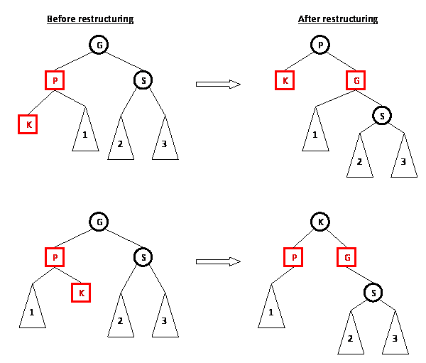
Note the recoloring of the 3 nodes.
Now it is a valid red-black tree.
Why?

Slide 6
Note the recoloring of the 3 nodes.
Now it is a valid red-black tree.
Why?

Slide 7
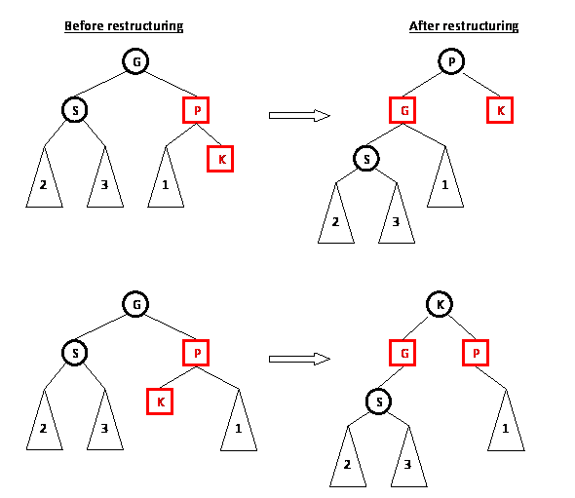
Note the recoloring of the 3 nodes.
Now it is a valid red-black tree.
Why?

Slide 8
Note the recoloring of the 3 nodes.
Now it is a valid red-black tree.
Why?

Slide 9
Recoloring
We know P and K are both red. If S, P’s sibling, is also red we do a recoloring – P and S become black:

Slide 10
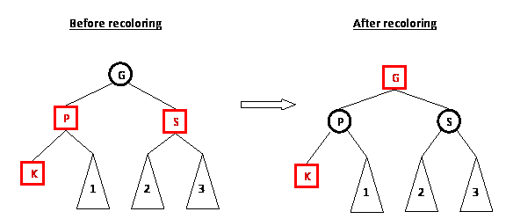
The red-red conflict between P and K is resolved.
Moreover, the count of black nodes is unchanged.

Slide 11
But, recoloring G to red might introduce a red-red conflict between G and its parent.
If so, we just reapply the restructure/recolor rules to those two nodes and resolve the problem (working up the tree toward the root).

Slide 12
Insertion Example
Recall that inserting keys in numeric or alphabetic order can create very unbalanced BSTs.
For 1,2,3,4 we got:
1
2
3
4

Slide 13
Let’s do the same insertions using red-black trees.
We insert 1 as a red node. Since it is a root, it is immediately recolored to black:
Next we insert 2 as a red node (getting a valid red-black tree):
1
1
2

Slide 14
Next we add 3 as a red node getting an invalid red-black tree:
1
2
3

Slide 15
The tree is restructured, making 2 the new root:
2
1
3

Slide 16
Now 4 is inserted as a red node, creating an invalid red-black tree:
2
1
3
4

Slide 17
Since 1, 3 and 4 are all red, we do a recoloring. Nodes 1 and 3 become black. Node 2 becomes red, then is changed back to black because it is the root.
2
1
3
4

Slide 18
Finally, 5 is added as a red node:
2
1
3
4
5

Slide 19
The 3 – 4– 5 subtree is restructured:
2
1
4
3
5

Slide 20
Class Participation
Insert the following into a red-black tree:
7, 14, 18, 23, 1, 11, 20, 29, 25, 27

Slide 21
Complexity of Insertion into a Red-black Tree
Insertion requires three steps:
An ordinary BST insertion. This is O(log n) if the tree is balanced.
Color new node red – O(1) time

Slide 22
Restore red-black properties (if needed).
Restructuring is done at most once. It is O(1) since only a limited number of
pointers are reset.
Recoloring is also O(1) but may need to be repeated up the tree. Since the tree is balanced, at most O(log n) recolorings are needed.
The overall complexity is therefore O(log n).

Slide 23
Deletion from Red-black Trees
The delete operation is similar in feel to the insert operation, but more complicated. You will not be expected to know its operation.

Slide 24
Hashing
We’ve studied a number of tree-based data structures. All offer O(log n) insertion and lookup speeds
– if the tree is reasonably balanced.

Slide 25
Can we do better?
Yes!
Using hashing, insertion and lookup can have a logarithmic worst case
and a constant (O(1)) average case!
The idea is simple:
we store data in an array and use the key value as an index into the array.

Slide 26
For example, assume you want to store this year’s daily calendar efficiently.
A balanced BST is a possibility.
But better is an array of 366 entries. Each day in the year is mapped to an integer in the range 1 to 366 (this is called a Julian date).
Lookup and entry are constant time (just go to the correct array entry)
but a lot of space may be wasted for empty days.

Slide 27
Hashing Terminology
The array is called the hashtable.
The size of the array is TABLE_SIZE.
The function that maps a key value to the array index is called the hash function.
For our example, the key is the Julian date, and the hash function is: hash(d) = d – 1.

Slide 28
If we want multi-year calendars, more space is needed.
To cover your lifetime, more than 30,000 array entries are needed.
To cover all Anno Domini dates, more than 700,000 entries would be needed.

Slide 29
In other cases, hashing, as we’ve described, it is simply infeasible.
Student ids have 10 digits, spanning a range of 10¹⁰ values – larger than the entire memory of many computers!
The solution is to use a smaller sized array and map a large range of keys into a smaller range of array entries.

Slide 30
Suppose we decide to use an array of size 10 and we use the hash function:
hash(ID) = (sum of digits in ID) mod 10
For example:
ID | Sum of Digits | Sum mod 10
9014638161 | 39 | 9
9103287648 | 48 | 8
4757414352 | 42 | 2
8377690440 | 48 | 8
9031397831 | 44 | 4

Slide 31
We have a problem:
Both the second and the fourth ID have the same hash value (8).
This is called a collision.

Slide 32
How can we store both keys in array[8]?
We can make the array an array of linked lists,
or an array of search trees.
In case of collisions, we store multiple keys at the same array location.
Assume we use linked lists; here's what the hashtable looks like after the 5 ID numbers have been inserted:

Slide 33
[0] [1] [2] [3 [4] [5 [6] [7] [8] [9]
+---+---+---+---+---+---+---+---+---+---+
| \ | \ | | \ | | \ | \ | \ | | |
| \| \| | | \| | | \| \| \| | | |
+---+---+-|-+---+-|-+---+---+---+-|-+-|-+
| | | |
v v v v
4757414352 9031397831 8377690440 9014638161
|
|
v
9103287648

Slide 34
How Common are Collisions?
More common than you might imagine.
Assume we use your birthday as a hash index. There are 366 possible values.
How many people must we enter before the chance of collision reaches 50%?
Only 23!
99.9% probability?
Only 70!
This is the “Birthday Paradox”

Slide 35
Lookup in a Hashtable
Lookup is straightforward.
You apply the hash function to get a position in the hash table.
If the position is empty (null) the lookup fails.

Slide 36
Otherwise you have a reference to a list or BST.
You then do a normal lookup.
With a good hash function lookup time is constant. Otherwise it is linear (or logarithmic) in the length of the collision chain.

Slide 37
Insertion into a Hashtable
Insertion is also straightforward.
You apply the hash function to get a position in the hash table.
If the position is empty (null) you enter the item as a list or BST containing a single item.

Slide 38
Otherwise you have a reference to a list or BST.
You then do a normal insertion.
With a good hash function insertion time is constant. Otherwise it is linear (or logarithmic) in the length of the collision chain.

Slide 39
Deletion froma Hashtable
Deletion is is also easy.
You apply the hash function to get a position in the hash table.
If the position is empty (null) just return (or throw an exception).

Slide 40
Otherwise you have a reference to a list or BST.
You then do a normal deletion.
With a good hash function deletion time is constant. Otherwise it is linear (or logarithmic) in the length of the collision chain.

Slide 41
Choosing the Hashtable Size
We want to balance table size with frequency of collisions.
The load factor of a table is the number of table entries divided by table size.
With a good hash function, we might aim for a load factor or 75% or so.

Slide 42
Some hash functions perform better if the table size is prime.
High quality implementations will resize the table if the load factor becomes too high.
That is, it might double the current size, perhaps going to the nearest prime size greater than twice the current size.

Slide 43
Each entry must be rehashed into the new table.
A variant of shadow array may be used, to keep the fast lookup and entry times expected of hashtables.

Slide 44
Choosing a Hash Function
We have two goals:
Be reasonably fast in the hash computation
Cover the range of hash locations as evenly as possible

Slide 45
For keys that are integers, we can simply use the remainder after dividing the integer by the table size.
In Java the % operator computes this.
So ( i % TableSize ) could be used.

Slide 46
In some integers certain digits aren’t at all random:
Student ids often start with the same digit
Social security numbers have a prefix indicating region of issue
Phone numbers contain area codes and exchanges that are shared by many numbers

Slide 47
Hash Functions for Strings
Strings are often used as keys in a hash table.
It may be necessary in some applications to strip case (use only upper- or lower-case letters).

Slide 48
Individual characters may be cast into integers.
For example,
(int)(S.charAt(0))
The resulting integer is simply the corresponding character code. Most Java program use the ASCII character set.
For example, (int) ‘a’ == 97

Slide 49
One simple hash function is to simply add the individual characters in a string.
This function isn’t very good if strings are short and the table is large – entries “cluster” at the left end of the hash table.
Also, permutations of the same characters map to the same location.
That is “the” and “hte” map to the same position!
Why is this bad?

Slide 50
We might multiply characters, but this function has its own problems.
Products get big quickly, but we intend to do a mod operation anyway.
We can use the fact that (a*b) mod m =
((a mod m) * b) mod m
Why is this fact useful?

Slide 51
The real problem is that in a product hash, if even one character is even, the whole product will be even.
If the hash table size is even, the hash position chosen will also be even!
Why is this bad?

Slide 52
Similarly, if even one character is a multiple of 3, the whole product will also be a product of 3.
To see how nasty this can get, let’s choose a hash table size of 210.
Why 210?
It is 2*3*5*7.
How lets use a product hash with this table.
If we hash the entire Unix spell checker dictionary, 56.7% of all entries hit position 0 in the table!

Slide 53
Why such non-uniformity?
If a word contains characters that are multiples of 2, 3, 5 and 7, the hash must be a multiple of 210. This means it will map to position 0.
For example, in “Wisconsin”,
The letter ‘n’ has a code of 110 = 2*55.
Also ‘i’ has a code of 105 = 7*5*3.

Slide 54
A Prime Table Size
If we change the table size from 210 to 211 (a prime), no table position gets more than 1% of the 26,000 words – a very good distribution.
This illustrates the source of the “folk wisdom” that hash table size ought to be prime.

Slide 55
A Modified Addition Hash
A simple modification to the “sum the characters” hash is to take the character’s position into account.
The first character is multiplied by 1, the 2nd by 2, etc.
Thus the hash for “abc” becomes 1*’a’ + 2* ‘b’ + 3* ‘c’

Slide 56

This generates a wider range of values (but overflow is a possibility).
Also, permutations are handled correctly: h(“the”) != h(“hte”).
Why?
In fact Java’s hash function for strings is a variant of this concept:

Slide 57
The Java hashCode Method
In Java, all objects inherit a hash function from the parent class Object.
For many classes, it is simply based on the object’s memory location.
In some cases, it may return a negative value, which must be anticipated when it is used to index a hashtable.

Slide 58
You can override the standard definition of hashCode if you wish.
But there is one requirement:
If you have two objects, a and b (of the same class) and a.equals(b)
Then it must be the case that hashCode(a) == hashCode(b)
Why is this necessary?

Slide 59
If you override the equals method (which is fairly common), you usually have to redefine hashCode too.
Why?

Slide 60
Java Support for Hashing
Hashtable<K,V>
HashMap<K,V>
Both are very similar – handle collisions using chaining

Slide 61
TreeMap vs. HashMap
 | TreeMap | HashMap
Implementation | Red-black Tree | Hash table with chaining
Complexity | O(log n) | O(1) on average O(N) worst case
Iterate on Keys | In ascending order | No fixed order
Iterate on Values | O(N) Tree traversal | O(Table size+N) Check all table entries

Slide 62
Comparison Sorts
Most sorting techniques take a simple approach – they compare and swap values until everything is in order.
Most have an O(N²) running time, though some can reach O(N log n).

Slide 63
In studying sorting techniques we’ll ask:
Is the average case speed always equal to the worst-case speed?
What happens if the array is sorted (or nearly sorted)?
Is extra space beyond the array itself required?

Slide 64
We’ll study these comparison-sort algorithms:
Selection sort
Insertion sort
Merge sort
Quick sort

Slide 65
Selection Sort
The idea is simple:
Find the smallest value in array A. Put it into A[0]
Find the next smallest value and place it into A[1]
Repeat for remaining values

Slide 66
The approach is as follows:
Use an outer loop from 0 to N-1 (the loop index, k, tells which position in A to fill next).
Each time around, use a nested loop (from k+1 to N-1) to find the smallest value (and its index) in the unsorted part of the array.
Swap that value with A[k].

Slide 67
public static <E extends Comparable<E>>
void selectionSort(E[] A) {
int j, k, minIndex;
E min;
int N = A.length;

Slide 68
for (k = 0; k < N; k++) {
min = A[k];
minIndex = k;
for (j = k+1; j < N; j++) {
if (A[j].compareTo(min) < 0) {
min = A[j];
minIndex = j; }
}
A[minIndex] = A[k];
A[k] = min;
}
}

Slide 69
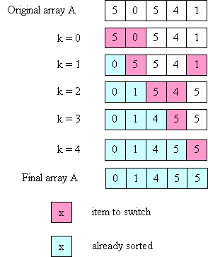

Slide 70
Time Complexity of Selection Sort
1st iteration of outer loop: inner executes N - 1 times
2nd iteration of outer loop: inner executes N - 2 times
...
Nth iteration of outer loop: inner executes 0 times

Slide 71
This is a familiar sum:
N-1 + N-2 + ... + 3 + 2 + 1 + 0
which we know is O(N²).

Slide 72
What if the array is already sorted?
Makes no difference!
Why?

Slide 73
Minor Efficiency Improvement
When k = N-1 (last iteration of outer loop), inner loop iterates zero times.
Why?
How can this be exploited?

Slide 74
Insertion Sort
The idea behind insertion sort is:
Put the first 2 items in correct relative order.
Insert the 3rd item in the correct place relative to the first 2.
Insert the 4th item in the correct place relative to the first 3.
etc

Slide 75
The loop invariant is:
after the i-th time around the outer loop, the items in A[0] through A[i-1] are in order relative to each other
(but are not necessarily in their final places).
To insert an item into its correct place in the (relatively) sorted part of the array, it is necessary to move some values to the right to make room.

Slide 76
public static
<E extends Comparable<E>>
void insertionSort(E[] A) {
int k, j;
E tmp;
int N = A.length;

Slide 77
for (k = 1; k < N, k++) {
tmp = A[k];
j = k - 1;
while ((j >= 0) &&
(A[j].compareTo(tmp) > 0)) {
A[j+1] = A[j];
// move one place to the right
j--; }
A[j+1] = tmp;
// insert kth value into correct place
}
}

Slide 78
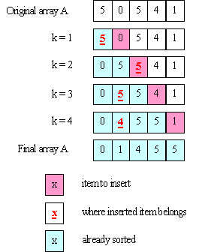

Slide 79
Complexity of Insertion Sort
The inner loop can execute a different number of times for every iteration of the outer loop.
In the worst case:
1st iteration of outer loop: inner executes 1 time
2nd iteration of outer loop: inner executes 2 times
3rd iteration of outer loop: inner executes 3 times
...
N-1st iteration of outer loop: inner executes N-1 times

Slide 80
So we get:
1 + 2 + ... + N-1
which is still O(N²).

Slide 81
Ho hum! Why another O(N²) Sort?
What if the array is already sorted?
The inner loop never executes!
Run-time is O(N)!
What if array is “mostly” sorted?
If only k elements of N total are “out of order” time is O(k * N).
If k << N
run-time is O(N)!

Slide 82
What if Array is in Reverse Order?
Worst possible situation – inner loop executes maximum number of iterations.
Solution?
Create right-to left version of insertion sort
Reverse array before and after sort!

Slide 83
Merge Sort
Unlike the previous two sorts, a merge sort requires only O(N log N) time. For large arrays, this can be a very substantial advantage.
For example, if N = 1,000,000, N² is 1,000,000,000,ooo whereas N log N is less than 20,000,000.
A 50,000 to 1 ratio!

Slide 84
The key insight is that we can merge two sorted arrays of size N/2 in linear (O(N)) time.
You just step through the two arrays, always choosing the smaller of the two values to put into the final array (and only advancing in the array from which you took the smaller value).

Slide 85
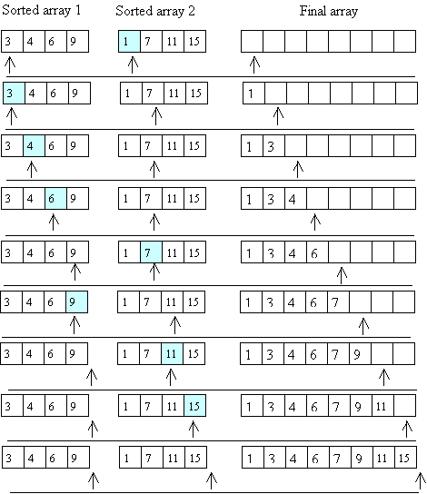

Slide 87
How do we get those sorted halves?
Recursion!
Divide the array into two halves.
Recursively, sort the left half.
Recursively, sort the right half.
Merge the two sorted halves.

Slide 88
The base case is an array of size 1 – it’s trivially sorted.
To access sub arrays, we use the whole original array, with two index values (low and high) that determine the fraction of the array we may access.
If high == low, we have the trivial base case.

Slide 89
We start with a user-level method, that asks for a sort of an entire array:
public static
<E extends Comparable<E>>
void mergeSort(E[] A) {
mergeAux(A, 0, A.length - 1);
// call the aux. function to do
// all the work
}

Slide 90
private static <E extends Comparable<E>>
void mergeAux(E[] A, int low, int high) {
// base case
if (low == high) return;
// recursive case
// Step 1: Find the middle of the array
// (conceptually, divide it in half)
int mid = (low + high) / 2;
// Steps 2 and 3: Sort the 2 halves of A
mergeAux(A, low, mid);
mergeAux(A, mid+1, high);

Slide 91
// Step 4: Merge sorted halves
//into an auxiliary array
E[] tmp =
(E[]) (new Comparable[high-low+1]);
int left = low;
// index to left half
int right = mid+1;
// index into right half
int pos = 0; // index into tmp

Slide 92
while ((left <= mid) && (right <= high)) {
// choose the smaller of the two values
// copy that value into tmp[pos]
// increment either left or right
// increment pos
if (A[left].compareTo(A[right] <= 0) {
tmp[pos] = A[left];
left++; }
else {
tmp[pos] = A[right];
right++;}
pos++;
}

Slide 93
// If one of the sorted halves "runs out"
// of values, copy any remaining
// values to tmp
// Note: only 1 of the loops will execute
while (left <= mid) {
tmp[pos] = A[left];
left++;
pos++; }
while (right <= high) {
tmp[pos] = A[right];
right++;
pos++; }
// answer is in tmp; copy back into A
arraycopy(tmp, 0, A, low, tmp.length);
}

Slide 94
Divide and Conquer
Some algorithms operate in two steps:
First, the problem is broken into smaller pieces. Each piece is solved independently.
Then each “sub solution” is combined into a complete solution
This approach is called “divide and conquer”

Slide 95
Google searches operate in this manner:
A query is sent to hundreds (or thousands) of query servers. Each server handles a small fraction of Google’s knowledge space.
After possible solutions are returned, they are ranked and merged to create the reply sent to the user.

Slide 96
Merge Sort uses Divide and Conquer
Arrays are first repeatedly split, until size 1 arrays are reached.
Then sorted sub arrays are merged, forming progressively larger sorted pieces, until a complete sorted array is built.

Slide 97
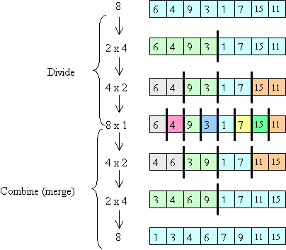

Slide 98
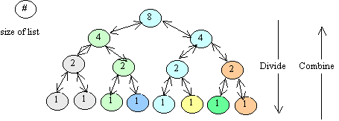
Complexity of Merge Sort
Consider the call tree:
There are log(N) “levels”

Slide 99
At each level, O(N) work is done.
First recursive calls are set up.
Then sub-arrays are merged.
Thus log(N) levels, with O(N) work at each level leads to O(N log(N)) run-time.

Slide 100
Concurrent execution of Merge Sort
Merge sort adapts nicely to a multi-processor environment.
If you have k “cores” or “threads” each can take a fraction of the calls, leading to almost a factor of k speedup.
Why almost?

Slide 101
What if you had an Unlimited number of Processors?
Notice that almost all the work in the sort is done during the merge phase.
At the top level you need O(N) time to do the merge.
At the next level you do 2 O(N/2) merges, but with parallelism this takes only O(N/2) time.

Slide 102
The next level does four concurrent merges, in O(N/4) time.
So the total time is:
O(N) + O(N/2) + O(N/4) + ... + O(1)
This sums to ...
O(N) – the best possible result!

Slide 103
What if Merge Sort is given a Sorted array?
Doesn’t matter!
The same recursive calls and merge loops will be executed.

