Slide 1
CS 367 Introduction to Data Structures
Lecture 17

Slide 2
Today:
Midterm exam discussion
Hashing
Sorting

Slide 3
Choosing a Hash Function
We have two goals:
Be reasonably fast in the hash computation
Cover the range of hash locations as evenly as possible

Slide 4
For keys that are integers, we can simply use the remainder after dividing the integer by the table size.
In Java the % operator computes this.
So ( i % TableSize ) could be used.

Slide 5
In some integers certain digits aren’t at all random:
Student ids often start with the same digit
Social security numbers have a prefix indicating region of issue
Phone numbers contain area codes and exchanges that are shared by many numbers

Slide 6
Hash Functions for Strings
Strings are often used as keys in a hash table.
It may be necessary in some applications to strip case (use only upper- or lower-case letters).

Slide 7
Individual characters may be cast into integers.
For example,
(int)(S.charAt(0))
The resulting integer is simply the corresponding character code. Most Java program use the ASCII character set.
For example, (int) ‘a’ == 97

Slide 8
One simple hash function is to simply add the individual characters in a string.
This function isn’t very good if strings are short and the table is large – entries “cluster” at the left end of the hash table.
Also, permutations of the same characters map to the same location.
That is “the” and “hte” map to the same position!
Why is this bad?

Slide 9
We might multiply characters, but this function has its own problems.
Products get big quickly, but we intend to do a mod operation anyway.
We can use the fact that (a*b) mod m =
((a mod m) * b) mod m
Why is this fact useful?

Slide 10
The real problem is that in a product hash, if even one character is even, the whole product will be even.
If the hash table size is even, the hash position chosen will also be even!
Why is this bad?

Slide 11
Similarly, if even one character is a multiple of 3, the whole product will also be a product of 3.
To see how nasty this can get, let’s choose a hash table size of 210.
Why 210?
It is 2*3*5*7.
How lets use a product hash with this table.
If we hash the entire Unix spell checker dictionary, 56.7% of all entries hit position 0 in the table!

Slide 12
Why such non-uniformity?
If a word contains characters that are multiples of 2, 3, 5 and 7, the hash must be a multiple of 210. This means it will map to position 0.
For example, in “Wisconsin”,
The letter ‘n’ has a code of 110 = 2*55.
Also ‘i’ has a code of 105 = 7*5*3.

Slide 13
A Prime Table Size
If we change the table size from 210 to 211 (a prime), no table position gets more than 1% of the 26,000 words – a very good distribution.
This illustrates the source of the “folk wisdom” that hash table size ought to be prime.

Slide 14
A Modified Addition Hash
A simple modification to the “sum the characters” hash is to take the character’s position into account.
The first character is multiplied by 1, the 2nd by 2, etc.
Thus the hash for “abc” becomes 1*’a’ + 2* ‘b’ + 3* ‘c’

Slide 15

This generates a wider range of values (but overflow is a possibility).
Also, permutations are handled correctly: h(“the”) != h(“hte”).
Why?
In fact Java’s hash function for strings is a variant of this concept:

Slide 16
The Java hashCode Method
In Java, all objects inherit a hash function from the parent class Object.
For many classes, it is simply based on the object’s memory location.
In some cases, it may return a negative value, which must be anticipated when it is used to index a hashtable.

Slide 17
You can override the standard definition of hashCode if you wish.
But there is one requirement:
If you have two objects, a and b (of the same class) and a.equals(b)
Then it must be the case that hashCode(a) == hashCode(b)
Why is this necessary?

Slide 18
If you override the equals method (which is fairly common), you usually have to redefine hashCode too.
Why?

Slide 19
Java Support for Hashing
Hashtable<K,V>
HashMap<K,V>
Both are very similar – handle collisions using chaining

Slide 20
TreeMap vs. HashMap
 | TreeMap | HashMap
Implementation | Red-black Tree | Hash table with chaining
Complexity | O(log n) | O(1) on average O(N) worst case
Iterate on Keys | In ascending order | No fixed order
Iterate on Values | O(N) Tree traversal | O(Table size+N) Check all table entries

Slide 21
Comparison Sorts
Most sorting techniques take a simple approach – they compare and swap values until everything is in order.
Most have an O(N²) running time, though some can reach O(N log n).

Slide 22
In studying sorting techniques we’ll ask:
Is the average case speed always equal to the worst-case speed?
What happens if the array is sorted (or nearly sorted)?
Is extra space beyond the array itself required?

Slide 23
We’ll study these comparison-sort algorithms:
Selection sort
Insertion sort
Merge sort
Quick sort

Slide 24
Selection Sort
The idea is simple:
Find the smallest value in array A. Put it into A[0]
Find the next smallest value and place it into A[1]
Repeat for remaining values

Slide 25
The approach is as follows:
Use an outer loop from 0 to N-1 (the loop index, k, tells which position in A to fill next).
Each time around, use a nested loop (from k+1 to N-1) to find the smallest value (and its index) in the unsorted part of the array.
Swap that value with A[k].

Slide 26
public static <E extends Comparable<E>>
void selectionSort(E[] A) {
int j, k, minIndex;
E min;
int N = A.length;

Slide 27
for (k = 0; k < N; k++) {
min = A[k];
minIndex = k;
for (j = k+1; j < N; j++) {
if (A[j].compareTo(min) < 0) {
min = A[j];
minIndex = j; }
}
A[minIndex] = A[k];
A[k] = min;
}
}

Slide 28
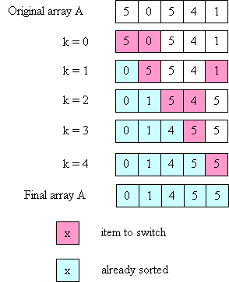

Slide 29
Time Complexity of Selection Sort
1st iteration of outer loop: inner executes N - 1 times
2nd iteration of outer loop: inner executes N - 2 times
...
Nth iteration of outer loop: inner executes 0 times

Slide 30
This is a familiar sum:
N-1 + N-2 + ... + 3 + 2 + 1 + 0
which we know is O(N²).

Slide 31
What if the array is already sorted?
Makes no difference!
Why?

Slide 32
Minor Efficiency Improvement
When k = N-1 (last iteration of outer loop), inner loop iterates zero times.
Why?
How can this be exploited?

Slide 33
Insertion Sort
The idea behind insertion sort is:
Put the first 2 items in correct relative order.
Insert the 3rd item in the correct place relative to the first 2.
Insert the 4th item in the correct place relative to the first 3.
etc

Slide 34
The loop invariant is:
after the i-th time around the outer loop, the items in A[0] through A[i-1] are in order relative to each other
(but are not necessarily in their final places).
To insert an item into its correct place in the (relatively) sorted part of the array, it is necessary to move some values to the right to make room.

Slide 35
public static
<E extends Comparable<E>>
void insertionSort(E[] A) {
int k, j;
E tmp;
int N = A.length;

Slide 36
for (k = 1; k < N, k++) {
tmp = A[k];
j = k - 1;
while ((j >= 0) &&
(A[j].compareTo(tmp) > 0)) {
A[j+1] = A[j];
// move one place to the right
j--; }
A[j+1] = tmp;
// insert kth value into correct place
}
}

Slide 37
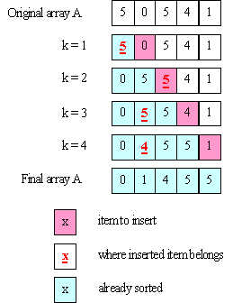

Slide 38
Complexity of Insertion Sort
The inner loop can execute a different number of times for every iteration of the outer loop.
In the worst case:
1st iteration of outer loop: inner executes 1 time
2nd iteration of outer loop: inner executes 2 times
3rd iteration of outer loop: inner executes 3 times
...
N-1st iteration of outer loop: inner executes N-1 times

Slide 39
So we get:
1 + 2 + ... + N-1
which is still O(N²).

Slide 40
Ho hum! Why another O(N²) Sort?
What if the array is already sorted?
The inner loop never executes!
Run-time is O(N)!
What if array is “mostly” sorted?
If only k elements of N total are “out of order” time is O(k * N).
If k << N
run-time is O(N)!

Slide 41
What if Array is in Reverse Order?
Worst possible situation – inner loop executes maximum number of iterations.
Solution?
Create right-to left version of insertion sort
Reverse array before and after sort!

Slide 42
Merge Sort
Unlike the previous two sorts, a merge sort requires only O(N log N) time. For large arrays, this can be a very substantial advantage.
For example, if N = 1,000,000, N² is 1,000,000,000,ooo whereas N log N is less than 20,000,000.
A 50,000 to 1 ratio!

Slide 43
The key insight is that we can merge two sorted arrays of size N/2 in linear (O(N)) time.
You just step through the two arrays, always choosing the smaller of the two values to put into the final array (and only advancing in the array from which you took the smaller value).

Slide 44
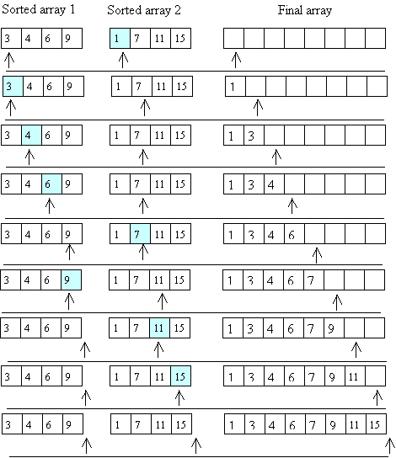

Slide 46
How do we get those sorted halves?
Recursion!
Divide the array into two halves.
Recursively, sort the left half.
Recursively, sort the right half.
Merge the two sorted halves.

Slide 47
The base case is an array of size 1 – it’s trivially sorted.
To access sub arrays, we use the whole original array, with two index values (low and high) that determine the fraction of the array we may access.
If high == low, we have the trivial base case.

Slide 48
We start with a user-level method, that asks for a sort of an entire array:
public static
<E extends Comparable<E>>
void mergeSort(E[] A) {
mergeAux(A, 0, A.length - 1);
// call the aux. function to do
// all the work
}

Slide 49
private static <E extends Comparable<E>>
void mergeAux(E[] A, int low, int high) {
// base case
if (low == high) return;
// recursive case
// Step 1: Find the middle of the array
// (conceptually, divide it in half)
int mid = (low + high) / 2;
// Steps 2 and 3: Sort the 2 halves of A
mergeAux(A, low, mid);
mergeAux(A, mid+1, high);

Slide 50
// Step 4: Merge sorted halves
//into an auxiliary array
E[] tmp =
(E[]) (new Comparable[high-low+1]);
int left = low;
// index to left half
int right = mid+1;
// index into right half
int pos = 0; // index into tmp

Slide 51
while ((left <= mid) && (right <= high)) {
// choose the smaller of the two values
// copy that value into tmp[pos]
// increment either left or right
// increment pos
if (A[left].compareTo(A[right] <= 0) {
tmp[pos] = A[left];
left++; }
else {
tmp[pos] = A[right];
right++;}
pos++;
}

Slide 52
// If one of the sorted halves "runs out"
// of values, copy any remaining
// values to tmp
// Note: only 1 of the loops will execute
while (left <= mid) {
tmp[pos] = A[left];
left++;
pos++; }
while (right <= high) {
tmp[pos] = A[right];
right++;
pos++; }
// answer is in tmp; copy back into A
arraycopy(tmp, 0, A, low, tmp.length);
}

Slide 53
Divide and Conquer
Some algorithms operate in two steps:
First, the problem is broken into smaller pieces. Each piece is solved independently.
Then each “sub solution” is combined into a complete solution
This approach is called “divide and conquer”

Slide 54
Google searches operate in this manner:
A query is sent to hundreds (or thousands) of query servers. Each server handles a small fraction of Google’s knowledge space.
After possible solutions are returned, they are ranked and merged to create the reply sent to the user.

Slide 55
Merge Sort uses Divide and Conquer
Arrays are first repeatedly split, until size 1 arrays are reached.
Then sorted sub arrays are merged, forming progressively larger sorted pieces, until a complete sorted array is built.

Slide 56
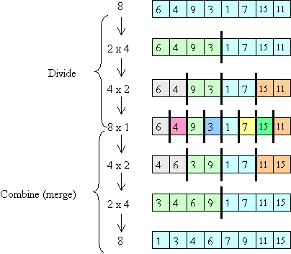

Slide 57
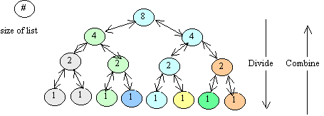
Complexity of Merge Sort
Consider the call tree:
There are log(N) “levels”

Slide 58
At each level, O(N) work is done.
First recursive calls are set up.
Then sub-arrays are merged.
Thus log(N) levels, with O(N) work at each level leads to O(N log(N)) run-time.

Slide 59
Concurrent execution of Merge Sort
Merge sort adapts nicely to a multi-processor environment.
If you have k “cores” or “threads” each can take a fraction of the calls, leading to almost a factor of k speedup.
Why almost?

Slide 60
What if you had an Unlimited number of Processors?
Notice that almost all the work in the sort is done during the merge phase.
At the top level you need O(N) time to do the merge.
At the next level you do 2 O(N/2) merges, but with parallelism this takes only O(N/2) time.

Slide 61
The next level does four concurrent merges, in O(N/4) time.
So the total time is:
O(N) + O(N/2) + O(N/4) + ... + O(1)
This sums to ...
O(N) – the best possible result!

Slide 62
What if Merge Sort is given a Sorted array?
Doesn’t matter!
The same recursive calls and merge loops will be executed.

