Slide 1
CS 367 Introduction to Data Structures
Lecture 18

Slide 2
Today:
Midterm exam discussion:
Max = 61
Min = 20
Median = 46
Distribution:
61-60: 3
59-50: 27
49-40: 34
39-30: 14
29-20 2
Sorting

Slide 3
Comparison Sorts
Most sorting techniques take a simple approach – they compare and swap values until everything is in order.
Most have an O(N²) running time, though some can reach O(N log n).

Slide 4
In studying sorting techniques we’ll ask:
Is the average case speed always equal to the worst-case speed?
What happens if the array is sorted (or nearly sorted)?
Is extra space beyond the array itself required?

Slide 5
We’ll study these comparison-sort algorithms:
Selection sort
Insertion sort
Merge sort
Quick sort

Slide 6
Selection Sort
The idea is simple:
Find the smallest value in array A. Put it into A[0]
Find the next smallest value and place it into A[1]
Repeat for remaining values

Slide 7
The approach is as follows:
Use an outer loop from 0 to N-1 (the loop index, k, tells which position in A to fill next).
Each time around, use a nested loop (from k+1 to N-1) to find the smallest value (and its index) in the unsorted part of the array.
Swap that value with A[k].

Slide 8
public static <E extends Comparable<E>>
void selectionSort(E[] A) {
int j, k, minIndex;
E min;
int N = A.length;

Slide 9
for (k = 0; k < N; k++) {
min = A[k];
minIndex = k;
for (j = k+1; j < N; j++) {
if (A[j].compareTo(min) < 0) {
min = A[j];
minIndex = j; }
}
A[minIndex] = A[k];
A[k] = min;
}
}

Slide 10
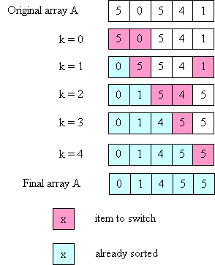

Slide 11
Time Complexity of Selection Sort
1st iteration of outer loop: inner executes N - 1 times
2nd iteration of outer loop: inner executes N - 2 times
...
Nth iteration of outer loop: inner executes 0 times

Slide 12
This is a familiar sum:
N-1 + N-2 + ... + 3 + 2 + 1 + 0
which we know is O(N²).

Slide 13
What if the array is already sorted?
Makes no difference!
Why?

Slide 14
Minor Efficiency Improvement
When k = N-1 (last iteration of outer loop), inner loop iterates zero times.
Why?
How can this be exploited?

Slide 15
Insertion Sort
The idea behind insertion sort is:
Put the first 2 items in correct relative order.
Insert the 3rd item in the correct place relative to the first 2.
Insert the 4th item in the correct place relative to the first 3.
etc

Slide 16
The loop invariant is:
after the i-th time around the outer loop, the items in A[0] through A[i-1] are in order relative to each other
(but are not necessarily in their final places).
To insert an item into its correct place in the (relatively) sorted part of the array, it is necessary to move some values to the right to make room.

Slide 17
public static
<E extends Comparable<E>>
void insertionSort(E[] A) {
int k, j;
E tmp;
int N = A.length;

Slide 18
for (k = 1; k < N, k++) {
tmp = A[k];
j = k - 1;
while ((j >= 0) &&
(A[j].compareTo(tmp) > 0)) {
A[j+1] = A[j];
// move one place to the right
j--; }
A[j+1] = tmp;
// insert kth value into correct place
}
}

Slide 19
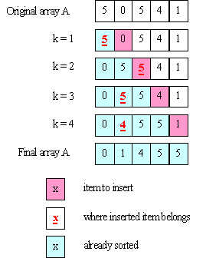

Slide 20
Complexity of Insertion Sort
The inner loop can execute a different number of times for every iteration of the outer loop.
In the worst case:
1st iteration of outer loop: inner executes 1 time
2nd iteration of outer loop: inner executes 2 times
3rd iteration of outer loop: inner executes 3 times
...
N-1st iteration of outer loop: inner executes N-1 times

Slide 21
So we get:
1 + 2 + ... + N-1
which is still O(N²).

Slide 22
Ho hum! Why another O(N²) Sort?
What if the array is already sorted?
The inner loop never executes!
Run-time is O(N)!
What if array is “mostly” sorted?
If only k elements of N total are “out of order” time is O(k * N).
If k << N
run-time is O(N)!

Slide 23
What if Array is in Reverse Order?
Worst possible situation – inner loop executes maximum number of iterations.
Solution?
Create right-to left version of insertion sort
Reverse array before and after sort!

Slide 24
Merge Sort
Unlike the previous two sorts, a merge sort requires only O(N log N) time. For large arrays, this can be a very substantial advantage.
For example, if N = 1,000,000, N² is 1,000,000,000,ooo whereas N log N is less than 20,000,000.
A 50,000 to 1 ratio!

Slide 25
The key insight is that we can merge two sorted arrays of size N/2 in linear (O(N)) time.
You just step through the two arrays, always choosing the smaller of the two values to put into the final array (and only advancing in the array from which you took the smaller value).

Slide 26
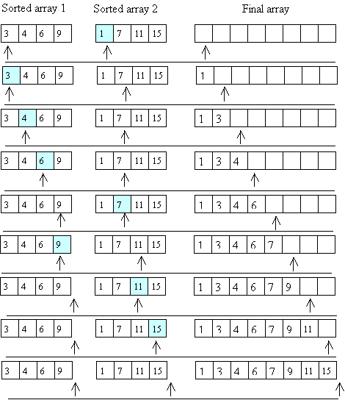

Slide 28
How do we get those sorted halves?
Recursion!
Divide the array into two halves.
Recursively, sort the left half.
Recursively, sort the right half.
Merge the two sorted halves.

Slide 29
The base case is an array of size 1 – it’s trivially sorted.
To access sub arrays, we use the whole original array, with two index values (low and high) that determine the fraction of the array we may access.
If high == low, we have the trivial base case.

Slide 30
We start with a user-level method, that asks for a sort of an entire array:
public static
<E extends Comparable<E>>
void mergeSort(E[] A) {
mergeAux(A, 0, A.length - 1);
// call the aux. function to do
// all the work
}

Slide 31
private static <E extends Comparable<E>>
void mergeAux(E[] A, int low, int high) {
// base case
if (low == high) return;
// recursive case
// Step 1: Find the middle of the array
// (conceptually, divide it in half)
int mid = (low + high) / 2;
// Steps 2 and 3: Sort the 2 halves of A
mergeAux(A, low, mid);
mergeAux(A, mid+1, high);

Slide 32
// Step 4: Merge sorted halves
//into an auxiliary array
E[] tmp =
(E[]) (new Comparable[high-low+1]);
int left = low;
// index to left half
int right = mid+1;
// index into right half
int pos = 0; // index into tmp

Slide 33
while ((left <= mid) && (right <= high)) {
// choose the smaller of the two values
// copy that value into tmp[pos]
// increment either left or right
// increment pos
if (A[left].compareTo(A[right] <= 0) {
tmp[pos] = A[left];
left++; }
else {
tmp[pos] = A[right];
right++;}
pos++;
}

Slide 34
// If one of the sorted halves "runs out"
// of values, copy any remaining
// values to tmp
// Note: only 1 of the loops will execute
while (left <= mid) {
tmp[pos] = A[left];
left++;
pos++; }
while (right <= high) {
tmp[pos] = A[right];
right++;
pos++; }
// answer is in tmp; copy back into A
arraycopy(tmp, 0, A, low, tmp.length);
}

Slide 35
Divide and Conquer
Some algorithms operate in two steps:
First, the problem is broken into smaller pieces. Each piece is solved independently.
Then each “sub solution” is combined into a complete solution
This approach is called “divide and conquer”

Slide 36
Google searches operate in this manner:
A query is sent to hundreds (or thousands) of query servers. Each server handles a small fraction of Google’s knowledge space.
After possible solutions are returned, they are ranked and merged to create the reply sent to the user.

Slide 37
Merge Sort uses Divide and Conquer
Arrays are first repeatedly split, until size 1 arrays are reached.
Then sorted sub arrays are merged, forming progressively larger sorted pieces, until a complete sorted array is built.

Slide 38
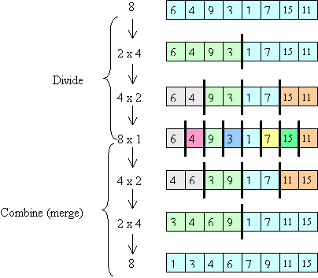

Slide 39
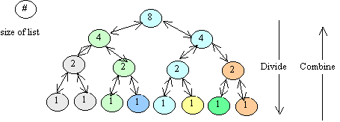
Complexity of Merge Sort
Consider the call tree:
There are log(N) “levels”

Slide 40
At each level, O(N) work is done.
First recursive calls are set up.
Then sub-arrays are merged.
Thus log(N) levels, with O(N) work at each level leads to O(N log(N)) run-time.

Slide 41
Concurrent execution of Merge Sort
Merge sort adapts nicely to a multi-processor environment.
If you have k “cores” or “threads” each can take a fraction of the calls, leading to almost a factor of k speedup.
Why almost?

Slide 42
What if you had an Unlimited number of Processors?
Notice that almost all the work in the sort is done during the merge phase.
At the top level you need O(N) time to do the merge.
At the next level you do 2 O(N/2) merges, but with parallelism this takes only O(N/2) time.

Slide 43
The next level does four concurrent merges, in O(N/4) time.
So the total time is:
O(N) + O(N/2) + O(N/4) + ... + O(1)
This sums to ...
O(N) – the best possible result!

Slide 44
What if Merge Sort is given a Sorted array?
Doesn’t matter!
The same recursive calls and merge loops will be executed.

