Slide 1
CS 367 Introduction to Data Structures
Lecture 22

Slide 2
Today’s topics:
Graphs
Depth-First Search
Graph Algorithms

Slide 3
Epic Picnic
When: Tuesday, April 17th, 5:45-7:30pm
Where: Epic Campus, Verona – Voyager Hall – MIR Commons
Transportation:
Shuttles will depart at approximately 5:15pm, 5:30pm and 5:45pm. Return shuttles will leave Epic at approximately 7:00pm, 7:15pm and 7:30pm.
Dress: Casual

Slide 4
Graphs
A generalization of trees
Graphs have nodes and edges
(Sometimes called vertices and arcs)
Nodes can have any number of incoming edges.
Every tree is a graph, but not all graphs are trees

Slide 5
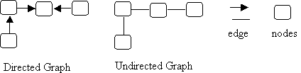
Directed and Undirected Graphs
Edges may have a direction (be an arrow)
or may be undirected (just a line)

Slide 6
In a directed graph you must follow the direction of the arrow
In an undirected graph you may go in either direction
Directed graphs may reach a “dead end”

Slide 7
Graph Terminology
The two nodes are adjacent (they are neighbors).
Node 2 is a predecessor of node 1.
Node 1 is a successor of node 2.
The source of the edge is node 2 and the target of the edge is node 1.

Slide 8
Nodes 1 and 3 are adjacent (they are neighbors).

Slide 9

In this graph, there is a path from node 2 to node 5: 2→1→5.
There is a path from node 1 to node 2: 1→3→4→2.
There is also a path from node 1 back to itself: 1→3→4→2→1.
The first two paths are acyclic paths: no node is repeated; the last path is a cyclic path because node 1 occurs twice.

Slide 10
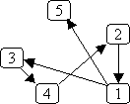
Graph layout is somewhat arbitrary;
the following two graphs are equivalent.
Why?
Which is “cleaner”?

Slide 11

An edge may connect a node to itself:

Slide 12
Special Kinds of Graphs
A directed graph that has no cyclic paths (that contains no cycles) is called a DAG (a Directed Acyclic Graph).

Slide 13

An undirected graph that has an edge between every pair of nodes is called a complete graph. Here's an example:
A directed graph can also be a complete graph; in that case, there must be an edge from every node to every other node.

Slide 14
A graph that has values associated with its edges is called a weighted graph. The graph can be either directed or undirected. The weights can represent things like:
The cost of traversing the edge.
The length of the edge.
The time needed to traverse the edge.

Slide 15

A weighted graph:

Slide 16


An undirected graph is connected if there is a path from every node to every other node.
For example:
(connected) (not connected)

Slide 17
A directed graph is strongly connected if there is a path from every node to every other node. A directed graph is weakly connected if, treating all edges as being undirected, there is a path from every node to every other node.

Slide 18



For example:
Strongly Weakly connected Neither weakly
connected Not strongly connected nor strongly connected

Slide 19
Uses for Graphs
Usually, nodes are objects and edges relationships.
For example:
Flights between cities. The nodes represent the cities and edge j → k means there is a flight from city j to city k. This graph could be weighted, using the weights to represent distance, flight time, or cost.

Slide 20
Interdependent tasks to be done. Nodes represent the tasks and an edge j → k means task j must be completed before task k. For example, we can use a graph to represent courses to be taken, with edges representing prerequisites:

Slide 21
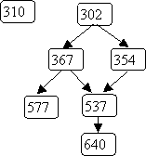

Slide 22
Flow charts (also known as control-flow graphs). Nodes represent statements and conditions in a program and the edges represent potential flow of control.

Slide 23
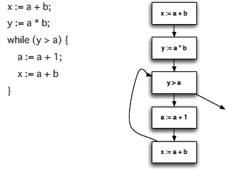

Slide 24
State transition diagrams. Nodes represent states and edges represent legal moves from state to state. For example, we could use a graph to represent legal moves in a game of tic-tac-toe.
Here's a small part of that graph:

Slide 25
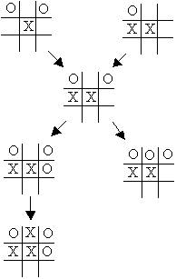

Slide 26
Graphs can be used to answer a variety of interesting questions:
What is the cheapest way to fly from Madison to Kauai?
What are the prerequisites to CS 367?
Can variable v be used before it is initialized?
Can I force a win in tic-tac-toe given my current position?

Slide 27
Representing Graphs
Trees are represented using a number of Treenodes, with a Tree class that points to the root node of the tree.
Some graphs also have a special source or “start node.” In such cases we use a number of Graphnodes, along with a Graph class that points to the start node.

Slide 28
Other graphs have no special start node, so a graph is simply a list (or set or array) of Graphnodes.
Of course each Graphnode will contain data (parameterized as type T) and a list of successor nodes.

Slide 29
class Graphnode<T> {
// *** fields ***
private T data;
private List<Graphnode<T>> sucessors =
new ArrayList<Graphnode<T>>();
// *** methods ***
...
}

Slide 30
public class Graph<T> {
// *** fields ***
private List<Graphnode<T>> nodes = new ArrayList<Graphnode<T>>;
// *** methods ***
...
}

Slide 31
What about Weighted Graphs?
We need to store a weight along with the edges.
We can store a list of weight, successor pairs or store a second list of edge weights.

Slide 32
Depth-first Search
We visit nodes in the graph by following edges, with the rule that we visit “new nodes” whenever possible.
Of course, not all nodes are necessarily reachable from a given start node.

Slide 33
Depth-first searches allow us to answer many interesting graph-related questions:
• Is it connected?
Is there a path from node j to node k?
Does it contain a cycle?
What nodes are reachable from node j?
Can the nodes be ordered so that for every node j, j comes before all of its successors in the ordering?

Slide 34
Basic Idea in Depth-first Search
We keep an array of booleans called visited, one for each node.
The algorithm is simply:
Start at node n.
Mark n as visited.
Recursively do a depth-first search from each of n’s unvisited successors.

Slide 35
public static void dfs (Graphnode<T> n) {
n.setVisited(true);
for (Graphnode<T> m : n.getSuccessors()) {
if (! m.getVisited()) {
dfs(m);
}
}
}

Slide 36
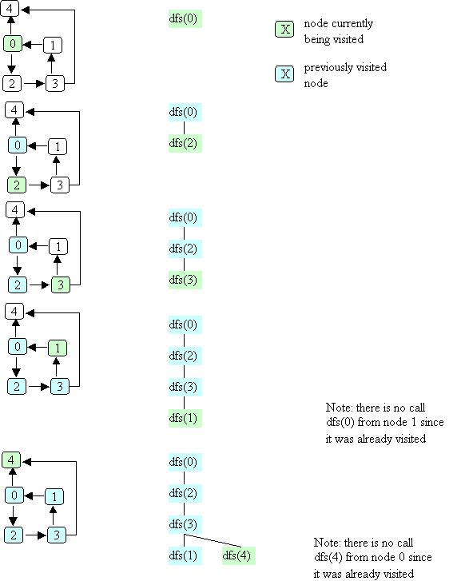
Example of Depth-first Search

Slide 41
Complexity of Depth-first Search
We have a call for each reachable node and we examine each edge from reachable nodes.
In the worst case, we may visit all nodes and edges.
Complexity is O(N + E)

Slide 42
Uses for Depth-first Search
Is there a path from node j to node k?
What nodes are reachable from node j?
Is a graph connected?
Does a graph contain a cycle?
Can the nodes be ordered so that for every node j, j comes before all of its successors in the ordering?

Slide 43
Path Testing
We want to know if a path from node j to node k exists.
But our DFS algorithm already tells us this!
If such a path exists, then a DFS, starting at j, will mark k as visited!

Slide 44
boolean pathExists(Graphnode<T> j, Graphnode<T> k){
this.setVisited(false);
dfs(j);
return k.getVisited();
}

Slide 45
Reachable Nodes
Here we can use our path test.
We try each possible node and ask if a path from the start node exists.

Slide 46
ArrayList<Graphnode<T>> reachable(Graphnode<T> j){
ArrayList<Graphnode<T>> in =
new ArrayList<Graphnode<T>>();
for(Graphnode<T> k:
this.getNodes()){
if (pathExists(j,k)
in.add(k);
return in;
}

Slide 47
Connected Graph Testing
We can check where is graph is connected (or strongly connected) by simply checking if a path from each pair of nodes exists.

Slide 48
boolean isConnected(){
for(Graphnode<T> j:
this.getNodes()){
for(Graphnode<T> k:
this.getNodes()){
if (! pathExists(j,k)
return false;
} }
return true;
}

Slide 49
Cycle Detection
Many graph algorithms, like reachability, assume a path of length 0 always exists from a node to itself.
Thus node n is always reachable from itself by doing nothing.
But a path of length 1 or more may be problematic. For example, a course may not be its own prerequisite!

Slide 50
Our algorithm for cycle detection will consider two cases:
A node n is its own immediate successor. This is possible, but also easy to test for (look at edges from n).
A path of length 2 or more is also possible. Here we simple look at all immediate successors of n. From each we ask if a path from that node to n exists.

Slide 51
boolean hasCycle(Graphnode<T> j){
if (j.getSucessors().contains(j))
return true;
for (Graphnode<T> k:
j.getsuccessors()){
if (pathExists(k,j)
return true; }
return false;
}

Slide 52
We may also want to know if a graph has a cycle anywhere. This is easy too – we just check each node in turn for a cycle starting at that node.

Slide 53
boolean hasCycle(){
for (Graphnode<T> k:
this.getnodes()){
if (hasCycle(k))
return true;
}
return false;
}

Slide 54
Topological Ordering
Graphs can be used to define ordering relations among nodes. That is j → k means node j must be visited before node k is.

Slide 55
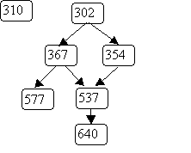
An example of ordering relations represented by graphs is a course prerequisite chain. For example:

Slide 56
A student may register for a course like 640 only after 537, 367, 354 and 302 have been taken. However 310 may be taken before or after 640, since no ordering between them is indicated.

Slide 57
A topological ordering of nodes in a graph is a sequencing of nodes that respects the graph’s ordering relations.
That is, if the graph contains j → k,
then j must always be listed before k.
We can use a variant of depth-first search to do a topological ordering.
We require that the graph we will order has no cycles. Cycles make a valid numbering impossible.
Why?

Slide 58
Recall that we already know for to test a graph for cycles.
We will identify one or more “start nodes” in a graph. A start node is simply a node that has no incoming edges.
We start at such nodes because starting elsewhere makes them unreachable.
Each node has a boolean flag isDone, initially false. When a node’s isDone flag becomes true, it is assigned an ordering number and needs no further processing.

Slide 59
As in depth first search, we process a node after all its children have been processed. Thus leaf nodes get a number, then their parents, etc.
We assign numbers last to first so that the order number assigned to a leaf is larger than that assigned to its parent.

Slide 60
The method we will use is
int topOrder(Graphnode<T> n, int num)
The parameter num is the last (highest) number to be assigned. The method returns the highest unused order number (the graph may not be connected, so numbering may need to be done in pieces).

Slide 61
int topOrder(Graphnode<T> n, int num) {
for (Graphnode<T> m : n.getSuccessors()) {
if (! m.isDone) {
num = topOrder(m, num);
}
}
// here when n has no more successors
n.isDone = true;
n.setOrder(num);
return num - 1;
}

Slide 62
Example of topOrder
We order the course prerequisite graph
We’ll start at node 302 with num = 7.

Slide 63
Breadth-first Search
An alternative to depth-first choice is breadth-first search.
From a starting node all nodes at distance one are visited, then nodes at distance 2, etc.
This sort of search is used to find the shortest path between two nodes.

Slide 64
We’ve already seen the tree-oriented version of breadth-first search – level order traversal.
As in level-order traversal, we use a queue to remember nodes waiting to be fully processed.
We also use a “visited” flag to remember nodes already processed (and queued).

Slide 65
public void bfs(Graphnode<T> n) {
Queue<Graphnode> queue =
new Queue<Graphnode>();
n.setVisited(true);
queue.enqueue( n );
while (!queue.isEmpty())) {
Graphnode<T> current = queue.dequeue();
for (Graphnode<T> k : current.getSuccessors()) {
if (! k.getVisited()){
k.setVisited(true);
queue.enqueue(k);
} // end if k not visited
} // end for every successor k
} // end while queue not empty
}

Slide 66
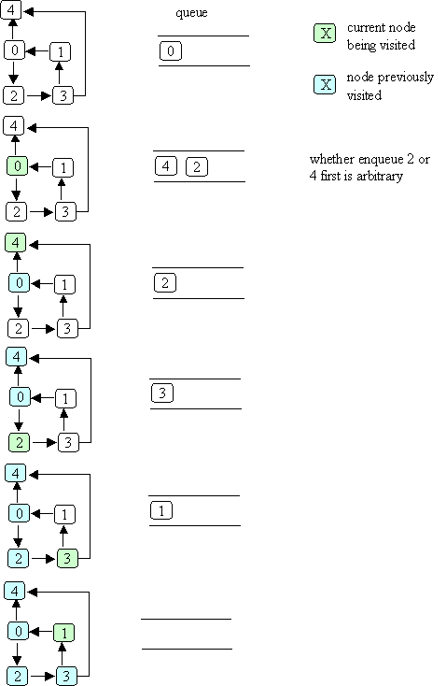
Example of Breadth-first Search

Slide 68

Starting at node 0, the visit order is

Slide 69
Shortest Path
We can use bfs to find the shortest distance to each reachable node:
add a distance field to each node
when bfs is called with node n, set n's distance to zero
when a node k is about to be enqueued, set k's distance to the distance of the current node (the one that was just dequeued) + 1

Slide 70
Shortest Weighted Path
The shortest path does not always give us the best result. Consider a highway map, listing cities and distances:

Slide 71
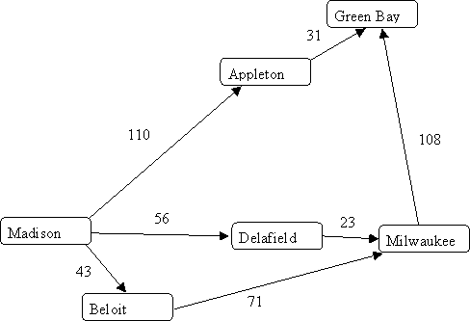

Slide 72
Shortest path tells us the best route from Madison to Milwaukee is through Beloit, since it takes just “two steps.”
But looking at distances tells us the route through Delafield is better.
What we need is a shortest weighted path algorithm.
Dijkstra’s algorithm lets us compute shortest weighted paths efficiently.

Slide 73
Dijkstra’s Algorithm
Dijkstra’s algorithm uses an “explorer” approach, in which we visit nodes along various paths, always recording the shortest (or fastest, or cheapest) distance.
We start at a source node. The distance from source s to itself is trivially 0.

Slide 74
We then look at nodes one step away from the source. Tentative distances are recorded. The smallest distance gives us the shortest path from s to one node.
Why?
This node is marked as “finished.”
We next look the nearest node not marked as finished. Its successors are explored. The node marked with the shortest distance is marked as finished.
Then the unfinished node with the shortest distance is explored.

Slide 75
The process continues until all nodes are marked as finished.
Here is an outline of Dijkstra’s Algorithm.
We start with:
A graph, G, with edges E of the form
(v1, v2) and vertices (nodes) V, and a source vertex, s.

Slide 76
The data structures we use are:
dist : array of distances from the source to each vertex
prev : array of pointers to preceding vertices
i : loop index
F : list of finished vertices
U : list or heap unfinished vertices

Slide 77
Initialization:
F = Empty list
U = All vertices (nodes)
for (i = 0 ; i < U.size(); i++) {
dist[i] = INFINITY;
prev[i] = NULL;
}
dist[s] = 0; // Starting node

Slide 78
while (U.size() > 0) {
pick the vertex, v, in U with the
shortest path to s;
add v to F; remove v from U;
for each edge of v, (v1, v2) {
if (dist[v1] + length(v1, v2)
< dist[v2]) {
dist[v2] =
dist[v1] + length(v1, v2);
prev[v2] = v1;
}
}
}

Slide 79
Example of Dijkstra’s Algorithm

Slide 80
Complexityof Dijkstra’s Algorithm
The complexity is measured in terms of edges (E) and vertices (nodes) N.
If list U is implemented as an unordered list, execution time is O(N²)
Why?
As each node is processed, the U list must be searched for the cheapest unfinished node.

Slide 81
But the U list may also be implemented as a priority queue (using a heap).
Then getting the cheapest unfinished node is only log N.
But each time an edge is used to update the best known distance, the priority queue may need to be restructured into heap form.
This leads to O(E log N), which is usually better than O(N²).

Slide 82
Traveling Salesman Problem
Given n cities we wish the shortest (or fastest, or cheapest) path that visits each city and returns to the starting point.

Slide 83
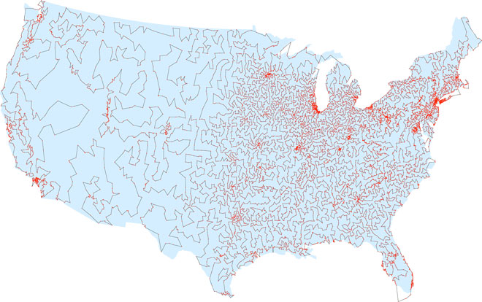

Slide 84
The obvious approach is to try all possible paths. But this is exponential!
Perhap a generalization of Dijkstra’s algorithm?
No – theoretical computer science tells us the best we can do most likely must be exponential.

Slide 85
Approximation Algorithms
What if we accept something close to optimal?
Christofis’s algorithm guarantees a solution no worst than 50% above optimal. It is O(N³).
Heuristics often improve Christofis’s bound. For example, try to swap pairs of adjacent cities.

Slide 86
CS 577 Introduction to Algorithms
Basic paradigms for the design and analysis of efficient algorithms: greed, divide-and-conquer, dynamic programming, reductions, and the use of randomness. Computational intractability including typical NP-complete problems and ways to deal with them.

Slide 87
No Office Hours Wed and Thurs
Today’s topics:
Graphs
Depth-First Search
Graph Algorithms

