Slide 1
CS 367 Introduction to Data Structures
Lecture 23

Slide 2
Today’s topics:
Depth-First Search
Graph Algorithms

Slide 3
Depth-first Search
We visit nodes in the graph by following edges, with the rule that we visit “new nodes” whenever possible.
Of course, not all nodes are necessarily reachable from a given start node.

Slide 4
Depth-first searches allow us to answer many interesting graph-related questions:
• Is it connected?
Is there a path from node j to node k?
Does it contain a cycle?
What nodes are reachable from node j?
Can the nodes be ordered so that for every node j, j comes before all of its successors in the ordering?

Slide 5
Basic Idea in Depth-first Search
We keep an array of booleans called visited, one for each node.
The algorithm is simply:
Start at node n.
Mark n as visited.
Recursively do a depth-first search from each of n’s unvisited successors.

Slide 6
public static void dfs (Graphnode<T> n) {
n.setVisited(true);
for (Graphnode<T> m : n.getSuccessors()) {
if (! m.getVisited()) {
dfs(m);
}
}
}

Slide 7
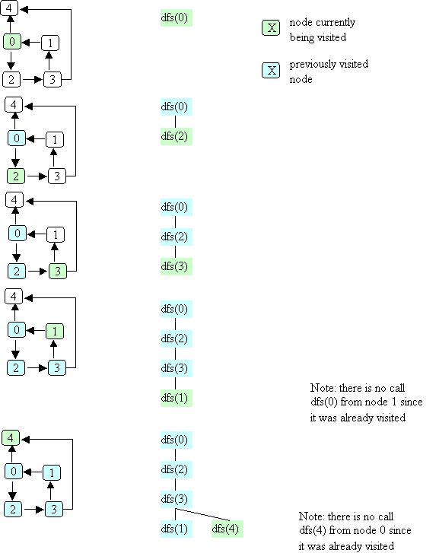
Example of Depth-first Search

Slide 12
Complexity of Depth-first Search
We have a call for each reachable node and we examine each edge from reachable nodes.
In the worst case, we may visit all nodes and edges.
Complexity is O(N + E)

Slide 13
Uses for Depth-first Search
Is there a path from node j to node k?
What nodes are reachable from node j?
Is a graph connected?
Does a graph contain a cycle?
Can the nodes be ordered so that for every node j, j comes before all of its successors in the ordering?

Slide 14
Path Testing
We want to know if a path from node j to node k exists.
But our DFS algorithm already tells us this!
If such a path exists, then a DFS, starting at j, will mark k as visited!

Slide 15
boolean pathExists(Graphnode<T> j, Graphnode<T> k){
this.setVisited(false);
dfs(j);
return k.getVisited();
}

Slide 16
Reachable Nodes
Here we can use our path test.
We try each possible node and ask if a path from the start node exists.

Slide 17
ArrayList<Graphnode<T>> reachable(Graphnode<T> j){
ArrayList<Graphnode<T>> in =
new ArrayList<Graphnode<T>>();
for(Graphnode<T> k:
this.getNodes()){
if (pathExists(j,k)
in.add(k);
return in;
}

Slide 18
Connected Graph Testing
We can check if graph is connected (or strongly connected) by simply checking if a path from each pair of nodes exists.

Slide 19
boolean isConnected(){
for(Graphnode<T> j:
this.getNodes()){
for(Graphnode<T> k:
this.getNodes()){
if (! pathExists(j,k)
return false;
} }
return true;
}

Slide 20
Cycle Detection
Many graph algorithms, like reachability, assume a path of length 0 always exists from a node to itself.
Thus node n is always reachable from itself by doing nothing.
But a path of length 1 or more may be problematic. For example, a course may not be its own prerequisite!

Slide 21
Our algorithm for cycle detection will consider two cases:
A node n is its own immediate successor. This is possible, but also easy to test for (look at edges from n).
A path of length 2 or more is also possible. Here we simple look at all immediate successors of n. From each we ask if a path from that node to n exists.

Slide 22
boolean hasCycle(Graphnode<T> j){
if (j.getSucessors().contains(j))
return true;
for (Graphnode<T> k:
j.getsuccessors()){
if (pathExists(k,j)
return true; }
return false;
}

Slide 23
We may also want to know if a graph has a cycle anywhere. This is easy too – we just check each node in turn for a cycle starting at that node.

Slide 24
boolean hasCycle(){
for (Graphnode<T> k:
this.getnodes()){
if (hasCycle(k))
return true;
}
return false;
}

Slide 25
Topological Ordering
Graphs can be used to define ordering relations among nodes. That is j → k means node j must be visited before node k is.

Slide 26
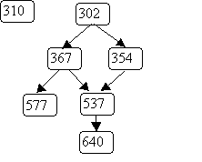
An example of ordering relations represented by graphs is a course prerequisite chain. For example:

Slide 27
A student may register for a course like 640 only after 537, 367, 354 and 302 have been taken. However 310 may be taken before or after 640, since no ordering between them is indicated.

Slide 28
A topological ordering of nodes in a graph is a sequencing of nodes that respects the graph’s ordering relations.
That is, if the graph contains j → k,
then j must always be listed before k.
We can use a variant of depth-first search to do a topological ordering.
We require that the graph we will order has no cycles. Cycles make a valid numbering impossible.
Why?

Slide 29
Recall that we already know for to test a graph for cycles.
We will identify one or more “start nodes” in a graph. A start node is simply a node that has no incoming edges.
We start at such nodes because starting elsewhere makes them unreachable.
Each node has a boolean flag isDone, initially false. When a node’s isDone flag becomes true, it is assigned an ordering number and needs no further processing.

Slide 30
As in depth first search, we process a node after all its children have been processed. Thus leaf nodes get a number, then their parents, etc.
We assign numbers last to first so that the order number assigned to a leaf is larger than that assigned to its parent.

Slide 31
The method we will use is
int topOrder(Graphnode<T> n, int num)
The parameter num is the last (highest) number to be assigned. The method returns the highest unused order number (the graph may not be connected, so numbering may need to be done in pieces).

Slide 32
int topOrder(Graphnode<T> n, int num) {
for (Graphnode<T> m : n.getSuccessors()) {
if (! m.isDone) {
num = topOrder(m, num);
}
}
// here when n has no more successors
n.isDone = true;
n.setOrder(num);
return num - 1;
}

Slide 33
Example of topOrder
We order the course prerequisite graph
We’ll start at node 302 with num = 7.

Slide 34
Breadth-first Search
An alternative to depth-first choice is breadth-first search.
From a starting node all nodes at distance one are visited, then nodes at distance 2, etc.
This sort of search is used to find the shortest path between two nodes.

Slide 35
We’ve already seen the tree-oriented version of breadth-first search – level order traversal.
As in level-order traversal, we use a queue to remember nodes waiting to be fully processed.
We also use a “visited” flag to remember nodes already processed (and queued).

Slide 36
public void bfs(Graphnode<T> n) {
Queue<Graphnode> queue =
new Queue<Graphnode>();
n.setVisited(true);
queue.enqueue( n );
while (!queue.isEmpty())) {
Graphnode<T> current = queue.dequeue();
for (Graphnode<T> k : current.getSuccessors()) {
if (! k.getVisited()){
k.setVisited(true);
queue.enqueue(k);
} // end if k not visited
} // end for every successor k
} // end while queue not empty
}

Slide 37
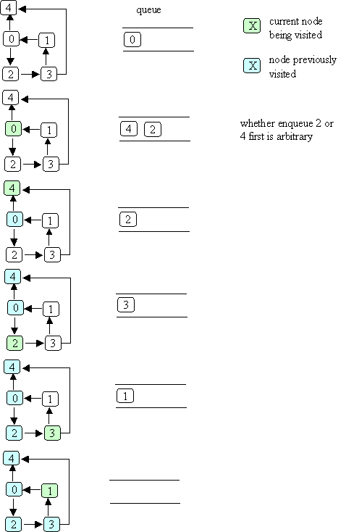
Example of Breadth-first Search

Slide 39

Starting at node 0, the visit order is

Slide 40
Shortest Path
We can use bfs to find the shortest distance to each reachable node:
add a distance field to each node
when bfs is called with node n, set n's distance to zero
when a node k is about to be enqueued, set k's distance to the distance of the current node (the one that was just dequeued) + 1

Slide 41
Shortest Weighted Path
The shortest path does not always give us the best result. Consider a highway map, listing cities and distances:

Slide 42
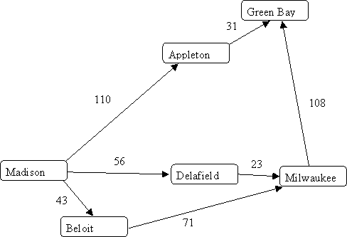

Slide 43
Shortest path tells us the best route from Madison to Milwaukee is through Beloit, since it takes just “two steps.”
But looking at distances tells us the route through Delafield is better.
What we need is a shortest weighted path algorithm.
Dijkstra’s algorithm lets us compute shortest weighted paths efficiently.

Slide 44
Dijkstra’s Algorithm
Dijkstra’s algorithm uses an “explorer” approach, in which we visit nodes along various paths, always recording the shortest (or fastest, or cheapest) distance.
We start at a source node. The distance from source s to itself is trivially 0.

Slide 45
We then look at nodes one step away from the source. Tentative distances are recorded. The smallest distance gives us the shortest path from s to one node.
Why?
This node is marked as “finished.”
We next look the nearest node not marked as finished. Its successors are explored. The node marked with the shortest distance is marked as finished.
Then the unfinished node with the shortest distance is explored.

Slide 46
The process continues until all nodes are marked as finished.
Here is an outline of Dijkstra’s Algorithm.
We start with:
A graph, G, with edges E of the form
(v1, v2) and vertices (nodes) V, and a source vertex, s.

Slide 47
The data structures we use are:
dist : array of distances from the source to each vertex
prev : array of pointers to preceding vertices
i : loop index
F : list of finished vertices
U : list or heap unfinished vertices

Slide 48
Initialization:
F = Empty list
U = All vertices (nodes)
for (i = 0 ; i < U.size(); i++) {
dist[i] = INFINITY;
prev[i] = NULL;
}
dist[s] = 0; // Starting node

Slide 49
while (U.size() > 0) {
pick the vertex, v, in U with the
shortest path to s;
add v to F; remove v from U;
for each edge of v, (v1, v2) {
if (dist[v1] + length(v1, v2)
< dist[v2]) {
dist[v2] =
dist[v1] + length(v1, v2);
prev[v2] = v1;
}
}
}

Slide 50
Example of Dijkstra’s Algorithm

Slide 51
Complexityof Dijkstra’s Algorithm
The complexity is measured in terms of edges (E) and vertices (nodes) N.
If list U is implemented as an unordered list, execution time is O(N²)
Why?
As each node is processed, the U list must be searched for the cheapest unfinished node.

Slide 52
But the U list may also be implemented as a priority queue (using a heap).
Then getting the cheapest unfinished node is only log N.
But each time an edge is used to update the best known distance, the priority queue may need to be restructured into heap form.
This leads to O(E log N), which is usually better than O(N²).

Slide 53
Traveling Salesman Problem
Given n cities we wish the shortest (or fastest, or cheapest) path that visits each city and returns to the starting point.

Slide 54
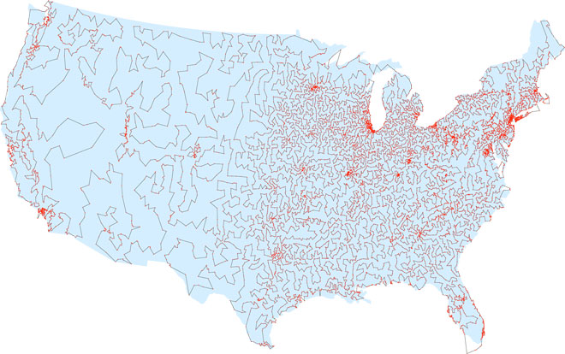

Slide 55
The obvious approach is to try all possible paths. But this is exponential!
Perhap a generalization of Dijkstra’s algorithm?
No – theoretical computer science tells us the best we can do most likely must be exponential.

Slide 56
Approximation Algorithms
What if we accept something close to optimal?
Christofis’s algorithm guarantees a solution no worst than 50% above optimal. It is O(N³).
Heuristics often improve Christofis’s bound. For example, try to swap pairs of adjacent cities.

Slide 57
CS 577 Introduction to Algorithms
Basic paradigms for the design and analysis of efficient algorithms: greed, divide-and-conquer, dynamic programming, reductions, and the use of randomness. Computational intractability including typical NP-complete problems and ways to deal with them.

