Slide 1
CS 367 Introduction to Data Structures
Lecture 24

Slide 2
Today’s topics:
Graph Algorithms
Data Structures in Computer Systems

Slide 3
Breadth-first Search
An alternative to depth-first choice is breadth-first search.
From a starting node all nodes at distance one are visited, then nodes at distance 2, etc.
This sort of search is used to find the shortest path between two nodes.

Slide 4
We’ve already seen the tree-oriented version of breadth-first search – level order traversal.
As in level-order traversal, we use a queue to remember nodes waiting to be fully processed.
We also use a “visited” flag to remember nodes already processed (and queued).

Slide 5
public void bfs(Graphnode<T> n) {
Queue<Graphnode> queue =
new Queue<Graphnode>();
n.setVisited(true);
queue.enqueue( n );
while (!queue.isEmpty())) {
Graphnode<T> current = queue.dequeue();
for (Graphnode<T> k : current.getSuccessors()) {
if (! k.getVisited()){
k.setVisited(true);
queue.enqueue(k);
} // end if k not visited
} // end for every successor k
} // end while queue not empty
}

Slide 6
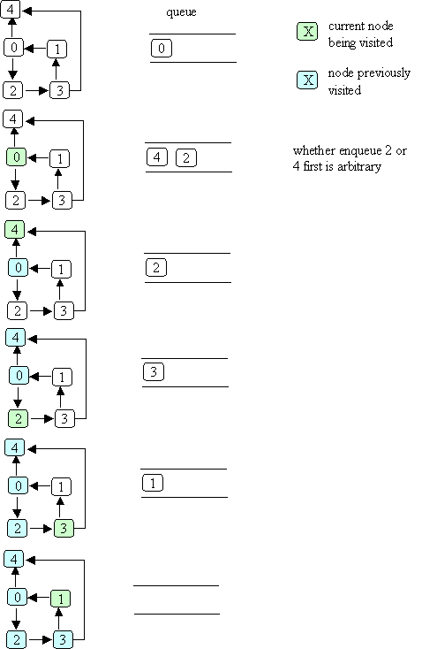
Example of Breadth-first Search

Slide 8

Starting at node 0, the visit order is

Slide 9
Shortest Path
We can use bfs to find the shortest distance to each reachable node:
add a distance field to each node
when bfs is called with node n, set n's distance to zero
when a node k is about to be enqueued, set k's distance to the distance of the current node (the one that was just dequeued) + 1

Slide 10
Shortest Weighted Path
The shortest path does not always give us the best result. Consider a highway map, listing cities and distances:

Slide 11
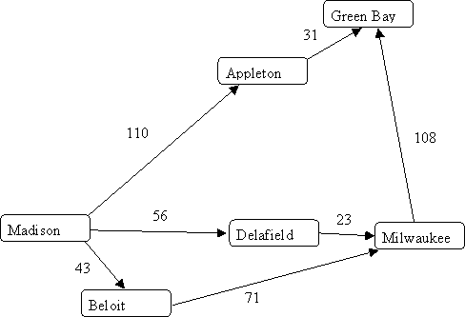

Slide 12
Shortest path tells us the best route from Madison to Milwaukee is through Beloit, since it takes just “two steps.”
But looking at distances tells us the route through Delafield is better.
What we need is a shortest weighted path algorithm.
Dijkstra’s algorithm lets us compute shortest weighted paths efficiently.

Slide 13
Dijkstra’s Algorithm
Dijkstra’s algorithm uses an “explorer” approach, in which we visit nodes along various paths, always recording the shortest (or fastest, or cheapest) distance.
We start at a source node. The distance from source s to itself is trivially 0.

Slide 14
We then look at nodes one step away from the source. Tentative distances are recorded. The smallest distance gives us the shortest path from s to one node.
Why?
This node is marked as “finished.”
We next look the nearest node not marked as finished. Its successors are explored. The node marked with the shortest distance is marked as finished.
Then the unfinished node with the shortest distance is explored.

Slide 15
The process continues until all nodes are marked as finished.
Here is an outline of Dijkstra’s Algorithm.
We start with:
A graph, G, with edges E of the form
(v1, v2) and vertices (nodes) V, and a source vertex, s.

Slide 16
The data structures we use are:
dist : array of distances from the source to each vertex
prev : array of pointers to preceding vertices
i : loop index
F : list of finished vertices
U : list or heap unfinished vertices

Slide 17
Initialization:
F = Empty list
U = All vertices (nodes)
for (i = 0 ; i < U.size(); i++) {
dist[i] = INFINITY;
prev[i] = NULL;
}
dist[s] = 0; // Starting node

Slide 18
while (U.size() > 0) {
pick the vertex, v, in U with the
shortest path to s;
add v to F; remove v from U;
for each edge of v, (v1, v2) {
if (dist[v1] + length(v1, v2)
< dist[v2]) {
dist[v2] =
dist[v1] + length(v1, v2);
prev[v2] = v1;
}
}
}

Slide 19
Example of Dijkstra’s Algorithm

Slide 20
Complexityof Dijkstra’s Algorithm
The complexity is measured in terms of edges (E) and vertices (nodes) N.
If list U is implemented as an unordered list, execution time is O(N²)
Why?
As each node is processed, the U list must be searched for the cheapest unfinished node.

Slide 21
But the U list may also be implemented as a priority queue (using a heap).
Then getting the cheapest unfinished node is only log N.
But each time an edge is used to update the best known distance, the priority queue may need to be restructured into heap form.
This leads to O(E log N), which is usually better than O(N²).

Slide 22
Traveling Salesman Problem
Given n cities we wish the shortest (or fastest, or cheapest) path that visits each city and returns to the starting point.

Slide 23


Slide 24
The obvious approach is to try all possible paths. But this is exponential!
Perhap a generalization of Dijkstra’s algorithm?
No – theoretical computer science tells us the best we can do most likely must be exponential.

Slide 25
Approximation Algorithms
What if we accept something close to optimal?
Christofis’s algorithm guarantees a solution no worst than 50% above optimal. It is O(N³).
Heuristics often improve Christofis’s bound. For example, try to swap pairs of adjacent cities.

Slide 26
CS 577 Introduction to Algorithms
Basic paradigms for the design and analysis of efficient algorithms: greed, divide-and-conquer, dynamic programming, reductions, and the use of randomness. Computational intractability including typical NP-complete problems and ways to deal with them.

Slide 27
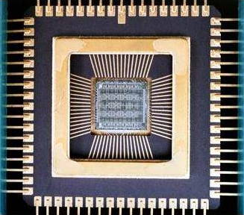
Data Structures in Computer Systems
Modern computers are built using integrated circuits:

Slide 28
These are microscopic circuits composed of transistors and wires.
A single processor chip may contain over a billion transistors.
Each transistor is a microscopic on/off circuit. Its output is a low (near zero) voltage or a higher voltage.

Slide 29
Before integrated circuits, computers were built using individual transistors, or tubes, or even relays.
Computer data is represented by the binary values 0 and 1. But these are merely symbols for a transistor putting out a low (0) or high (1) voltage.

Slide 30
A modern computer has these parts:
processor: the “brain” that does arithmetic, responds to incoming information, and generates outgoing information
primary storage (memory or RAM): the “blackboard” that remembers information used by the processor. It is connected to the processor by a system bus (wiring).
system and expansion busses: the transfer mechanisms (wiring plus connectors) that connect the processor to primary storage and input/output devices.

Slide 31
A computer usually comes with several input/output devices.
For input: a keyboard, a mouse;
For output, a display (monitor), a printer;
For both input and output: an internal disk drive, memory key, CD reader/writer, as well as connections to external networks.

Slide 32
For reasons of speed, primary storage is connected “more closely” to the processor than are the input/output devices.
Most of the devices (e.g., internal disk, printer) are themselves primitive computers that contain simple processors to help transfer information to/from the processor to/from the device.

Slide 33
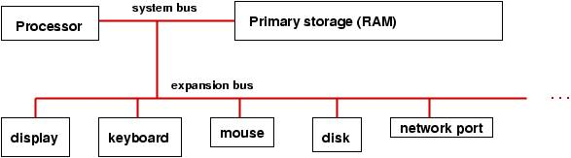

Slide 34
Binary Coding
The information in a computer is encoded as electrical off-on (“0 and 1”) pulses that travel on the bus and arrive to the processor.
Here is a summary of base-2 (binary) coding of numbers, which is the concept upon which computer information is based:

Slide 35
number binary coding
0 0000
1 0001
2 0010
3 0011
4 0100
5 0101
6 0110
7 0111
8 1000
...
14 1110
15 1111

Slide 36
It is possible to do arithmetic in base two; 3+5 is written:
0011
+0101
-----
1000
The addition works like normal (base-10) arithmetic, where 1 + 1 = 10 (0 with a carry of 1). Subtraction, multiplication, etc., work this way, too..

Slide 37
Negative values
Negative values can also be represented in binary. The leftmost bit is reserved as a sign bit. A 1 means negative; a 0 means positive or zero.

Slide 38
We create a negative value using two’s complement:
Take a positive value, invert each bit, then add 1.
Thus since 3 is 0011,
to get -3, we first “flip” each bit to get 1100
Then add 1 to get 1101.
To see that value really is -3, lets add 3 to -3:
0011
+1101
-----
0000

Slide 39
Why did we add that 1?
Because we don’t want two different o encodings, “plus zero” = 0000
and “negative zero” = 1111
In our encoding if we negate 0, we start with 0000, then flip bits to get 1111,
Then add 1 to get 0000!

Slide 40
Registers
A register is a high speed memory location directly attached to a processor.
All arithmetic is done through registers.
A register holds a sequence of bits, representing a numeric value.

Slide 41
Here is a picture of an 8-bit register that holds the number 9:
+--+--+--+--+--+--+--+--+
| 0| 0| 0| 0| 1| 0| 0| 1|
+--+--+--+--+--+--+--+--+
A processor has multiple registers, typically from 8 to 64, depending on the processor’s design.

Slide 42
A processor would compute 3+5 by placing 3 (0000 0011) and 5 (0000 0101) into two registers and then using the wiring between the registers to compute the sum, which might be saved in a third register.
A typical, modern register has 32 bits, called a fullword. Such a register can store a value in the approximate range of -2 billion to +2 billion.

Slide 43
The typical series of step in computing
A = B + 1;
is:
Load B from memory into a register
Add 1 to that register
Store the register’s updated contents into A

Slide 44
Central processing unit
The central processing unit (CPU) is the heart of any computer.
It is a very complex circuit wired to compute arithmetic operations on numbers using data registers. Here is a simplistic picture of the parts of a processor:

Slide 45
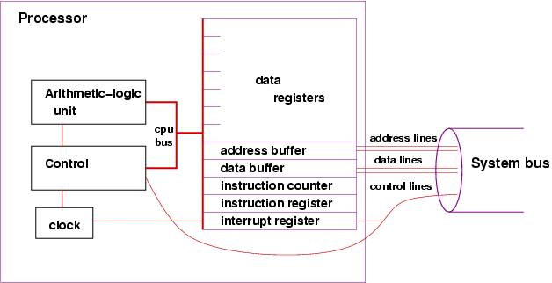

Slide 46
Its key components include:
Data registers to hold numbers for computation.
A simple clock --- a pulse generator --- that helps the Control Unit do instructions in proper time steps.
An arithmetic-logic unit (ALU) that does arithmetic on the numbers held in the data registers.

Slide 47
A control unit triggers the arithmetic operations in the ALU. How does the control unit know to request an addition or a subtraction?
Simple: it obtains instructions, one at a time, that have been stored in memory.
An instruction counter -- a register that tells the control unit where to find the instruction to be done.

Slide 48
An instruction register where an instruction is copied and held for execution by the control unit,
An address buffer and data buffer -- two registers that are used when the processor wishes to write information from a register to primary storage (or read information from primary storage).
An interrupt register used to handle external devices.

Slide 49
Processor Speed
A processor's speed is measured in Hertz (a measure of frequency).
It is literally the speed of the computer's internal clock; the larger the Hertz number, the faster the processor.
A modern processor runs at several gigahertz. So billions of instructions per second are possible.

Slide 50
Primary Storage (Main Memory)
Primary storage (also called random-access memory --- RAM) is a very long sequence of fullwords, representing data to be used by the processor.
Here is a simple picture:

Slide 51
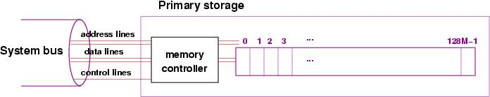

Slide 52
Each fullword is numbered by a unique address (analogous to street addresses for houses).
Information transferred from the processor can be saved at a specific memory address and can be later retrieved by referring to that same address.
.

Slide 53
The diagram shows an additional component, the memory controller.
It is itself a primitive processor that can quickly find addresses and copy information stored in the addresses to/from the system bus. This works faster than if the processor did the work of reaching into storage to extract information

Slide 54
When a number is copied from the processor into storage, we say it is written; when it is copied from storage into the processor, we say it is read.
The address lines are wires that transfer the bits that form the address of the location in storage that must be read or written
The data lines are wires that transfer the information between the processor's data buffer and the cell in storage.
Control lines transmit whether the operation is a read or write to primary storage.

Slide 55
We measure size of storage in bytes, where 8 bits equal one byte, and 4 bytes equal one fullword. The larger the number, the larger the storage.
A storage size of 2 to 8 gigabytes is common today.

Slide 56
Stored Program Architecture
In the earliest days of computing, programs were simply wired circuits.
A plugboard with jumper wires represented a particular program.
To change a program, one circuit was removed and replaced by another.

Slide 57
In the 1950's, John von Neumann made one of the most profound breakthroughs of the computer age.
He realized that primary storage could hold not only numbers, but also patterns of bits that represented instructions that could tell the processor what to do. A sequence of instructions formed a program. This was the beginning of stored-program, general purpose computers, where each time a computer was started, it could receive a new program in storage.

Slide 58
Here is a simple example of a stored program that tells the processor to compute the sum of three numbers held in memory at addresses, 64, 65, and 66. The result is stored at address 67:

Slide 59
LOAD (read) the number at storage address 64 into data register 1
LOAD the number at storage address 65 into data register 2
ADD register 1 to register 2 and leave the sum in register 2
LOAD the number at address 66 to register 1
ADD register 1 to register 2 and leave the sum in register 2
STORE (write) the value in register 2 to storage address 67

Slide 60
Instructions like LOAD, ADD, and STORE are represented as bit patterns that are copied into the processor's instruction register.
Here is a simple coding of our six-instruction program, stored at addresses 1-6 of primary storage (the numbers are at 64-66). The instructions are coded in bit patterns. We assume that LOAD is 1001, ADD is 1010, and STORE is 1011. Registers 1 and 2 are 0001 and 0010. Storage addresses 64 -- 67 are of course 0100 0000 to 0100 0011.

Slide 61
Instruction Format
The format of each instruction is:
IIII RRRR DDDD DDDD,
where IIII is the coding that states the operation required, RRRR is the coding of which data register to use, and
DDDD DDDD is the data, which is either a storage address or another register number.

Slide 62
PRIMARY STORAGE
address: contents
------- --------
0: ...
1: 1001 0001 0100 0000
2: 1001 0010 0100 0001
3: 1010 0010 0000 0001
4: 1001 0001 0100 0010
5: 1010 0010 0000 0001
6: 1011 0010 0100 0011
7: ...
...
64: 0000 0000 0000 0100
65: 0000 0000 0000 0011
66: 0000 0000 0000 0001

Slide 63
Assembly Language
It is tedious and error-prone for humans to read and write such binary codings, which are called machine language.
A better alternative, called assembly language, uses text form. Here is an assembly-language version of the addition program:
LOAD R1 64
LOAD R2 65
ADD R2 R1
LOAD R1 66
ADD R2 R1
STORE R2 67

Slide 64
Instruction Cycle
The instructor cycle are the actions taken by the processor to execute one instruction.
Each time the processor's clock pulses (ticks) the control unit does these steps:
Uses the number in the instruction counter to fetch an instruction from primary storage and copy it into the instruction register
Reads the pattern of bits in the instruction register and decodes the instruction

Slide 65
Based on the decoding, tells the ALU to execute the instruction, which means that the ALU manipulates the registers accordingly.
Performs an interrupt check.

Slide 66
An Example
The clock has “ticked” (pulsed), and the instruction register holds 3.
Address 3 in primary storage holds the coding of the instruction, ADD R2 R1.
The instruction cycle is:
Fetch: Consult the instruction counter; see it holds 0000 0011, that is, 3. Signal the memory controller to copy the contents of address 0000 0011 into the data buffer. When the instruction arrives, copy it from the data buffer into the instruction register. Increment the instruction counter to 4 (that is, 0000 0100).

Slide 67
Decode: Read the first (leading or high-order) bits and see that they indicate an ADD. Extract the bits that state the two registers to be added, R2 and R1.
Execute: Signal the ALU to add the values in registers 1 and 2 and place the result in register 2.

Slide 68
Instruction Set
The forms of instruction that the processor can execute are called the instruction set.
These are these forms of instructions found in an instruction set:
Data transfer between storage and registers (LOAD and STORE)
Arithmetic and logic (ADD, SUBTRACT, ...)
Control (test and branch) (the ALU perhaps resets the instruction counter)
Input and output (the ALU sends a request on the system bus to an input/output device to read or write new information into storage)

Slide 69
Development of Programming Languages
Both machine language and assembly language are tedious and error-prone.
Moreover, they are highly machine-dependent. An assembly language program for an IBM 360 won’t run on a CDC 6400.

Slide 70
A break-through language was FORTRAN (formula translator language), developed in the 1950's by John Backus.
FORTRAN, utilizes mathematical notation. Instead of using specific numerical storage addresses, names from algebra (variable names), like x and y, are used instead.
Here is a FORTRAN example, that places a value in a storage location, named x, and then divides it by 2, saving the result again in the same cell:
x = 3.14159
x = x / 2

Slide 71
Though over 60 years old, this language is remarkably similar to modern languages like C, C++ and Java.
Using a compiler, such a program can be translated into machine language for a particular machine. Different machines have different FORTRAN compilers, but they all accept the same source programs. Thus programs have become machine-independent.

Slide 72
Discs and Hard Drives
Programs and numbers are saved in primary storage.
But there is a limited amount of primary storage, and it is used to hold the program that the computer is executing now.
Programs and information saved for later use can be copied to secondary storage, such as the internal disk that is common to almost all computers.

Slide 73
Although it looks and operates differently than primary storage, it is perfectly fine to think of disk storage as a variant of primary storage, connected to the processor by means of the system bus, using its own controller to help read and write information.
The main distinction is that secondary storage is cheaper to buy than primary storage, but also slower to read and write from.

Slide 74
A typical computer uses disk secondary storage to hold a wide variety of programs that can be copied into primary storage for execution, as requested by the user. Secondary storage is also used to archive data files.

Slide 75
Secondary-storage devices are activated when the processor executes a READ or WRITE instruction.
These instructions are not as simple to do as the LOAD and STORE instructions, because the secondary-storage devices are so slow, and the processor should not waste time, doing nothing, waiting for the device to finish its work.

Slide 76
The solution:
The processor makes the request for a read or write and then proceeds to do other work.

Slide 77
To execute a WRITE instruction to the disk:
Fetch: The control unit obtains the instruction from primary storage and places it in the instruction register, as usual.
Decode: The control unit reads the instruction and determines that it is a WRITE. It extracts that name of the device to be used (the disk), it extracts the address on the device where the information should be written, and it extracts the name of the register than holds the information to be written.

Slide 78
Execute: The control unit writes the address and data to the disk's address buffer and data buffer, which are two fullwords in primary storage.
When these writes are finished, the controller signals the disk along the control lines of the system bus that there is information waiting for it in primary storage.

Slide 79
Now that the processor has initiated the disk-write, it proceeds to the next instruction to execute.
At the same time, the disk starts to spin, its own controller does a read of primary storage for the address and data information saved there, and finally, the data is written from primary storage to the disk.
Each secondary-storage device has its own buffers reserved for it in primary storage --- this is simpler than wiring the processor for buffers for each possible storage device.

Slide 80
An important output device is the computer's display.
A typical display is a huge grid of pixels (colored dots), each of which is defined by a trio of red-green-blue numerical values.
The display has a huge buffer in primary storage, where there is one or more bytes that describes the color of each pixel.

Slide 81
A write instruction executed by the processor causes the display's buffer to be altered at the appropriate cells, and the video controller reads the information in the buffer and copies its contents to the display, thus repainting the display.
A computer with buffers reserved for input/output devices in primary storage:

Slide 82
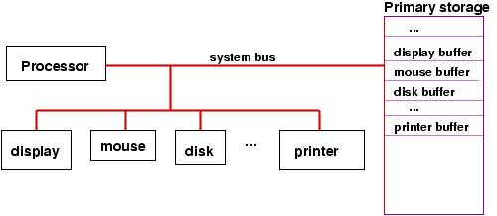

Slide 83
Interrupts
A processor need not wait for a secondary-storage device to complete an I/O operation.
But if the processor asks the device to perform a read operation, how will the processor know when the information has been successfully read and deposited into the device's buffer in storage?

Slide 84
Similarly:
A human presses a mouse button, demanding attention from the processor (perhaps to start or stop a program or to provide input to the program that the processor is executing).
How is the processor signaled about the mouse click?

Slide 85
To handle such situations, all processors are wired for interruption of their normal executions.
Such an interruption is called an interrupt.
Recall the standard execution cycle:
fetch
decode
execute
check for interrupts

Slide 86
Recall the extra register, the interrupt register, that is embedded in the processor:

Slide 87
The interrupt register is connected to the the system bus, so that when a secondary storage device has completed an action, it signals the control unit by setting to 1 one of the bits in the interrupt register.
Now we can explain the final step of the execution cycle, the check for interrupts:
After the execution step, the control unit examines the contents of the interrupt register, checking to see if any bit in the register is set to 1. If all bits are 0, then no device has completed an action, so the processor can start a new instruction.

Slide 88
But if a bit is set to 1, then there is an interrupt --- the processor must pause its execution and do whatever instructions are needed.

Slide 89
Perhaps the user has pressed the mouse button.
The device controller for the mouse sends a signal on the system bus to set to 1 the bit for a “mouse interrupt” in the interrupt register.
When the control unit examines the interrupt register at the end of its current execution cycle, it sees that the bit for the mouse is set to 1.

Slide 90
It resets the bit to 0 and resets the instruction counter to the address of the program that must be executed whenever the mouse button is pressed. Once the mouse-button program finishes, the processor can resume the work it was doing.
The mouse-button program is called an interrupt handler.

Slide 91
The previous explanation skipped a lot of details:
Where does the processor find the interrupt-handler program for the mouse?
What happens to the information resting in the registers if we must pause execution and start an interrupt handler?
What if more than one interrupt bit is set?
What if a new interrupt bit gets set while the processor is executing the mouse-button program?

Slide 92
Here is an illustration of how interrupt handlers are organized:

Slide 93
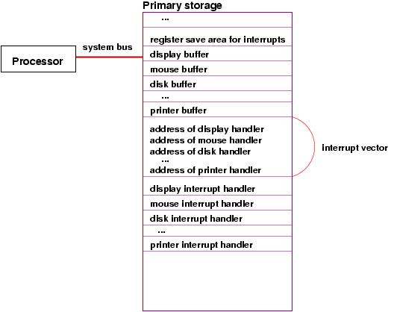

Slide 94
Locations in memory hold the addresses of the starting instructions for each of the interrupt handlers for the devices.
The sequence of addresses is called an interrupt vector.
The processor finds the address of the needed interrupt handler from the interrupt vector.

Slide 95
Before the processor starts executing an interrupt handler, it must copy the current values in all its registers to a register-save area in primary storage.
When the interrupt handler is finished, the values in the register-save area are copied back into the registers in the processor, so that the processor can resume what it was doing before the interrupt.

Slide 96
To handle multiple interrupts, the basic idea is that an executing interrupt handler can itself be interrupted and its own registers can be saved.

Slide 97
The Operating System
It is clear that a computer's operation can be complicated – there are special storage areas, special programs, etc.
It is useful to have a startup program that creates these special items and manages everything.

Slide 98
The startup- and manager-program is the operating system.
When the computer is first started, the operating system is the program that executes first.
It initializes the computer's storage as well as the controllers for the various devices. The interrupt handlers just discussed are considered parts of the operating system.

Slide 99
In addition, the operating system helps the processor execute multiple programs “simultaneously” by executing each program a bit at a time.
This technique, multi-programming, is crucial so that a human user can start and use, say, a web browser and a text editor, at the same time.

Slide 100
The operating system is especially helpful at managing one particular output device – the computer's display. The operating system includes a program called the window manager, which when executed, paints and repaints as needed the pixels in the display.
The window manager must be executing all the time, even while the human user starts programs like a web browser, text editor, etc.

Slide 101
The operating system lets the window manager repaint the display in stages: when the window-manager program repaints the display, it must execute a sequence of WRITE instructions.
When the processor executes one of the WRITE instructions, this triggers the display's controller to paint part of the display.

Slide 102
When the display controller finishes painting the part, it sets a bit in the interrupt register so that the interrupt handler for the display can execute and tell the processor to restart the window manager and continue repainting the display.
In this way, the window manager is executing “all the time,” in starts and stops.

Slide 103
Here is an illustration of a computer with an operating system loaded and running:

Slide 104
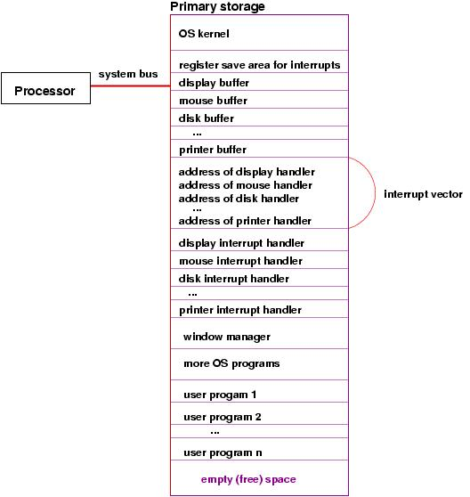

Slide 105
Virtual Memory
An operating system allows hundreds or even thousands of programs to co-exist during execution.
How does it protect against interference between programs?
A remarkable mechanism – virtual memory – guarantees non-interference!

Slide 106
The addresses used by a program are virtual.
This means an address used by a program isn’t the address actually accessed.
When executing, a program is given two special registers, called base and bound.
The base register stores an the first memory address assigned to a program.
When a program reads or writes address v it actually accesses address base + v.

Slide 107
Similarly, the bound register represents the largest address a program may access. This guarantees memory addresses beyond a program’s allocation are untouched.
With virtual memory no program can touch another program’s memory allocation, guaranteeing peaceful co-existence.

Slide 108
Paging
Even with virtual memory, we face another problem in running hundreds of programs simultaneously.
A big program may need megabytes of memory space. But we may not have a free block of memory that big!
Here we exploit a very clever extension of virtual memory called paging.

Slide 109
Memory is divided into a large number of fixed size units called pages. Page size is commonly in the range 4k to 32k bytes.
If a program needs 100k bytes, it is allocated 25 pages.
But, each page is mapped into processor memory independently.
And some are not mapped at all!
Thus the first page allocated may be at location 100,000. The second may be at

Slide 110
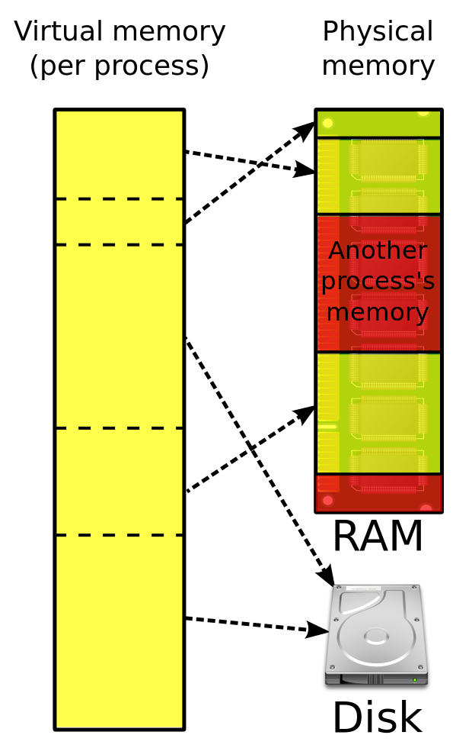
location 40,000. The third may not have any memory allocation (yet).
Here is an illustration:

Slide 111
If a program grows too large, parts of it (in terms of pages) may be removed from memory and copied to the hard drive.
This means 2 programs, each of size 1 megabyte, can co-exist in a single 1 megabyte block of processor memory!

