Slide 1
數位系統實驗
LAB-11
陳培殷
國立成功大學 資訊工程系

Slide 2
Outline
複習
Lab review
Lab 說明
Lab Notice
Lab 11

Slide 3
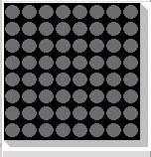
複習 - Lab Review
In DE0-CV external board
column
[7][6][5][4][3][2][1][0]
[7][6][5][4][3][2][1][0]
row[7]
row[6]
row[5]
row[4]
row[3]
row[2]
row[1]
row[0]
DM1
DM0

Slide 4
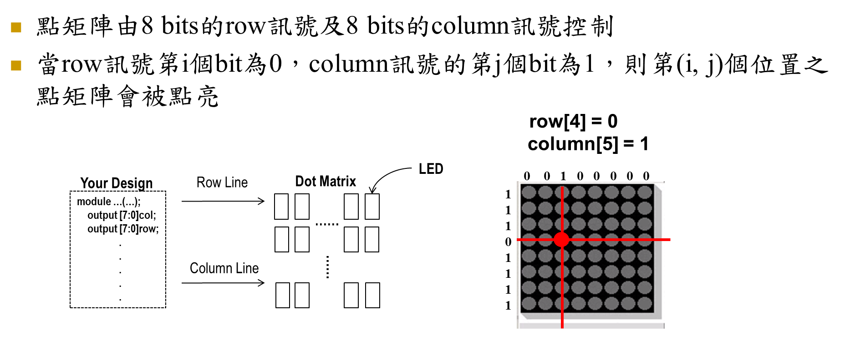
複習 - Lab Review

Slide 5
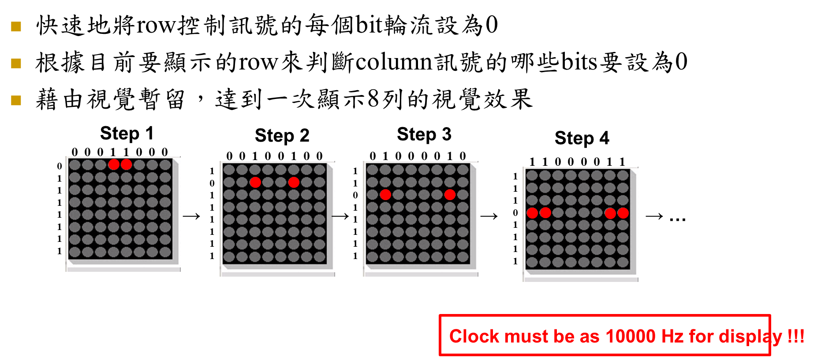
複習 - Lab Review

Slide 6
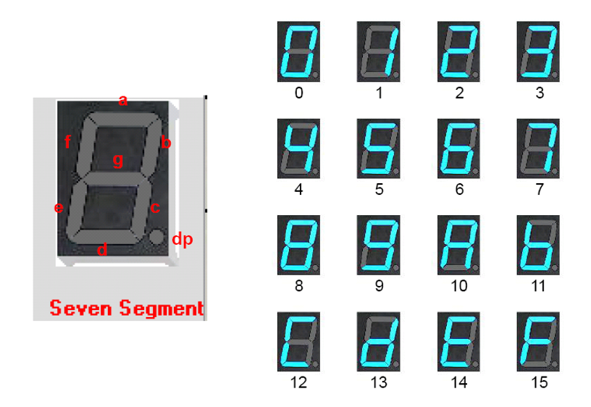
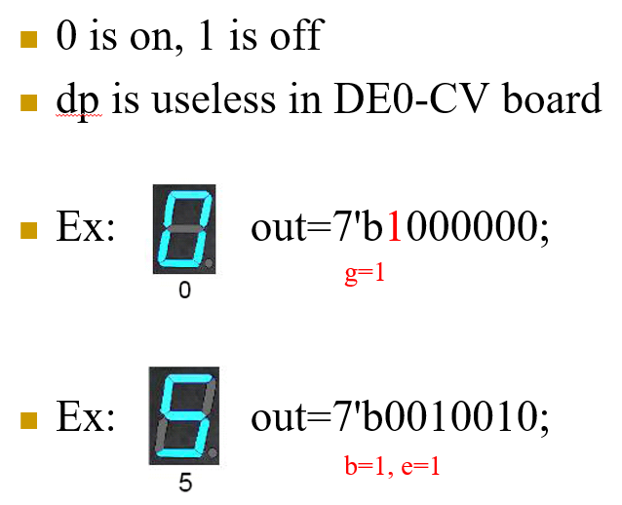
複習 - Lab Review

Slide 7
複習 - Lab Review
Assign out to seven segment digit pin of FPGA
Take seven segment digit 0 as example
Signal Name | FPGA Pin No. | Description | Signal Assigned | 對應字母
HEX00 | PIN_C14 | Seven Segment Digit 0[0] | out[0] | a
HEX01 | PIN_E15 | Seven Segment Digit 0[1] | out[1] | b
HEX02 | PIN_C15 | Seven Segment Digit 0[2] | out[2] | c
HEX03 | PIN_C16 | Seven Segment Digit 0[3] | out[3] | d
HEX04 | PIN_E16 | Seven Segment Digit 0[4] | out[4] | e
HEX05 | PIN_D17 | Seven Segment Digit 0[5] | out[5] | f
HEX06 | PIN_C17 | Seven Segment Digit 0[6] | out[6] | g

Slide 8
Lab 說明 - Lab Notice
請勿命名中文或數字開頭的資料夾
Device family 請確認與 FPGA Chip 符合 (10M50DAF484C7G)
Top module name & Project name 需要一致
在組合電路中，case、if…else…若沒有寫滿，合成後會產生latch

Slide 9
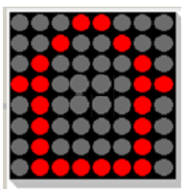

Lab 說明 - Lab Notice

Slide 10
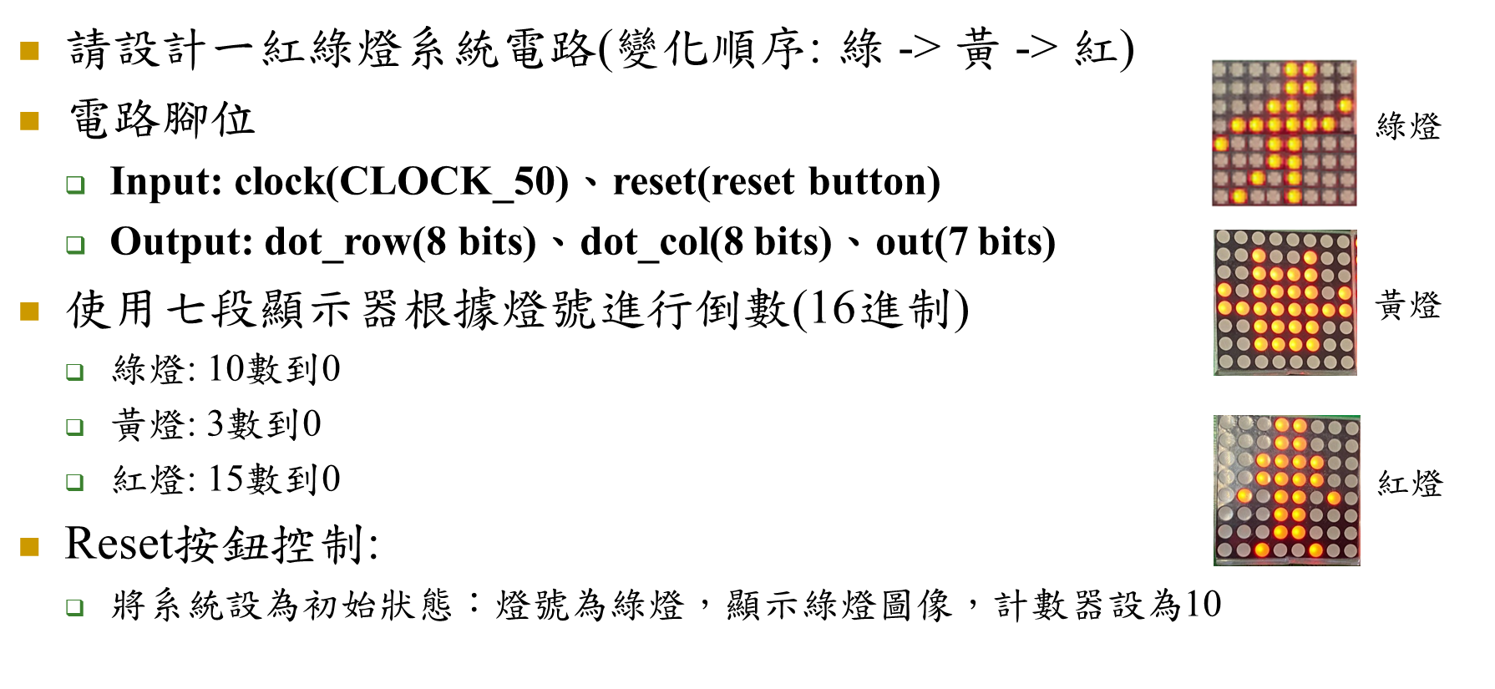
Lab 說明 - Lab 11 Traffic Light System
clock(MAX10_CLK1_50)、Reset(KEY0)
Notes:
錯誤：此時不需化簡(已修正)

Slide 11




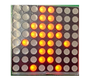
Lab 說明 - Lab 11 Traffic Light System
七段顯示器 demo
Notes:
錯誤：此時不需化簡(已修正)

Slide 12
Lab 說明 - Lab 11 Traffic Light System
FSM
Dot Matrix
Display
dot_row
dot_column
clock
reset
Seven Digit
Display
state
out

