Slide 1
Predicting Student Success
Can we predict student success and use it for early interventions?

Slide 2
Problem Statement - Virtual Learning in 2021
For Business:
For Students:
Online learning provides an alternative to in-person education
$325 Billion Industry by 2025
Students who fail to complete the program could be missed revenue / increase churn
VLE (Virtual Learning Environments) are new normal in COVID-19 pandemic
Increased flexibility and work-life balance
Missed opportunities for student interventions compared to in-person environment
Can we predict student pass/fail outcomes? How soon can we reliably predict outcomes for early interventions?
Notes:
Online learning is $101 Billion industry - higher education for adults
Due to the Covid-19 pandemic, online learning has become the solution to continue the school year without interruption. However, it does come with its limitations compared to the in-person classroom environment and more opportunities for students to
Purpose, brief overview of scope of data and source

Slide 3
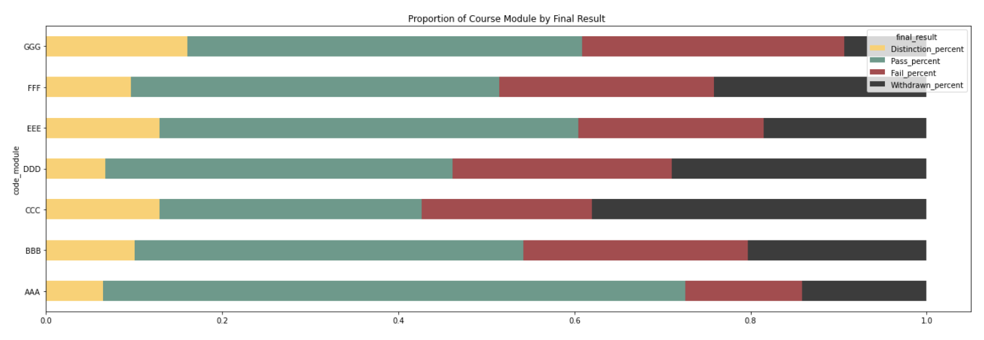
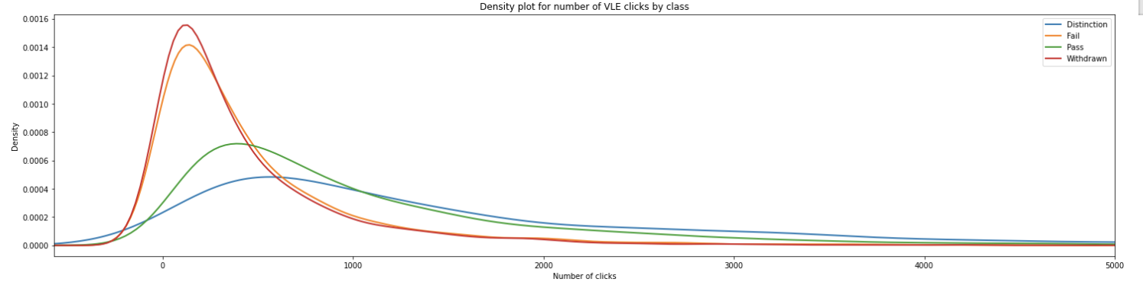
Data + EDA
Open University Learning Analytics Dataset (OULAD)
Student demographic data: location, age group, disability, education level, gender
Performance data: Student assessment marks
VLE data: interactions with the Virtual Learning Environment (VLE); clicks
Notes:
Although online education is new to many due to the pandemic, it has a long history
Open university has provided distance education to non-traditional students since 1969
They have a long history of offering online courses
Open University is a public British University that also has the highest number of undergraduate students in the UK. It is the largest academic institution in the United Kingdom (and one of the largest in Europe) with 2 Million enrolled students since it is established at 1969. As can be understood from its name, Open University mainly populated by off-campus students.

Slide 4
Data preparation
Defined early intervention period: 50% cutoff
Demographic | Performance | VLE Engagement
gender | avg_grade | sum_click
region | num_of_prev_attempts | sum_days
highest_education | studied_credits | percent_clicks
disability | date_registration | avg_clicks
age_band | date_unregistration
Notes:
Overview of data should include the general size (how many students do we end up with) in the notebook

Slide 5
Summary of Data Set
7
30K
20.7M
968K
# of courses
# of students
Total clicks in the VLE
Days interacted

Slide 6
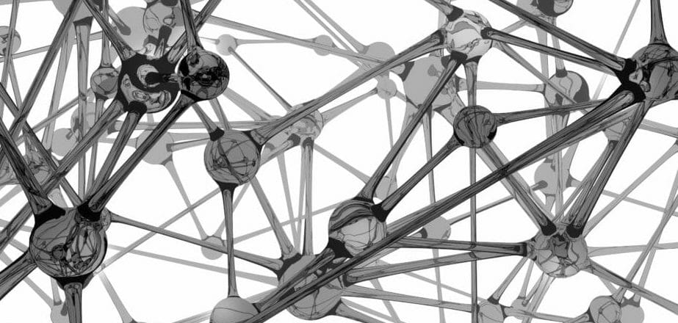
Modeling Process

Slide 7
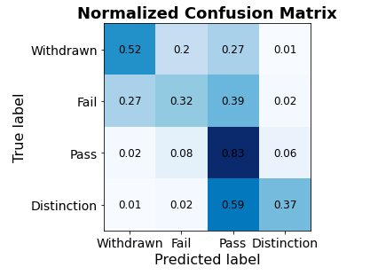



Modeling Process
One-Hot Encode Variables
Classes
Algorithm Exploration
Preliminary results
3: Distinction
•K-nearest neighbors
•Naïve-bayes
•Logistic Regression
•Decision Tree
2: Pass
1: Fail
0: Withdraw
16 variables to 113
Notes:
Normalization: we one-hot encoded all the variables to make them binary variables, so that the learning algorithms treat them all equally. Some models used a different method for normalization.
4 different classes in the dataset: students who withdrawn, students who failed, students who passed and students who obtained distinction.
First pass to explore how different algorithms perform with the data. Explored four classification algorithms: k-nearest neighbor, naive-bayes, logistic regression and decision trees.
Selected algorithms that are widely used in many different scenarios.
k-nearest neighbors because it is a very simple and intuitive algorithm.
Naive Bayes and Logistic Regression because are very widely used in many different scenarios.
Decision trees for interpretability. Have a non-linear model in the mix.
Preliminary results showed that the algorithms were labeling many distinction cases as passed, and that in general the algorithms were not performing well in classifying withdraw and fail cases.
Decided to lump together withdraw and fail, and pass and distinction groups. Since the purpose of this study is to predict student success for early interventions, we could consider both a withdraw and fail and as a student who failed, and pass and distinction as a student who succeeded.

Slide 8
Modeling Process
One-Hot Encode Variables
Classes
Algorithms
Ensemble of models
KNN
•K-nearest neighbors
•Naïve-bayes
•Logistic Regression
•Decision Tree
•Neural Networks ensembles
NB
1: Pass/Dist.
0: Fail/With.
LR
Result
16 variables to 113
DT
NN-1 layer
NN-2 layers
Notes:
Next iteration: only two classes.
Explored neural networks too:
Ensemble with several one-hidden layer neural networks models.
Ensemble of two-hidden layers neural networks models.
All the algorithms that we evaluated performed relatively well.
Decided to create an ensemble of these models and see if we could further improve the accuracy of the predictions by using all the models at the same time.

Slide 9
Results

Slide 10
Individual Model Results
F-1 Score
“Pass” Accuracy
“Fail” Accuracy
K-NN
0.781
80%
76%
Naïve-bayes
0.751
77%
73%
Logistic Regression
0.813
86%
76%
Decision Tree
0.786
83%
74%
Neural Net Ensemble - 1 Layer
0.820
87%
77%
Neural Net Ensemble - 2 Layer
0.824
87%
78%
Notes:
We optimized each model during the process. So that included non-binarized data for the KNN as well as searching for the optimal K (which in this case was 40). For the Naive-bayes model, we did a search for the optimal alpha (which was 1) and for the decision tree model we reduced the number of features in the model to simplify and boost the accuracy by about 10 points.
Overall, the 2-layer neural network model performed the best, it has the highest f1 score and the high accuracy in predicting students who will not complete the course
It performed about on-par with the one-layer neural network in predicting students who pass.
The naive bayes model performed the worst relative to other models, but all-in-all the range of success across models is not too drastic.
We can also see that all the models are better at accurately predicting which students will succeed, and are less likely to correctly predict students that will fail.

Slide 11
Ensemble Method
How it Works
1 vote per model
Tie-breaker uses the most accurate model’s prediction (two-layer neural network ensemble)
Interesting Findings
Naive Bayes is the model most likely to be the only one correct
Tie-breaker system was used 92 times, with 66% success
Half of the incorrect predictions were unanimous votes
F-1 Score
“Pass” Accuracy
“Fail” Accuracy
0.819
87%
77%
Notes:
We wanted to pursue and ensemble method, because although the two-layer neural network was successful, we were curious to see if a voting system would help further improve the accuracy. We could see that some of the models were able to accurately predict where the 2 layer model could not.
We gave each model one vote, but since we have an even number of models, the tie-breaker methodology was to choose the model with the highest accuracy (2 layer NN)
Overall, this model performed well, but not much better than the existing best model. We were able to achieve the highest accuracy at predicting students who pass, but did not improve upon the accuracy predicting students who would fail.
If we look more into the voting data, we had some interesting results, though. One is that in instance where only 1 of the 6 models correctly predicted the outcome, it was most likely the Naive Bayes model which was the least accurate one. So for example, there were 79 instances where all but one model incorrectly predicted ‘pass.’ Among those, the correct model was Naive Bayes more than half the time.
#54 instances where all models except one incorrectly predict ‘fail’, 29 of those its NB that gets it right
#When all but one model incorrectly predicts ‘pass’ (79 times), NB gets it right 41 times
Another is that the tie-breaker system was used 92 times, and correctly chose the right outcome 2 out of 3 of those times. If we look at the tiebreakers, the 2 layer NN was the most likely to get it correct so that was the best outcome with this method.
And also, we didn’t have a lot of prediction on the cusp of being correct. Half of all the incorrect predictions were unanimously wrong across all the models which tells us that there’s probably something the data is not capturing here that could be a powerful predictor.

Slide 12
Challenges and Insights

Slide 13
Challenges
Mix of variable types required bucketing data
Minimal detail on student demographics
No information on course subject or design
Inconsistent approach to assessments across courses
Challenging to differentiate between students who withdraw and students who fail
Notes:
Although the dataset was fairly clean and well organized, there were some aspects of it that made the work more challenging.
First, we had a mix of variable types that included quantitative data, such as grades on assignments and exams and the amount of times students clicked into the Virtual Learning Environment each day, as well as qualitative data, such as information about the students’ locations and socioeconomic status. To handle this, we decided to divide the quantitative data in to buckets.
We also had minimal information on student demographics, which limited the ability to make predictions based on these features. For example, we were interested in seeing how age related to pass rate. Information on age was provided, but there were only three, rather wide age bands provided: 0-35, 35-55 and Other.
The course titles were anonymized, so although we observed that there were significant differences in the courses, based on the distribution of student pass fail/rates and the number of assessments, there was no way to investigate this further.
There was also an inconsistent approach to assessments across the courses. Some of the courses had frequent assessments distributed throughout the term, and others had fewer. One course had no assessments outside of the exams, which meant that we were not able to use the average grade at 50% of the course feature to predict success for students taking that course.
Although we had initially hoped to classify students into four categories: withdraw, fail, pass, and pass with distinction, we found that all of the models struggled to differentiate students who withdrew from students who failed, and students who passed with students who passed with distinction. For our business case of predicting failure, this is an issue. We decided to remove students who withdrew before the semester started, and to group the remaining students who withdrew and the students who failed together, reasoning that in most cases, students withdraw after the start of the semester because they are struggling.

Slide 14
Insights
The models were more effective at predicting broader categories of student outcomes
Students who withdraw are very similar to students who fail
Students who pass are very similar to students who pass with distinction
Graded assessments in the first half of the term are important for predicting student success
All the models were better at predicting which students will pass than which students will fail
Notes:
We learned a good deal along the way as we navigated these challenges and optimized the models.
First, we found that the models were substantially more accurate at predicting broader categories of student outcomes. When we grouped pass and pass with distinction, and fail with withdraw, the models were much more accurate.
We also found that including graded assessments in the first half of the term was really important for predicting student success. The models were much less accurate when we excluded this feature. This insight would be very helpful to the university, which could evolve its approach to assessment design and timing.
Finally, we found that all of the models were better at predicting which students will pass than which students will fail. For example, the most accurate model had an 87% success rate for predicting students who pass compared to a 78% success rate at predicting students who fail. For this reason, it’s very important that any student intervention implemented based on the predictions of these models be planned strategically to not give passing students the false impression that they were doing poorly.

Slide 15
Ideas for enhancement

Slide 16
Ideas for Enhancement
Test how course design and discipline impacts model efficacy
Predict student success at different points in the term
Experiment with different metrics of Virtual Learning Environment (VLE) click data
Experiment with different ways of filtering assessment score features
Additional feature engineering
Notes:
First, it would be interesting to see how effective the models would be if we created them for each of the 7 courses in the dataset vs all of the data. Because there are differences in course discipline and design that we do not have much insight on, this could reveal the features of a given course that improve the models’ ability to predict.
We would also like to try to predict student success at different points in the term
Models were trained and tested on 50% of the assessment data and the Virtual Learning Environment data
We’d like to see how effective the models are at 25%? 75%? 100%?
There are quite a few different metrics of the VLE data that we could try using.
Models used two features from VLE data: average clicks per day and percent of days with a click
Other summarization metrics could prove more effective
VLE pages are also categorized by page type, and exploring this could also improve our result.
Finally, we could update the threshold on the minimum number of clicks in a day to count in our VLE metric. Currently, we include days with only one click. A higher minimum, such as 5 clicks, might better differentiate students.
It also might be helpful to filter out the assessments.
For example, computer graded assessments might be a better or worse predictor of success as compared to instructor graded assignments
We would also like to do some additional feature engineering.
Our models included a large number of features
Removing some of the less important features might improve our accuracy

Slide 17
Thank you!

