Slide 1
Obesity: A Pandemic? Analysis of its prevalence in the U.S. and the rest of the world
Charlene, Eli, Rein, Kent
Data Analytics & Visualization – UCBX
April 2019

Slide 2


Slide 3
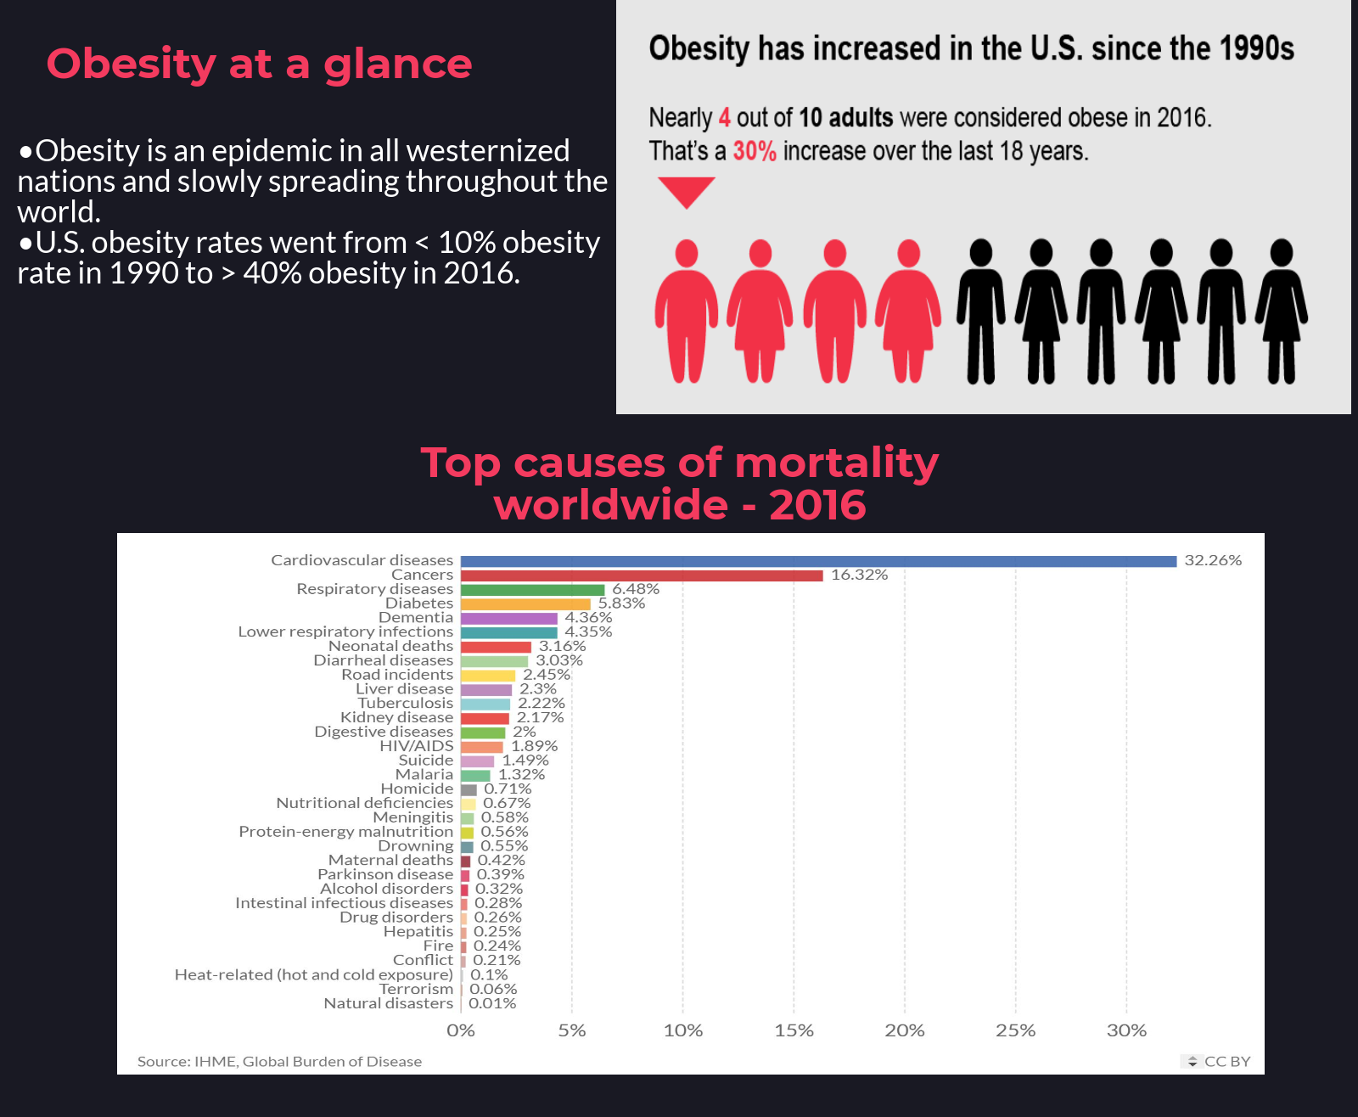

Slide 4
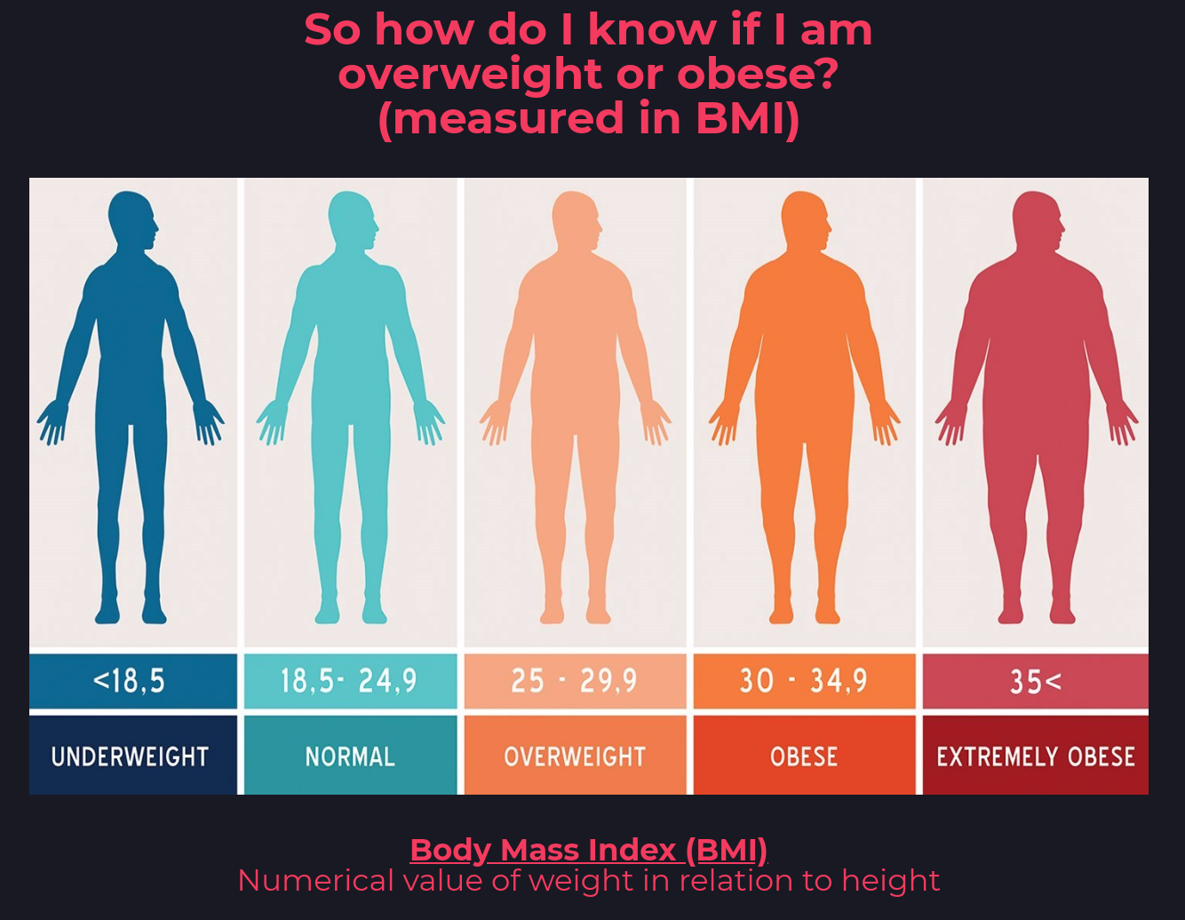

Slide 5
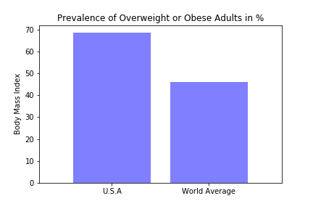
Question/Hypothesis
High caloric intake leads to higher % of adults are overweight and obese
An increase in BMI significantly increases mortality from coronary heart disease (CHD)
Adult BMI in men & women in the US is higher than the rest of the world

Slide 6
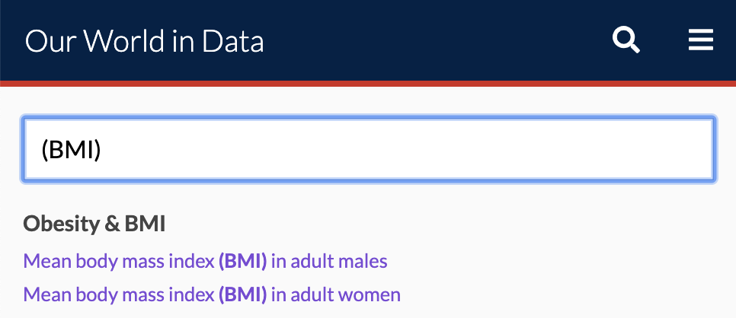


Meet the Data Our World in Data
Seven different data sets merged on country name for 2013
Our World in Data
https://ourworldindata.org/

Slide 7
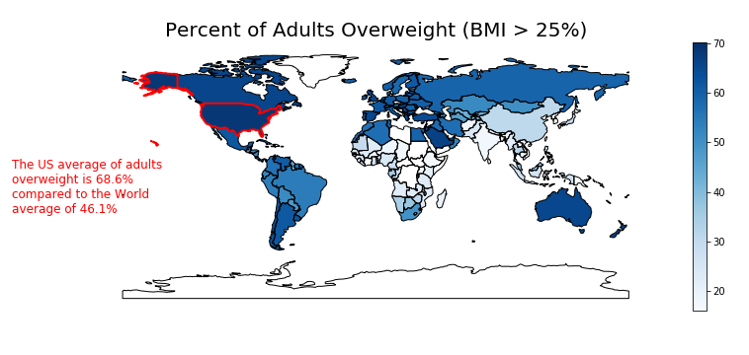
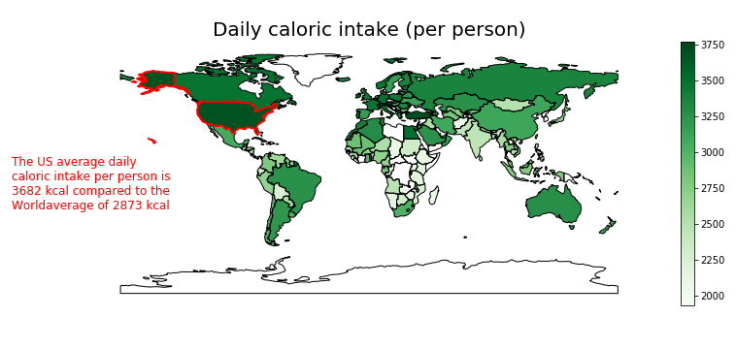
Is daily caloric intake correlated to higher rates of overweight & obesity?
The % of adults overweight appears to be to correlated to daily caloric intake
Notes:
So we decided to look at it from a birds eye perspective and then drill down to look into other factors.
First we wanted to see how the percent of adults overweight looked across the world to get an understanding of where the US stood.. And you can see, we’re way up there.
Our initial hypothesis was that a high caloric intake directly impacted the percent of a country to be overweight, so we graphed out the same world view from a caloric intake perspective and as you can see, there seems to be a correlation between the two.

Slide 8
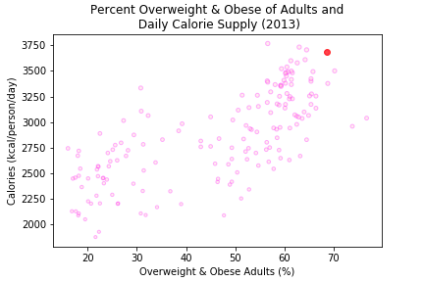
Calorie Intake vs. % Obesity & Overweight per country
There is a positive correlation in between the Daily calorie supply and % Obesity and Overweight by country.

Slide 9
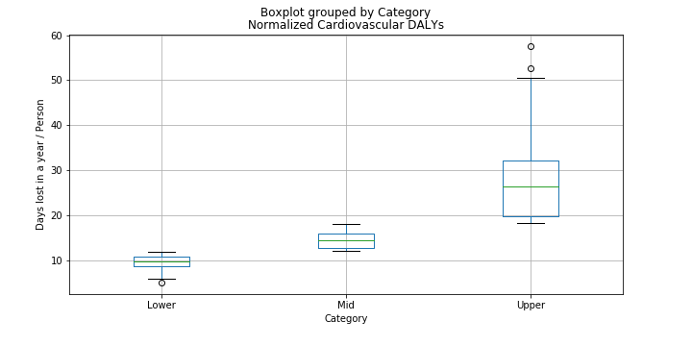
Correlation Between Increase in BMI with Cardiovascular Disease
One Disability-Adjusted Life Year (DALY) is one lost year of "healthy" life summed up across a given population.
ANOVA TEST

Slide 10
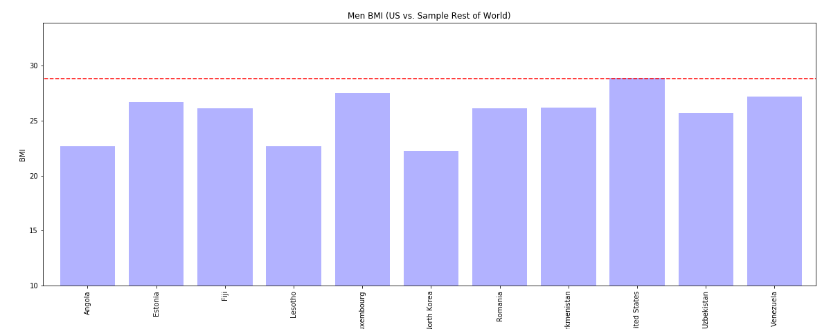
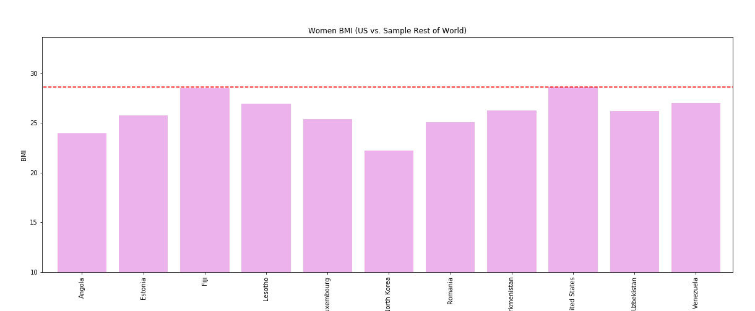
Breaking Out Men & Women BMI in the US vs. Rest of World
Men and women in the US are among the highest BMI rates Around the World.

Slide 11
Conclusions
Significant positive correlation between caloric intake and % of adults considered overweight/obese.
Greater prevalence of obesity in a country has a direct correlation with a higher burden of disease measured by DALYs, specifically Cardiovascular disease.

Slide 12
Future Directions
Research historical trends of obesity rates
Additional factors to consider:
Composition of caloric intake
Physical daily activity
Economic status of countries
Genetics
Cultural beliefs and diets

