Slide 1
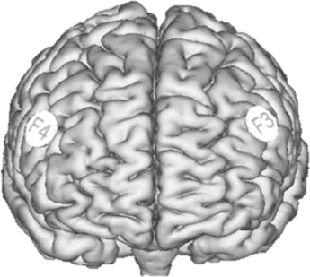
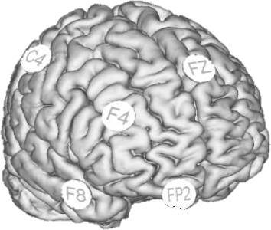
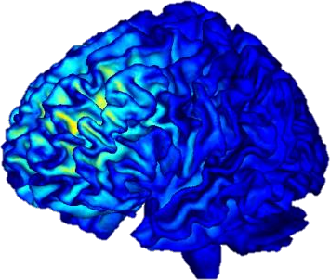
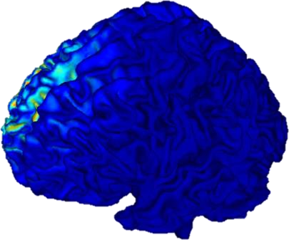
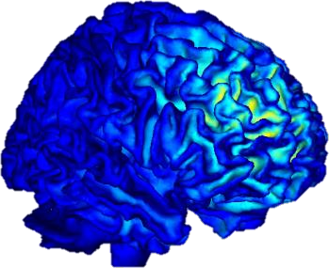
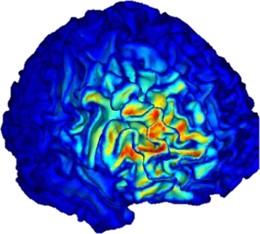
SHAM
tRNS
Montage
Influence
left
Influence
right
||En|| (mV)
0
0.02
0.04
0.06 0.08
0.10

Slide 2
Montage
SHAM
tRNS
Influence
right
||En|| (mV)
0
0.02
0.04
0.06 0.08
0.10

