Slide 1
Intellectual Property
Law Society
General Meeting: Sep 9, 2026

Slide 2
What is Intellectual Property?
IP Law is the law of ideas
  It protects inventions, chemical compounds, music, poetry, logos, slogans, image & likeness, and much more!
It is one of the most versatile areas of law, depending on what area of IP you want to practice:
  State or Federal, transactional or litigation, and even JD-preferred career options
  Concepts frequently encountered: contract law, business entity (corporations & LLCs), antitrust, employment/labor, cybersecurity, health/food/drug, and tax law

Slide 3
Kinds of IP
Patents
Machines, new chemical compounds, drugs, business methods
Copyrights
Creative works
Trademarks
Concepts used in Commerce
Trade Secrets, NIL, Sports & Entertainment
TS: ideas, formulas, etc. intentionally kept secret instead of published
NIL: the protection of a (often famous) persons name, image, & likeness being misappropriated
S&E: issues dealing with the S&E field
Books, poems, paintings, architecture designs, audio compositions, movies, software, choreography, etc.
Logos, slogans, packaging, colors, smells
Designs – nonfunctional ornamental designs
Plants – so long as they aren’t found in nature
Things used to distinguish brands for a good or service

Slide 4
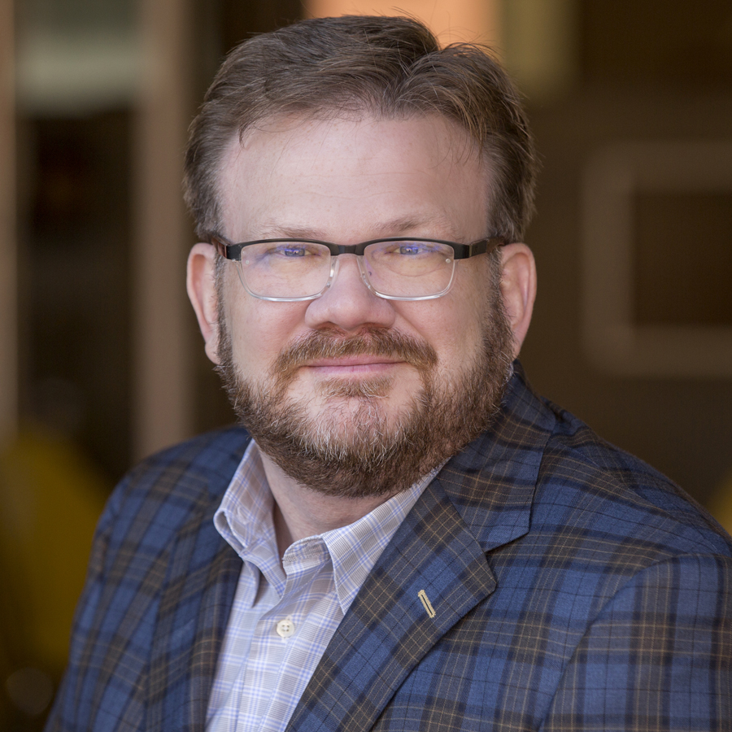
Douglas Sorocco:
Faculty Advisor
School:
  B.S. Chemistry from Butler University
  J.D. from University of Dayton School of Law
Attorney-Director at Dunlap Codding
  Practices include IP litigation, patent prosecution, licensing, commercialization, and portfolio management
Adjunct Faculty teaching Intellectual Property and will teach Patent Law in the spring
Outside of School:
  Photography
  Woodworking
  Restoration and renovation of historical homes
***Ranked in Band 1 (top band) for intellectual property by Chambers USA

Slide 5
Cloudia Ozeir: Co-President
Class: 3L; IPSEL Certificate
From: Tulsa, OK
School:
  Oklahoma University

Slide 6
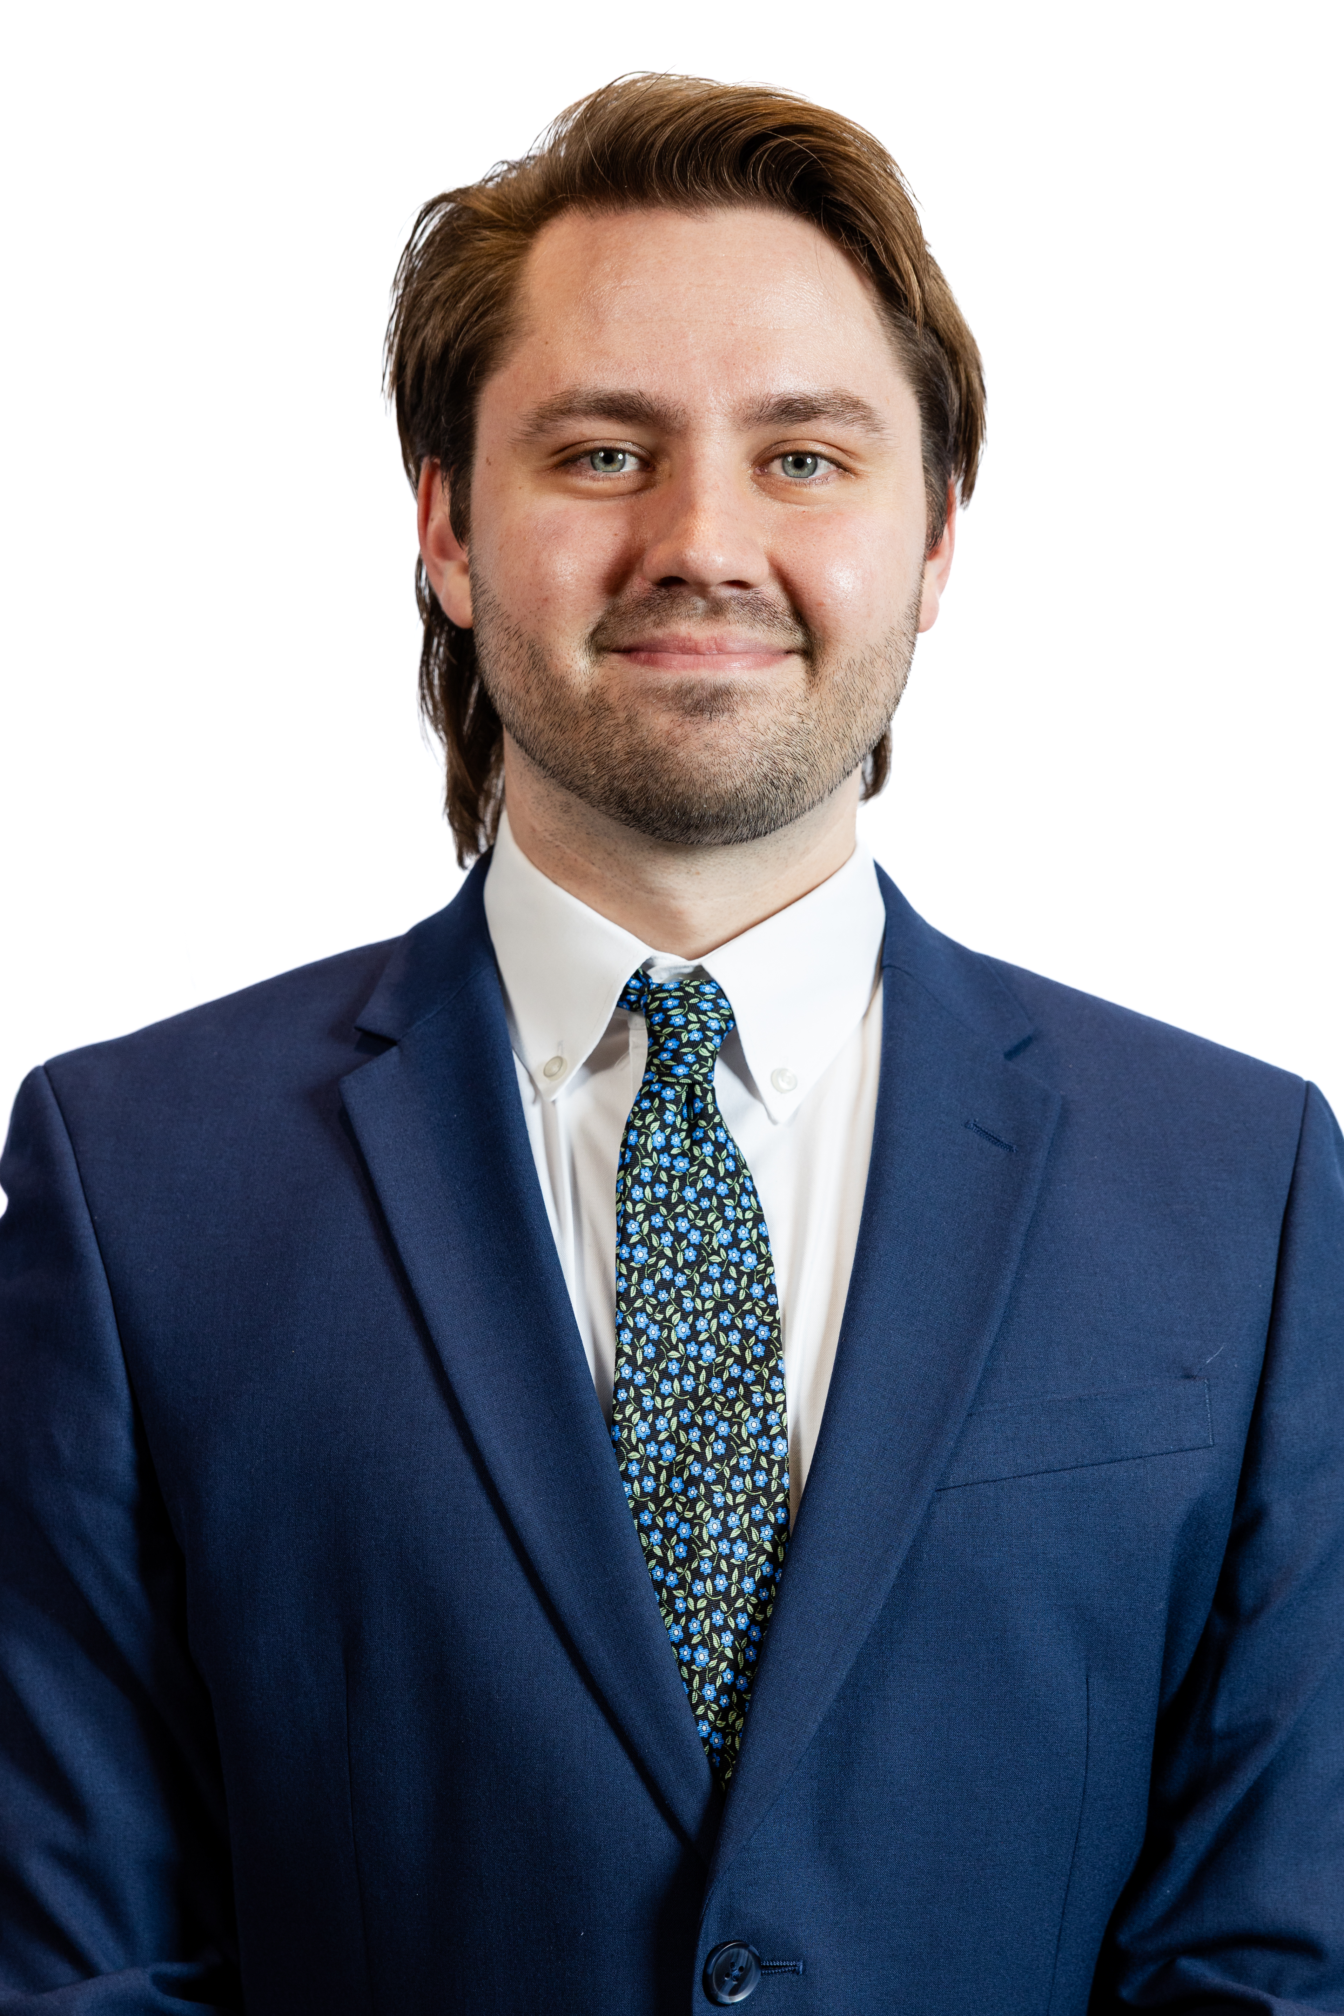
Jacob Beckham: Co-President
Class: 3L; IPSEL Certificate
From: Tulsa, OK
School:
  B.S. in Microbiology, Cellular, & Molecular Biology from Oklahoma State University
Work:
  Biopharmaceuticals, Laboratory Marijuana Testing, Medical Toxicology, and baker
Outside of School:
  Baking (attempting to make baklava atm)
  Video games (currently “playing” Dead by Daylight)
  Drag, Sci-fi and Fantasy media, and ice skating or roller-blading when I have health insurance
Plans after Grad:
  I will sit for Oklahoma Bar next July and start studying for the Patent Bar Exam

Slide 7
Helene Bergmann-busby:
Vice President
Class: 3L
From: Fort Worth, Texas
School:
  B.B.A from Texas Tech University
Outside of Law School:
  I have an interest in photography
  Reading thrillers
  Hiking and HIIT workouts
  Spending time with my dog and cat!
Plans after Grad:
  Taking the Oklahoma Bar Exam next July and working in Oklahoma before eventually moving to Colorado

Slide 8
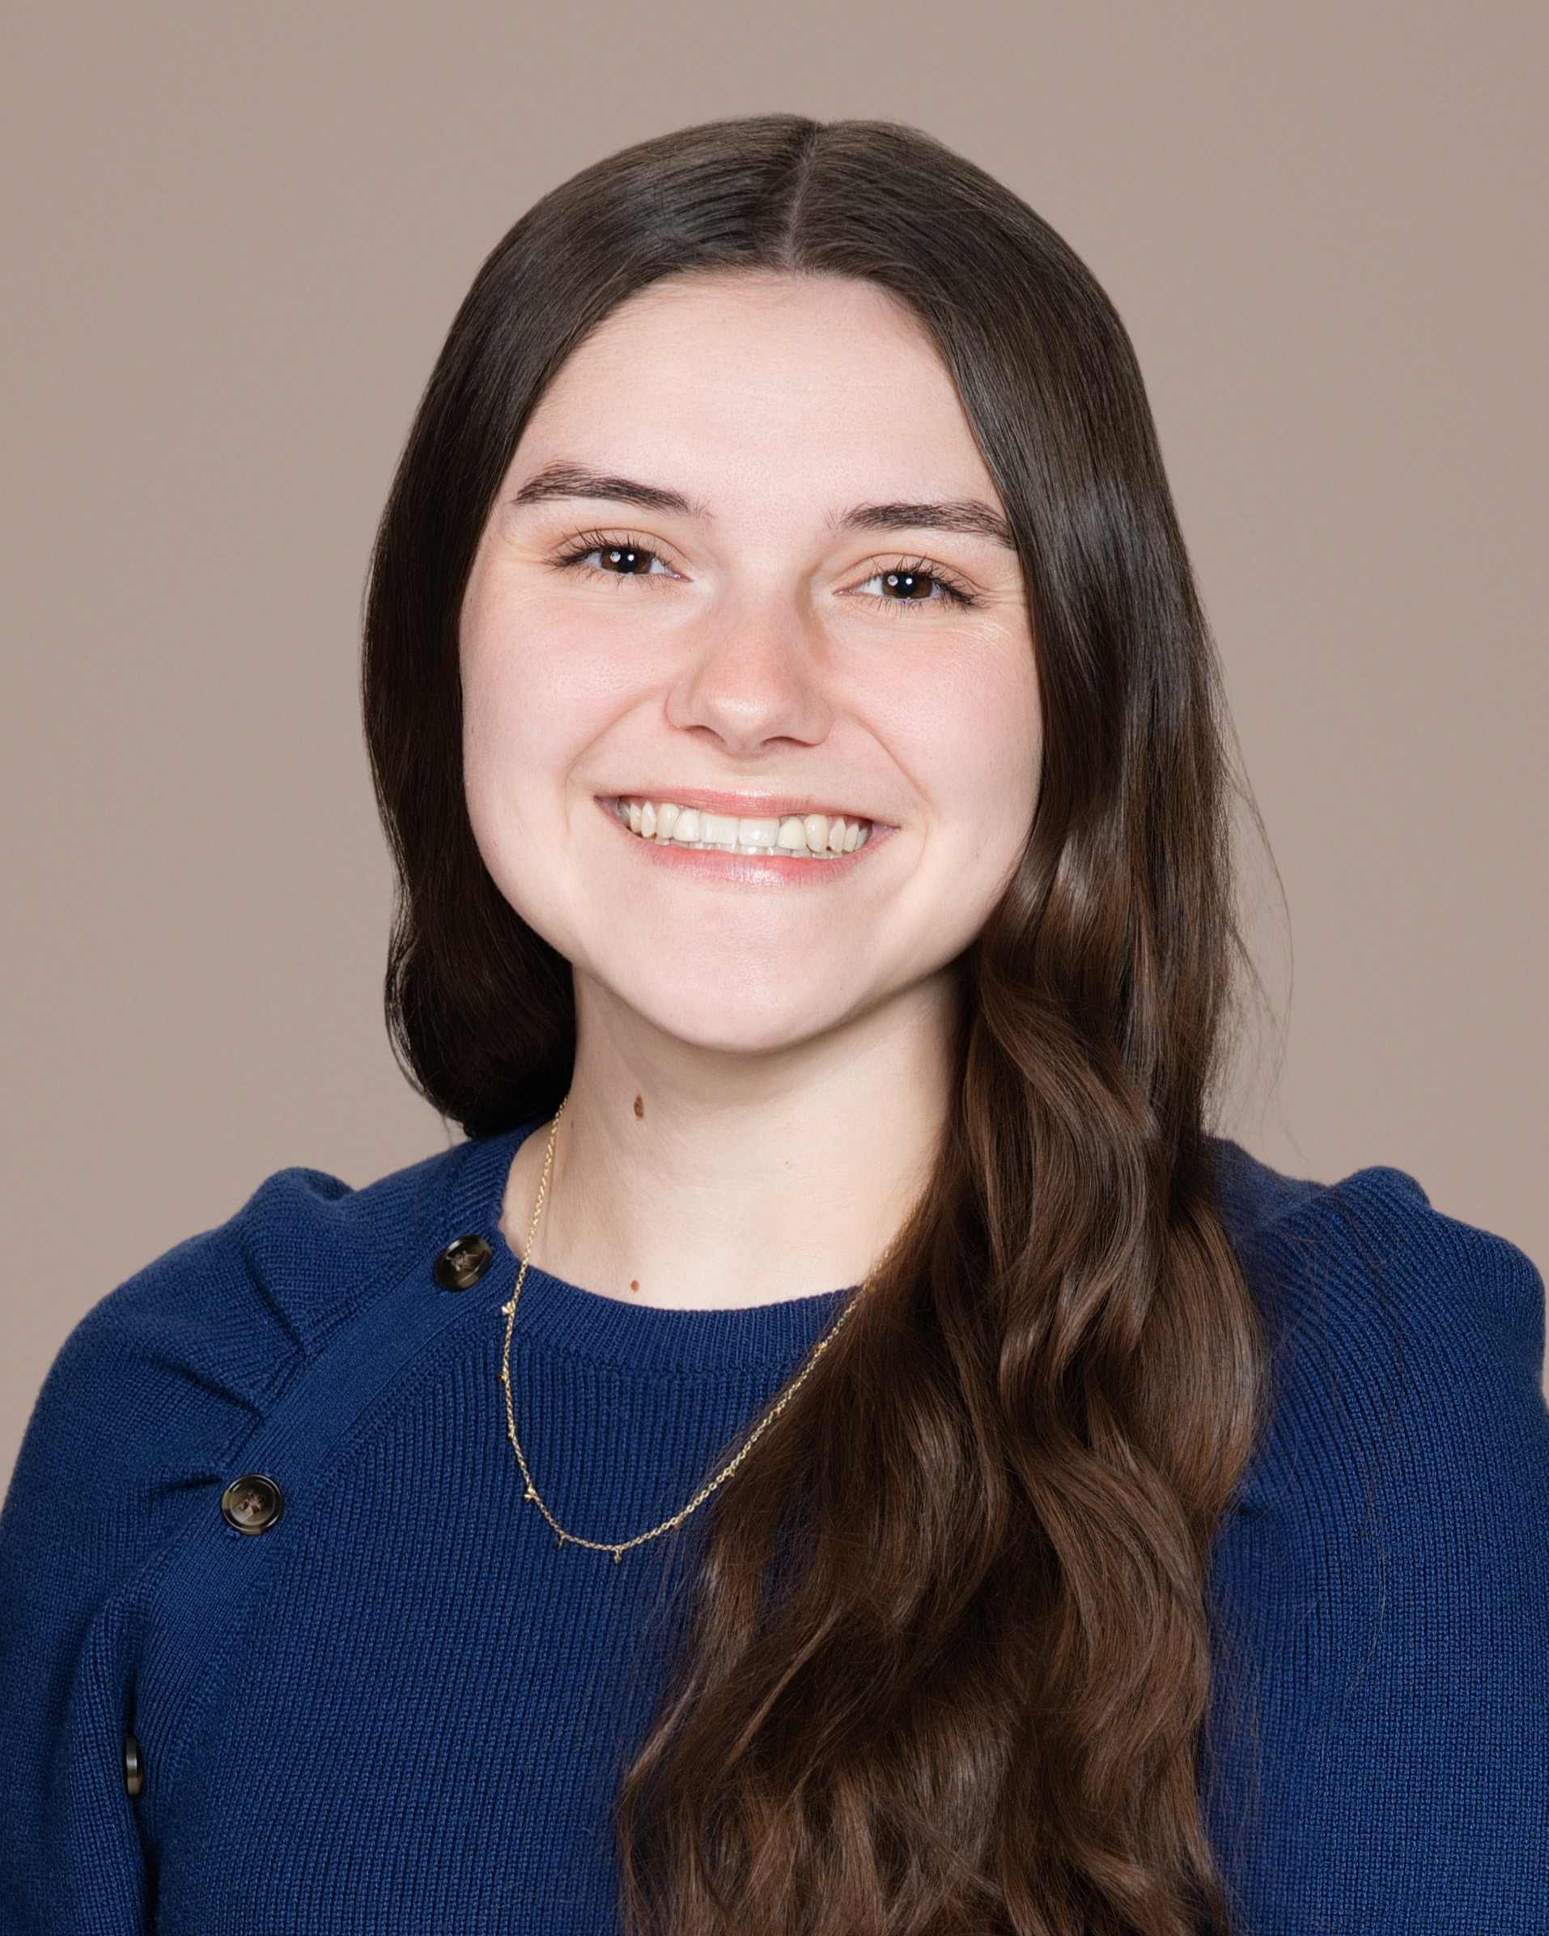
Danyelle Adamez: Treasurer
Class: 2L
From: Corpus Christi, Texas
School:
  B.S. Industrial Distribution from Texas A&M University
Outside of Law School:
  Going to the movies (big horror movie fan)
  Baking
  Video games (currently playing Star Wars Droid Tycoon)
  Sleeping

Slide 9
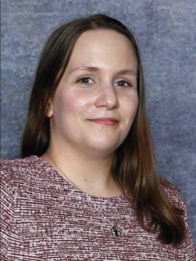
Kristyn Hart: Secretary
Class: 2L; IPSEL + Business Law Certificates
From: Peoria, IL (Born and Raised); Oklahoma City (as of 2024).
School:
  Illinois State University: B.S., Marketing with specializations in Integrated Marketing Communications (IMC) and Professional Sales
  University of Illinois: Graduate Cert, Digital Marketing (planning an MBA from U of I post JD).
Outside of Law School:
  I’m a huge sports fan (almost any sport) and can usually be found following NIL developments, business trends, or the latest innovations in marketing and entrepreneurship.
  I’m a lifelong University of Illinois basketball supporter, a dedicated St. Louis Cardinals fan, and someone who genuinely enjoys the intersection of sports, branding, and business.
  When I’m not keeping up with the sports world, I love reading, baking, embroidery, antiquing, and traveling whenever I get the chance.
  I’m always interested in discovering new places, new ideas, and the stories behind both people and businesses.

Slide 10
Our Mission
  Educate and promote the field of Intellectual Property Law
  Make connections between IP practitioners and law students
  Facilitate opportunities for our members (internships, externships, moot court sponsorships, mentorships, etc.)
  Provide a network to help law students navigate the tight knit IP community

Slide 11
Fees and Eligibility
  We have increased our fees to a $15 annual payment
    Goes to food and drinks for events/meetings, stoles and cords for graduation, setting up merch fundraisers
  Some of the events we host will be for eligible members only
    Eligible members have paid their dues by our second meeting and have attended at least two meetings this academic year

Slide 12
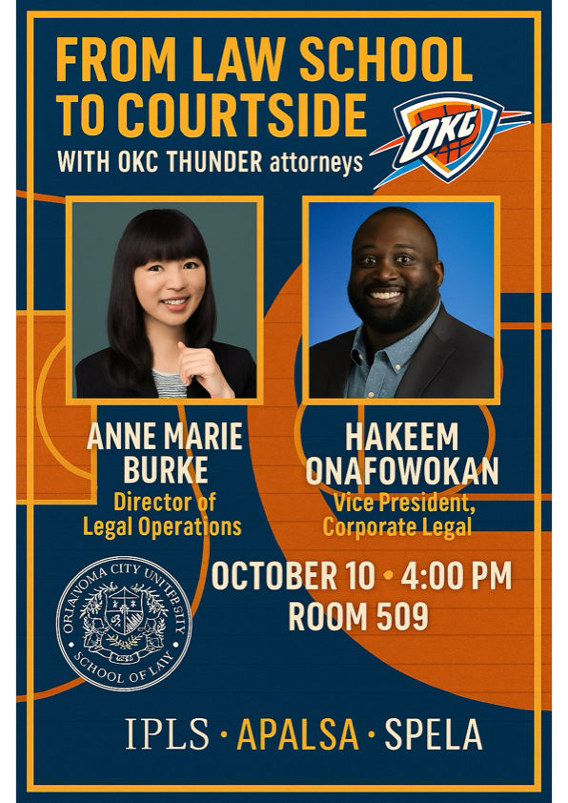
Upcoming events
“Thunder Up” OKC Thunder Attorney Panel
October TBD
Dust Bowl Fundraiser
w/ local IP Attorneys
November TBD
OK IP Bar Association
Networking Event
Spring 2027
Dunlap Codding
Networking Mixer
Spring 2027

Slide 13
Thank you All so much!!!!
We will be sending out emails to the general email and in the GroupMe about upcoming dates, updates, and opportunities!
If you have any questions, we are always happy to talk so don’t be afraid to reach out!

