Slide 1
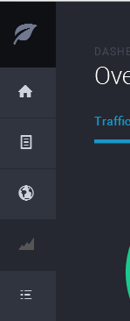
Part –1: Requirements (front – end)
Use Bootstrap, Angular
Left nav-bar default – just icons (no text)
When window is minimized – collapse
Theme peference – dark blue background (https://themes.getbootstrap.com/products/dashboard)
Theme background and navbar style (example)

Slide 2

Navbar collapse
Top: A logo image with a caption text (Onedevice) next to it.
Icon-1
(Dashboard)
ng-view (load from dashboard.html page)
{{Value1}}
(Value –1)
{{Value2}}
(Value –2)
{{ Bar Chart}}
Icon-2
(Date picker)
{{ Pie Chart}}
Page Requirements:
Box-1, 2 look like
Load any sample data from controller - $scope

Slide 3
Navbar collapse
Top: A logo image with a caption text (Onedevice) next to it.
Icon-1
(Dashboard)
ng-view (load from Datepicker.html page)
Select Date:
{{{date time}}
Button-icon
Icon-2
(Date picker)
{{{date time –2 }}
Page Requirements:
When button clicked, it will open a dialog to select date and time
Selected date and time will be shown in the text area.
Use $scope to read selected {{date time}} and update the {{ date time-2}} box.

Slide 4
Part –2: Requirements (backend– end)
Create a SQLLite test database
Use Nodejs and write Restful API to get some data
Write Angular controller code; use the API, get data and update {{Bar chart}} in dashboard.html

