Slide 1

How to make fluid in your computer?
Sareh Ataiee
Ferdowsi University of Mashhad
9-11 Ordibehesht 1404
School of Astronomy, IPM, Tehran

Slide 2
Judy Kirpich and Alex Berry
The Wave of the Future, 1981

Slide 3
Outline
Lagrangian vs Eulerian
Descritization
Accuracy, Stability, Convergence
Artificial viscosity
Finite volume method
Flux limiters
Boundary condition
Are my results correct?

Slide 4
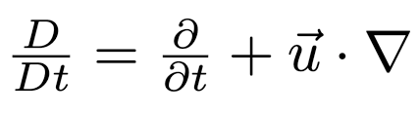
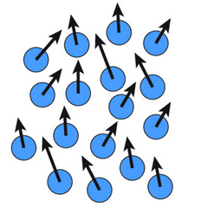
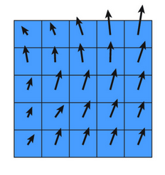
Lagrangian vs Eulerian

Slide 5

Lagrangian vs Eulerian
https://www.divecae.com/resources/sph-basics

Slide 6
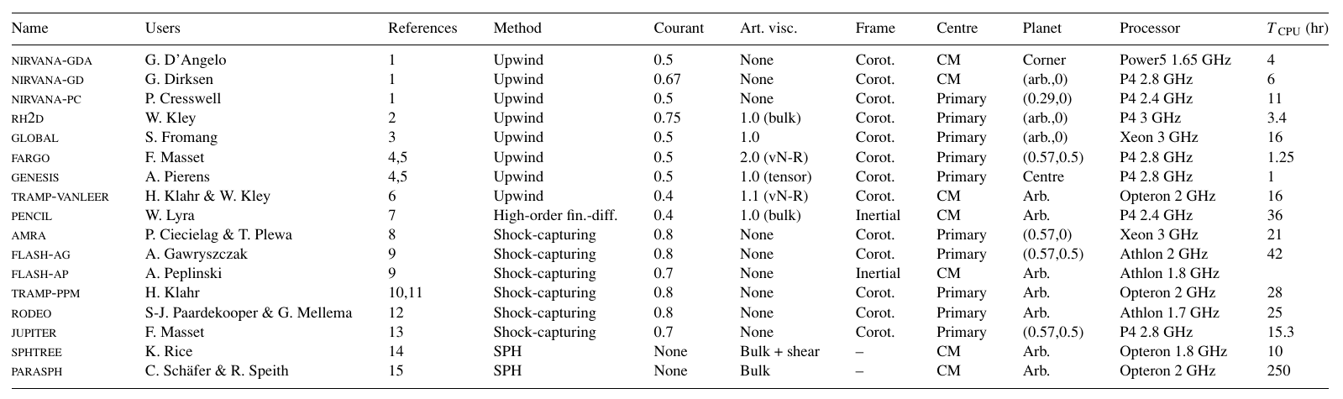
Lagrangian vs Eulerian
de val borro+2006

Slide 7
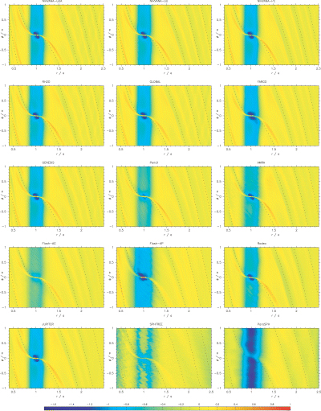
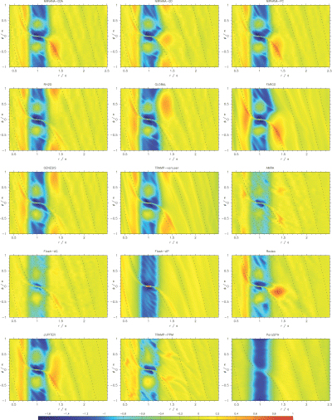
Lagrangian vs Eulerian
de val borro+2006

Slide 8
Descretization

Slide 9
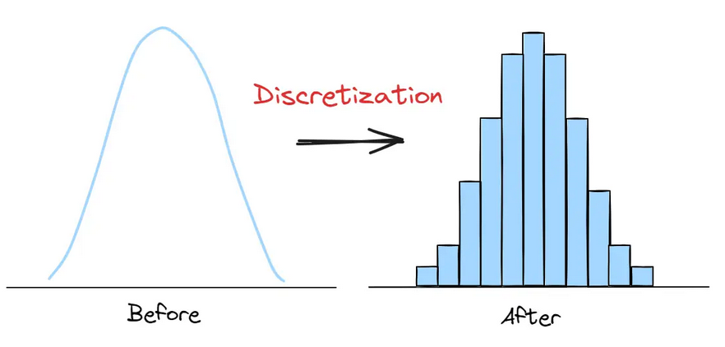
Descretization

Slide 10
Descretization
  Space:
    Computational domain → boundary condition
    Mesh/Grid → spacial resolution → even, nested, log, AMR
    Method
  Time:
    Begining and ending time
    Initial condition
    Time-step → temporal resolution → adaptive, constant

Slide 11
Descretization
  Space:
    Computational domain → boundary condition
    Mesh/Grid → spacial resolution → even, nested, log, AMR
    Method
  Time:
    Begining and ending time
    Initial condition
    Time-step → temporal resolution → adaptive, constant

Slide 12
Descretization
  Space:
    Computational domain → boundary condition
    Mesh/Grid → spacial resolution → even, nested, log, AMR
    Method
  Time:
    Begining and ending time
    Initial condition
    Time-step → temporal resolution → adaptive, constant

Slide 13
Descretization

Slide 14
Descretization
Forward-difference
Backward-difference
Centered-difference

Slide 15
Descretization
t
t^{n+1}
t^{n}
t^{n-1}
xj-1
xj
xj+1
x

Slide 16
Descretization
In space:
Cornered
Wall
Centered
Staggered:
Scalers: center
Vectors: wall
t
t^{n+1}
t^{n}
t^{n-1}
In time:
Explicit (use past)
Implicit (use future )
xj-1
xj
xj+1
x

Slide 17
Descretization

Slide 18
Descretization

Slide 19
Descretization
j-1/2
j+1/2
j-1
j
j+1

Slide 20
Descretization
j-1/2
j+1/2
j-1
j
j+1
j-1/2
j+1/2
j-1
j
j+1

Slide 21
Descretization

Slide 22
Descretization
t
t^{n+1}
t^{n}
t^{n-1}
Explicit
xj-1
xj
xj+1
x

Slide 23
Descretization

Slide 24
Descretization
t
t^{n+1}
t^{n}
t^{n-1}
Implicit
xj-1
xj
xj+1
x

Slide 25
Descretization
t
t^{n+1}
t^{n}
t^{n-1}
Implicit
xj-1
xj
xj+1
x

Slide 26
Descretization
t
t^{n+1}
t^{n}
t^{n-1}
Implicit
xj-1
xj
xj+1
x

Slide 27
Descretization
t
t^{n+1}
t^{n}
t^{n-1}
Implicit
xj-1
xj
xj+1
x

Slide 28
Accuracy, Stability, Convergence
Accuracy: how closely the finite difference approximation is to the true derivative

Slide 29
Accuracy, Stability, Convergence
Accuracy: how closely the finite difference approximation is to the true derivative

Slide 30
Accuracy, Stability, Convergence
Accuracy: how closely the finite difference approximation is to the true derivative
→ Forward-difference is a first order method.

Slide 31
Accuracy, Stability, Convergence
Accuracy: how closely the finite difference approximation is to the true derivative
→ Centered-difference is a second order method.

Slide 32
Accuracy, Stability, Convergence
Stability: how errors evolve during computation?
Von Neumann stability analysis
Fourier series expansion
Apply on the numerical method
Analysing the amplification
(Amplitude + Phase)

Slide 33
Accuracy, Stability, Convergence
Stability: how errors evolve during computation?

Slide 34
Accuracy, Stability, Convergence
Stability: how errors evolve during computation?

Slide 35
Accuracy, Stability, Convergence
Stability: how errors evolve during computation?

Slide 36
Accuracy, Stability, Convergence
Stability: how errors evolve during computation?

Slide 37
Accuracy, Stability, Convergence
Stability: how errors evolve during computation?
Timestep must be smaller that the information
propagation timescale in a cell.

Slide 38
Accuracy, Stability, Convergence
Stability: how errors evolve during computation?
Timestep must be smaller that the information
propagation timescale in a cell.
Courant–Friedrichs–Lewy (CFL) condition:

Slide 39
Accuracy, Stability, Convergence
Convergence: The solution approache the true solution as grid refines.
Accuracy + Stability
Convergence

Slide 40
Accuracy, Stability, Convergence
Convergence: The solution approache the true solution as grid refines.
Accuracy + Stability
Convergence
How to test the convergence?
  Validation on test problems
  Theoretical analysis of stability and accuracy
  Resolution test

Slide 41
Artificial viscosity

Slide 42
Artificial viscosity
Von Neumann
stability analysis

Slide 43
Artificial viscosity
Von Neumann
stability analysis

Slide 44
Artificial viscosity

Slide 45
Artificial viscosity
Von Neumann
stability analysis

Slide 46
Artificial viscosity
Von Neumann
stability analysis

Slide 47
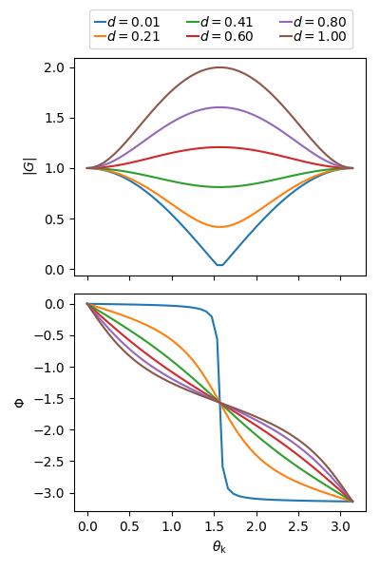
Artificial viscosity
Von Neumann
stability analysis

Slide 48

Artificial viscosity

Slide 49
Artificial viscosity
Von Neumann
stability analysis
Numerical diffusion

Slide 50
Artificial viscosity
Some times we add an artificial diffusion to smooth the shocks → Artificial viscosity

Slide 51
Artificial viscosity
Some times we add an artificial diffusion to smooth the shocks → Artificial viscosity

Slide 52


Slide 53
Finite volume method

Slide 54
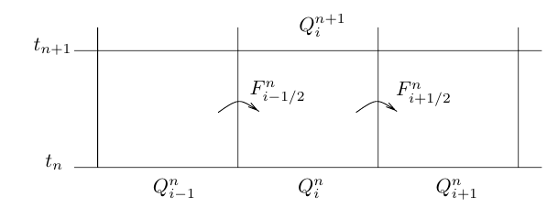
Finite volume method

Slide 55
Finite volume method

Slide 56
Finite volume method

Slide 57
Finite volume method
Method which use flux-conserving schemes are called
Finite Volume Methods.

Slide 58
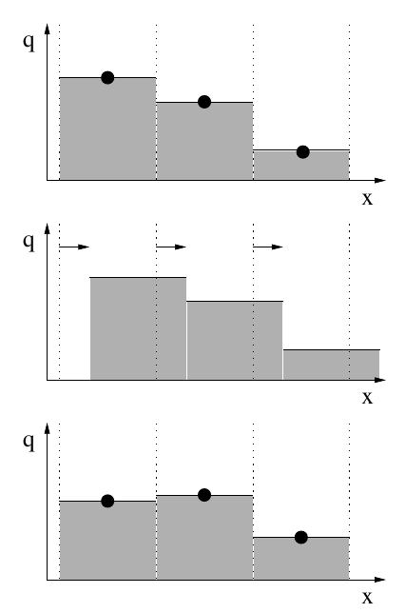
Donor-cell scheme

Slide 59
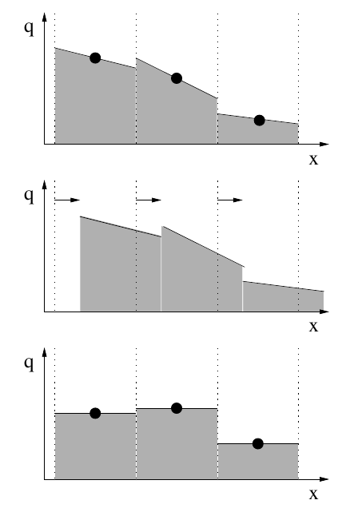
Different slopes

Slide 60
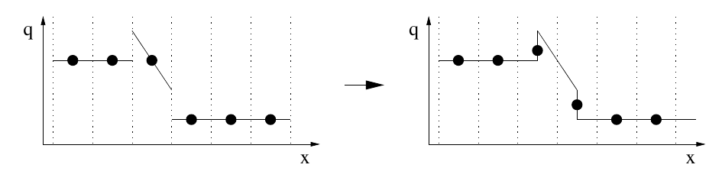
Slope limiters

Slide 61
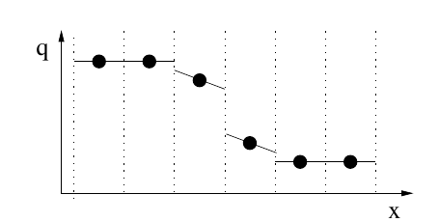
Slope limiters

Slide 62
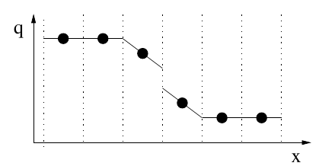
Slope limiters

Slide 63
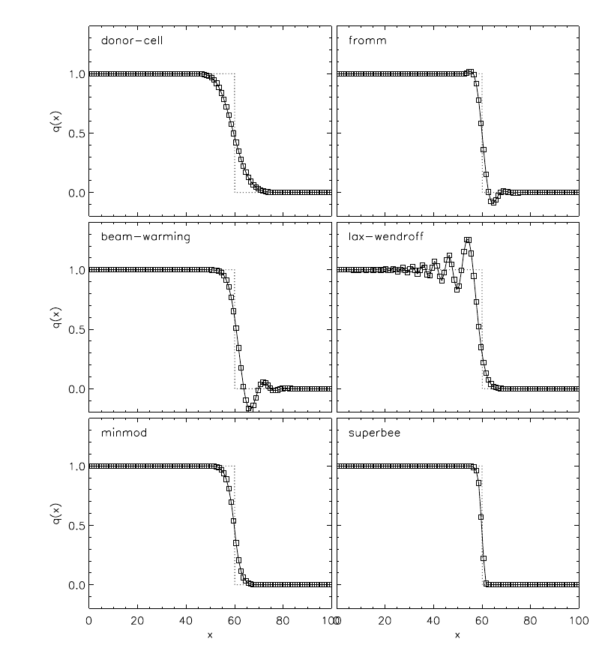
Slope limiters

Slide 64
Flux limiters

Slide 65
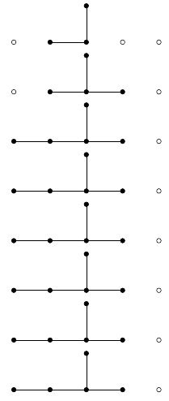
Flux limiters
Name | Order | Lin? | Stable | Stencil
Donor-cell | 1 | lin | yes
Lax-Wendroff | 2 | lin | yes
Beam-Warming | 2 | lin | yes
Fromm | 2 | lin | yes
Minmod | 2/1 | non-lin | yes
Superbee | 2/1 | non-lin | yes
MC | 2/1 | non-lin | yes
van Leer | 2/1 | non-lin | yes

Slide 66
Boundary condition
x0
x1
x2
xn

Slide 67
Boundary condition
x0
x1
x2
xn

Slide 68

Boundary condition
x0
x1
x2
xn

Slide 69

Boundary condition

Slide 70
Boundary condition
x0
x1
x2
xn

Slide 71
Boundary condition

Slide 72
Boundary condition

Slide 73
Boundary condition

Slide 74
Hydrodynamics code
Initial condition
Boundary condition
Timestep calculation
Advance one timestep
t ? tdue
Apply boundary condition
Write the outputs
and (maybe)
Finish

Slide 75
Hydrodynamics code
Initial condition
Boundary condition
Timestep calculation
Advance one timestep
t ? tdue
Apply boundary condition
Write the outputs
and (maybe)
Finish

Slide 76
Operator splitting

Slide 77
And many more...
Multidimensional solvers

Slide 78
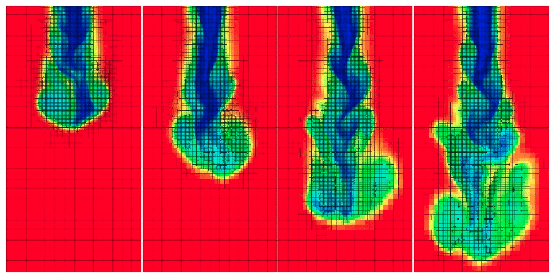
And many more...
Multidimensional solvers
AMR (Adaptive Mesh Refinement)

Slide 79
And many more...
Multidimensional solvers
AMR (Adaptive Mesh Refinement)
Shock capturing methods
Non-square grids
...

Slide 80
Are my results correct?
Proper code
Proper initial condition (GIGO)
Proper boundary condition (test, modify, compare)
Convergence and resolution test
Compare with a second code (different method)
(if possible) Compare with an analytical solution

Slide 81
Resources
C.P.Dullemond lecture notes on Numerical Fluid Mechanics
Randall J. LeVeque, "Finite Volume Methods for Hyperbolic Problems", 2002, Cambridge University Press
Bodenheimer, Laughlin, Rozyczka and Yorke, "Numerical Methods in Astrophysics: An Introduction" , 2006, CRC Press.
Hoffmann, K.A. and Chiang, S.T. “Computational Fluid Dynamics Volume I.”, 2000, Engineering Education System, Wichita, USA.

