Slide 1


Predicting Employee Salary Based on Years of Experience
Simple Linear Regression
Machine Learning Project
Presented by:-
Ali Azim
Batch – 05
IIM Rohtak

Slide 2

Project Objective
Understanding the relationship between employee experience and salary
Constructing a linear regression model to estimate salaries.
Analyzing how each additional year of experience affects salary
Checking the model’s effectiveness and accuracy

Slide 3
Dataset Overview
Source: Kaggle.com
Salary Dataset for Simple Linear Regression https://www.kaggle.com/datasets/abhishek14398/salary-dataset-simple-linear-regression
Total Records: 30 employees
Variables: 2 (Years of Experience, Salary)
Independent Variable (X): Years of Experience (in years)
Dependent Variable (Y): Salary (in $)

Slide 4
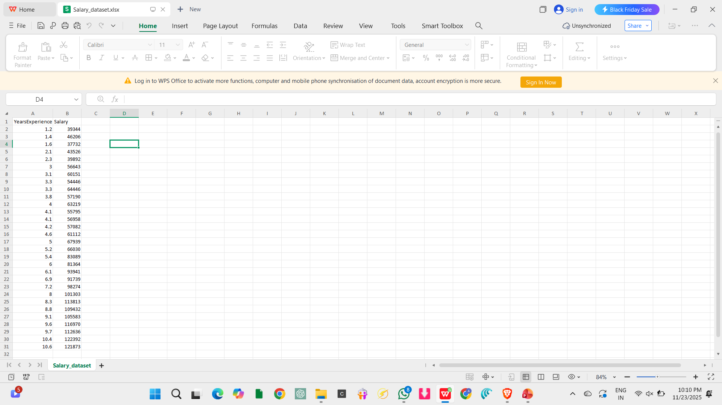
Dataset
Targeted dataset for our Linear Regression test

Slide 5
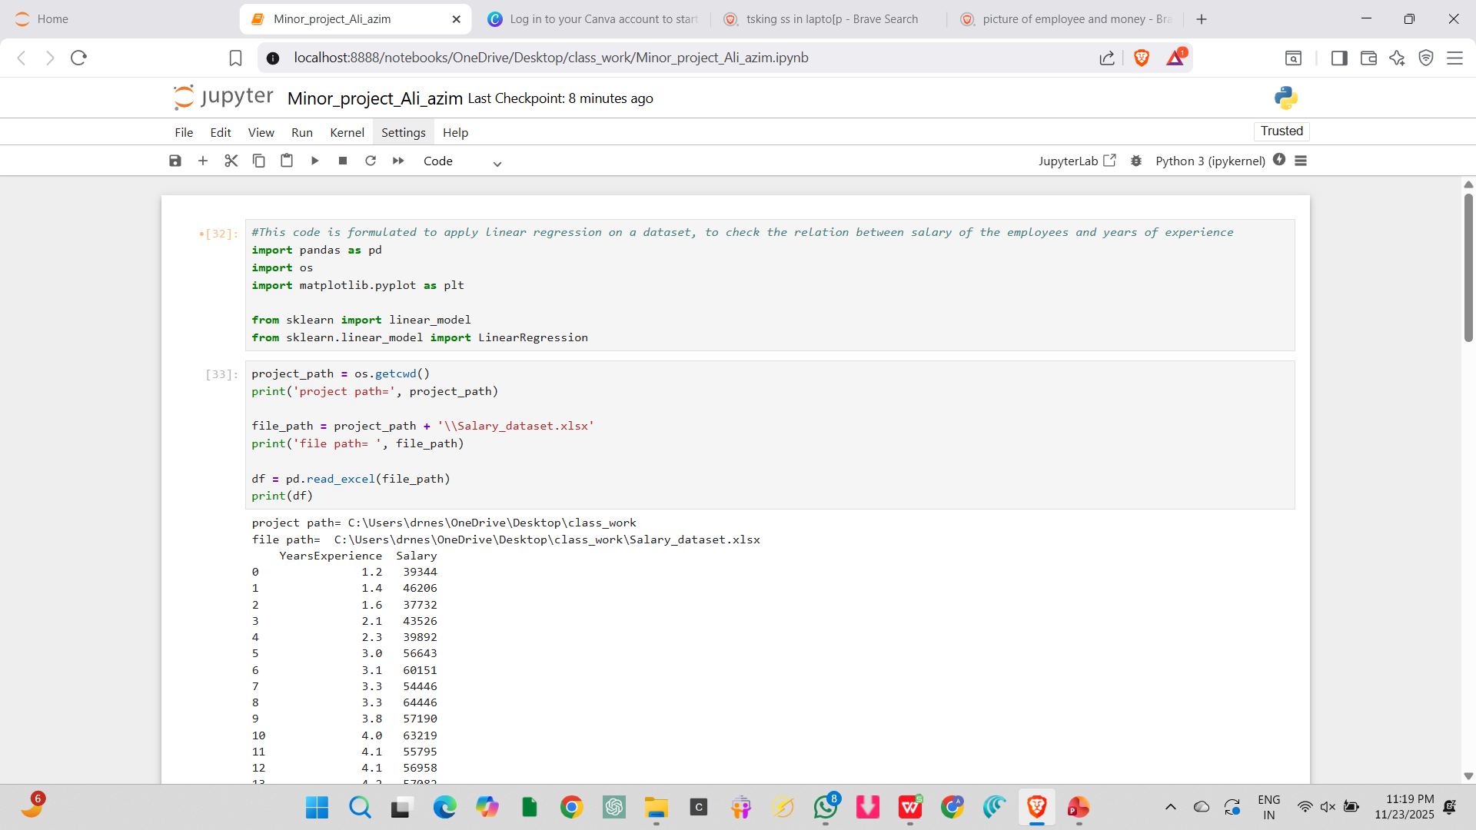
Data Preparation & Loading
Imported required libraries:
pandas: Supports reading or writing data from various CSV, Excel etc. files.
matplotlib: Used for data visualization and graph plotting
sklearn: Used for machine learning including regression, classification and clustering.
Loaded dataset from Excel file using pd.read_excel()

Slide 6
Reading Excel Data into Jupyter Notebook
Through this code, we include the dataset into jupyter notebook along with file path and project path for further processes, coding and calculations.

Slide 7
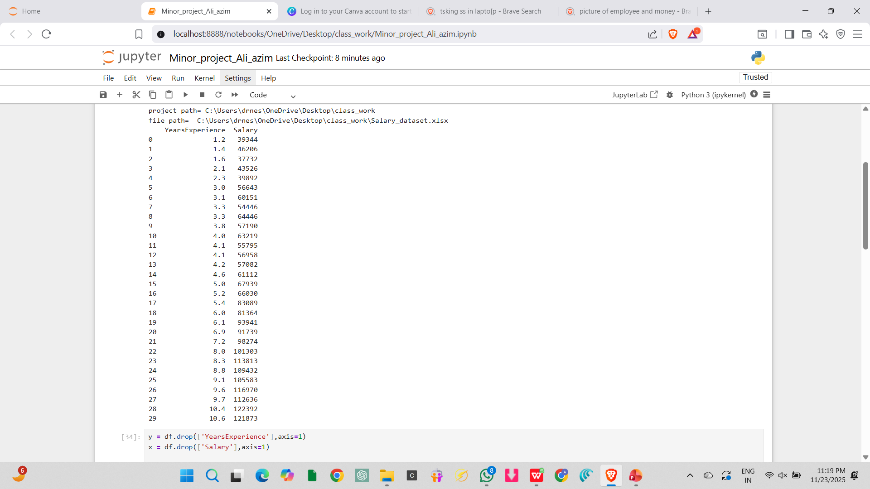
Output

Slide 8
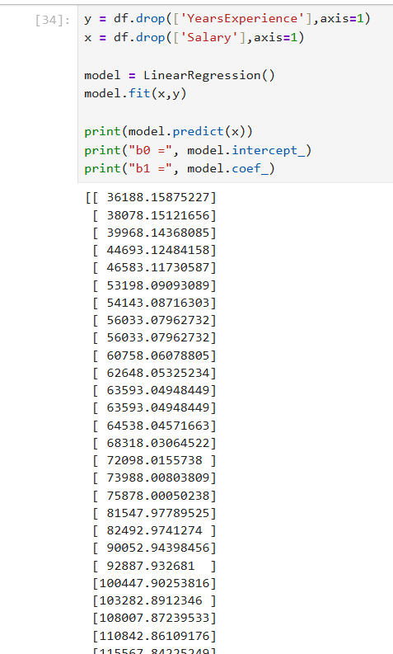
Model Building Process
Imported LinearRegression from sklearn.linear_model
Created the model: model = LinearRegression()
Fitted the model: model.fit(x, y)
Model learns the relationship between x and y
Generated regression coefficients (intercept and slope, where b0 is the intercept and b1 is the slope)

Slide 9
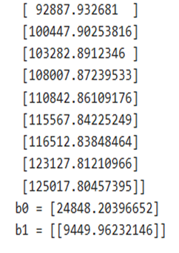
Continued
Regression Equation: Salary = b₀ + b₁ × YearsExperience (based on y = mx + c)
b₀ (Intercept): approximately 24,848 i.e. Base salary with 0 years experience
b₁ (Slope): approximately 9,449.96 i.e. Salary increase per year of experience
For every additional year of experience, salary increases approximately by $9,450

Slide 10
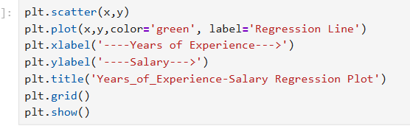
Usage of matplotlib.pyplot
Used functions like scatter, plot, xlabel, ylabel, title, grid, functions to accurately display the graph of Linear Regression

Slide 11
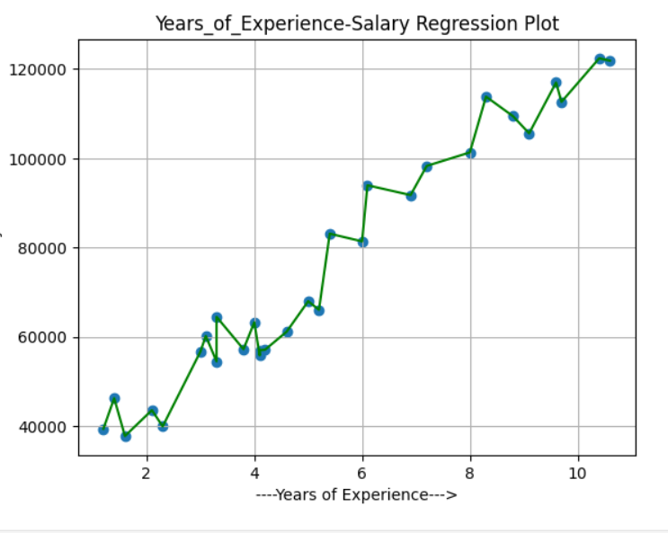
Key Findings of the Regression Plot
Blue Scatter Points: Actual employee salaries
Green Line: Linear regression line showing the positive trend
Observation: Strong positive correlation between experience and salary
As experience increases from 1-10 years, salary increases from $40K to $122K
The regression line captures this upward trend accurately

Slide 12
Key Findings & Conclusions
Strong positive linear relationship: More experience leads to higher salary
Each year adds approximately $9,450 to expected salary
Model is effective for salary prediction within the given experience range
Linear regression successfully captures the relationship pattern

Slide 13



Real-World Applications
HR departments can use this for salary benchmarking
We can predict salary ranges for job candidates based on experience
This can act as a foundation for more complex models with multiple variables

Slide 14
Thank You!
Simple Linear Regression - Salary Prediction
This Project was made under the guidance of Sir Vikas Goel, for which I am highly grateful to him.

