Slide 1
Save The Forest
IPMAIA
Let’s start!

Slide 2
What is
Save the Forest?
We are an international non-profit organization,
which aims to create healthy coast-to-coast forests from stable bottoms
to fight and prevent fires and forest clearing.
Learn more!
Notes:
We are an international non-profit organization,
which aims to create healthy coast-to-coast forests from stable bottoms
to fight and prevent fires and forest clearing.

Slide 3
Sketches

Slide 4
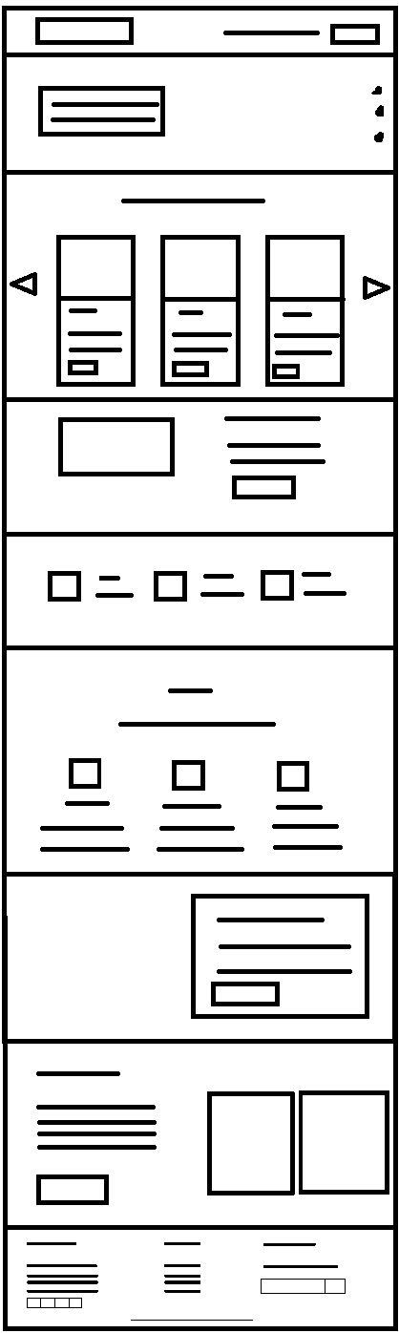
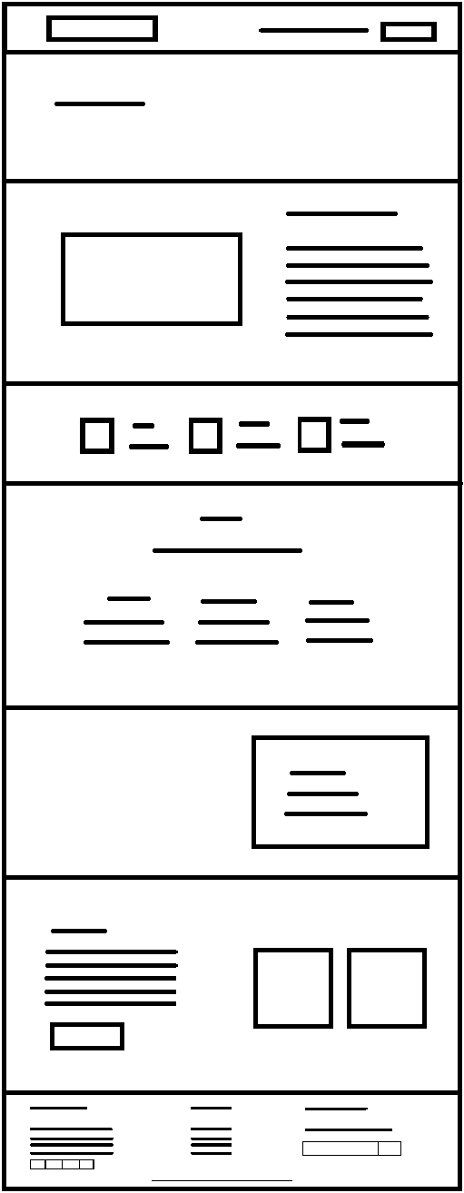
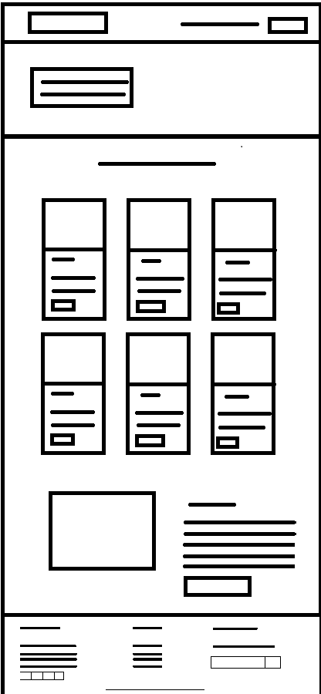
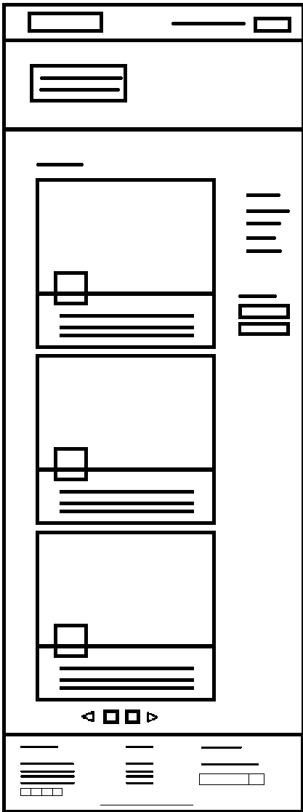

Slide 5
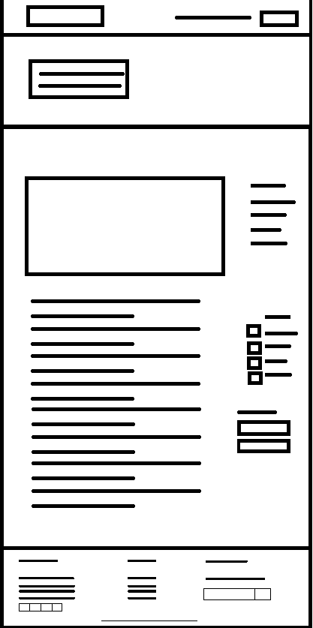
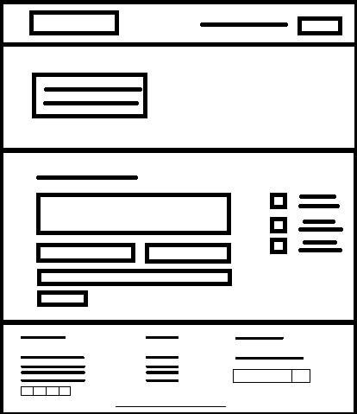
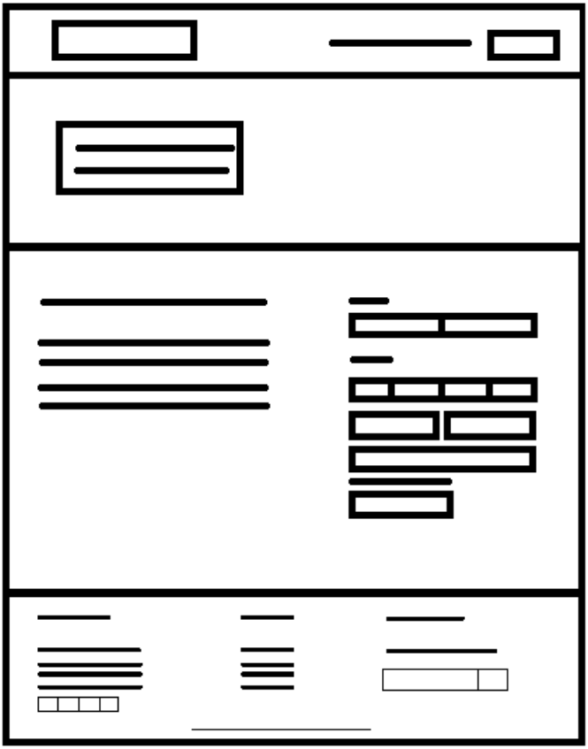

Slide 6
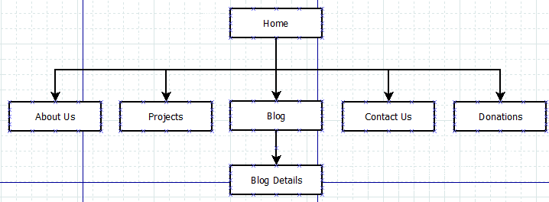
Site Map

Slide 7
Product
Back
It is possible to access the site from
https://tiwm21-ti-g05.netlify.app

Slide 8
Instalation
Back
In order to run our project it is necessary to have some type of program:
Wamp acts like a virtual server on your computer. It allows you to test all WordPress features without any consequences since it’s localized on your machine and is not connected to the web.
Play!

Slide 9
What about
technologies
HTML5, CSS3, Javascript and XML

Slide 10
What about
Frameworks
& libraries

Slide 11
jQuery
Next
jQuery is a lightweight, JavaScript library. The purpose of jQuery is to make it much easier to use JavaScript on your website.

Slide 12
Why jQuery?
Next
JavaScript enhancement without the overhead of learning new syntax;
Ability to keep the code simple, clear, readable and reusable;
Ease of use
Large library

Slide 13
jQuery Barfiller
jQuery Form
jQuery Validate
jQuery Nice Select
jQuery Slicknav
CounterUp
popper
slick
Next

Slide 14
Bootstrap
Next
It is a front-end framework used for easier and faster web development and includes HTML and CSS based design templates

Slide 15
Why use Bootstrap
Next
Responsive structures and styles;
Several JavaScript plugins using the jQuery;
Loads of free and professional templates, WordPress themes and plugins;

Slide 16
SASS
Next
Sass is a CSS preprocessor

Slide 17
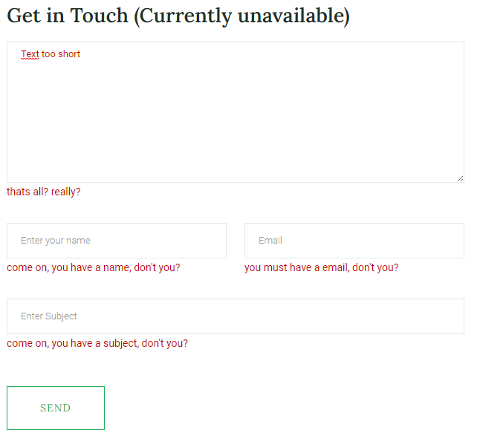
Forms
Next
Spix’s Macaw

Slide 18
Application - Html
Back
The page is divided into 7 pages:
Home;
About Us;
Projects;
Blog;
Blog Details;
Contact Us;
Donations.

Slide 19
Application - XML/XSD
Back
blog.xml
blog.xsd;
projects.xml;
projects.xsd.

Slide 20

Website
Back

Slide 21

Thanks
Any doubt?

