Slide 1
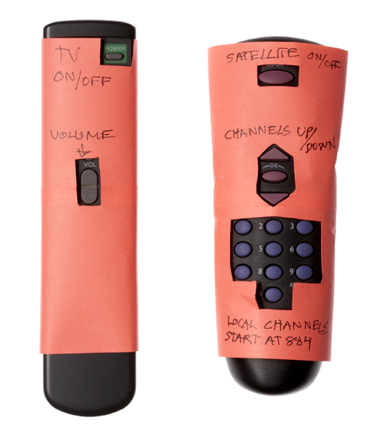
Assignment # 1
From your surroundings from your interest pick any two interactive products (1 software and 1 Hardware) study their interaction features and list down at least 5 God & Bad design points. As a user, for those 5 bad design points you are requested to provide your improved design as an alternative. CLO 1
You Have to make presentation and inform class regarding improvements you suggested.
Group of 2 members each will describe 1 product. (Next Monday)

