Slide 1
Discernment Analysis
Reporter : 王士銘

Slide 2
Outline
Classification
Minimum Error – Maximum A Posterior
Estimation of parameters
Maximum Likelihood
Bayesian Estimation
Discernment Function
Conclusion

Slide 3

Classification
Given an object, tell which class it belongs to
Step -
Learn from training objects with class labels
Classifying testing objects without class labels
Assumption - Each class of object follow a probability distribution with some parameters
Machine learning theory guarantees small training error leads to small testing error
The object of classifying algorithm is thus minimizing training error

Slide 4
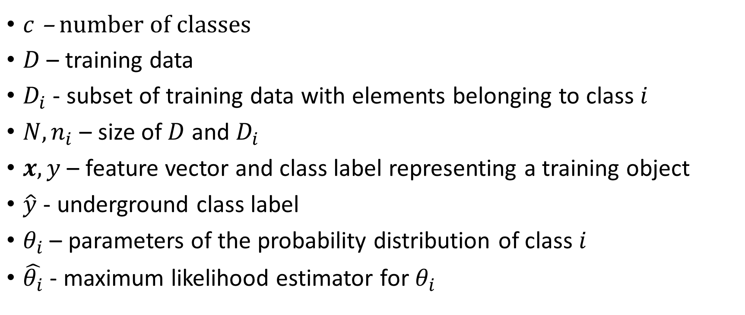
Notations
$c$ – number of classes
$D$ – training data
$D_{i}$ - subset of training data with elements belonging to class $i$
$N,n_{i}$ – size of $D$ and $D_{i}$
$x,y$ – feature vector and class label representing a training object
$\hat{y}$ - underground class label
$θ_{i}$ – parameters of the probability distribution of class $i$
$\hat{θ_{i}}$ - maximum likelihood estimator for $θ_{i}$

Slide 5

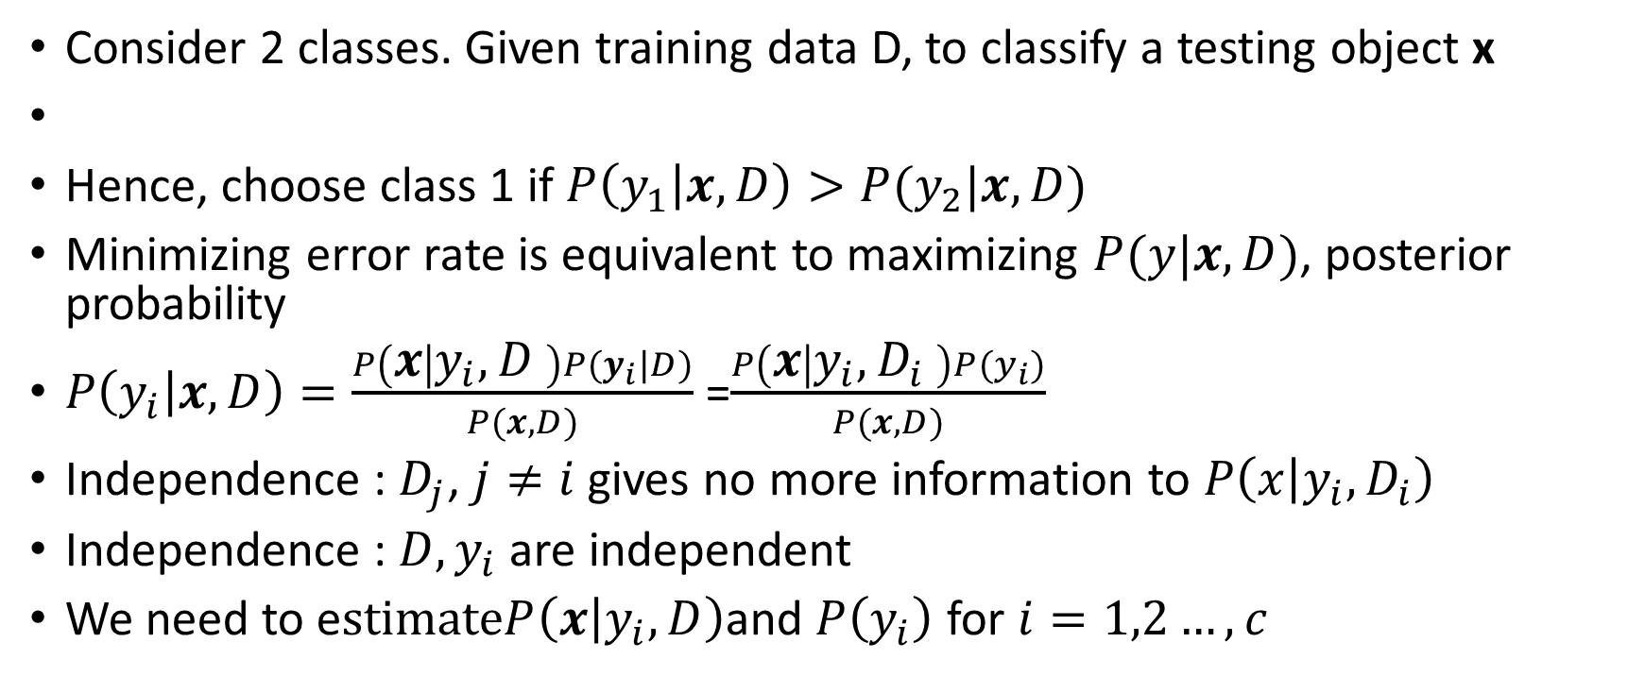
Minimum Error (Testing)
Consider 2 classes. Given training data D, to classify a testing object x
Hence, choose class 1 if $P\left(y_{1} | x,D\right)>P(y_{2}|x,D)$
Minimizing error rate is equivalent to maximizing $P(y|x,D)$, posterior probability
$P\left(y_{i} | x,D\right)=\frac{P\left(x | y_{i},D \right)P(y_{i}|D)}{P(x,D)}$ =$\frac{P\left(x | y_{i},D_{i} \right)P(y_{i})}{P(x,D)}$
Independence : $D_{j}$, $j≠i$ gives no more information to $P\left(x | y_{i}, D_{i}\right)$
Independence : $D, y_{i}$ are independent
We need to e$stimateP\left(x | y_{i},D\right)$and $P\left(y_{i}\right)$ for $i=1,2…, c$

Slide 6
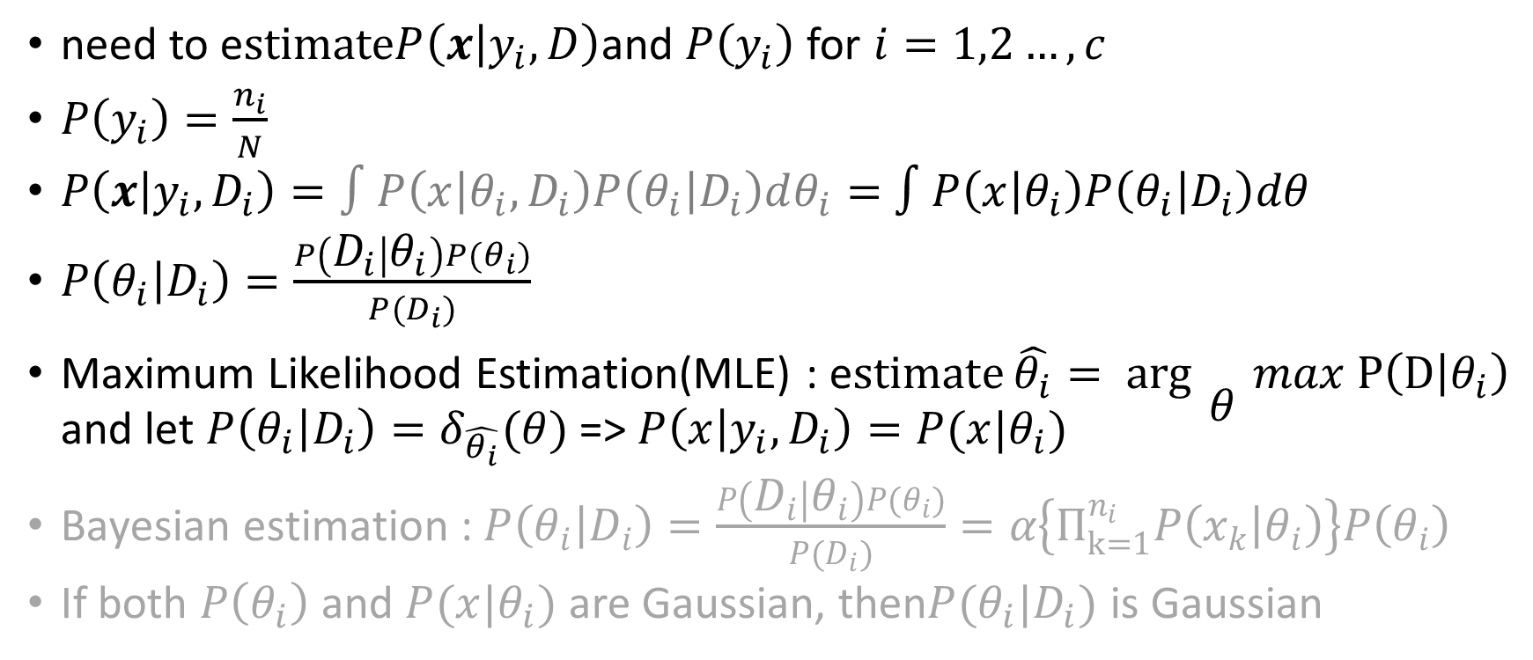
Estimation of Parameters(Training)
need to e$stimateP\left(x | y_{i},D\right)$and $P\left(y_{i}\right)$ for $i=1,2…, c$
$P\left(y_{i}\right)=\frac{n_{i}}{N}$
$P\left(x | {y_{i}, D}_{i}\right)=∫P\left(x | θ_{i},D_{i}\right)P\left(θ_{i} | D_{i}\right)dθ_{i}=$ $∫P\left(x | θ_{i}\right)P\left(θ_{i} | D_{i}\right)dθ$
$P\left(θ_{i} | D_{i}\right)=\frac{P\left(D_{i} | θ_{i}\right)P(θ_{i})}{P(D_{i})}$
Maximum Likelihood Estimation(MLE) : e$stimate\hat{θ_{i}}= arg{\begin{aligned} \\ θ\end{aligned}}max P\left(D | θ_{i}\right)$ and let $P\left(θ_{i} | D_{i}\right)=δ_{\hat{θ_{i}}}(θ)$ => $P\left(x | y_{i},D_{i}\right)=P(x|θ_{i})$
$\text{Bayesian} \text{estimation}\text{ : }P\left(θ_{i} | D_{i}\right)=\frac{P\left(D_{i} | θ_{i}\right)P(θ_{i})}{P(D_{i})}=α\left\{Π_{k=1}^{n_{i}}P\left(x_{k} | θ_{i}\right)\right\}P\left(θ_{i}\right)$
If both $P\left(θ_{i}\right)$ and $P(x|θ_{i})$ are Gaussian, then$P(θ_{i}|D_{i})$ is Gaussian

Slide 7
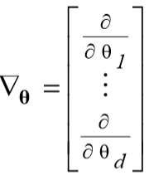
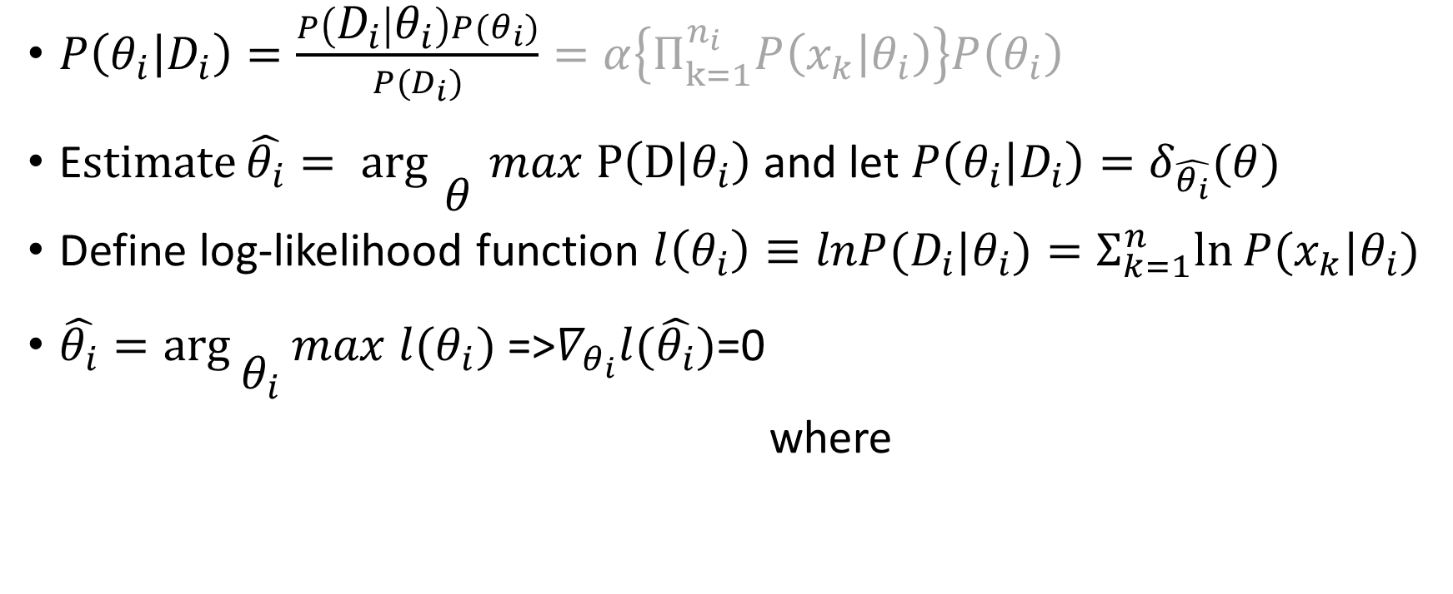
Maximum Likelihood Estimation(Training)
$P\left(θ_{i} | D_{i}\right)=\frac{P\left(D_{i} | θ_{i}\right)P(θ_{i})}{P(D_{i})}=α\left\{Π_{k=1}^{n_{i}}P\left(x_{k} | θ_{i}\right)\right\}P\left(θ_{i}\right)$
E$stimate\hat{θ_{i}}= arg{\begin{aligned} \\ θ\end{aligned}}max P\left(D | θ_{i}\right)$ and let $P\left(θ_{i} | D_{i}\right)=δ_{\hat{θ_{i}}}(θ)$
Define log-likelihood function $l\left(θ_{i}\right)≡lnP(D_{i}|θ_{i})=Σ_{k=1}^{n}ln⁡P(x_{k}|θ_{i})$
$\hat{θ_{i}}=\arg{\begin{aligned} \\ θ_{i}\end{aligned}}max l(θ_{i})$ =>$∇_{θ_{i}}l(\hat{θ_{i}})$=0
where

Slide 8
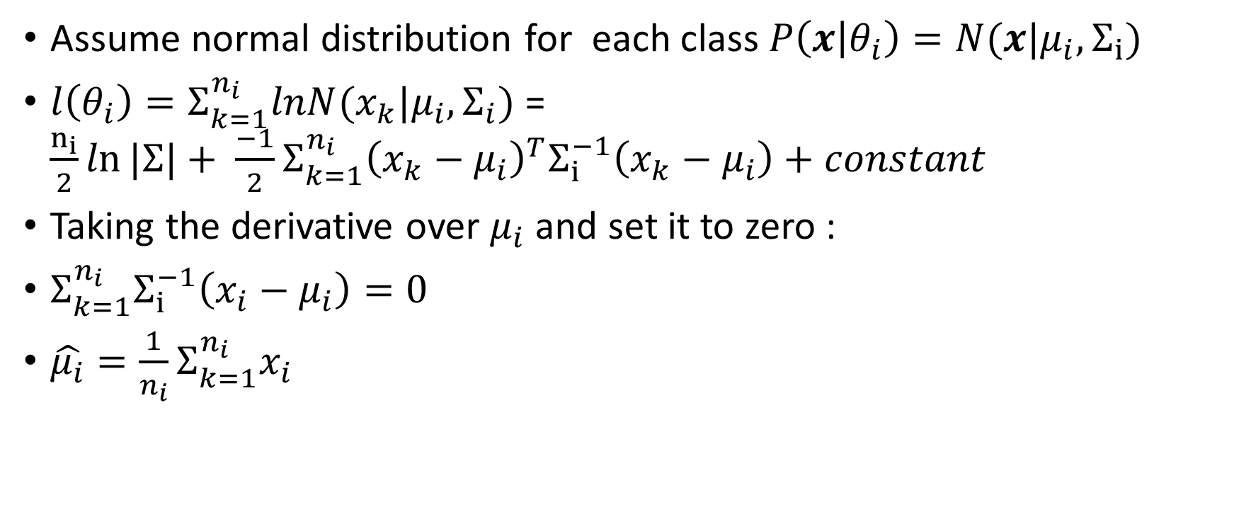
Maximum Likelihood Estimation(Training)
Assume normal distribution for each class $P\left(x | θ_{i}\right)=N(x|μ_{i},Σ_{i})$
$l\left(θ_{i}\right)=Σ_{k=1}^{n_{i}}lnN(x_{k}|μ_{i},Σ_{i})$ = $\frac{n_{i}}{2}ln⁡|Σ|+ {\frac{−1}{2}Σ}_{k=1}^{n_{i}}{\left(x_{k}−μ_{i}\right)}^{T}Σ_{i}^{−1}\left(x_{k}−μ_{i}\right)+constant$
Taking the derivative over $μ_{i}$ and set it to zero :
$Σ_{k=1}^{n_{i}}Σ_{i}^{−1}\left(x_{i}−μ_{i}\right)=0$
$\hat{μ_{i}}=\frac{1}{n_{i}}Σ_{k=1}^{n_{i}}x_{i}$

Slide 9
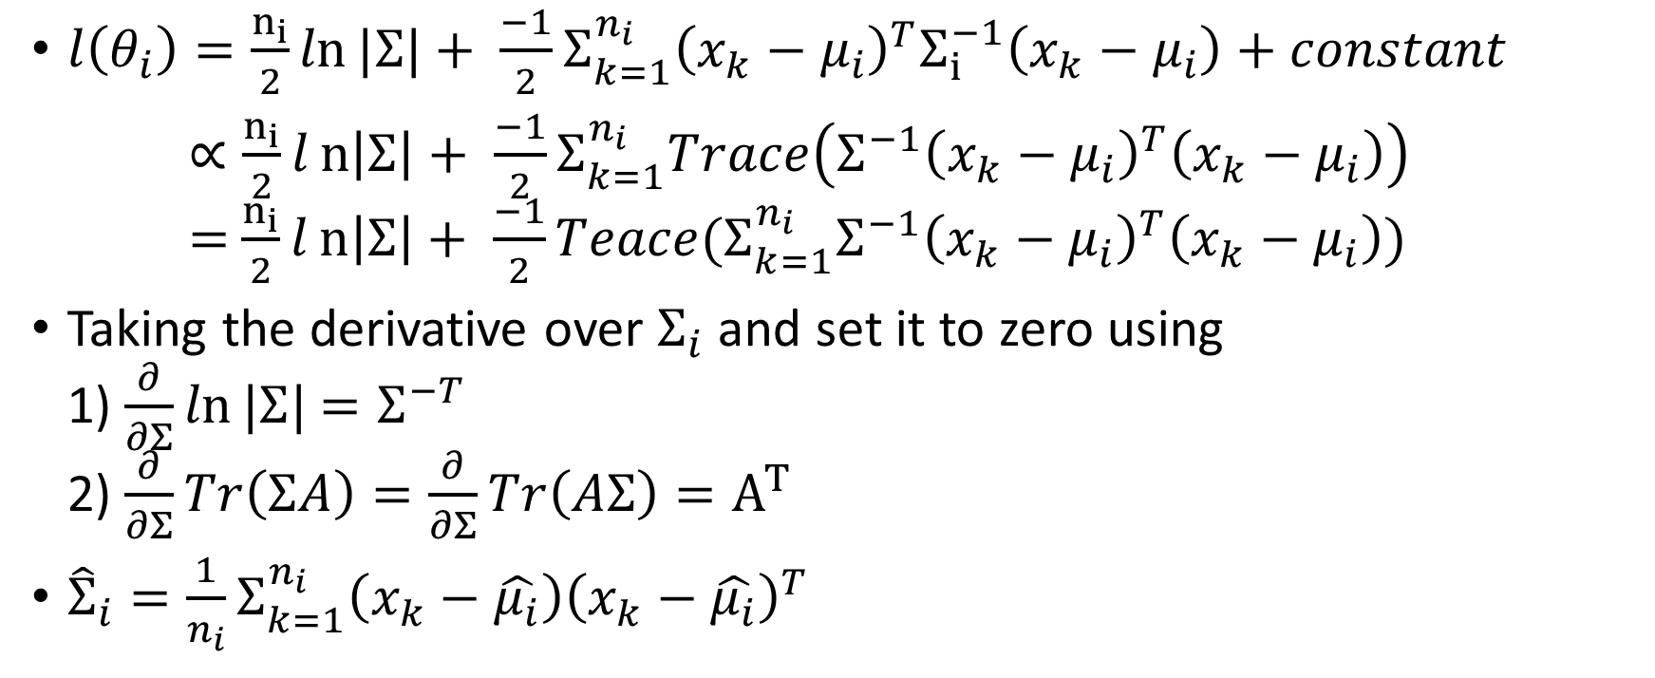
Maximum Likelihood Estimation (Training)
$l\left(θ_{i}\right)=\frac{n_{i}}{2}ln⁡|Σ|+ {\frac{−1}{2}Σ}_{k=1}^{n_{i}}{\left(x_{k}−μ_{i}\right)}^{T}Σ_{i}^{−1}\left(x_{k}−μ_{i}\right)+constant$
$∝\frac{n_{i}}{2}ln\left|Σ\right|+ {\frac{−1}{2}Σ}_{k=1}^{n_{i}}Trace\left(Σ^{−1}{\left(x_{k}−μ_{i}\right)}^{T}\left(x_{k}−μ_{i}\right)\right)$ = $\frac{n_{i}}{2}ln\left|Σ\right|+ {\frac{−1}{2}Teace(Σ}_{k=1}^{n_{i}}Σ^{−1}{\left(x_{k}−μ_{i}\right)}^{T}\left(x_{k}−μ_{i}\right))$
Taking the derivative over $Σ_{i}$ and set it to zero using 1) $\frac{∂}{∂Σ}ln⁡|Σ|$ $=Σ^{−T}$ 2) $\frac{∂}{∂Σ}Tr\left(ΣA\right)=\frac{∂}{∂Σ}Tr\left(AΣ\right)=A^{T}$
${\hat{Σ}}_{i}=\frac{1}{n_{i}}Σ_{k=1}^{n_{i}}\left(x_{k}−\hat{μ_{i}}\right){\left(x_{k}−\hat{μ_{i}}\right)}^{T}$

Slide 10
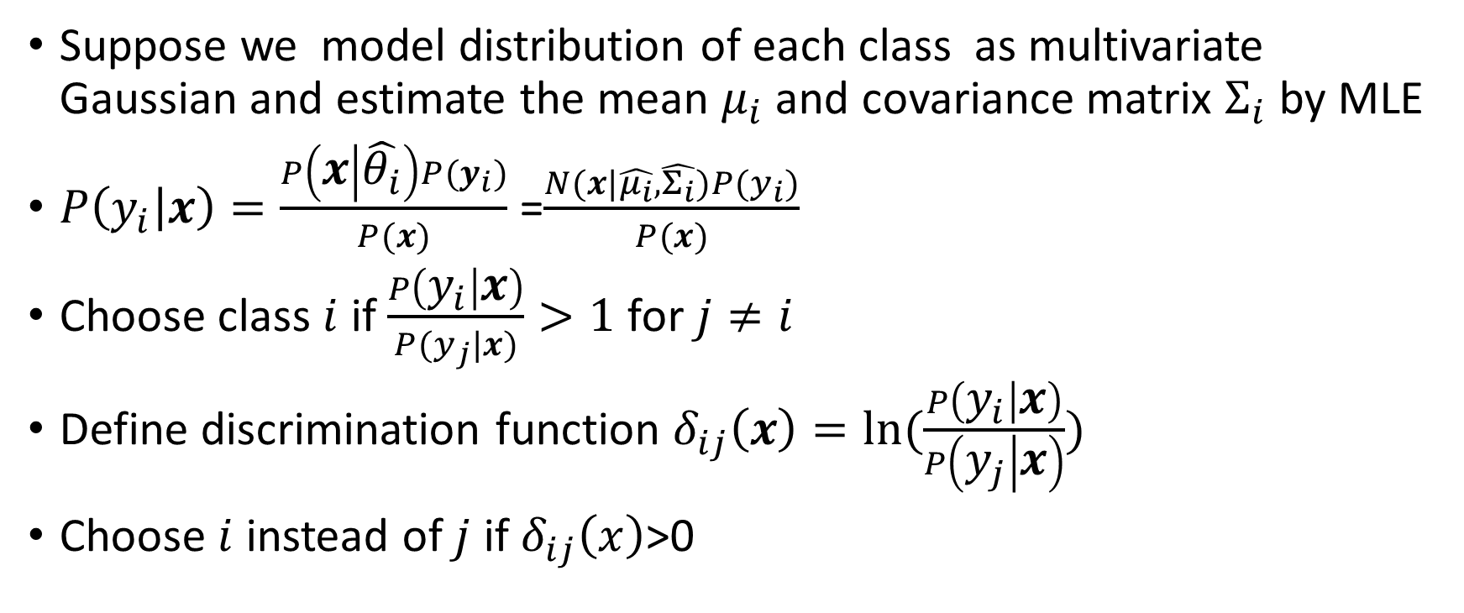
Discriminant Function (Testing)
Suppose we model distribution of each class as multivariate Gaussian and estimate the mean $μ_{i}$ and covariance matrix $Σ_{i}$ by MLE
$P\left(y_{i} | x\right)=\frac{P\left(x | \hat{θ_{i}}\right)P(y_{i})}{P(x)}$ =$\frac{N(x|\hat{μ_{i}},\hat{Σ_{i}})P(y_{i})}{P(x)}$
Choose class $i$ if $\frac{P\left(y_{i} | x\right)}{P(y_{j}|x)}>1$ for $j≠i$
Define discrimination function $δ_{ij}\left(x\right)=ln⁡(\frac{P\left(y_{i} | x\right)}{P\left(y_{j} | x\right)})$
Choose $i$ instead of $j$ if $δ_{ij}\left(x\right)$>0

Slide 11
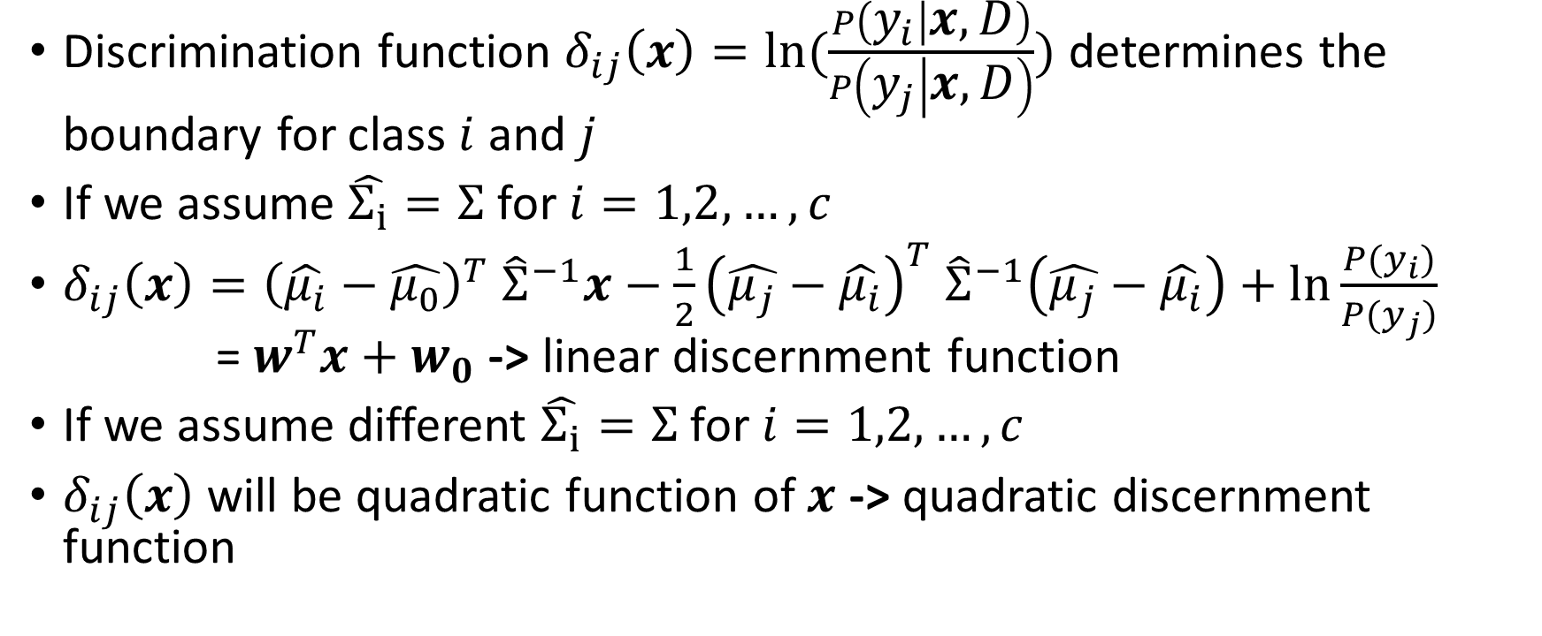
Discriminant Function (Testing)
Discrimination function $δ_{ij}\left(x\right)=ln⁡(\frac{P\left(y_{i} | x,D\right)}{P\left(y_{j} | x,D\right)})$ determines the boundary for class $i$ and $j$
If we assume $\hat{Σ_{i}}=Σ$ for $i=1,2,…,c$
$δ_{ij}\left(x\right)={\left(\hat{μ_{i}}−\hat{μ_{0}}\right)}^{T} {\hat{Σ}}^{−1}x−\frac{1}{2}{\left(\hat{μ_{j}}−\hat{μ_{i}}\right)}^{T} {\hat{Σ}}^{−1}\left(\hat{μ_{j}}−\hat{μ_{i}}\right)+\ln{\frac{P(y_{i})}{P(y_{j})}}$ = $w^{T}x+w_{0}$ -> linear discernment function
If we assume different $\hat{Σ_{i}}=Σ$ for $i=1,2,…,c$
$δ_{ij}\left(x\right)$ will be quadratic function of $x$ -> quadratic discernment function

Slide 12
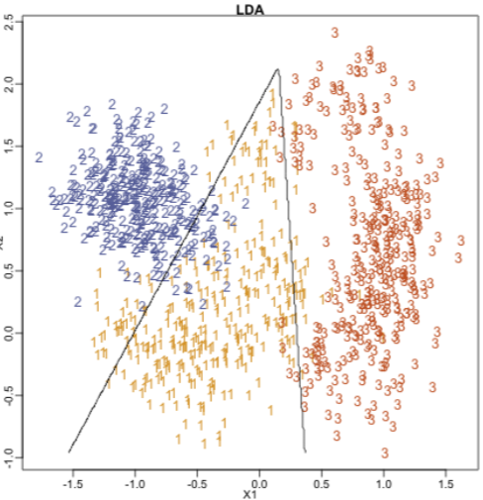
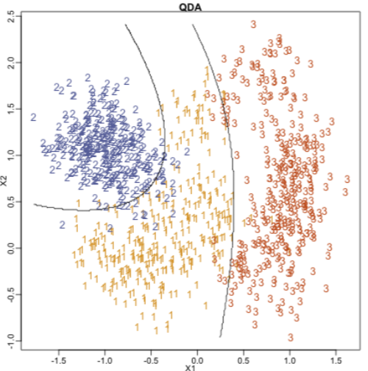
Discriminant Function (Testing)

Slide 13
Conclusion
A traditional algorithm but has not bad performance
Chinese handwritten recognition with Gabor filter feature
QDA | 0.8724
Neural Network | 0.8870
SVM | 0.918945

