Slide 1

Security of Family Pocket App
Created by Ivan Poluboiarynov

Slide 2
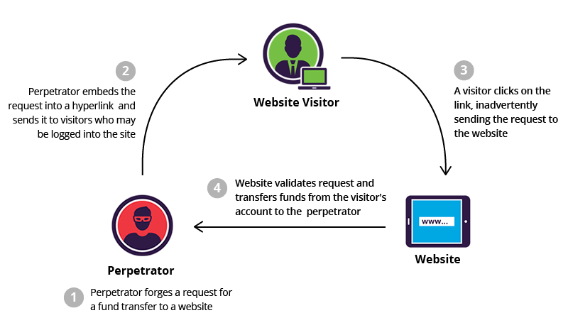
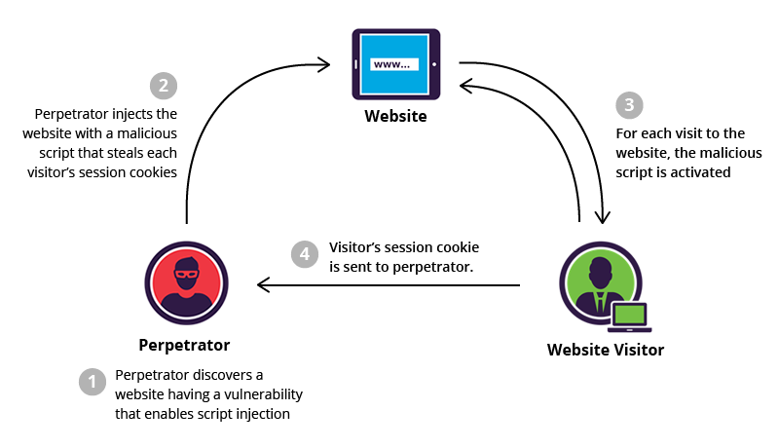
Types of attacks
Any web project must be able to defend itself against at least the most popular types of attacks.
CSRF attacks (Cross-site request forgery)
The hacker gains access to cookies or local storage of the browser and extracts user credentials from there
The hacker adds them to his requests and the server validates the user credentials and provides access to the data to the hacker.
Therefore, we need to limit the list of valid domains that the server will trust.
XSS attack (Cross-Site Scripting)
A malicious script is introduced that, in parallel with the user's work, sends its requests through the user's computer.
Source: https://www.imperva.com/learn/application-security/csrf-cross-site-request-forgery/
Source: https://www.imperva.com/learn/application-security/cross-site-scripting-xss-attacks/

Slide 3
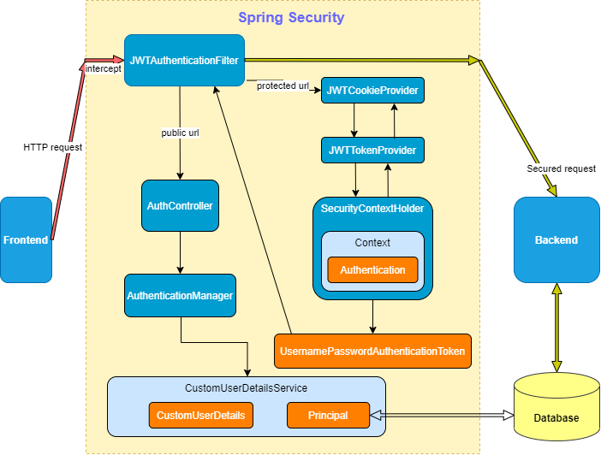
Application Protection Scheme
Basic protection modules:
Filtration;
Authentication;
Json Web Token (JWT);
Cookie management.
Security Configurations
(SecurityConfig class):
disable default csrf defender and basic browser validator;
set up https encrypted data only;
set the session creation policy to the stateless mode;
include JWT Authentication Filter before standart UserName Password Authentication Filter;
include exception Handler before our filter.

Slide 4
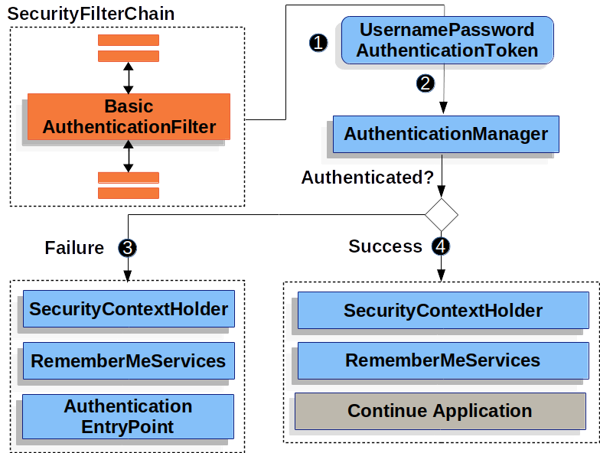
Filtration
JWTAuthenticateFilter does the following:
is integrated in the system filter chain before the standard UsernamePasswordAuthenticationToken filter,
intercepts all requests from the frontend and processes all protected URLs and passes public ones,
checks for the presence of a token and sends it for validation,
authenticates and stores the user in the SecurityContextHolder.
passes the request further to the appropriate controller or returns a failed authentication message
Source: https://docs.spring.io/spring-security/site/docs/current/reference/html5/

Slide 5
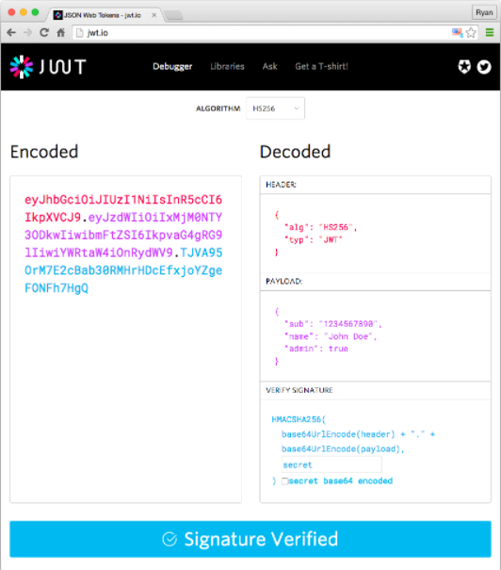
JWT
Since I am developing an application that in the future can work with synchronization with bank accounts, I need good protection. Therefore, I use Json Web Token authentication in my application.
JWT is a special JSON format for transferring user data.
It consists of:
- Header - contains metadata, encryption algorithm,
- Payload - our data for exchange (claims),
- Signature - the signature of the first 2 parts in order to make sure on the server that they have not been changed.
Source: https://jwt.io/introduction

Slide 6
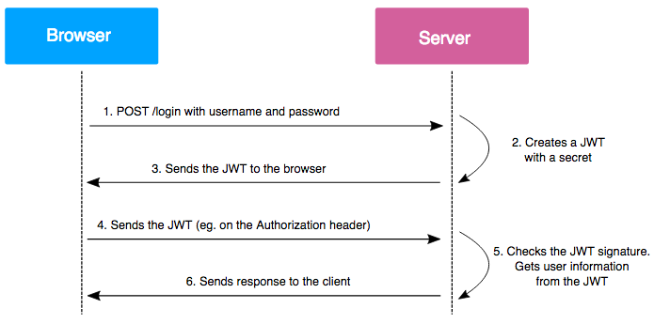
Cookie
Stateless architecture
In our case, the Stateless architecture is more suitable, because requests for web services can be from different clients (browser, mobile application, etc.). Therefore, there is no need to store the session on the backend. We will use JSON Web Token, which will store the necessary information about the user. We will write the token in the user's browser cookies using the Set-Cookie header.
JWTCookieProvider does the following:
creates a cookie that contains the generated jwt token and adds a header called Set-Cookie to the request, which then writes the cookie to the browser,
receives a token from a jwt request and passes it for further processing,
removes the token in the cookie on logout.
Source: https://www.vaadata.com/blog/jwt-tokens-and-security-working-principles-and-use-cases/

Slide 7
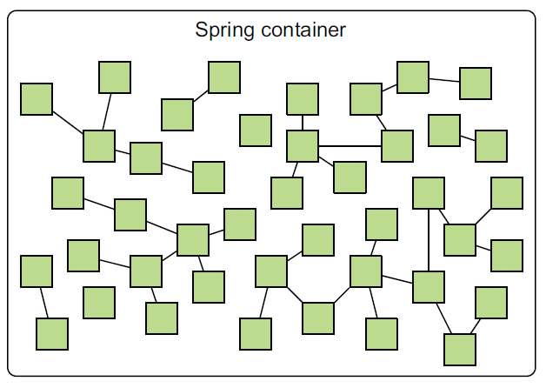
UserDetails and UserDetailsService
UserDetails and UserDetailsService are interfaces, implementations of which are used by the Spring container to interact with, perform actions on the user, and store data.
UserDetails - stores user data
UserDetailsService - gets a user object (in our case, from the database)
Our task is to create implementations of these interfaces so that the Spring container can use these objects (@Service annotation).
UserDetails and UserDetailsService are also Spring beans, since they will have the @Service annotation. Therefore, they will be visible to any other bins from the container.
This means that we will be able to receive user data in any place where it is necessary (controllers, services, etc.)
We cannot use the User entity object, which we get from the database, because The Spring container doesn't "understand" it.
We need to get convert it to UserDetails in order to inject it into the Spring container.
Source: https://medium.com/lifeinhurry/what-is-spring-container-spring-core-9f6755966fe9

Slide 8
Application protection structure
the security folder contains all the main classes responsible for security,
the controller folder contains AuthController, which is responsible for user authorization actions (login, logout, registration),
the service folder contains the CustomUserDetailsService, which is responsible for actions with the UserDetails object, which is a container for the User class

