Slide 1
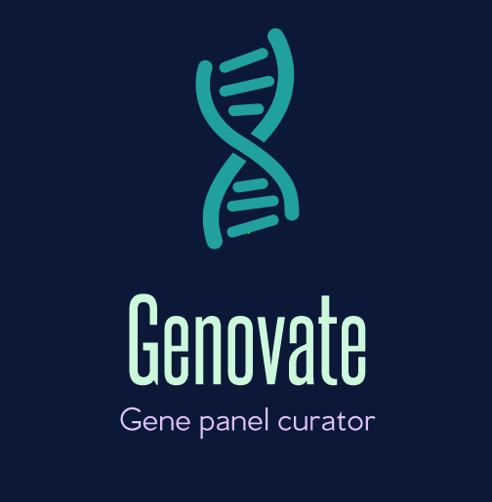
Christian Moller
Alison Aird
Jonathan Smellie
Ian Poole
In a clinical setting, genetic diseases are complex.
A critical element of a genetic test is the selection of an appropriate panel of genes to be sequenced.
Our product, Genovate, automates the process of gene panel curation.

Slide 2




Medical Genetics NHS Workflow
Patient given diagnosis and referred for DNA test.
Clinical scientist selects gene panel relevant to disease referral.
Clinical scientist interprets gene panel sequences.
Knowledge events require reviewing gene panels
Gene panels are a list of genes which are considered clinically relevant to a class of diagnoses
This manual process is labour intensive and time consuming!

Slide 3
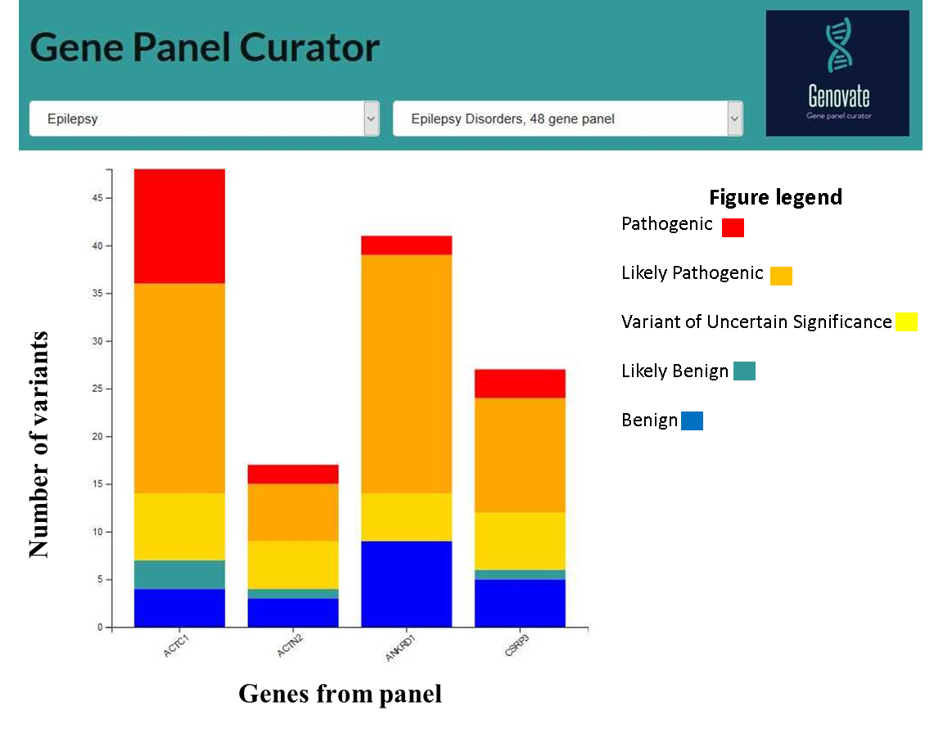
Our App: Genovate!
Genovate User
A Clinical Scientist maintains gene panels
What for?
Up to date list of disease specific genes
Interrogation of genomic databases
Reducing clinical interpretation time
(expected time saving ~ 25%)

Slide 4
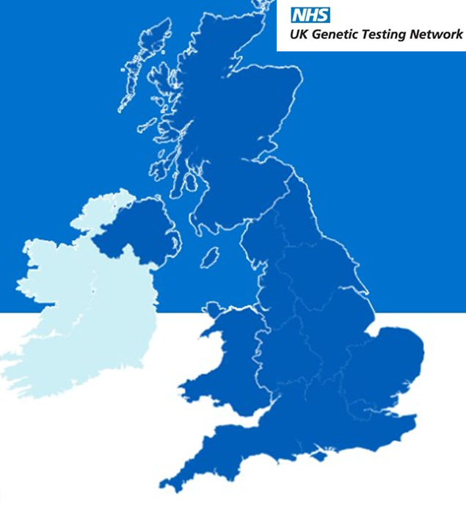
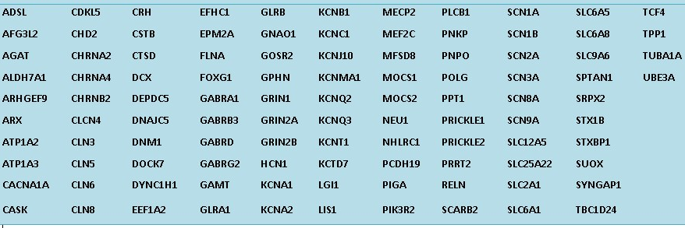
NHS Gene Panels
105 Genes on Glasgow Epilepsy Panel
Gene panels are a list of genes which are considered clinically relevant to a class of diagnoses
Gold Stars indicate the 7 UK labs offering Epilepsy panels

Slide 5
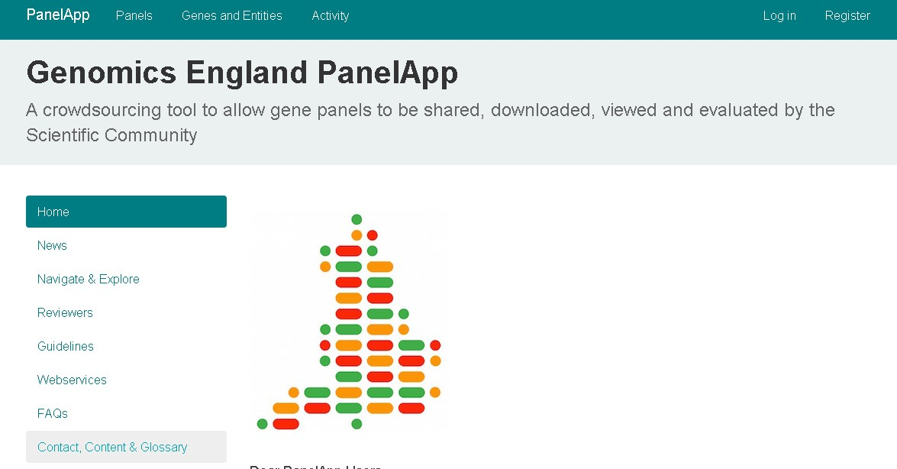
Competitors/Business Case
PanelApp is still Manual.
Genovate can automate!

Slide 6
Project Status
Shared learning of clinical genetics and accessing of genomic databases
Outline design of CDS for clinical scientists
Implementation of programmatic query of genomic database
Implementation of processing variants and prototype front end histogram generation.

