Slide 1
KONNECT ANDROID · KNOWLEDGE TRANSFER
Play Store
Release Runbook
Bump version + build AAB
1
▼
Upload to Open testing
2
▼
Promote to Production
How a build gets from the repo to Google Play:
bump → build the AAB → Open testing → promote to Production → Google review → live.
3
▼
Google review → live
4
com.konnect.kr · Play Console + Gradle · September 2026
Konnect · Play Store Release Runbook
1
Notes:
Cover. Audience: whoever takes over Android releases. The whole flow is one AAB per release: it is uploaded once to Open testing and then the same bundle is promoted to Production.

Slide 2
OVERVIEW
The release flow at a glance
1
2
3
4
5
6
7
Bump version
›
Build the AAB
›
Upload to Open testing
›
Verify on a phone
›
Promote to Production
›
Google review
›
Live on Play
Repo
Terminal
Play Console
Device
Play Console
Google
Play Console
app.json + build.gradle
gradlew bundleRelease
Create new release
Sign-in, search, cashback
Same bundle, no rebuild
Hours to a few days
“Available on Google Play”
One bundle per release
versionCode only goes up
Nothing is live until Google approves
The AAB you test is the AAB that ships. Promotion moves it; it is never rebuilt.
Play rejects any code it has already seen. Codes need not be consecutive, only larger.
With managed publishing off, an approved release publishes itself.
Konnect · Play Store Release Runbook
2
Notes:
Seven steps, three places: the repo/terminal, the Play Console, and a real phone. Steps 3 and 5 happen in the console; step 6 is Google. Stress the three facts at the bottom — they explain most mistakes people make.

Slide 3
PREREQUISITES
Before you start: access, key, toolchain
🔐
Play Console access
🔑
Upload keystore (never in the repo)
Owner or Release manager on the Konnect developer account
App: Konnect (com.konnect.kr)
play.google.com/console → Test and release
~/konnect-upload.keystore · alias konnect-upload
Cert CN=Konnect, OU=Mobile, valid to Dec 2053
SHA-1 37:37:70:3E:69:6A:37:FC:56:74:71:23:B4:51:6D:18:7A:C6:0D:33
Backed up off-machine — losing it locks the listing
⚙️
Gradle signing properties
🧰
Toolchain
~/.gradle/gradle.properties on the build machine:
KONNECT_UPLOAD_STORE_FILE / _STORE_PASSWORD
KONNECT_UPLOAD_KEY_ALIAS / _KEY_PASSWORD
Missing → release silently signs with the debug key
Node 22, JDK 17, Android SDK + build-tools 37
Repo on the release branch, `npm install` done
Android project lives in android/ (not committed)
docs/RELEASE.md is the written source of truth
Konnect · Play Store Release Runbook
3
Notes:
Two things are one-time setup and easy to forget when the release moves to a new laptop: the upload keystore file and the four Gradle properties. Without them the build still succeeds — but Play rejects it as debug-signed.

Slide 4
1
STEP 1 · REPO
Bump the version in two files
EDIT BOTH — KEEP versionName == expo.version
Upload history (Play Console → Latest releases and bundles)
// app.json
"expo": {
"version": "1.0.6",
...
}
// android/app/build.gradle (defaultConfig)
versionCode 8
versionName "1.0.6"
Code | Name | Uploaded | Status
3 | 1.0.2 | Aug 22, 2026 | Inactive
4 | 1.0.3 | Aug 25, 2026 | Inactive
5 | 1.0.4 | Aug 28, 2026 | Active
6 | 1.0.5 | Sep 14, 2026 | Production · available
8 | 1.0.6 | Sep 30, 2026 | Production · in review
Next release: versionCode 9, versionName 1.0.7 (or 1.1.0 for a feature release).
The rule Play enforces
Commit the bump
versionCode must be strictly greater than every code ever uploaded to any track. "Version code N has already been used" means bump it again. Codes need not be consecutive — 7 was built locally and never uploaded, so 8 followed 6.
Commit app.json and build.gradle together with the release, so the next person sees which code is already taken.
Konnect · Play Store Release Runbook
4
Notes:
Two files must move together. versionName is what users see (1.0.6); versionCode is the integer Play keys on (8). Play only cares that the code is larger than anything already uploaded.

Slide 5
2
STEP 2 · REPO
Point the build at the right API host
The API host is compiled into the JS bundle at build time — it cannot be changed after the build.
It is one constant: DEFAULT_API_HOST in src/config/index.ts. Today it is https://staging.konnect.kr.
Store releases must be built against the host the release is meant for. Decide, edit the constant, commit it with the version bump.
Metro caches the transformed module, so purge its cache and run gradlew clean before the build, or the old host stays baked in.
VERIFY WHAT GOT BAKED
# after the build: what host is actually inside the artifact?
unzip -p android/app/build/outputs/bundle/release/app-release.aab \
base/assets/index.android.bundle | grep -aoE "https://[a-z0-9.-]*konnect\.kr" | sort -u
# expect exactly one line, e.g.
https://api.konnect.kr
Why this step exists
Two builds in September went out with the staging host because Metro reused a cached bundle from an earlier build. Editing the constant, purging the cache and running the verify command on the finished AAB is the combination that proved reliable. The verify takes two seconds — run it every time.
SET THE HOST
// src/config/index.ts
const DEFAULT_API_HOST = 'https://api.konnect.kr';
# purge Metro cache, then clean
rm -rf "$LOCALAPPDATA/Temp/metro-cache" "$LOCALAPPDATA/Temp/metro-file-map-"*
cd android && ./gradlew clean
Replace api.konnect.kr with the agreed production host; staging is the default today.
Konnect · Play Store Release Runbook
5
Notes:
This is the step most likely to bite. The value is compiled into the bundle, so it must be right before gradlew runs. Always run the verify command on the finished AAB before uploading.

Slide 6
3
STEP 3 · TERMINAL
Build the AAB and verify it before upload
BUILD → COPY → VERIFY
Green before you upload
# 1. build (3–5 min)
cd android && ./gradlew bundleRelease
# → android/app/build/outputs/bundle/release/app-release.aab
# 2. keep a copy in release/ named by version
cp android/app/build/outputs/bundle/release/app-release.aab release/konnect-v1.0.6.aab
# 3. who signed it? (must be CN=Konnect, not CN=Android Debug)
keytool -printcert -jarfile release/konnect-v1.0.6.aab | grep -E "Owner|SHA1"
Owner: CN=Konnect, OU=Mobile, O=Konnect, L=Seoul, C=KR
SHA1: 37:37:70:3E:69:6A:37:FC:56:74:71:23:B4:51:6D:18:7A:C6:0D:33
# 4. which version is inside?
aapt2 dump badging android/app/build/outputs/apk/release/app-release.apk | grep -o "versionCode='[0-9]*' versionName='[^']*'"
versionCode='8' versionName='1.0.6'
☐ Signer is CN=Konnect (upload key)
☐ versionCode is higher than the last upload
☐ API host inside the bundle is the intended one
☐ Size is in the usual range (~88 MB)
☐ assembleRelease APK installs and signs in on a real phone
☐ Version bump is committed
The APK (assembleRelease) is only for sideloading and device checks — Play accepts the AAB.
Konnect · Play Store Release Runbook
6
Notes:
Signer check is the one that saves you a rejected upload: "CN=Android Debug" means the four Gradle properties were not found. The version check catches the "already used" rejection before the console does.

Slide 7
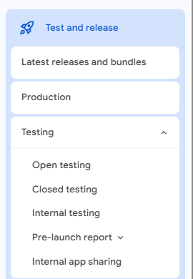
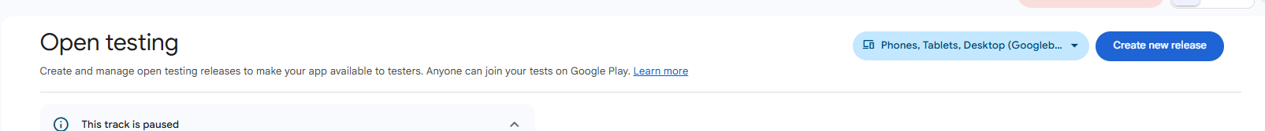
4
STEP 4 · PLAY CONSOLE
Upload to the Open testing track
Open testing page — “Create new release” (top right)
Play Console → Konnect → Test and release → Testing → Open testing.
Click Create new release (top right). The device selector stays on the default: Phones, Tablets, Desktop.
“This track is paused” just means the previous test rollout was paused — starting the new rollout resumes it.
Anyone can join an open test from the Play listing, so this is a public-but-quiet step: keep release notes user-facing.
Play Console · Test and release
Why Open testing first
It exercises the exact bundle Play will ship (re-signed by Play App Signing) on real devices, including Google and Facebook sign-in against the registered fingerprints. Production is then a promotion of that bundle, not a new upload.
Konnect · Play Store Release Runbook
7
Notes:
Real screenshots from the console on Sep 30, 2026. The paused banner is normal for us — the last open test was paused after promotion.

Slide 8
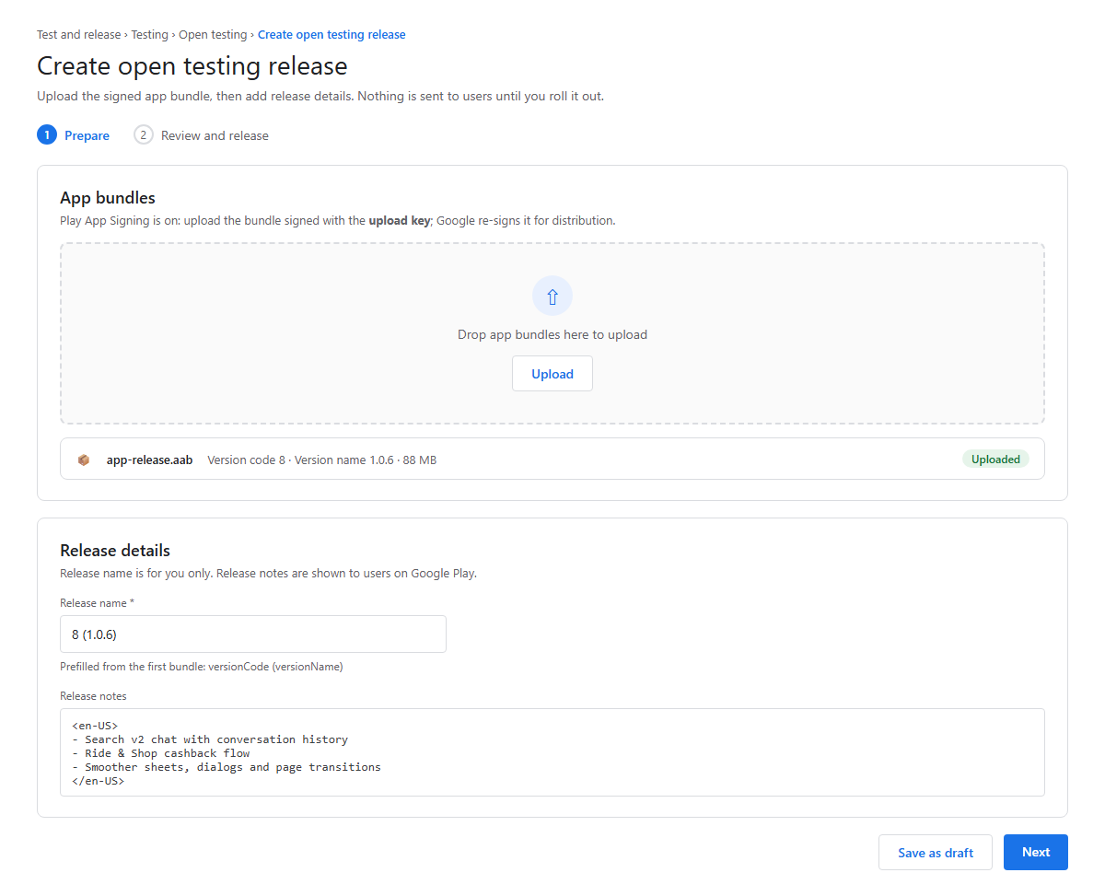
4
STEP 4 (CONT.) · PLAY CONSOLE
Fill in the release: bundle, name, notes
App bundles: upload release/konnect-v<ver>.aab and wait for the “Uploaded” chip. Play reads versionCode/versionName from it.
Release name is prefilled as “<code> (<name>)”, e.g. 8 (1.0.6) — keep it; it is how the release is listed everywhere.
Release notes: inside <en-US> … </en-US>. These are shown to users on the store listing after Production.
Next → takes you to Review and release. Save as draft if you need to stop here.
Errors at this point are almost always version already used or wrong signing key — fix in the repo, rebuild, re-upload.
Illustration — mock-up of the Play Console “Create open testing release” form
Konnect · Play Store Release Runbook
8
Notes:
The upload takes a minute for an 88 MB bundle. If the console shows a red error under the bundle, read it: the two common ones are covered on the troubleshooting slide.

Slide 9
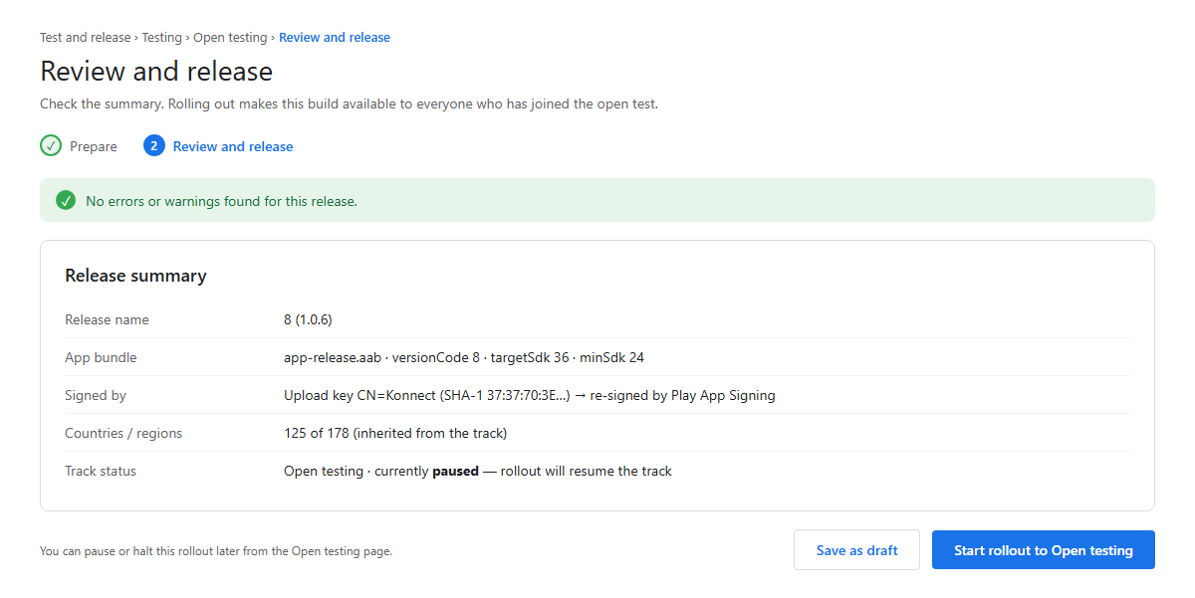
5
STEP 5 · PLAY CONSOLE + DEVICE
Roll out to testers and verify on a phone
Check the summary: no errors or warnings, right release name, right bundle.
Start rollout to Open testing. Testers get the update within about an hour.
Install it from Play (not adb) on at least one real phone and smoke-test: Google sign-in, Facebook sign-in, a search, History, the Ride & Shop cashback page.
Sign-in is the canary: it fails only if the Play-signed certificate is not registered in Firebase / Facebook.
Glance at the Pre-launch report (Testing → Pre-launch report) for crashes on Google’s test devices.
Illustration — mock-up of the “Review and release” summary before rollout
Konnect · Play Store Release Runbook
9
Notes:
The point of this step is to test the Play-signed build, which is different from the APK you sideload. Sign-in through Google and Facebook is the check that matters most.

Slide 10
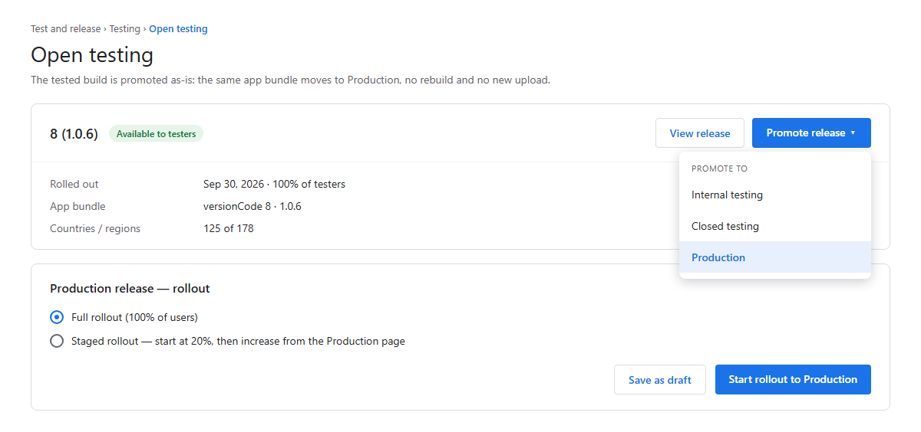
6
STEP 6 · PLAY CONSOLE
Promote the same release to Production
Open testing → the release card → Promote release → Production.
Nothing is rebuilt or re-uploaded: the promoted release reuses the tested bundle and its notes.
Choose the rollout: Full rollout (our current practice) or a staged percentage you raise later from the Production page.
Start rollout to Production sends it to Google review. Users see nothing until the review passes.
Countries/regions are inherited from the Production track (125 of 178 today).
Illustration — mock-up of “Promote release ▾ → Production” on the Open testing page
Konnect · Play Store Release Runbook
10
Notes:
Promotion is a console-only action. If you find a bug during open testing, do not promote: fix, bump the code, and start again from step 1.

Slide 11
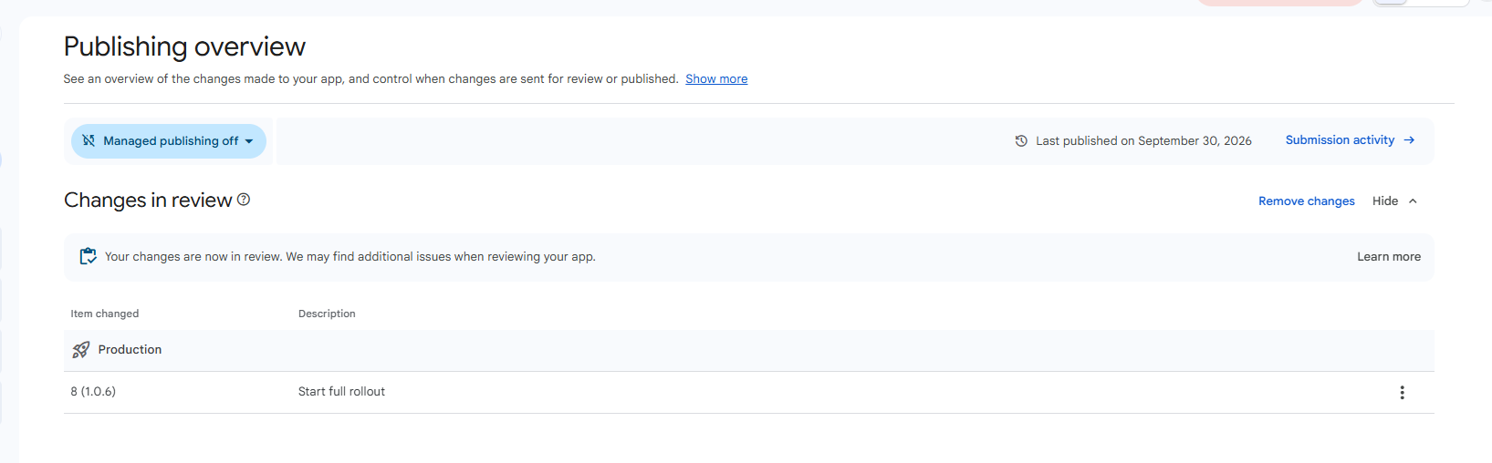
7
STEP 7 · GOOGLE
Google review: watch Publishing overview
Where the time goes
Sep 30 upload at 2:30 AM → Production release created 11:13 AM → “In review”. Check Publishing overview once a day; no action is needed from us while it is in review.
Publishing overview on Sep 30, 2026 — release 8 (1.0.6) waiting for review
“Changes in review” lists what Google is looking at: here Production → 8 (1.0.6) → Start full rollout.
Managed publishing is off: the moment Google approves, the release publishes itself. Turn it on only to hold an approved release for a launch date.
Review usually takes hours, sometimes a few days for a first policy check. “Remove changes” withdraws the submission while it is still in review.
If Google rejects
The rejection email and the Policy status page name the policy. Fix it in the app or the listing, bump versionCode, rebuild, and go back to step 1 — a rejected bundle cannot be resubmitted as-is.
Konnect · Play Store Release Runbook
11
Notes:
Real screenshot. Last published date at the top is a quick sanity check that the previous release actually went out.

Slide 12
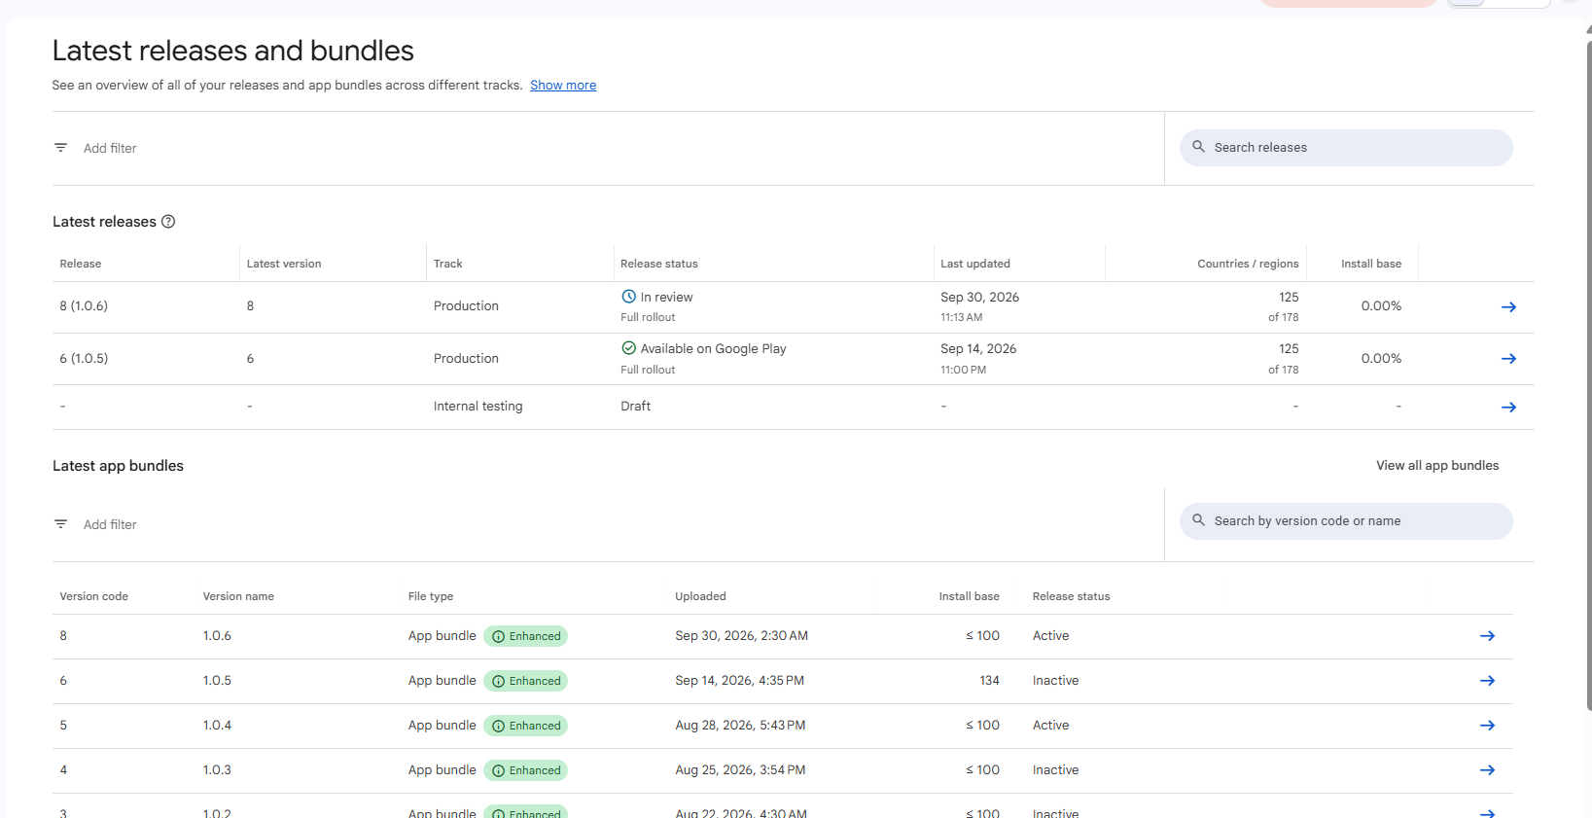
8
STEP 8 · PLAY CONSOLE
Confirm it is live, then keep an eye on it
Latest releases: the status flips from “In review” to “Available on Google Play”. That is the done signal.
Latest app bundles: the new code becomes Active; the previous one goes Inactive.
Install base and the crash rate (Quality → Android vitals) are worth a look for the first few days.
Rollback is a new release with a higher versionCode — Play never installs a lower code on a device that already has the newer one.
Keep the release/ folder and the git tag in sync with what is on Play, so the next person can rebuild exactly this version.
Latest releases and bundles — 8 (1.0.6) in review above the live 6 (1.0.5)
Konnect · Play Store Release Runbook
12
Notes:
Real screenshot. Note the Internal testing draft row — it is unused today; our path is Open testing → Production.

Slide 13
WHEN IT GOES WRONG
Troubleshooting
Symptom | Cause | Fix
Upload rejected: “Version code N has already been used” | versionCode not higher than a code already on any track | Bump versionCode in android/app/build.gradle (and versionName + app.json), rebuild, re-upload.
Upload rejected: “signed in debug mode” | The four KONNECT_UPLOAD_* properties were not found, so Gradle fell back to debug.keystore | Add them to ~/.gradle/gradle.properties on the build machine; verify with keytool -printcert (Owner must be CN=Konnect).
Google / Facebook sign-in fails only in the store build | Play App Signing certificate fingerprint is not registered | Play Console → Setup → App signing: copy the app signing SHA-1/SHA-256 into Firebase (konnectbackend) and the Facebook app key hashes; re-download google-services.json.
App talks to staging (or the wrong host) in production | Host is compiled in at build time; Metro served a cached bundle from a previous build | Edit DEFAULT_API_HOST in src/config/index.ts, purge the Metro cache, gradlew clean, rebuild, and run the unzip/grep check on the AAB.
Open testing shows “This track is paused” | The previous open-test rollout was paused after promotion | Nothing to do — starting the new rollout resumes the track.
Release stuck “In review” for days | Manual policy review, usually after a listing or permission change | Wait; check Policy status and the inbox. Only “Remove changes” if you need to resubmit a different build.
Upload keystore lost | File deleted or laptop gone without a backup | Play Console → Setup → App signing → “Request upload key reset” (Play App Signing must be on). Then register the new fingerprints.
Konnect · Play Store Release Runbook
13
Notes:
The first four rows are the ones we have actually hit. Keep this table updated when a new failure shows up.

Slide 14
ONE PAGE
Release checklist — copy, tick, ship
Before the build
Build and verify
☐ Decide the API host for this release
☐ Bump versionCode (+1 or more) and versionName in build.gradle
☐ Set expo.version in app.json to the same versionName
☐ Commit the bump
☐ DEFAULT_API_HOST in src/config/index.ts is the intended host
☐ Metro cache purged, gradlew clean run
☐ gradlew bundleRelease succeeded
☐ AAB copied to release/konnect-v<ver>.aab
☐ keytool: Owner is CN=Konnect (not Android Debug)
☐ aapt2: versionCode/versionName are the new ones
☐ unzip/grep: exactly one host, the intended one
☐ Host constant committed together with the version bump
Play Console
After
☐ Open testing → Create new release → upload AAB
☐ Release name “<code> (<name>)” kept
☐ Release notes in <en-US> written for users
☐ Review shows no errors → Start rollout to Open testing
☐ Smoke test the Play-installed build: both sign-ins, search, History, cashback
☐ Promote release → Production → Start rollout
☐ Publishing overview shows “Changes in review”
☐ Status becomes “Available on Google Play”
☐ Tag the commit (v1.0.6) and note the code in the team channel
☐ Check Android vitals after 24–48 h
☐ Update this runbook if anything surprised you
Konnect · Play Store Release Runbook
14
Notes:
Print this one. Every line maps to a step earlier in the deck.

Slide 15
REFERENCE
Where everything lives
Item | Location / value
Written runbook (source of truth) | docs/RELEASE.md
Version numbers | app.json → expo.version · android/app/build.gradle → versionCode / versionName
Default API host | src/config/index.ts → DEFAULT_API_HOST (staging today; change it here for a store release)
Build outputs | android/app/build/outputs/bundle/release/app-release.aab · …/apk/release/app-release.apk
Versioned artifacts kept locally | release/konnect-v<ver>.aab · release/konnect-v<ver>.apk · release/konnect-latest.apk
Upload keystore | ~/konnect-upload.keystore · alias konnect-upload · SHA-1 37:37:70:3E:…:C6:0D:33
Signing credentials | ~/.gradle/gradle.properties → KONNECT_UPLOAD_STORE_FILE / STORE_PASSWORD / KEY_ALIAS / KEY_PASSWORD
Play Console | play.google.com/console → Konnect (com.konnect.kr) → Test and release
Sign-in fingerprints | Firebase project konnectbackend → Android app → fingerprints · Facebook app 2266334640859593 → key hashes
Android project | android/ (generated by expo prebuild; not committed) — build from the local copy
Passwords are never in this deck or in the repo. They live only in ~/.gradle/gradle.properties on the release machine and in the team password manager.
Konnect · Play Store Release Runbook
15
Notes:
Hand this slide to anyone setting up a new release machine, together with the keystore file and the four properties from the password manager.

