Slide 1
MSS Authentication and Authorization Models
July, 2015

Slide 2
Agenda
Analysis: Authentication and Authorization Models
What is around?
Background - Authentication and Authorization
What is SAML 2.0
SAML 2.0 Use Cases
Universal ID – SAML 2.0 WEB SSO
Two factor authentication with current OpenAM
OAuth 2.0 Overview, Use Case
OAuth 2.0 Authentication and Authorization Flow
3-legged OAuth vs. 2-legged OAuth
OAuth2 Security Considerations
SSO with OAuth2
SAML 2.0 vs. OAuth 2.0
Reference Links
Summary
An application with 0% security and 100% functionality is still an application, but an application with 100% security and 0% functionality is useless. - Eve Maler

Slide 3
What is around?
OTP
Https
Authorization
AuthBroker
Attribute Bundles
Federation
WEBSSO
3-legged OAuth
Assertion
Resource
User-agent
SSL
API Modules
LDAP
User
OAuth 2.0
Authentication
Identity
Client
Two factor Authentication
IAM
Token
SAML 2.0
User Management
OpenAM
Consent
ClientId
Federation
Identity Provider
Claims
End Points
Data Store
2-legged OAuth
APIGEE
ClientSecret
Certificates
Http
Service Provider
TLS
FICAM
Resource Server
AuthCode
Scopes
Relying Party
Credentials
Authorization Provider

Slide 4
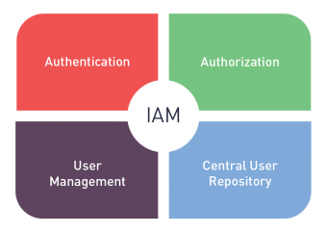
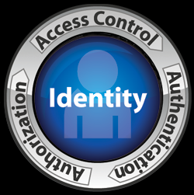
Background
Background:
The basic model of authentication and authorization over the internet is based on the traditional client-server model. In this model, at a minimum, there are two entities involved: the client and the application running on the server. A client with valid credentials is granted access to a particular resource controlled by the application. The client credentials may be in the form of a username/password that the application validates before granting access to the resource.
This basic model of authentication has evolved overtime as a result of the need for the client to provide its credentials (e.g. username/password) only once in order to be granted access to resources that are controlled by multiple applications in a distributed environment. This model is often referred to as Single Sign-On (SSO). In this model, the client “logs in” only once by providing its credentials to a single application. Upon validation by the application, the client receives a ticket (cookie) that enables it to seamlessly access resources of other applications. An example of SSO is a user logging into Connct.gov only once and accessing resources on multiple third party applications without having to login to each individual application.
Identity protocols/standards: SAML,OAuth,OpenID
Platform: OpenAM, APIGEE
Authentication & Authorization Options:
Universal ID - OpenAM with SAML 2.0
Two factor authentication with current OpenAM
OpenAM with OAuth 2.0

Slide 5
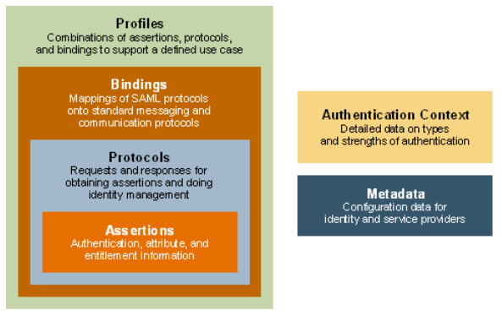
What is SAML 2.0
The OASIS (Organization for the Advancement of Structured Information Standards) group developed SAML as an XML-based framework for exchanging security information.
SAML (Security Assertion Markup Language) is a protocol which provides XML-based open standard data format for exchanging authentication and authorization data between parties, in particular, between an Identity Provider and a Service Provider.
SAML consists of a number of XML messages at its core which determine whether or not a person has been authenticated. It is mainly used for single sign-on (SSO) between external websites and organizations. Nevertheless, it can also be utilized for internal SSO applications within organizations. SAML has been designed for B2B and B2C transactions.
Assertions: SAML allows for one party to assert security information in the form of statements about a subject. For instance, a SAML assertion could state that the subject is named “John Doe”, has an email address of john.doe@example.com, and is a member of the “engineering” group.
Protocols: SAML defines a number of generalized request/response protocols
Bindings: SAML bindings detail exactly how the various SAML protocol messages can be carried over underlying transport protocols.
Profiles: SAML profiles define how the SAML assertions, protocols, and bindings are combined and constrained to provide greater interoperability in particular usage scenarios.
Metadata: Defines a way to express and share configuration information between SAML parties.
Authentication context: It is used in an assertion's authentication statement to carry this information. An SP can also include an authentication context in a request to an IdP to request that the user be authenticated using a specific set of authentication requirements, such as a multi-factor authentication.

Slide 6
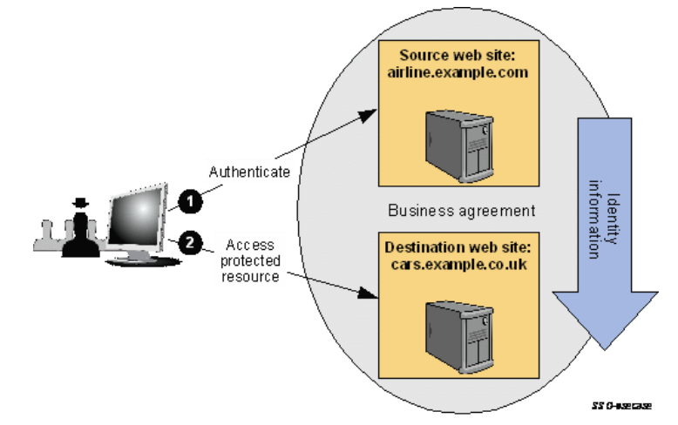
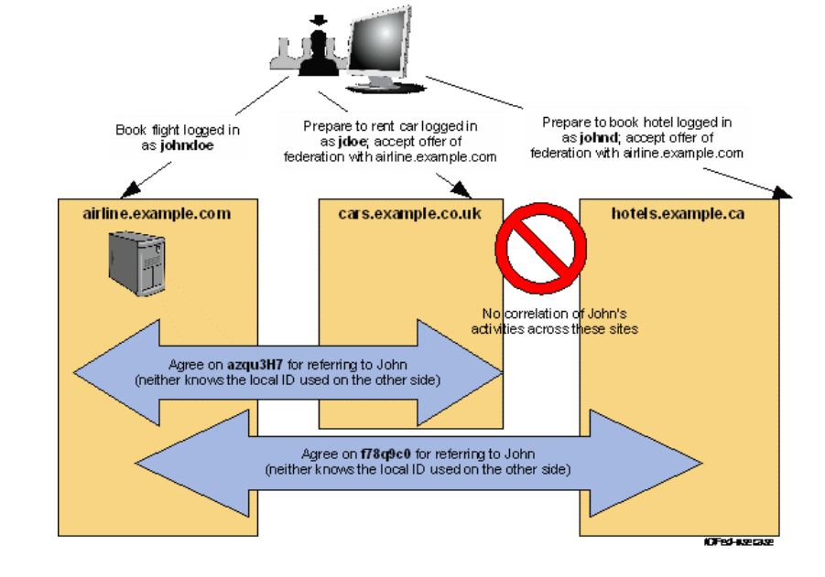
SAML 2.0 Use Cases
Web Single Sign-On
Identity Federation

Slide 7
Factors
F1
F2
REST OF Universal ID
AB
IDP
(Identity Provider Layer)
FEDERATION
C
User Consent
Proxy IDP
(Websso Layer)
Relying Party 1
Relying Party 2
Relying Party 2
Relying Party
(Applications)
Bundles
1
2
3
User
BROWSER
Universal ID – SAML 2.0 WEB SSO

Slide 8
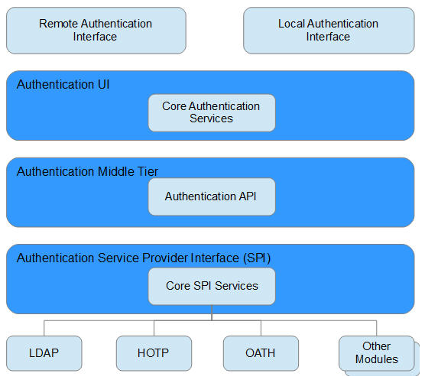
Two factor authentication with current OpenAM
Options/approach:
Explore the option of using current OpenAM for two factor authentication
Use OpenAM in the role of authentication server
Tracking user credentials in OpenDJ which is used for first factor authentication
Configure required authentication modules for use throughout OpenAM.
One authentication module in works in tandem with one or more other authentication modules as part of an authentication chain
OpenAM provides two authentication modules for One-Time Password capabilities: HOTP and OATH
Configuring Adaptive Risk Authentication module in the authentication chaining determine whether to require the user to complete further authentication steps
Leveraging OpenAM email/SMS service for OTP transmission
Creating and managing identity in OpenAM.
Look at user provisioning flow
Should be CPI-810 compliant
OpenAM Authentication Service Architecture

Slide 9
Two factor authentication with current OpenAM
Configuration:
Ensure the user attributes/credentials are present and validated against the DataStore or LDAP directory.
Build the authentication chain utilizing LDAP or DataStore, Adaptive Risk and HOTP or OATH authentication modules
Configure required authentication modules for use throughout OpenAM.
Build the authentication chain utilizing LDAP or DataStore, Adaptive Risk and HOTP or OATH authentication modules.
Functional flow:
First the user is required to authenticate against LDAP or DataStore.
Once the user is successfully authenticated against LDAP or DataStore, Adaptive Risk authentication module will look for a Cookie. If the cookie is present then user will be granted access. If not, the chain will fall through to the HOTP/OATH (One-Time Password) module.
The user can request the OTP. The HOTP/OATH authentication module knows the user is in the directory, so it looks for the email address (or cell phone for SMS delivery) and sends a One Time Password to the user with a time limited lifespan.
User will receive the OTP and submit to complete the authentication process.
Notes:
HOTP: HMAC-based One Time Password
OATH: Open Authentication. These can be HMAC Hash based (HOTP) or time based (TOTP).
OpenAM 10.1 or greater versions support these second factor authentication mechanism.
OATH should not be confused with OAuth. Both are different

Slide 10
OAuth 2.0 Overview
What is OAuth 2.0?
OAuth 2.0 is an open authorization protocol which enables a third-party application to obtain limited access to an HTTP service, either on behalf of a resource owner by orchestrating an approval interaction between the resource owner and the HTTP service, or by allowing the third-party application to obtain access on its own behalf.
What are the specifications in OAuth 2.0?
Let’s choose what we need for from the above specifications.
IAB: Internet Architecture Board
IETF: Internet Engineering Task Force
RFC: Requests for Comments
Roles | Client Types | Client Profiles | Authorization Grants | End points | Auth flow | Software Support
Resource Owner | Confidential | Web Application | Authorization Code | Authorization Endpoint | 2-legged auth flow | OpenAM
Resource Server | Public | User-agent-based Application | Implicit | Token Endpoint | 3-legged auth flow | APIGEE
Client Application |  | Native Application | Resource Owner Password Credentials | Redirect Endpoint |  | Spring Security
Authorization server |  | Hybrid Application | Client Credentials

Slide 11
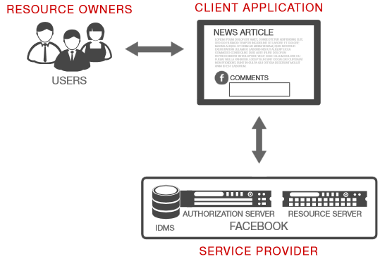
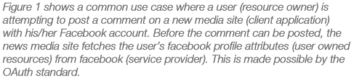
OAuth 2.0 Use case
A Simple use case:

Slide 12
OAuth 2.0 Authentication and Authorization Flow
Resource Owner
(User)
User-Agent
(Browser)
Client App
(Web App)
Authorization Server (OpenAM/APIGEE)
AuthBroker
(User Authentication)
Resource Server
(API Modules)
1
Enter URL / Initiate
Open URL
2
Redirect for resource authorization
3
4
With client_id,scope,state,redirect_uri
5
Validate client_id
Open login page
Http redirect (login page)
6
7
8
Get login page
Return 1st factor login page
Provide credentials
9
10
11
Submit login credentials
12
Authenticate resource owner
validate user credentials
Provide OTP
Return 2nd factor login page
13
14
Submit OTP
15
16
Authenticate resource owner
validate OTP
Return Authorization page
Provide Consent or deny
17
18
Submit consent
19
Post client_id,redirect_uri, scope
Verify and create auth code
20
21
22
Return redirect_uri with auth code
Redirect to user-agent with authorization code
23
24
Follow redirect to Client App
25
Present client_id,client_secret,grant_type,scope,auth code
Return access token
26
27
Call protected resource with access token
Request token validation and information
28
29
Access token validation and respond
Return protected resource
30

Slide 13
3-legged OAuth vs. 2-legged OAuth
3-legged OAuth
It does not imply a certain type of app as in "browser based". Three legged means that an application acts on the direct behalf of a user. In the three legged scenarios there is
an application (consumer),
a user (resource owner) and
an API (service provider).
3-legged OAuth has to be used in an open web environment of course. You do need the approval of the resource owner to grant access to its data to a third-party application.
2-legged OAuth
In this scenario there is no concept of a user. Typically this has to do with application-to-application solutions. There the application (consumer) acts on behalf of itself. So in two legged OAuth, there is:
an application (consumer),
an API (service provider)
On a conceptual level 2-legged OAuth simply consists of the first and last steps of 3-legged OAuth:
Client has signed up to the server and got his client credentials (also known as “consumer key and secret”)
Client uses his client credentials to access the protected resources on the server
Two Legged can only be used in a trusted environment by a super-owner of the accounts for e.g. local Twitter client application accessing your Twitter account.
Note : The difference is simply that there is no need of a user authorization step in the 2-legged approach

Slide 14
OAuth2 Security Considerations
The first version of OAuth (OAuth1) supported an authentication mechanism based on the HMAC algorithm to guarantee confidentiality and integrity.
The OAuth2 protocol does not guarantee confidentiality and integrity of communications. That means you must protect HTTP communications using an additional layer. One possible solution is the usage of SSL/TLS (HTTPS) to encrypt the communication channel from the client to the server.
Always use HTTPS for OAuth2, as it's the only way to guarantee message confidentiality and integrity with this protocol.
SSL: Secured Sockets Layer
TLS: Transport Layer Security

Slide 15

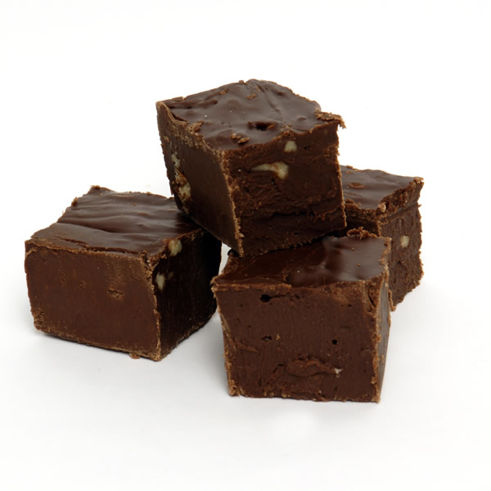
A delicious metaphor
Chocolate
Fudge
VS
OAuth is Chocolate
SSO is Fudge
OAuth is Chocolate
Delicious on its own
Versatile ingredient
Useful in many circumstances
Can be used to make fudge
A confection with several ingredients
Can be made with chocolate
But needs more than just chocolate
Could be made without chocolate
What OAuth tells you?
Somebody authorized the Client
Hints at what the client is authorized to do (scope) and for how long (expiration)
What OAuth doesn’t tell you?
Who the user is
If the user is still there
What to call the user
How the user authenticated in the first place
what information should be returned about the user or in what format
Single sign on would allow the enterprise system to securely store and own all of the user credentials. The platform can establish a trust relationship with the enterprise authentication server and client applications can be built to utilize the trusted auth server to authenticate users.
Notes:
Chocolate: http://www.honolulumagazine.com/Promotions/Hawaii%20Chocolate%20Festival/CHOCOLATE---iStock_000013266127Medium.jpg
Fudge: http://www.cartoondollemporium.com/forum/pics/cdeblog/chocolate%20fudge%202%20inch.jpg

Slide 16
A recipe for SSO with OAuth2
Create an identity API, protect it with OAuth
Authorization Server becomes Identity Provider
Client becomes Relying Party
Standardized user info coming from this API
Name, email, Address etc.
Session management
Is the user still logged in?
Request log out
Communicate authentication information
Step up to high levels of authentication
Keep compatibility with OAuth2

Slide 17
SAML 2.0 vs. OAuth 2.0
Features | SAML 2.0 | OAuth 2.0
Definition | SAML (Security Assertion Markup Language) is a protocol which provides XML-based open standard data format for exchanging authentication and authorization data between parties, in particular, between an identity provider and a service provider. | OAuth (Open Authorization) is an open standard protocol for secure authorization. It provides client applications a secure delegated access to server resources on behalf of a resource owner.
Terms | Service Provider, Client, Identity Provider | Resource Server, Client, Authorization Server
Token or Message Format | SAML deals with XML as the data construct or token format. | OAuth tokens can be binary, JSON Web Token (JWT) or SAML2 Assertions
Transport | SAML has Bindings that use HTTP such as HTTP POST Binding, HTTP REDIRECT Binding etc. But there is no restriction on the transport format. You can use SOAP or JMS or any transport you want to use to send SAML tokens or messages. | OAuth uses HTTP/HTTPS exclusively.
Identity Info | SAML token or assertion contains the user identity information. | With OAuth, you don't get that out of the box, and instead, the Resource Server needs to make an additional round trip to validate the token with the Authorization Server.
Client assumption | Default SAML Web Browser SSO Profile assumes the Client is a web-browser. | OAuth flows are that the communication from the Authorization Server back to the Client and Resource Server is done over HTTP Redirects with the token information provided as query parameters. OAuth2 also doesn't assume the Client is a web-browser
Scope | Even though SAML was designed to be applicable openly, it is typically used in Enterprise SSO scenarios - within an enterprise or enterprise to partner or enterprise to cloud scenarios. | OAuth has been designed for use with applications on the internet, primarily for delegated authorization of internet resources. OAuth is designed for Internet Scale.
Use Cases | If your use case involves SSO (when at least one actor or participant is an enterprise), then use SAML. If you need to provide access to a customer application to your portal, then use SAML. If your use case requires a centralized identity source, then use SAML (Identity provider). | If your use case involves providing access (temporarily or permanent) to resources (such as accounts, pictures, files etc), then use OAuth. If your use case involves mobile devices, then OAuth with some form of Bearer Tokens is appropriate.

Slide 18
Summary – Solution review
Exploring the ability of OpenAM in the role of authentication server and achieving two factor authentication with it. It’s a cost effective approach to implement two factor authentication
Both OAuth2 and SAML have nice features and both will work for SSO. Both are proven in multiple languages and various kinds of applications.
OAuth2 provides a simpler and more standardized solution which covers all of our current needs and avoids the use of workarounds for interoperability with native applications.
As this begins to unfold and we work with various security teams we need to see how far this holds up.
We may be asked to sign messages once the security team of the enterprise does final auditing of the OAuth2 implementation.
We need to evaluate our current Authentication Platform/infrastructure to make a decision on the implementation.
Taking a decision on “What we have vs. What we need to develop”.

Slide 19
Reference Links
SAML 2.0 & FICAM:
http://docs.oasis-open.org/security/saml/Post2.0/sstc-saml-tech-overview-2.0-cd-02.html
[SAMLBind] http://docs.oasis-open.org/security/saml/v2.0/saml-bindings-2.0-os.pdf
[SAMLCore] http://docs.oasis-open.org/security/saml/v2.0/saml-core-2.0-os.pdf.
[SAMLProf] http://docs.oasis-open.org/security/saml/v2.0/saml-profiles-2.0-os.pdf.
[SAMLMeta] http://docs.oasis-open.org/security/saml/v2.0/saml-metadata-2.0-os.pdf.
[SAMLMeta-Ext] http://www.oasis-open.org/committees/security
[SAMLSecure] http://www.oasisopen-org/committees/security
[SAML sstc-saml-x509-authn-attrib-profile] https://www.oasis-open.org/committees/download.php/18058/sstc-saml-x509-authn-att
FICAM Ticket - https://uiscollab.icsl.net/jira/browse/UIS-1854
OAuth 2.0
http://oauth.net/2/
http://tools.ietf.org/html/rfc6749

Slide 20
Thanks!

