Slide 1
Fundamentals of Pandas
import pandas as pd
IN T R O T O PY T H ON · S ES SI ON 1
Series, DataFrames, indexing and a first look at real data with plots
[Instructor name] · [Date]

Slide 2
Five steps from an empty notebook to a plot
TO D AY
01 | Setup | Load the libraries and get the notebook ready
02 | Series | One column of values, each with a label
03 | DataFrame | Build a table, load a CSV file and explore it
04 | Indexing | Pick out columns, rows and single cells
05 | Visualization | Line, bar and pie charts, then plots of real app data

Slide 3
Four libraries, imported once at the top
0 1 · SE TU P
Short names you will see elsewhere
import pandas, numpy, matplotlib import seaborn
from matplotlib import pyplot
%matplotlib inline
The last line makes plots appear right below the cell. Missing seaborn? Run !pip install seaborn, restart the kernel, and import again.
Library | Common alias
pandas | pd
numpy | np
pyplot | plt
seaborn | sns
The notebook writes the full names, like pandas.Series. So do these slides.

Slide 4
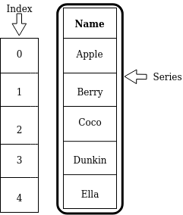
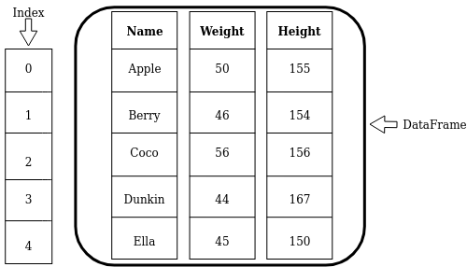
Pandas stores data in two shapes
0 2 · SE RIE S
Series
A 1-D column of values. Each value has a
label; all share one data type.
DataFrame
A 2-D table: row labels, column names, and a data type per column.

Slide 5
Creating a Series from a list
0 2 · SE RIE S
CPU_USAGE = pandas.Series( [0.16, 0.07, 0.23, 0.24, 0.14,
4.99, 0.23, 0.47, 0.46, 0.17])
What print shows
label | value
0 | 0.16
1 | 0.07
2 | 0.23
3 | 0.24
4 | 0.14
label | value
5 | 4.99
6 | 0.23
7 | 0.47
8 | 0.46
9 | 0.17
print(CPU_USAGE) print(len(CPU_USAGE)) # 10
Ten CPU-load measurements. With no labels given, pandas numbers them 0, 1, 2 … like a Python list.
dtype: float64

Slide 6
Square brackets look up a label, not a position
0 2 · SE RIE S
label 3
0.16
label 1
0.07
label 4
0.23
label 2
0.24
label 7
0.14
MEM_USAGE = pandas.Series( [0.16, 0.07, 0.23, 0.24, 0.14],
index=[3, 1, 4, 2, 7])
MEM_USAGE[3] is 0.16, the value labeled 3. It happens to sit first, in position 0.
A list of labels returns several values. A list of True/False, one per element, keeps only the True ones.
MEM_USAGE[3] # 0.16
MEM_USAGE[[1, 3]] # 0.07, 0.16
MEM_USAGE[[True, False,
False, True, True]] # labels 3, 2, 7

Slide 7
0 2 · SE RIE S
Change values with .loc[]
MEM_USAGE.loc[7] = 0.33 # step 1
MEM_USAGE.loc[[1, 3]] = [4, 2] # step 2
MEM_USAGE.loc[[True, False, False, True, True]] = [1.0, 2.0, 3.0] # step 3
label | 3 | 1 | 4 | 2 | 7
start | 0.16 | 0.07 | 0.23 | 0.24 | 0.14
step 1 | 0.16 | 0.07 | 0.23 | 0.24 | 0.33
step 2 | 2.00 | 4.00 | 0.23 | 0.24 | 0.33
step 3 | 1.00 | 4.00 | 0.23 | 2.00 | 3.00
Amber cells changed in that step. In step 3 the True values pick labels 3, 2 and 7, and the three new values go to them in or der.

Slide 8
The = sign does not make a copy
0 2 · SE RIE S · W ATC H O U T
Two names, one object
COPY_USAGE = MEM_USAGE COPY_USAGE[3] = 1.23
COPY_USAGE[3] # 1.23 MEM_USAGE[3] # 1.23 too!
Changing the "copy" changed the original.
A real, independent copy
COPY_USAGE = MEM_USAGE.copy() COPY_USAGE[3] = 1.23
COPY_USAGE[3] # 1.23
MEM_USAGE[3] # 0.16, unchanged
Use .copy() whenever you want to experiment safely.

Slide 9
Two ways to get the same table
0 3 · DA TA FRA M E
# 1. From a nested list source_table = [['Apple', 50, 155],
['Berry', 46, 154], ['Coco', 56, 156],
['Dunkin', 44, 167], ['Ella', 45, 150]]
avatars = pandas.DataFrame(source_table, columns=['Name', 'Weight', 'Height'])
Either way: avatars
 | Name | Weight | Height
0 | Apple | 50 | 155
1 | Berry | 46 | 154
2 | Coco | 56 | 156
3 | Dunkin | 44 | 167
4 | Ella | 45 | 150
# 2. From a CSV file
avatars_read = pandas.read_csv("avatars.csv")
read_csv takes the column names from the file's first line and works out each column's type.
Row labels default to 0, 1, 2 … unless you pass index=.

Slide 10
First questions to ask any new table
0 3 · DA TA FRA M E
You type | On avatars you get | It answers
len(avatars) | 5 | How many rows?
avatars.shape | (5, 3) | How many rows and columns?
avatars.columns | Name, Weight, Height | What are the columns called?
avatars.dtypes | text, int64, int64 | What kind of data is in each?
avatars.head(n) | first n rows (5 by default) | What does the data look like?
avatars.describe() | count, mean, min, max … | What are typical values?
avatars.info() | all of the above at once | Is anything missing?
No parentheses = an attribute you read. Parentheses = a method you call. Text columns show as object in older pandas and str in pandas 3.

Slide 11
Real data: how two phone apps use CPU and memory
0 3 · DA TA FRA M E
df_mystery = pandas.read_csv("sherlock/sherlock_mystery.csv")
200
rows: snapshots of a running app
14
columns: CPU_USAGE,
num_threads, vsize …
2
apps: Facebook (121 rows) and WhatsApp (79)
Quiz Run df_mystery.describe(). What is the mean of num_threads? 71.365 · 62.000 · 0.075 · none of these

Slide 12
[] picks columns, .loc[] picks rows by label
0 4 · IND E XING
You type (df6 = first 6 rows) | You select | You get
df6['ApplicationName'] | one column | Series
df6[['ApplicationName', 'CPU_USAGE']] | several columns | DataFrame
df6[[True, False, False, True, True, False]] | rows 0, 3, 4 | DataFrame
df6.loc[1] | row 1 | Series
df6.loc[[1, 3, 5]] | rows 1, 3, 5 | DataFrame
df6.loc[1, 'num_threads'] | one cell | 47
df6.loc[[1, 2, 5], ['num_threads', 'CPU_USAGE']] | rows × columns | DataFrame
One label in → a Series or a single value. A list of labels in → a DataFrame. To change cells, always use .loc: df6.loc[2, 'CPU_USAGE'] = 0.01

Slide 13
Slices with .loc include both ends
0 4 · IND E XING
You type | You select
df6.loc[1, :] | row 1, every column
df6.loc[:, 'CPU_USAGE'] | every row, one column
df6.loc[:3] | rows 0, 1, 2, 3
df6.loc[2:5] | rows 2, 3, 4, 5
df6.loc[:3, 'CPU_USAGE':'num_threads'] | rows 0–3; CPU_USAGE, cutime, lru, num_threads
Not like a list
[10, 20, 30, 40][:3]
# [10, 20, 30]
A Python list slice stops before the end. A .loc slice works with labels, so it stops at the end label.

Slide 14
Every pandas plot is drawn by matplotlib
0 5 · VISU ALIZ AT IO N
import matplotlib.pyplot as plt
Same chart, two ways to ask
plt.plot(x, y) # line graph plt.bar(x, heights) # bar chart plt.pie(values) # pie chart plt.show() # display it
Chart | pyplot | pandas
Line | plt.plot | kind='line'
Bar | plt.bar | kind='bar'
Pie | plt.pie | kind='pie'
Box | plt.boxplot | kind='box'
matplotlib is not part of standard Python. Install it once with pip install matplotlib, or !pip install matplotlib in a notebook cell.
pandas calls pyplot for you, so plt.title() and the other functions coming up work on pandas plots too.

Slide 15
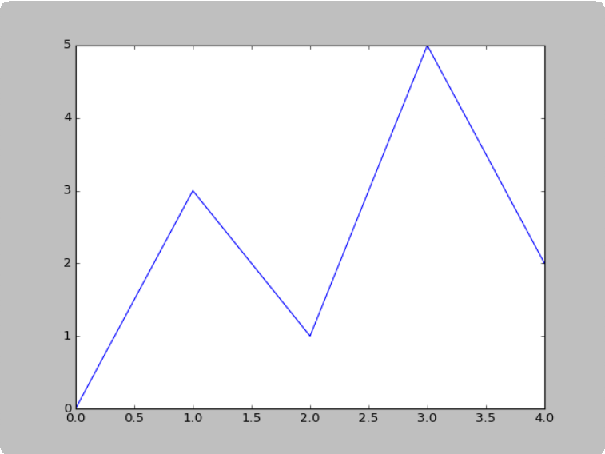
A line graph connects points in order
0 5 · VISU ALIZ AT IO N
import matplotlib.pyplot as plt
x_coords = [0, 1, 2, 3, 4]
y_coords = [0, 3, 1, 5, 2]
plt.plot(x_coords, y_coords)
plt.show()
Two lists of the same length: the first holds the x values, the
second the y values. Point 1 is (0, 0), point 2 is (1, 3), and so on.

Slide 16
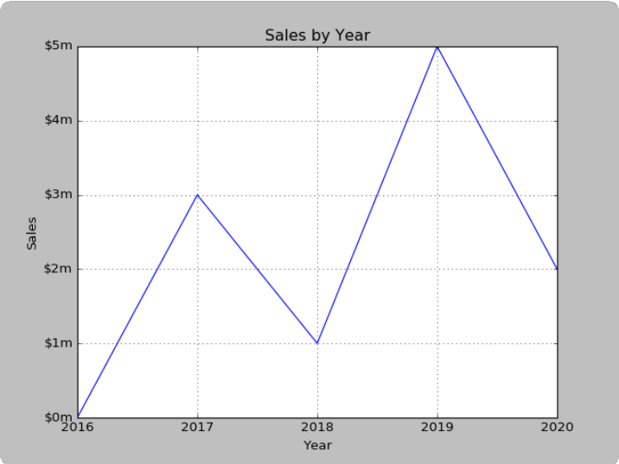
Label what the reader is looking at
0 5 · VISU ALIZ AT IO N
Add this line | To get
plt.title('Sales by Year') | the title on top
plt.xlabel('Year') | the x-axis name
plt.ylabel('Sales') | the y-axis name
plt.xticks([0, 1, 2, 3, 4], ['2016', …, '2020']) | years instead of 0–4
plt.yticks([0, 1, … 5], ['$0m', …, '$5m']) | dollar labels
plt.grid(True) | the dotted grid
plt.xlim(1, 100) · plt.ylim(10, 50) | set each axis's range (not used here)

Slide 17
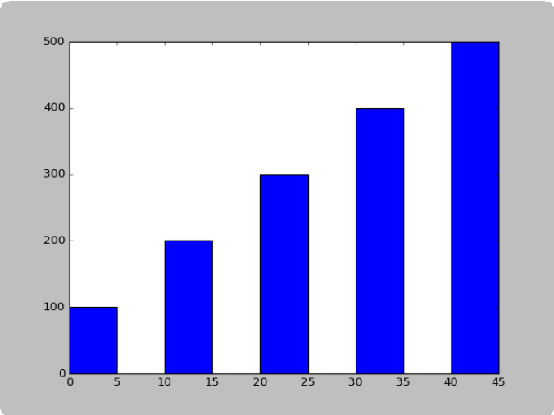
0 5 · VISU ALIZ AT IO N
A bar chart compares amounts
left_edges = [0, 10, 20, 30, 40]
heights = [100, 200, 300, 400, 500]
plt.bar(left_edges, heights, 5, align='edge') plt.show()
The third argument is the bar width (default 0.8). Bars are centered on their
x values unless you pass align='edge', as here.
Color codes for color=('r', 'g', 'b', 'w', 'k')
'b' | 'g' | 'r' | 'c' | 'm' | 'y' | 'k' | 'w'
blue | green | red | cyan | magenta | yellow | black | white

Slide 18
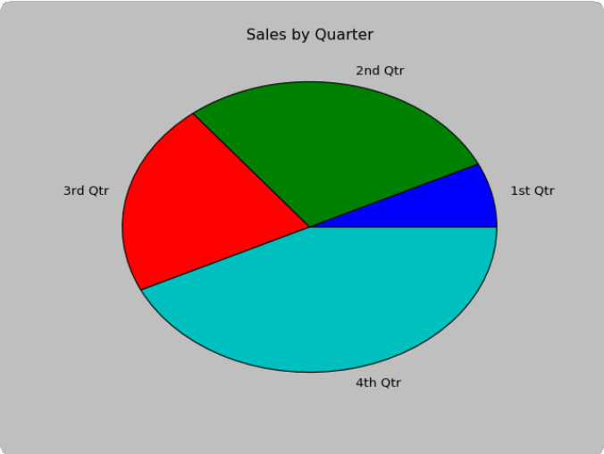
0 5 · VISU ALIZ AT IO N
A pie chart shows parts of a whole
sales = [100, 400, 300, 600]
slice_labels = ['1st Qtr', '2nd Qtr', '3rd Qtr', '4th Qtr']
plt.pie(sales, labels=slice_labels) plt.title('Sales by Quarter')
plt.show()
Each value becomes one slice, sized by its share of the total. The 4th quarter's 600 out of 1,400 fills 43% of the pie.
Choose slice colors with colors=('r', 'g', 'b', 'w', 'k'). Without it, current
matplotlib uses blue, orange, green, red …

Slide 19
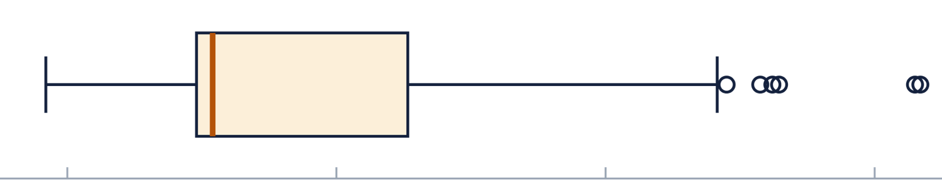
0 5 · VISU ALIZ AT IO N
A box plot summarizes a column in one picture
df_mystery['vsize'].plot(kind='line') # raw values, in row order df_mystery['vsize'].plot(kind='box') # the summary below seaborn.boxplot(x=df_mystery['vsize'], color='cyan')
vsize (virtual memory) of the 200 snapshots, in GB
describe() | GB | In the plot
min | 1.98 | left whisker
25% | 2.10 | box, left edge
50% (median) | 2.11 | amber line
75% | 2.25 | box, right edge
max | 2.63 | farthest circle
2.0 2.2 2.4 2.6
Most snapshots sit near 2.1 GB. Circles are outliers: values more than 1.5 × the box width beyond it.

Slide 20
The same charts, straight from a DataFrame
0 5 · VISU ALIZ AT IO N
counts = df_mystery['ApplicationName'].value_counts() counts.plot(kind='bar')
plt.title('Snapshots per app') plt.ylabel('Rows')
Snapshots per app
121
value_counts() counts the rows for each app. pandas uses the labels
(Facebook, WhatsApp) for the bars, so there is no x list to build.
Try kind='pie' on counts, or df_mystery['CPU_USAGE'].plot(kind='hist', bins=20). One plot per cell.
79
Facebook
WhatsApp

Slide 21
Four exercises on df_mystery
Y O UR TU RN · N O TE BO O K SE C TIO N 3 . 4
1 Spot the difference
What changes between each pair?
df_mystery['CPU_USAGE'] vs df_mystery[['CPU_USAGE']] df_mystery.loc[1] vs df_mystery.loc[[1]]
2 Cut out a block
Rows labeled 5 through 15, and only the columns from
ApplicationName through priority. Both ends included.
3 Drop the junk column
The first column, Unnamed: 0, is just a record number. Make a new DataFrame without it. Hint: it is the first column, so one compact slice does it.
4 Fill in a default
Every cminflt value in df6 is NaN (missing). Zero is a safe default:
set the whole column to 0 with one .loc assignment.

Slide 22
Six things to remember
RE C AP
Series and DataFrame
A labeled column, and a table of them.
[] for columns, .loc[] for rows
Labels, not positions
s[3] finds the value labeled 3.
.loc slices include the end
And .loc[] to change values.
= is not a copy
df.loc[:3] is four rows.
Explore, then plot
Use .copy() to experiment safely. shape, info(), describe(), then plot(kind='box').
Keep handy: the lesson page with its indexing summary table, and the pandas cheat sheet. Next session: analytics with filtering, sorting and grouping.

