Slide 1

Your First DataFrame
DEAPSECURE · BIG DATA · WARM-UP
with the four voyages of Christopher Columbus, 1492–1504
A short pandas exercise before Session 1, using small tables you can check by eye.
Carrack: large, high castles (the Santa María)
Caravel: small and fast (the Pinta, the Niña)
Notebook: BigData-warmup-columbus.ipynb · Slides: slides/Pandas-Warmup-Columbus.pdf (also .pptx)
Notes:
Welcome. Before we load real security data, we warm up with a table small enough to check by eye: the four voyages of Columbus to the Americas. The data comes from the Wikipedia article on his voyages. Everything students learn here (creating a DataFrame, inspecting it, filtering, grouping, plotting) is used again in Session 1 on real data. The picture shows the two kinds of ship in the SHIPS table: the carrack was larger, with high castles at bow and stern; the caravel was smaller, lower and faster. Many caravels, like the Pinta, carried square sails as well as the triangular lateen sails drawn here.

Slide 2
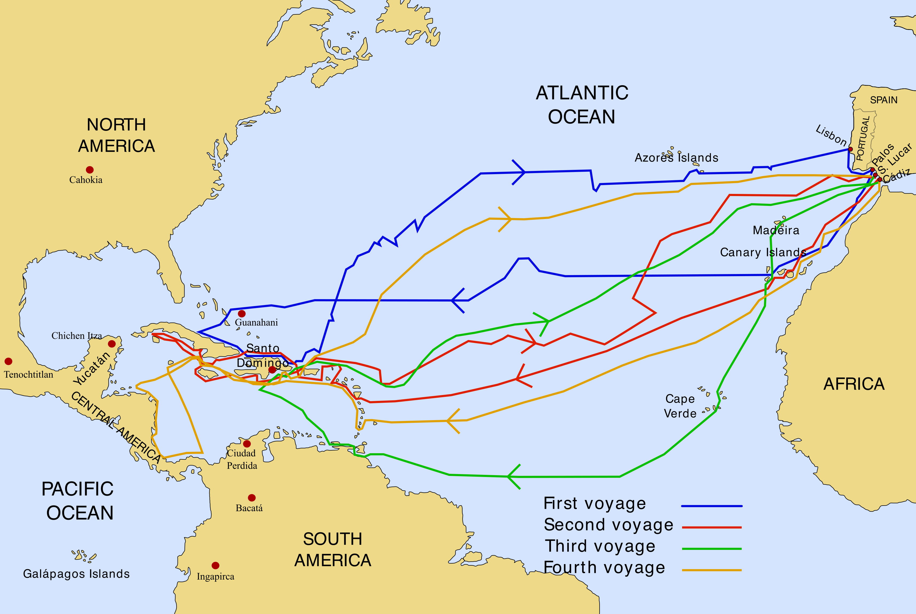
Four voyages across the Atlantic, 1492–1504
THE VOYAGES
4
voyages
30
ships in total (3 + 17 + 6 + 4)
12
years, from 1492 to 1504
21
main landfalls in our table
Pandas warm-up · Columbus's voyages · Map: Phirosiberia, Wikimedia Commons, CC BY-SA 3.0
2
Notes:
The routes of the four voyages, from Spain to the Caribbean and back. The first voyage reached the Bahamas, Cuba and Hispaniola. The second explored the Lesser Antilles, Puerto Rico and Jamaica. The third reached Trinidad and the coast of Venezuela. The fourth sailed along Central America and ended with the crew stranded on Jamaica for about a year. These are the voyages, ships and landfalls in the notebook's three tables.

Slide 3
Eight pandas skills on one small dataset
WHAT YOU WILL PRACTICE
1
2
3
4
Create a DataFrame
Inspect it
Select columns and rows
Filter rows
pandas.DataFrame()
df.shape, df.dtypes
df[df["col"] == x]
df["col"], df.loc[2]
5
6
7
8
Find missing values
Sort and add columns
Group and count
Plot and map
df.isna().sum()
sort_values()
groupby().count()
barh(), line_geo()
Pandas warm-up · Columbus's voyages
3
Notes:
These are the skills the notebook covers, in order. None of them needs a large dataset: three small tables (voyages, ships, landfalls) are enough. Point out that every one of these commands comes back in Sessions 1 to 3.

Slide 4
A dictionary becomes a table
1 · CREATING A DATAFRAME
VOYAGES = pandas.DataFrame({
"voyage": [1, 2, 3, 4],
"depart_port": ["Palos", "Cadiz", "Sanlucar", "Cadiz"],
"num_ships": [3, 17, 6, 4],
# ... depart_date, return_date, first_landfall
})
 | voyage | depart_port | num_ships
0 | 1 | Palos | 3
1 | 2 | Cadiz | 17
2 | 3 | Sanlucar | 6
3 | 4 | Cadiz | 4
Each key becomes a column label.
Each list holds one value per row.
pandas adds the index 0, 1, 2, 3 (shown in orange).
Pandas warm-up · Columbus's voyages
4
Notes:
The first table has one row per voyage. Ask students: which part of the output is the index, and which are the column labels? We never gave pandas an index, so it numbered the rows from 0. All the lists must have the same length, otherwise pandas raises an error.

Slide 5

Five things to check on any new table
2 · INSPECTING
Code | What it tells you | For VOYAGES
df.head() | The first rows (5 by default) | All 4 voyages
df.shape | (rows, columns) | (4, 6)
df.columns | The column labels | voyage, depart_date, …
df.dtypes | The data type of each column | Dates are stored as text
df.info() | All of the above, plus missing values | No missing values
Watch the dates: stored as text, they can't be subtracted to get a voyage's length. We fix this in Section 5.
Pandas warm-up · Columbus's voyages
5
Notes:
Exercises 2.1 and 2.2 ask for the shape and the data types. The key observation is that depart_date and return_date come out as text (str), not as dates. Ask students whether they could subtract one from the other, then tell them we come back to this later.

Slide 6
Picking columns and rows
3 · SELECTING
Code | Selects | Returns
df["depart_port"] | One column | A Series
df[["voyage", "num_ships"]] | Several columns | A DataFrame
df.loc[2] | The row with label 2 | A Series (one row)
df.iloc[0] | The first row, by position | A Series (one row)
Double brackets select several columns: the inner [ ] is a Python list of column names.
Pandas warm-up · Columbus's voyages
6
Notes:
One column comes back as a Series; several columns come back as a DataFrame. .loc selects by label and .iloc by position. With the default index they look the same, which is a good moment to remind students that Session 1 shows a Series with an irregular index where they differ. Exercises 3.1 and 3.2.

Slide 7
Which ships have a known captain?
4 · FILTERING AND MISSING VALUES
# keep the rows where the test is True
SHIPS[SHIPS["ship_type"] == "caravel"]
# count the missing values per column
SHIPS.isna().sum()
# ships whose captain is unknown
SHIPS[SHIPS["captain"].isna()]
voyage | ship | captain
1 | Santa Maria | Christopher Columbus
1 | Pinta | Martin Alonso Pinzon
1 | Nina | Vicente Yanez Pinzon
4 | Capitana | Christopher Columbus
4 | Gallega | NaN
4 | Vizcaina | NaN
4 | Santiago de Palos | NaN
The article names the 4th voyage's ships but not their captains, so those cells are NaN (missing).
Pandas warm-up · Columbus's voyages
7
Notes:
A comparison on a column gives a boolean Series, one True or False per row. Putting it inside the brackets keeps only the True rows. The missing captains are intentional: real data always has gaps, and isna().sum() is the first way to find them. On the first voyage Columbus commanded from the Santa Maria, which Juan de la Cosa owned. Exercises 4.1 to 4.4.

Slide 8
From text to dates, and from dates to days
5 · DATES, NEW COLUMNS AND SORTING
VOYAGES["depart_date"] = pandas.to_datetime(VOYAGES["depart_date"])
VOYAGES["return_date"] = pandas.to_datetime(VOYAGES["return_date"])
VOYAGES["duration_days"] = (VOYAGES["return_date"] - VOYAGES["depart_date"]).dt.days
VOYAGES.sort_values("duration_days", ascending=False)
voyage | depart_date | return_date | duration_days
2 | 1493-09-24 | 1496-06-11 | 991
4 | 1502-05-12 | 1504-11-07 | 910
3 | 1498-05-30 | 1500-08-23 | 815
1 | 1492-08-03 | 1493-03-04 | 213
Pandas warm-up · Columbus's voyages
8
Notes:
pandas.to_datetime turns text like 1492-08-03 into real dates. Subtracting two date columns gives a duration, and .dt.days turns it into a whole number of days. Assigning to a new column name adds that column. Exercise 5.1 builds duration_days and 5.2 sorts by it. Dates follow the Wikipedia infobox where the article text disagrees.

Slide 9
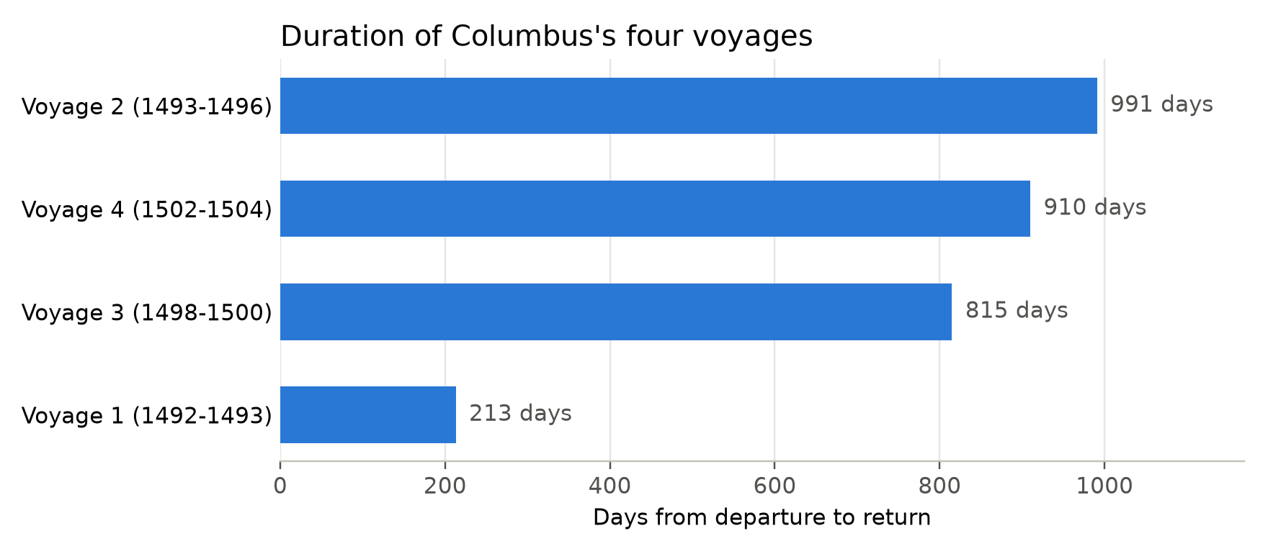
991 days
5 · YOUR FIRST PLOT
The 2nd voyage was the longest. The 1st, the most famous, was the shortest: 213 days.
ax.barh(labels, plot_data["duration_days"])
Pandas warm-up · Columbus's voyages
9
Notes:
The plot cell needs the duration_days column from Exercise 5.1, so students must finish that first or they get a KeyError. The data is sorted before plotting so the ranking is easy to read; ask students to try it unsorted. The 4th voyage comes second partly because the crew was stranded on Jamaica for about a year. Exercise 5.3 repeats the chart for num_ships.

Slide 10
How many landfalls on each voyage?
6 · GROUPING AND COUNTING
LANDFALLS.groupby("voyage")["place"].count()
counts = LANDFALLS["place"].value_counts()
counts[counts > 1] # places visited on more than one voyage
4
6
4
7
landfalls, voyage 1
landfalls, voyage 2
landfalls, voyage 3
landfalls, voyage 4
Hispaniola is the only place on more than one voyage: it appears 3 times.
Pandas warm-up · Columbus's voyages
10
Notes:
LANDFALLS has one row per event, the same shape as most real datasets: security logs have one row per connection or login. groupby splits the rows by voyage and count summarizes each group. value_counts counts how often each value appears. Only the main landfalls are listed, not every island. Exercises 6.1 to 6.4; the challenge finds each voyage's first and last landfall date with agg min and max.

Slide 11
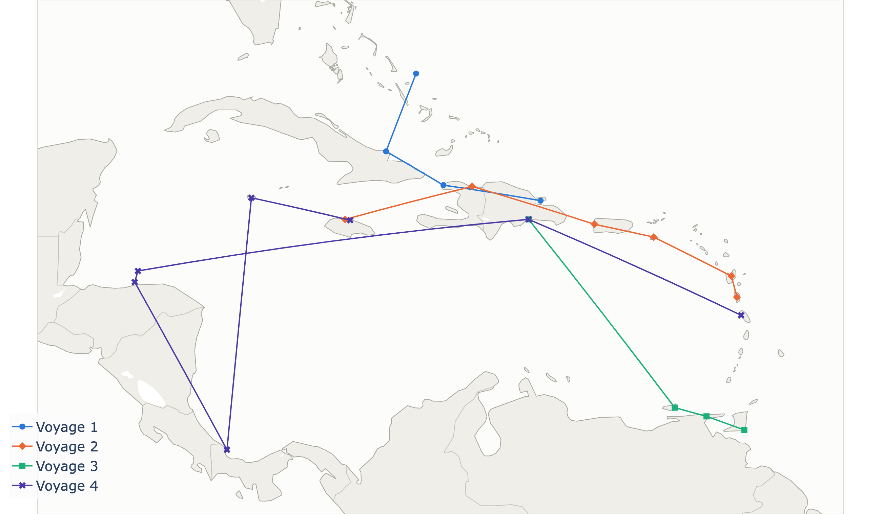
Each row becomes a point on the map
7 · MAPPING
px.line_geo(map_data,
lat="lat", lon="lon",
color="voyage",
symbol="voyage",
markers=True)
lat, lon: where each point goes
color, symbol: one style per voyage
Lines join landfalls in date order, not the real routes
Pandas warm-up · Columbus's voyages
11
Notes:
Section 7 adds approximate lat and lon columns by assigning lists, then draws the map with plotly, which works offline. Like pandas, plotly takes the DataFrame and the names of its columns. In the notebook the map is interactive: hover a point to see the place and date. Hispaniola shows as three points because each voyage landed somewhere different. If plotly is missing on the cluster, run pip install plotly first. Exercise 7.1 maps only the first voyage.

Slide 12
Joining each ship to its voyage
8 · BONUS: COMBINING TABLES
pandas.merge(SHIPS, VOYAGES[["voyage", "depart_port", "depart_date"]], on="voyage")
ship | voyage | depart_port | depart_date
Santa Maria | 1 | Palos | 1492-08-03
Pinta | 1 | Palos | 1492-08-03
Nina | 1 | Palos | 1492-08-03
Capitana | 4 | Cadiz | 1502-05-12
Gallega | 4 | Cadiz | 1502-05-12
Vizcaina | 4 | Cadiz | 1502-05-12
Santiago de Palos | 4 | Cadiz | 1502-05-12
Voyages 2 and 3 are missing. Why?
Hint: look up the how= argument of pandas.merge.
Pandas warm-up · Columbus's voyages
12
Notes:
Both tables share the column voyage, so merge can join them on it, like a SQL JOIN. The default is an inner join: only voyage numbers found in both tables survive. SHIPS lists ships for voyages 1 and 4 only, so voyages 2 and 3 drop out. With how="outer" or how="right" they come back, with NaN in the ship columns. Session 2 covers merge in detail.

Slide 13
Seventeen exercises, marked #TODO in the notebook
YOUR TURN
Section | Exercises
2 · Inspecting | 2.1 shape · 2.2 data types
3 · Selecting | 3.1 two columns · 3.2 one row with .loc
4 · Filtering | 4.1 the caravels · 4.2 Columbus's ships · 4.3 count missing values · 4.4 unknown captains
5 · Dates and plots | 5.1 duration_days · 5.2 sort by duration · 5.3 bar chart of num_ships
6 · Grouping | 6.1 landfalls per voyage · 6.2 top countries · 6.3 repeated places · 6.4 challenge: first and last dates
7 · Mapping | 7.1 map only the first voyage
9 · Excel and CSV | 9.1 load landfalls.csv with read_csv and check an Excel answer
Suggested solutions and the Excel answers are at the end of the notebook. Try each exercise first.
Pandas warm-up · Columbus's voyages
13
Notes:
Give students time to work through the notebook. Remind them that the duration plot needs Exercise 5.1 done first. Fast finishers can try the 6.4 challenge and the merge question in Section 8. Section 9 repeats seven of the questions in Excel on the CSV files in the columbus folder, then Exercise 9.1 loads one of them back into pandas with read_csv.

Slide 14

The same questions, answered in a spreadsheet
TRY IT IN EXCEL
# | Question | File | In Excel
1 | Which ships were caravels? | ships.csv | Filter
2 | Which ships have no known captain? | ships.csv | Filter: (Blanks)
3 | How many days did each voyage last? Sort longest first. | voyages.csv | Formula, then Sort
4 | How many landfalls on each voyage? | landfalls.csv | COUNTIF or PivotTable
5 | Which modern country appears most often? | landfalls.csv | PivotTable
6 | Which place appears on more than one voyage? | landfalls.csv | COUNTIF
7 | Make a bar chart of the voyage durations. | voyages.csv | Insert › Bar chart
Excel can't store dates before 1900, so the dates open as text. For question 3, add 800 years (the leap years repeat every 400):
=DATE(LEFT(C2,4)+800,MID(C2,6,2),RIGHT(C2,2)) - DATE(LEFT(B2,4)+800,MID(B2,6,2),RIGHT(B2,2))
Pandas warm-up · Columbus's voyages · Files in module-bd/columbus/
14
Notes:
The three CSV files in module-bd/columbus hold the same tables as the notebook: voyages.csv, ships.csv and landfalls.csv. Answers: 1. Pinta, Nina, Capitana, Gallega, Vizcaina and Santiago de Palos (6 caravels; only the Santa Maria is a carrack). 2. Gallega, Vizcaina and Santiago de Palos. 3. Voyage 2: 991 days, voyage 4: 910, voyage 3: 815, voyage 1: 213. 4. Voyage 1: 4, voyage 2: 6, voyage 3: 4, voyage 4: 7. 5. Dominican Republic, 3 times. 6. Hispaniola, 3 times. 7. The chart should match the one from the notebook. Discussion point: pandas handles dates from 1492 directly, while Excel needs a workaround. Spreadsheets are fine for 21 rows; the next sessions use datasets with hundreds of thousands of rows, where pandas is the better tool.

Slide 15
Answers to the Excel questions
TRY IT IN EXCEL · ANSWERS
# | Question | Answer
1 | Which ships were caravels? | Pinta, Nina, Capitana, Gallega, Vizcaina, Santiago de Palos (6 of 7)
2 | Which ships have no known captain? | Gallega, Vizcaina, Santiago de Palos
3 | How many days did each voyage last? | Voyage 2: 991 · voyage 4: 910 · voyage 3: 815 · voyage 1: 213
4 | How many landfalls on each voyage? | Voyage 1: 4 · voyage 2: 6 · voyage 3: 4 · voyage 4: 7
5 | Which modern country appears most often? | Dominican Republic, 3 times
6 | Which place appears on more than one voyage? | Hispaniola, 3 times
7 | Bar chart of the voyage durations | The same ranking as the notebook's chart in Section 5
Pandas warm-up · Columbus's voyages
15
Notes:
Show this slide after students have tried the questions. Every answer matches what pandas gives in the notebook. Only the Santa Maria is a carrack. For question 3, students who subtracted the dates directly will have hit the pre-1900 problem; the 800-year shift gives exactly the same day counts as pandas. Question 5 is also Exercise 9.1 in the notebook, where students check it with read_csv and value_counts.

Slide 16
These few commands cover most everyday exploration
RECAP
pandas.DataFrame()
head()
shape
dtypes
df["col"]
.loc[ ]
df[condition]
isna().sum()
to_datetime()
sort_values()
value_counts()
groupby()
merge()
Next: Session 1. The same tools, on real system data.
Pandas warm-up · Columbus's voyages
16
Notes:
Wrap up by pointing out that none of these commands is specific to history data. In Session 1 students load CPU and memory measurements with read_csv and use the same selection, filtering and plotting tools.

