Slide 1
GNU Radio Block Creation
Igor Povarich

Slide 2
Goals
Create 2 GNURadio blocks
Transmitter block
Preamble (fixed)
Flow ID (user configurable)
User Data (user configurable)
Checksum (calculation)
Receiver block
Catch the preamble to identify the start of the data stream
Filter based on the flow ID
Check for errors using the checksum
Pass user data, if validated

Slide 3

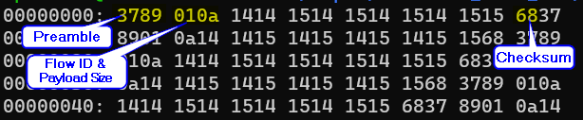
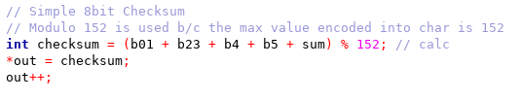
Transmitter Block
Transmitter block that writes a packed byte stream
Encodes Preamble identification of start of stream (0x37 and 0x89)
Encodes Flow ID for filtering and payload size for parsing the user data
Calculates and encodes a simple 8-bit checksum for error identification
The value 152 was used for the modulo calculation to avoid overflows because that seemed to be the max value a C++ char could encode
Packet Framer File Sink output

Slide 4
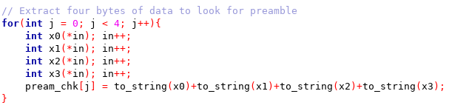

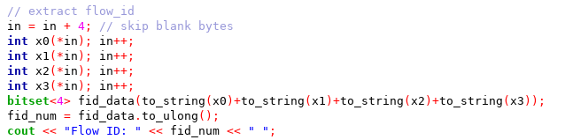
Receiver block
Performs the functions of the transmitter block in reverse, which is more involved
Speculatively builds 2 8-bit bytes (16 bits) to look for the preamble
Checked as matched strings
If the assembled bytes don’t match the preamble, it steps back 15 steps (+1 from starting point)
Other than preamble, data is reconstructed one bit a time, then packed into a bitset for processing

Slide 5
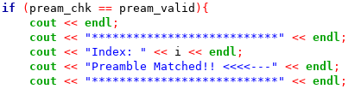


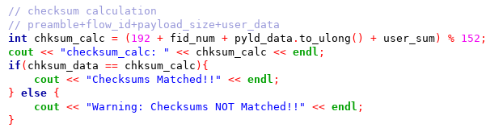
Receiver block
If preamble AND flow id are matched, the valid_stream bool is set to true, which allows rest of the code to run
If flow id is not validated, it returns to trying to find the next preamble
Next, payload_size, user data, and checksum are extracted
The checksum is calculated from the extracted data and matched against the extracted checksum
If they don’t match a warning is sent to the console
For a valid stream, all relevant data is passed through to the output

Slide 6
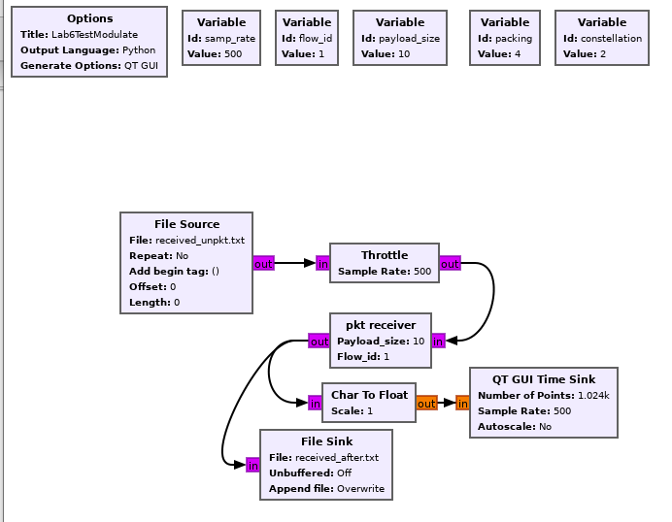
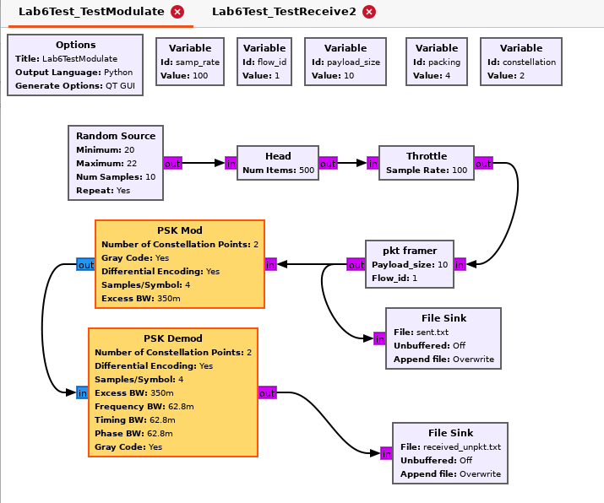
Test flowgraphs
Two main GNURadio Companion graphs are used for testing
The first passes the pkt_framer output through a PSK Mod/Demod block combo to a file sink “received_unpkt.txt”
The 2nd receives the data from the file sink, processes it, and passes on valid data to another file sink

Slide 7
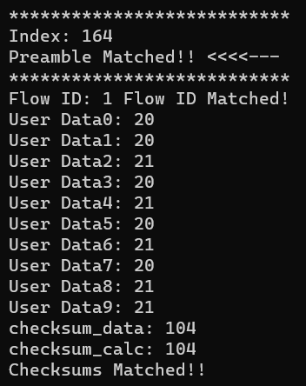
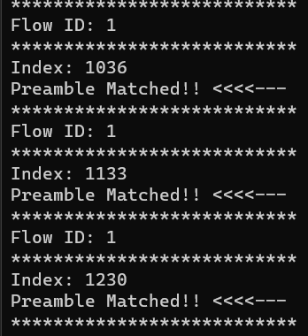

testing
Main console output from the pkt_receiver block includes notifications about matching and user data
If the flow_id is mismatched, everything after the preamble match is skipped

Slide 8
Challenges and Learning
Had a lot of difficulty with the exit conditions for the blocks in GRC (behavior when attempting to stop the simulation)
Made testing more difficult and time-consuming
Reason for choosing to have two separate graphs with a file sink in-between
Learned a lot about working with low-level binary data in GNURadio OOT blocks, especially how packing affects the way a data stream is processed or encoded
Re-learned some of the data type and pointer operations in C++
Like everyone else, I was confused by the single-bit output from the modulator blocks

