Slide 1
Comp eng 5430: Wireless communications Semester Project: gnuradio exploration of vanets
Igor Povarich
11/10/2021

Slide 2

Background
While modern cars are equipped with many new safety features, vehicle accidents are still on the rise^{[1]}
Some studies claim up to 60% of accidents on motorways could be avoided if warning messages were provided just a few seconds prior to the moment of the crash^{[2]}

Slide 3
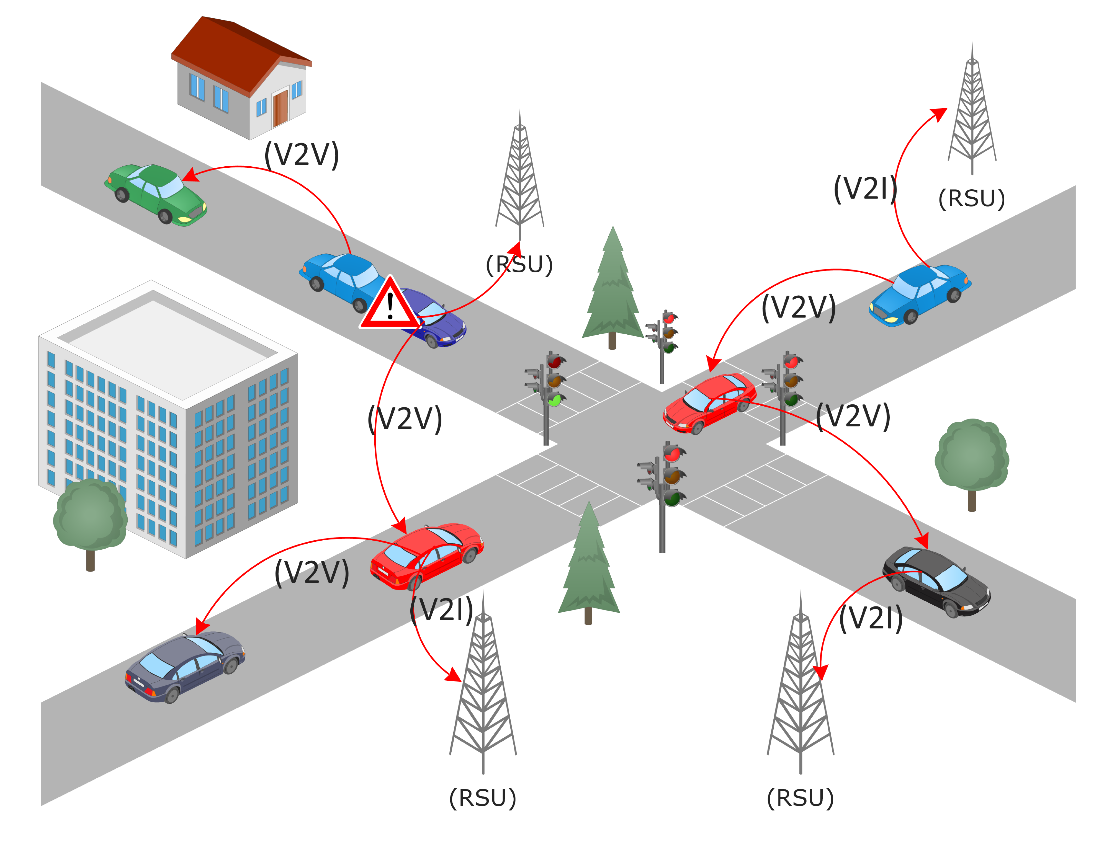
Vehicular ad-hoc networks
In recent years, significant interest has been directed toward the implementation of an ITS (Intelligent Transportation System) as a means of increasing road safety
Also provides opportunities to increase user convenience
Toward that end, VANET (Vehicular Ad-Hoc network) topologies have received much attention as a potential solution
A subset of MANET (Mobile Ad-Hoc network) topology
Traditional networks such as TCP/IP are not suitable due to high overhead or slow initial connection
A new communication standard was established to facilitate this development
Often called WAVE or 802.11p – operates at 5.85 to 5.925 GHz^{[5]}
Two main types of communication
V2V (Vehicle-to-Vehicle) – communication between any vehicles
V2I (Vehicle-to-Infrastructure) – communication between vehicles and RSU’s (Road-side Units)
Figure 2 VANET Communication Architecture
Shah, Syed Sarmad, et al (2019) ^{[4]}

Slide 4
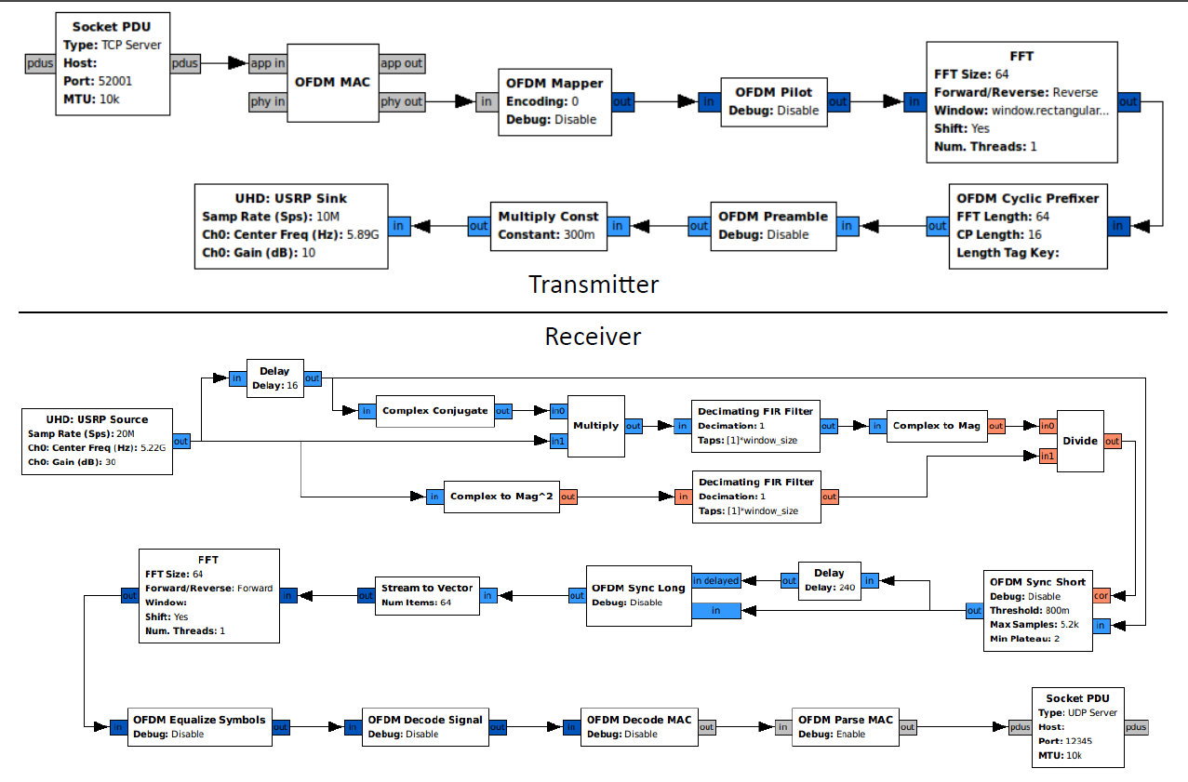
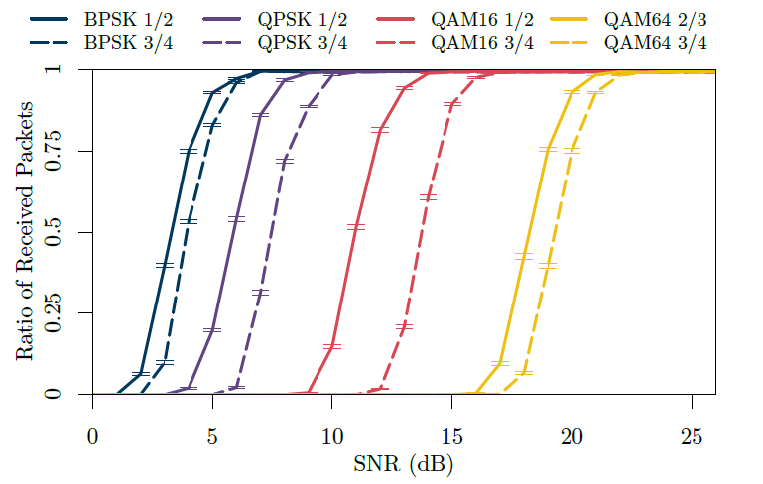
Previous Research and goals
Inspiration for the project was based on Bloessel, et al. [3]
Demonstrated the ability of a simulated Transceiver in GNURadio to accurately simulate the performance of a hardware Transceiver
The goal of the project is to use a similar structure to observe the performance of 802.11p vs. other standards such as 802.11e
Figure 3: Overview of transceiver structure in GNURadio Companion
Bloessel, et al (2013) ^{[3]}
Figure 4: Simulated determined packet deliver ration of 133B sized packets over AWGN channel
Bloessel, et al (2013) ^{[3]}

Slide 5
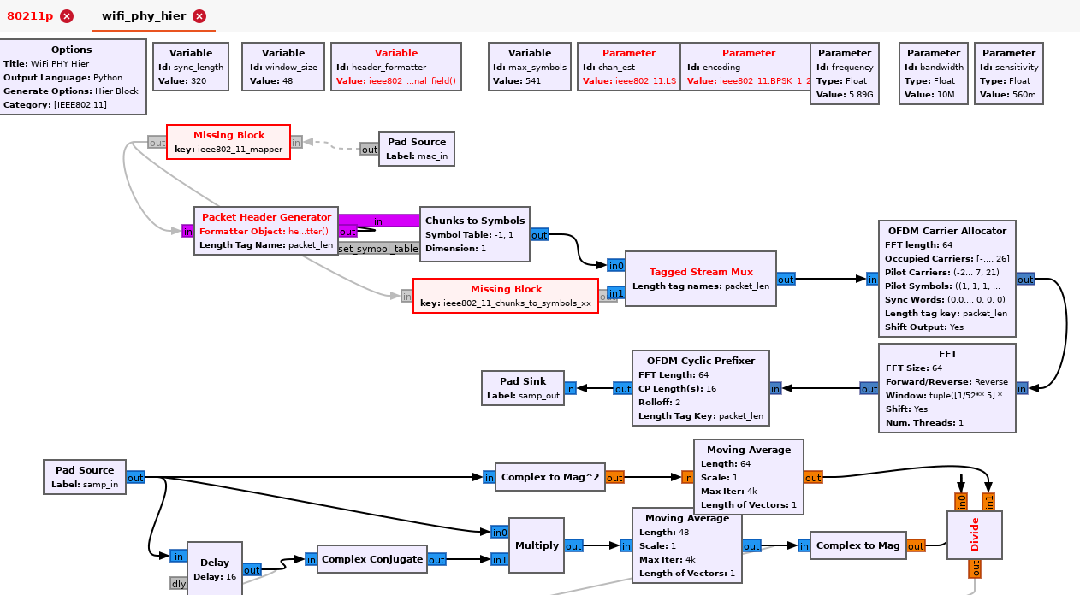
Implementation progress
Ran into issues with the installation of the 802.11 blocks
Required some manual modification of the source code to build successfully
Installation was successful but still some issues with missing blocks
Plan is to finish the installation and do some benchmark testing with the simulated transceiver
If the benchmark testing is successful, there may be an attempt to run it on hardware

Slide 6
References
C. D. Wang and J. P. Thompson, “Apparatus and method for motion detection and tracking of objects in a region for collision avoidance utilizing a real-time adaptive probabilistic neural network,” US5613039A, Mar. 18, 1997 Accessed: Oct. 04, 2021. [Online]. Available: https://patents.google.com/patent/US5613039A/en
B. Bloessl, M. Segata, C. Sommer, and F. Dressler, “Towards an Open Source IEEE 802.11p stack: A full SDR-based transceiver in GNU Radio,” in 2013 IEEE Vehicular Networking Conference, Boston, MA, USA, Dec. 2013, pp. 143–149. doi: 10.1109/VNC.2013.6737601.
E. C. Eze, S. Zhang, and E. Liu, “Vehicular ad hoc networks (VANETs): Current state, challenges, potentials and way forward,” in 2014 20th International Conference on Automation and Computing, Cranfield, Bedfordshire, United Kingdom, Sep. 2014, pp. 176–181. doi: 10.1109/IConAC.2014.6935482.
Shah, Syed Sarmad, Asad Malik, Anis Ur Rahman, Sohail Iqbal, and Samee Khan. “Time Barrier-Based Emergency Message Dissemination in Vehicular Ad-Hoc Networks.” IEEE Access PP (January 31, 2019): 1–1. https://doi.org/10.1109/ACCESS.2019.2895114.
IEEE Standard for Wireless Access in Vehicular Environments (WAVE) – Multi-Channel Operation, IEEE Standard 1609, Mar. 2016, pp. 1-94.

