Slide 1
GNU Radio Block Creation
Igor Povarich

Slide 2
Goals
Create 2 GNURadio blocks
Transmitter block
Preamble (fixed)
Flow ID (user configurable)
User Data (user configurable)
Checksum (calculation)
Receiver block
Catch the preamble to identify the start of the data stream
Filter based on the flow ID
Check for errors using the checksum
Pass user data, if validated

Slide 3
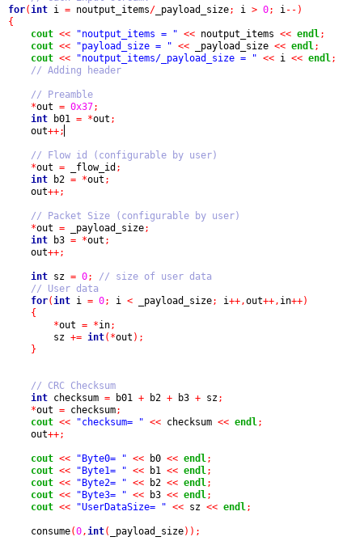
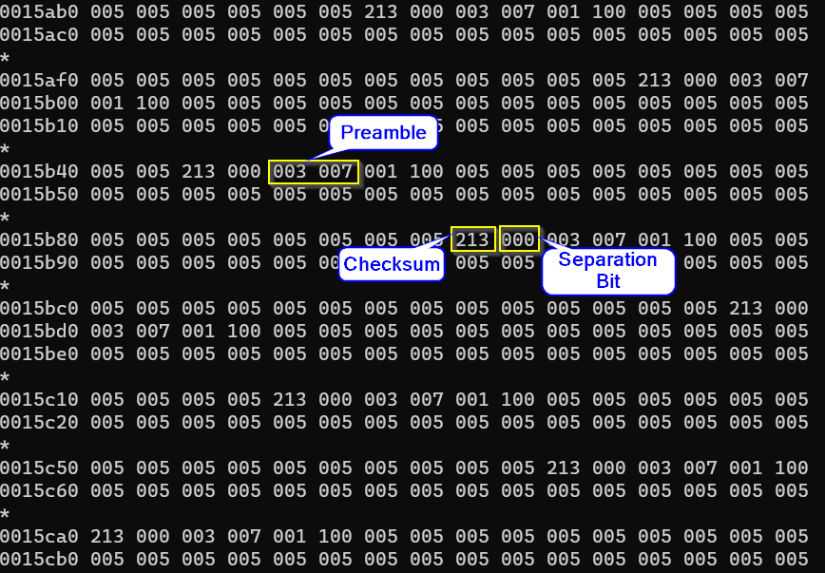
Progress
Functioning transmitter block that has been tested writing an unpacked byte stream

Slide 4
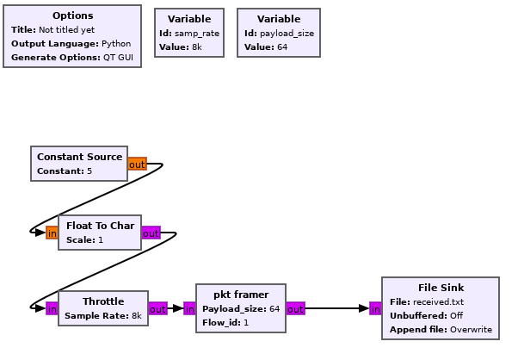
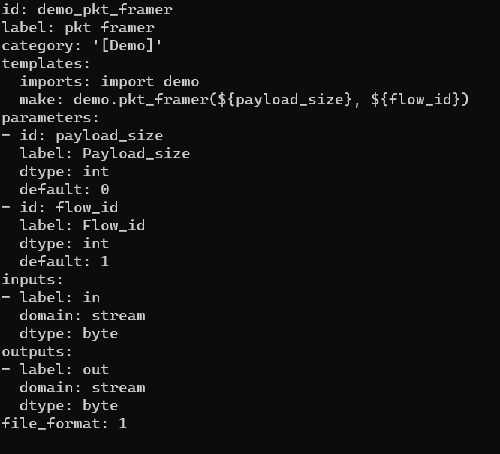
Progress
Building blocks to GNURadio worked well after some troubleshooting

Slide 5
Challenges and Future Work
Building pkt_receiver block has been unsuccessful so far
Errors may be due to not packing the data before sending to receiver block
Struggled for with syntax in gr_modtool and C++
Giving gr_modtool instructions to construct block with more than on user-defined parameter – the documentation is sparse
Needed refresher on functionality of pointers (e.g. *in, *out, etc.)
More comfortable with Python – would be good to have option of either language, as some tutorials showed building blocks using python
Future Work
Need to work on the gnuradio-companion test code
It has to pack the byte stream into symbols to be interpretable by the receiver

