Slide 1
GNU Radio Block Creation
Igor Povarich
Comp Eng 5430 Lab C-1

Slide 2
Goals
Create 2 GNURadio blocks
Transmitter block
Preamble (fixed)
Flow ID (user configurable)
User Data (user configurable)
Checksum (calculation)
Receiver block
Catch the preamble to identify the start of the data stream
Filter based on the flow ID
Check for errors using the checksum
Pass user data, if validated

Slide 3
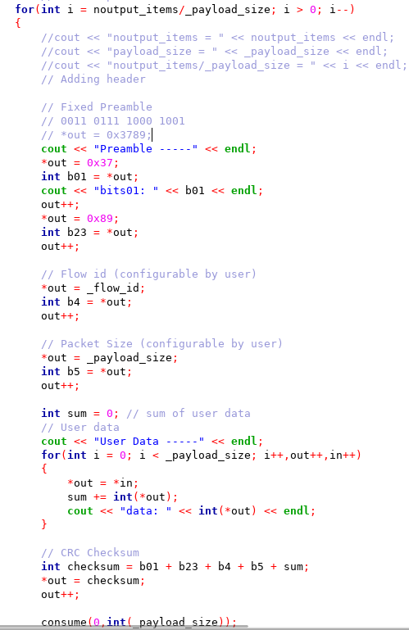


Transmitter Block
Functioning transmitter block that writes the correct byte stream
Flow_id=1
Payload=10
Preamble
Data: $20≤x<22$
Checksum

Slide 4


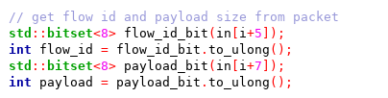
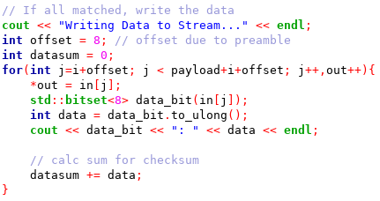
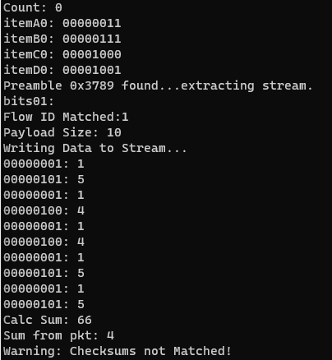
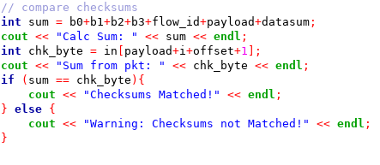
Receiver Block
Continuously grabs four sequential 4-bit bytes and compares them
As soon as they match the preamble, execute the main code
Extract flow id and payload
Filter based on Flow ID
If all matches, write the data to the output and sum it for the checksum
Currently a bug in the checksum due to the byte packing/unpacking used

Slide 5
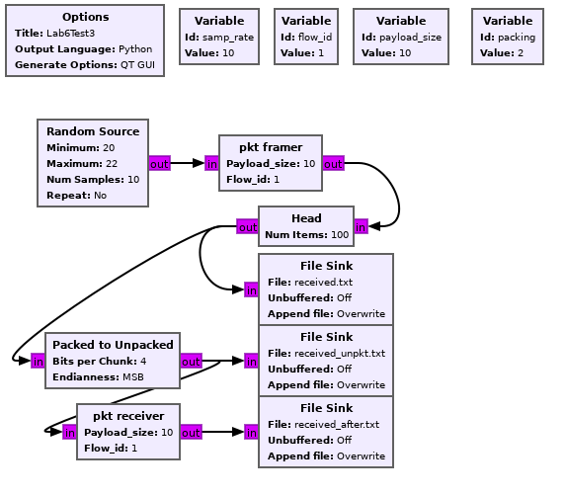
Current test code
Simply writing packed and unpacked data to file sinks to compare the block outputs
Use Packed to Unpacked block in to simulate packing of a modulator block

Slide 6
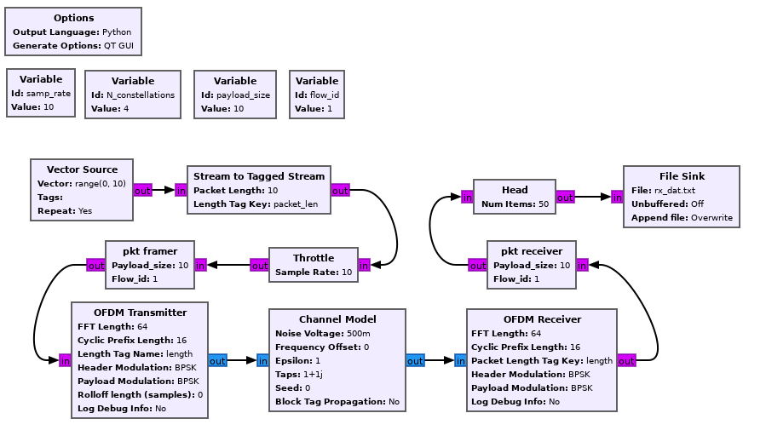
Planned example/test code
Use OFDM transmitter/receiver model
Vary the noise voltage in the channel model to determine the resilience of the receiver block to errors and noise

