Slide 1
Comp eng 5430: Wireless communications Semester Project examination of vehicular ad-hoc networks in gnuradio: 802.11p
Igor Povarich
12/06/2021

Slide 2

Background
While modern cars are equipped with many new safety features, vehicle accidents are still on the rise^{[1]}
Some studies claim up to 60% of accidents on motorways could be avoided if warning messages were provided just a few seconds prior to the moment of the crash^{[2]}
“With an unpredictable period of transition, someday vehicles will be all autonomous and connected, with the promise of no more deaths on the road, of more efficiency of traffic flows, and of more comfort for all passengers”^{[3]}

Slide 3
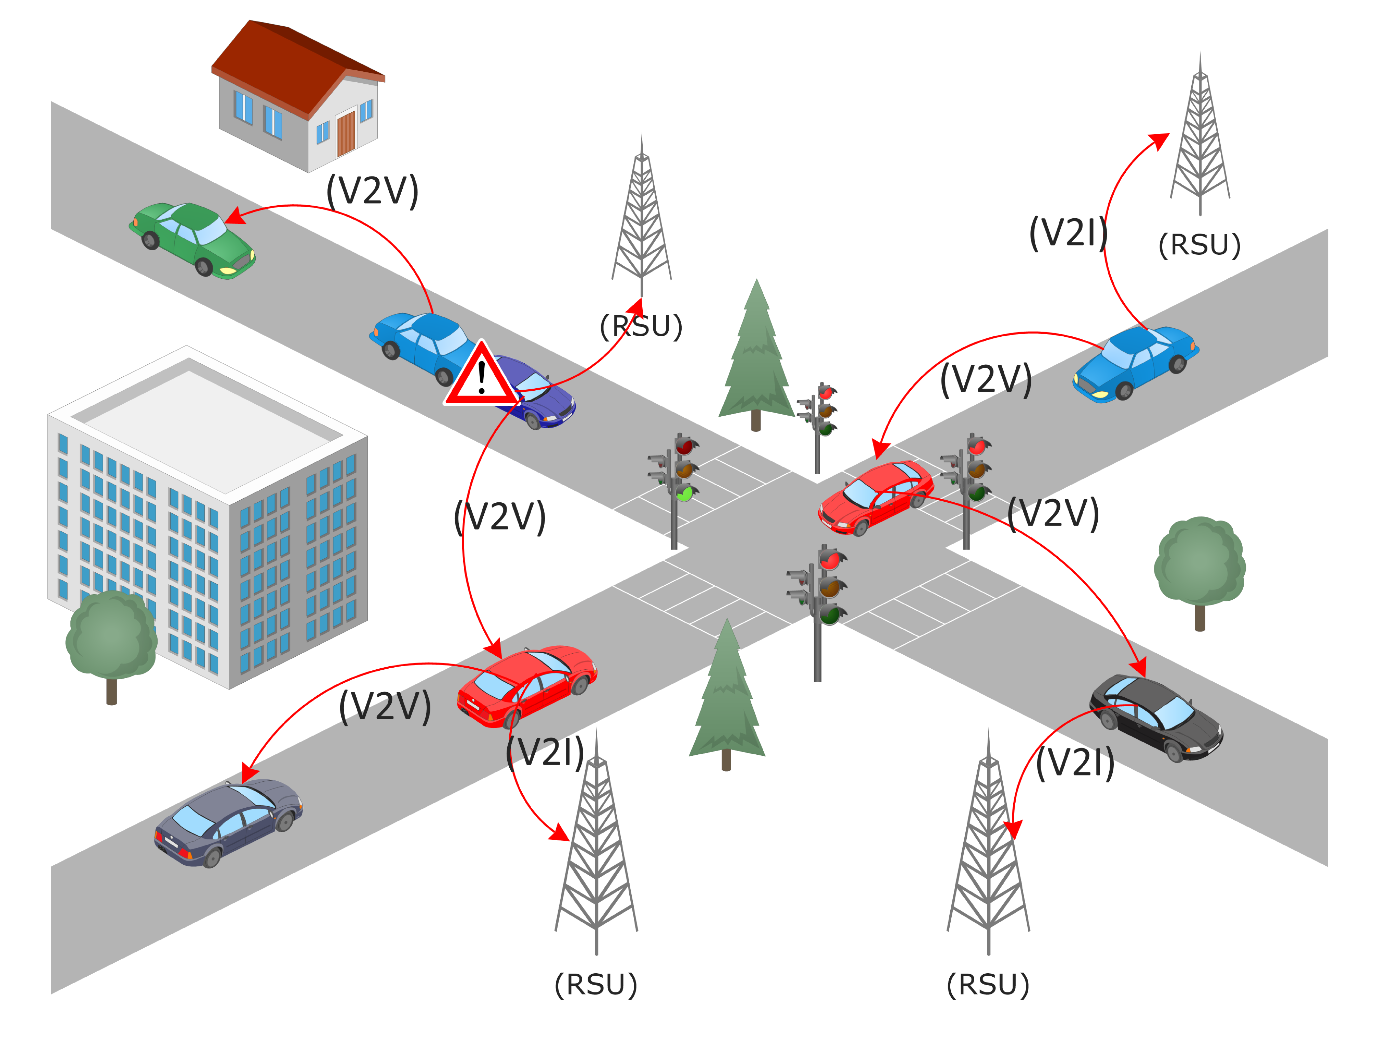
Vehicular ad-hoc networks
In recent years, significant interest has been directed toward the implementation of an ITS (Intelligent Transportation System) as a means of:
Increasing road safety
Enabling the implementation of autonomous vehicles
Increasing user convenience
VANET (Vehicular Ad-Hoc network) topologies have received much attention as a potential solution
A subset of MANET (Mobile Ad-Hoc network) topology
Traditional networks such as TCP/IP are not suitable due to high overhead or slow initial connection
A communication standard was approved in 2010 to facilitate this development
Initially allocated specifically for safety vehicles back in 1999
Often called WAVE or 802.11p – operates a 75MHz bandwidth at 5.85 to 5.925 GHz^{[5]}
Two main types of communication
V2V (Vehicle-to-Vehicle) – communication between any vehicles
V2I (Vehicle-to-Infrastructure) – communication between vehicles and RSU’s (Road-side Units)
Figure 2 VANET Communication Architecture
Shah, Syed Sarmad, et al (2019) ^{[11]}

Slide 4
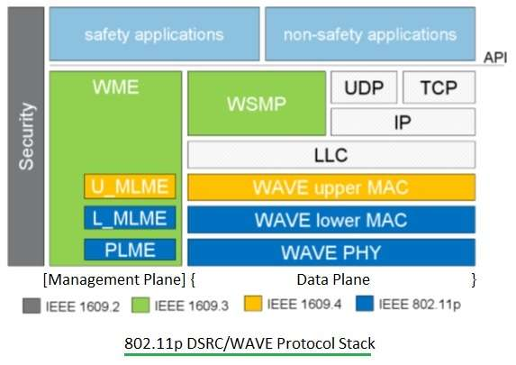
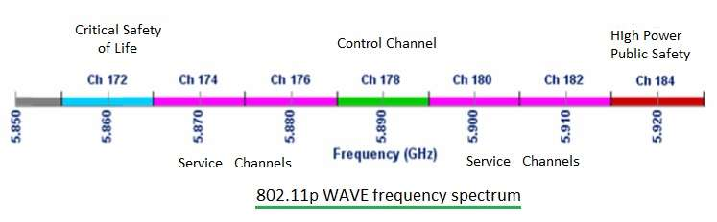
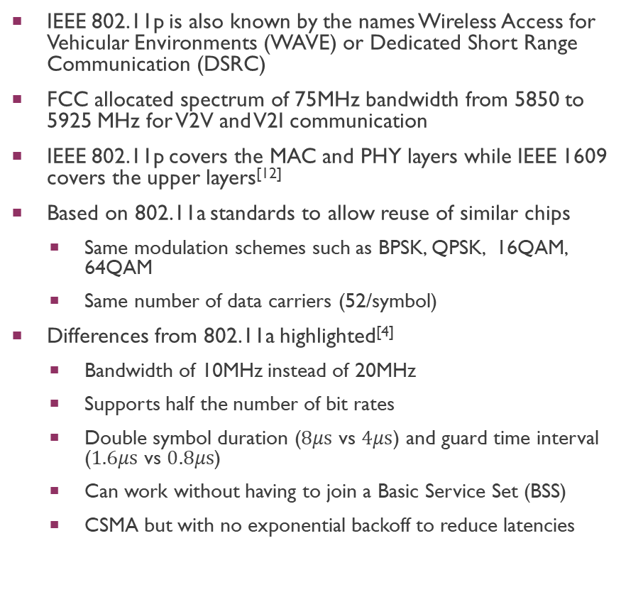
Ieee 802.11p / WAVE / DSRC
IEEE 802.11p is also known by the names Wireless Access for Vehicular Environments (WAVE) or Dedicated Short Range Communication (DSRC)
FCC allocated spectrum of 75MHz bandwidth from 5850 to 5925 MHz for V2V and V2I communication
IEEE 802.11p covers the MAC and PHY layers while IEEE 1609 covers the upper layers^{[12]}
Based on 802.11a standards to allow reuse of similar chips
Same modulation schemes such as BPSK, QPSK, 16QAM, 64QAM
Same number of data carriers (52/symbol)
Differences from 802.11a highlighted^{[4]}
Bandwidth of 10MHz instead of 20MHz
Supports half the number of bit rates
Double symbol duration ($8μs$ vs $4μs$) and guard time interval ($1.6μs$ vs $0.8μs$)
Can work without having to join a Basic Service Set (BSS)
CSMA but with no exponential backoff to reduce latencies
Figure 3
^{[4]}
Figure 4
^{[4]}

Slide 5
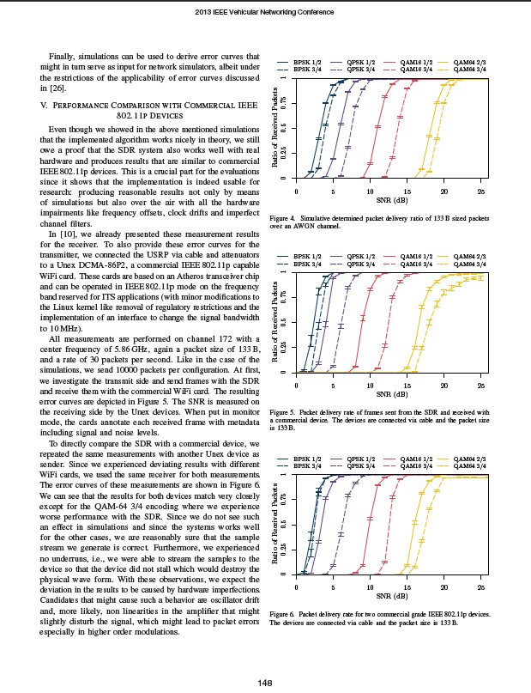
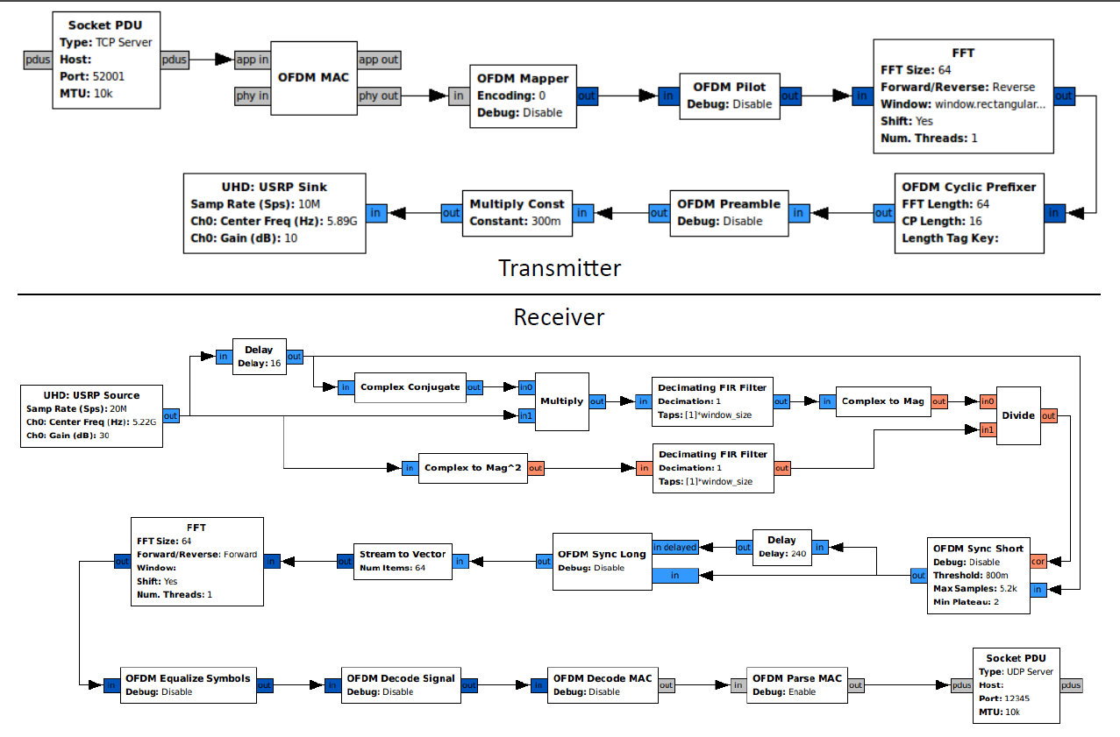
Previous Research and goals
Inspiration for the project was based on a series of papers by Bloessel, et al. [2] about 802.11p
Demonstrated the ability of a simulated Transceiver in GNURadio to accurately simulate the performance of prototype hardware 802.11p transceiver
The goal of this semester project was to re-use this structure to simulate and observe the performance of 802.11p in GNURadio
Figure 6: Overview of transceiver structure in GNURadio Companion
Bloessel, et al (2013) ^{[2]}
Figure 5: Hardware and simulated packet delivery ratio of 133B-sized packets
Bloessel, et al (2013) ^{[2]}

Slide 6
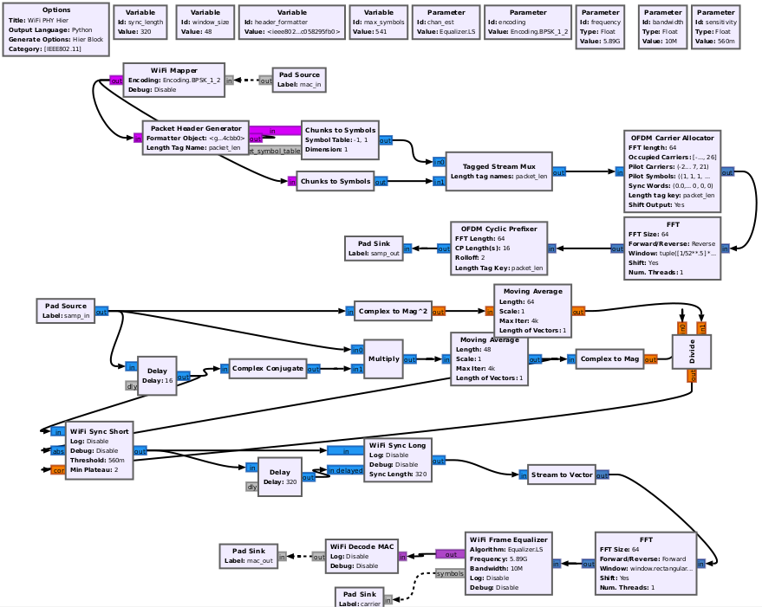
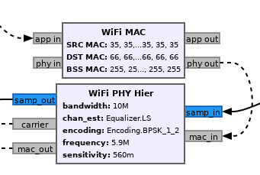
Building the wifi blocks in gnuradio
Several Github repos related to the papers were available at [7], supported by the open-source community and the authors of the previous studies
Forked the main repo and built the OOT modules to simulate the PHY and MAC layers
Heirarchical block was used for PHY layer, an OOT block for the MAC and some other supporting blocks
PHY block implemented the OFDM architecture (cyclic prefixers, stream management, etc.)
Getting the blocks to build blocks was challenging – lots of issues with missing dependencies that had to be fixed plus issues with GNURadio 3.8 vs. 3.9
Figure 7: WiFi PHY and MAC blocks
Figure 8: WiFi PHY Hier Block Architecture

Slide 7
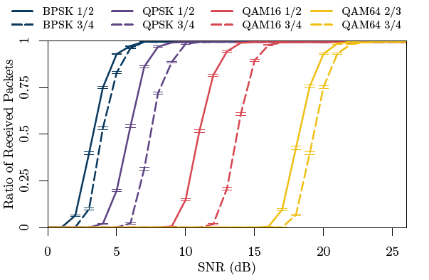
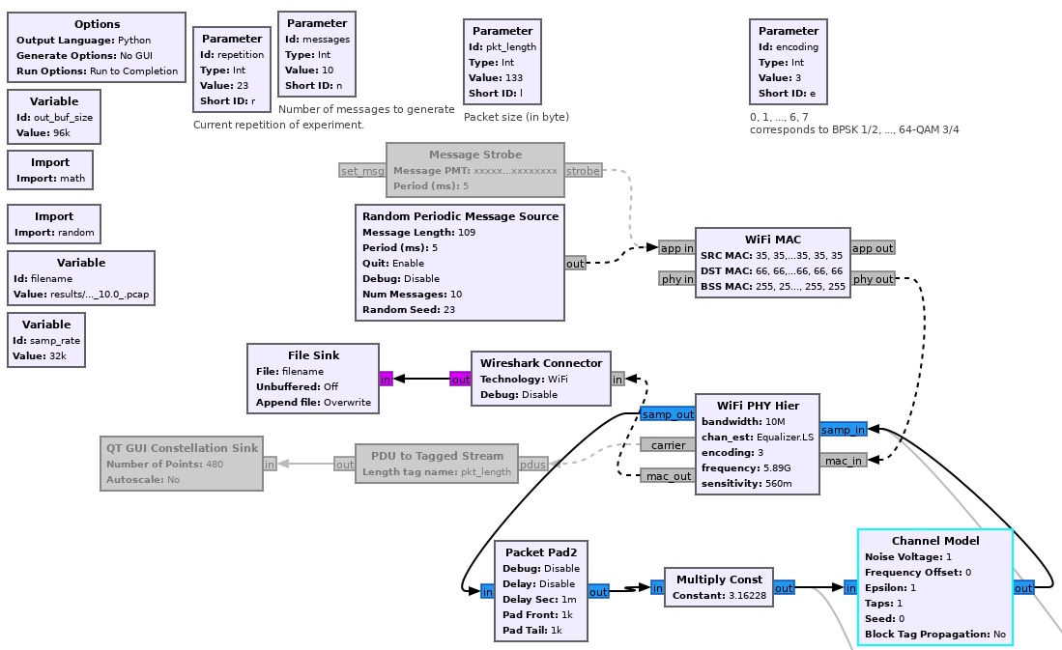
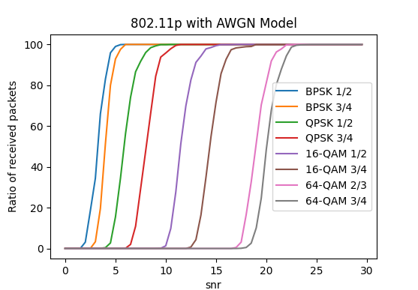
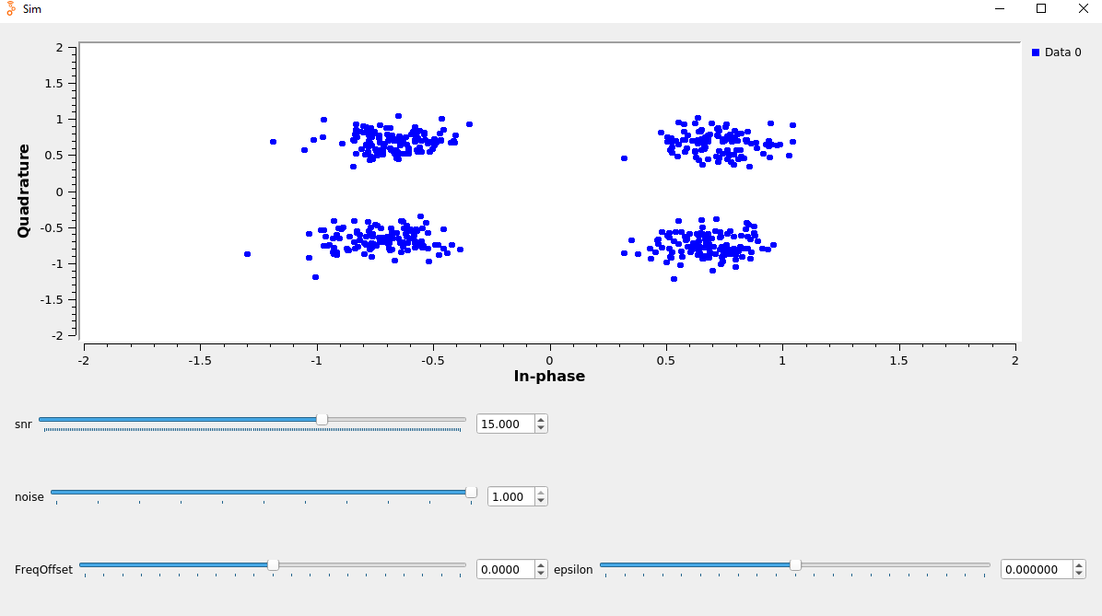
SIMULATE CHANNEL WITH AWGN
To ensure the system was behaving correctly, the first step was to re-create the simulated results of [2], and some templates were available
The simulations were performed using a headless (no GUI) GRC file outputting to a .pcap through a Wireshark connecter and executed using GRCC
It was orchestrated by an iterative Makefile compile script, afterwards parsed by a shell script into a .csv file, then plotted using python
The simulation used the Signal-to-Noise ratio and modulation as dependent variables
Each set of simulations was re-run 10 times and aggregated to smooth out stochastic effects
In the GRC file, the SNR plus the channel model were fed back into the Wifi PHY block
The channel model consisted of Additive White Gaussian Noise with a noise voltage of 1.0
Figure 10: Constellation plot with QPSK
Figure 9: Headless GRC file for simulation
Figure 11,12: Comparison of wifi simulations

Slide 8
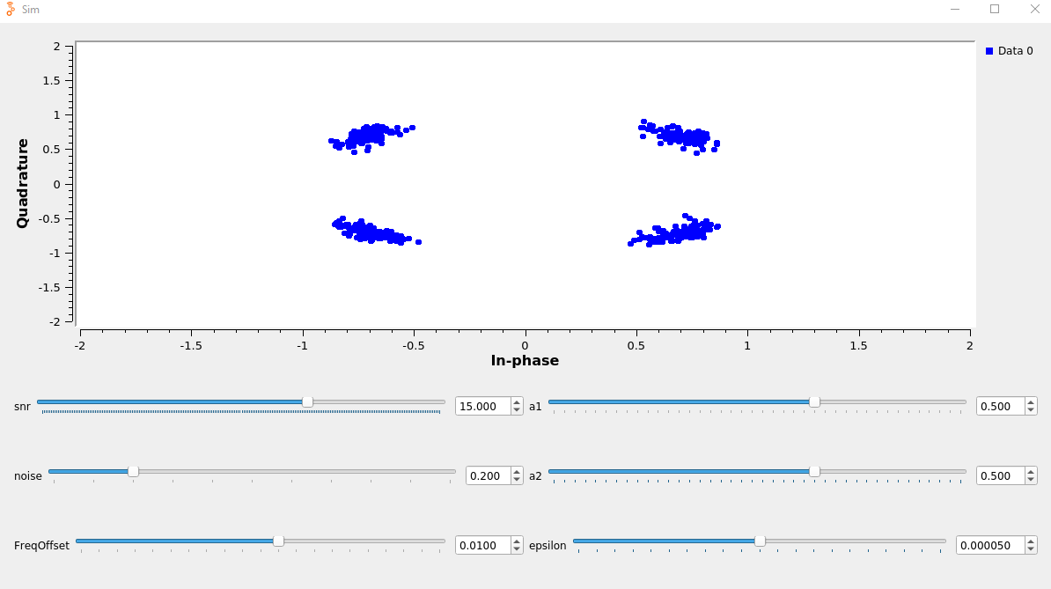
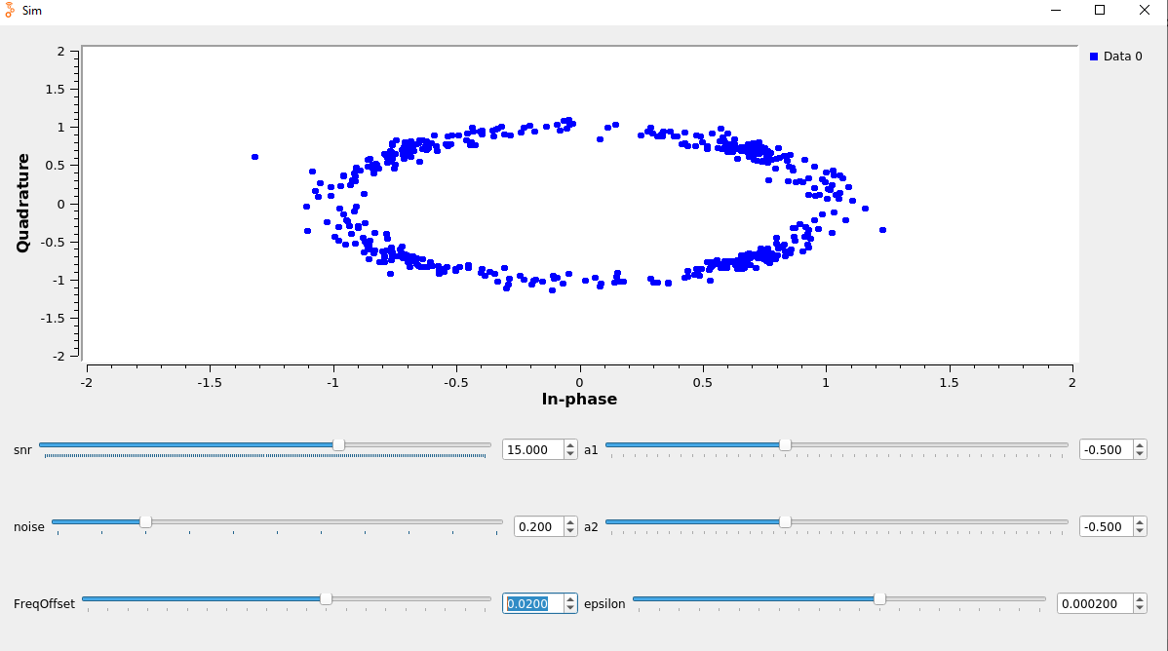
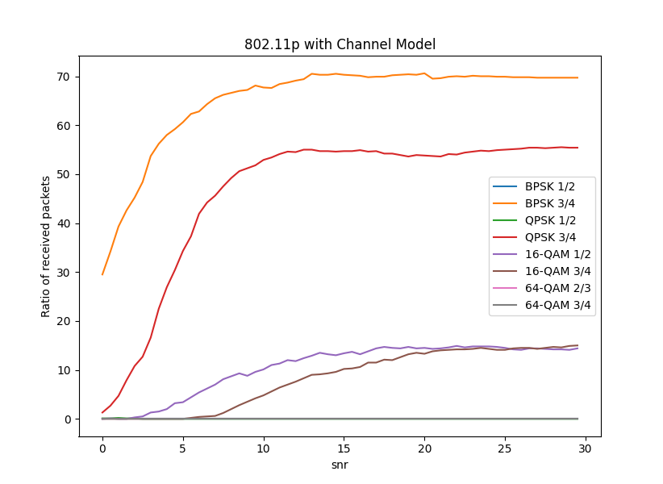
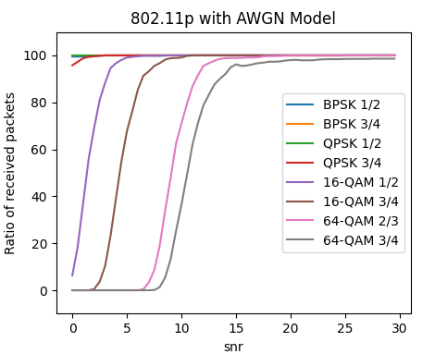
Simulate channel with Various channel models
Experimented with different channel models and varied loss parameters
Simulation A
Noise Voltage: 0.2
Frequency Offset: 0.01
Multipath Delay Profile: 0.5+0.5j
Sample Timing Offset: 0.00005
Added other sources of noise but
reduced the noise voltage
Simulation B
Noise Voltage: 0.2
Frequency Offset: 0.02
Multipath Delay Profile: -0.5-0.5j
Sample Timing Offset: 0.0002
Other sources high enough that signal
was barley unreadable
Figure 13: Simulation A constellation plot with QPSK
Figure 14: Simulation B constellation plot with QPSK
Channel noise appears to be biggest driver of missed packets, up until the point where freq/timing offsets make the signal unreadable
Figure 15: Simulation A results
Figure 16: Simulation B results

Slide 9
Challenges in implementation
The 802.11p standard has been around for a long time – why hasn’t it or some similar standard been implemented in modern vehicles?
DSRC [802.11p] has been extensively studied and it has been shown to be satisfactory for most vehicular safety applications that require end-to-end latency to be around 100msec and the density of vehicles is moderate
Performance rapidly deteriorates when vehicle density exceeds a certain limit, due to packet collisions due to simultaneous transmissions and due to hidden nodes^{[7]}
Another standard that was developed around 2016-2018 by 3GPP for cellular networks, aimed at the same purpose, also called Sidelink Cellular-V2X (C-V2X)
Sidelink Mode 4 is for communication to nodes that may not have access to a satellite uplink/downlink (i.e. sidelink)
Can reserve resources anonymously by means of a resource reservation algorithm
Performance has been shown to be better than 802.11p in terms of a higher link budget and more efficient utilization of the spectrum
But performance of C-V2X also falls off rapidly when traffic density increases, especially in Sidelink Mode 4^{[7]}

Slide 10
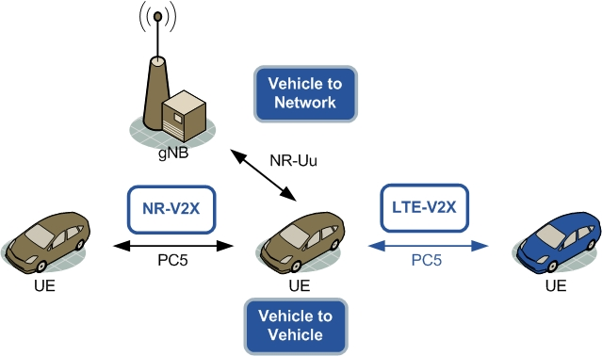
Going forward
Both standards are capable of supporting a basic set of vehicular safety applications based on issuing driver-alerts to indicate potentially dangerous situations (i.e. day-1 applications), however neither standard is capable of scaling to applications such as autonomous vehicles in its current state which have much more stringent QoS requirements^{[8][9]}
Both standards are currently being revised or improved upon and it remains to be seen which one will proliferate
For 802.11p, that is the amendment 802.11bd (also called NR-V2X), which currently has a working group, with the goal of investigating more advanced PHY technologies to amend the downfalls of the current standard – this will be backwards compatible with older 802.11P
3GPP decided to leave C-2VX as the only core of basic safety communications and will build the NR-C2X on top of 5G-NR
Not backwards compatible but adds an optional second interface with improved performance on other channels
Figure 17: Simulation B results

Slide 11
References
C. D. Wang and J. P. Thompson, “Apparatus and method for motion detection and tracking of objects in a region for collision avoidance utilizing a real-time adaptive probabilistic neural network,” US5613039A, Mar. 18, 1997 Accessed: Oct. 04, 2021. [Online]. Available: https://patents.google.com/patent/US5613039A/en
B. Bloessl, M. Segata, C. Sommer, and F. Dressler, “Towards an Open Source IEEE 802.11p stack: A full SDR-based transceiver in GNU Radio,” in 2013 IEEE Vehicular Networking Conference, Boston, MA, USA, Dec. 2013, pp. 143–149. doi: 10.1109/VNC.2013.6737601.
A. Bazzi et al., “Survey and Perspectives of Vehicular Wi-Fi versus Sidelink Cellular-V2X in the 5G Era,” Future Internet, vol. 11, no. 6, p. 122, 2019, doi: http://dx.doi.org/10.3390/fi11060122.
“IEEE 802.11p tutorial-802.11p,WAVE,DSRC protocol stack.” https://www.rfwireless-world.com/Tutorials/802-11p-WAVE-tutorial.html (accessed Dec. 05, 2021).
E. C. Eze, S. Zhang, and E. Liu, “Vehicular ad hoc networks (VANETs): Current state, challenges, potentials and way forward,” in 2014 20th International Conference on Automation and Computing, Cranfield, Bedfordshire, United Kingdom, Sep. 2014, pp. 176–181. doi: 10.1109/IConAC.2014.6935482.
Shah, Syed Sarmad, Asad Malik, Anis Ur Rahman, Sohail Iqbal, and Samee Khan. “Time Barrier-Based Emergency Message Dissemination in Vehicular Ad-Hoc Networks.” IEEE Access PP (January 31, 2019): 1–1. https://doi.org/10.1109/ACCESS.2019.2895114.
https://www.wime-project.net/
G. Naik, B. Choudhury, Jung-Min, and Park, “IEEE 802.11bd & 5G NR V2X: Evolution of Radio Access Technologies for V2X Communications,” arXiv:1903.08391 [cs, math], Mar. 2019, Accessed: Dec. 04, 2021. [Online]. Available: http://arxiv.org/abs/1903.08391
K. Hafeez, L. Zhao, B. Ma, and J. Mark, “Performance Analysis and Enhancement of the DSRC for VANET’s Safety Applications,” Vehicular Technology, IEEE Transactions on, vol. 62, pp. 3069–3083, Sep. 2013, doi: 10.1109/TVT.2013.2251374.
R. Molina-Masegosa and J. Gozálvez, “LTE-V for Sidelink 5G V2X Vehicular Communications: A New 5G Technology for Short-Range Vehicle-to-Everything Communications,” IEEE Vehicular Technology Magazine, 2017, doi: 10.1109/MVT.2017.2752798.
IEEE Standard for Wireless Access in Vehicular Environments (WAVE) – Multi-Channel Operation, IEEE Standard 1609, Mar. 2016, pp. 1-94.
“Highlighting the delivery and operation modes of 5G V2X,” Mpirical, Sep. 13, 2019. https://website.localhost.com/blog/5g-v2x-and-autonomous-vehicles (accessed Dec. 05, 2021).
Github Repositories
https://github.com/bastibl/gr-ieee802-11
https://github.com/ipovaric/gr-ieee802-11
https://github.com/ipovaric/wireless_comm_lab

Slide 12
appendix

Slide 13
Improvements of 802.11p and C-v2x
802.11bd proposed improvements over 802.11p
OFDM numerology re-design: definition of new optimized tone spacing and guard interval
duration to better cope with 5.9 GHz frequencies and high-speed mobility;
LDPC codes to improve coding effectiveness;
MIMO diversity through STBC codes or cyclic shift diversity (CSD);
Addition of midambles (control sequences in the middle of the packet) to improve Doppler recovery;
Dual carrier modulation (DCM) and 20 MHz channels.
5G-V2X modifications designed to enhance PC5 interface
Carrier aggregation with support of up to eight bands;
Use of frequencies above 6 GHz;
Flexible numerology, with the possibility of subcarrier spacing of 30 kHz and 60 kHz at 5.9 GHz;
Higher order of MCSs, also including 64-QAM;
Possibility to transmit over single slots and even portions of slots;
Addition of a sidelink feedback channel to allow higher reliability and lower latency;
LDPC and polar codes designed to offer higher robustness without increasing encoding and decoding complexity;
Use of MIMO receiving antennas to enable spatial diversity especially useful to mitigate multipath
in urban scenarios;

Slide 14
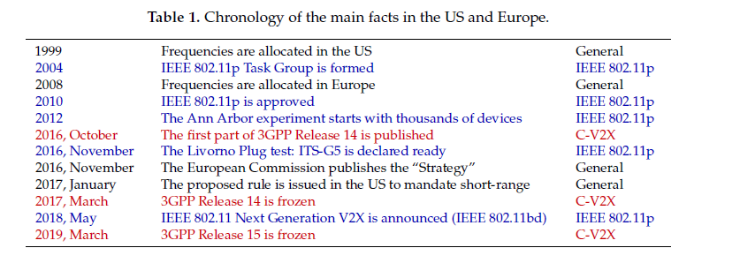
802.11p and c-v2x timeline

